Slide 1
The Blaine Public Library
Yesterday
and
Today

Slide 2
Library Building History
1911 – Central House – corner of Martin Street and Washington Avenue (Peace Portal Drive) - middle room on the ground floor
WW1 Years – Home State Bank Building – east corner of Washington Avenue and G Street – a couple upstairs rooms
Early 1920’s – future building of Amsberry’s Variety Store - west corner of G Street and Washington Avenue
Late 1920’s – library books stored in a dark room behind the Blaine Utility Office in the Leader Building – northeast corner of 3rd and Martin Streets
1932 – Blaine City Hall on H Street
1988 – converted Blaine Public Works Garage – corner of 3rd and G Streets

Slide 3
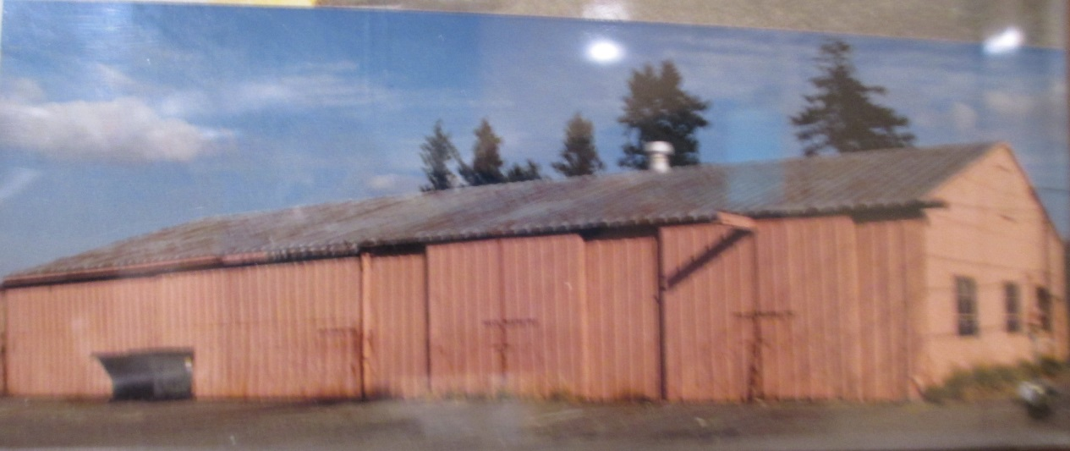
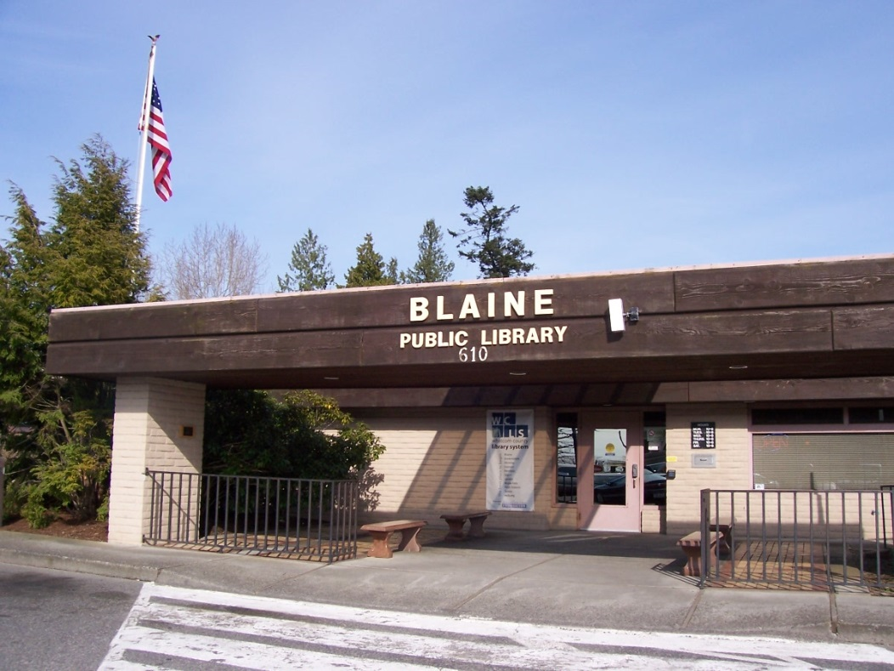
Before
After

Slide 4
Current Building
*Owned and maintained by the City of Blaine
*5,400 square feet
*Meeting room capacity – 45 persons

Slide 5
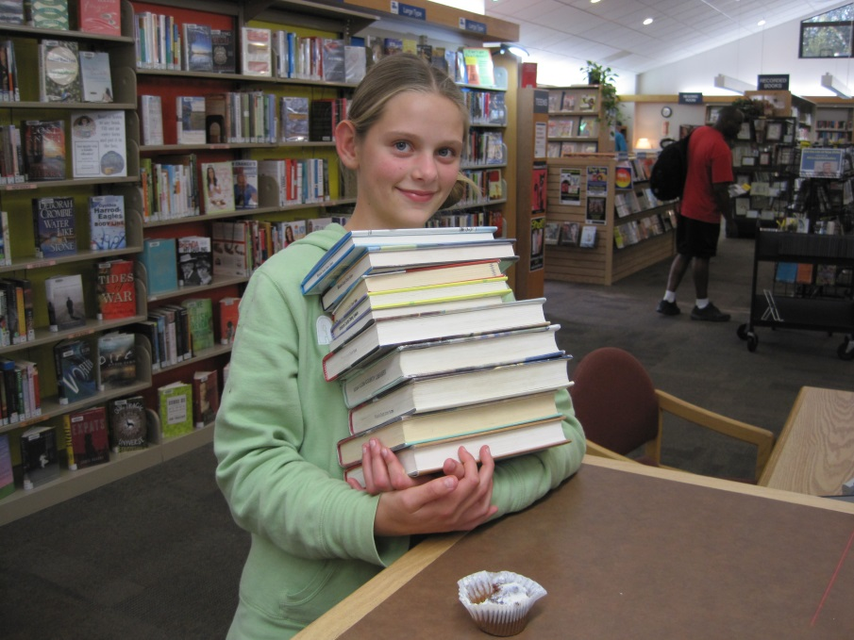
Items
checked
out
1988………..47,642
2014………..220,456

Slide 6
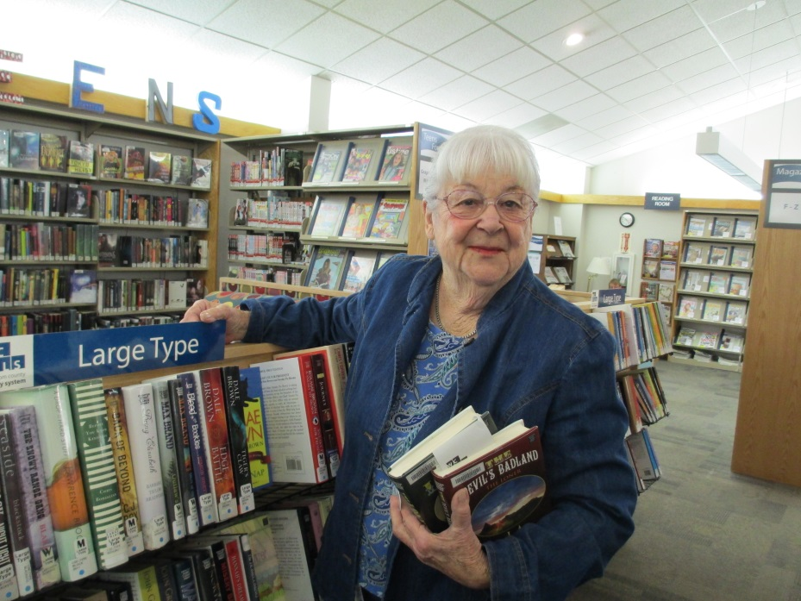
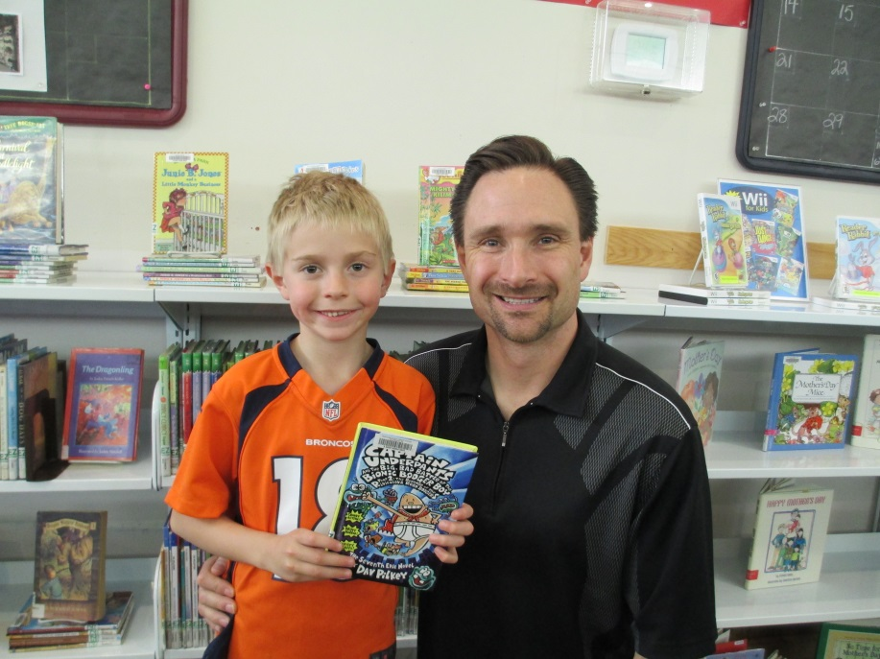
Visitors through the doors
(Does not include foyer area or restrooms)
133,703 in 2014

Slide 7
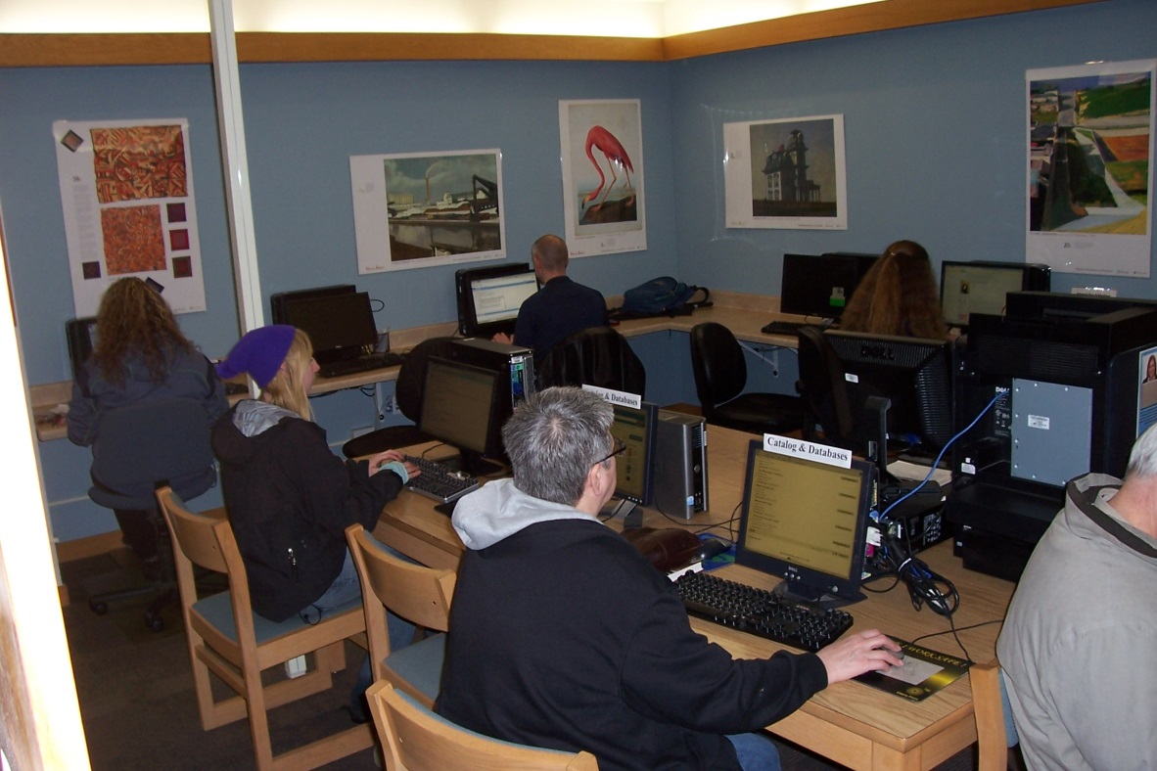
Internet sessions
on 7 public stations
15,986
In 2014

Slide 8
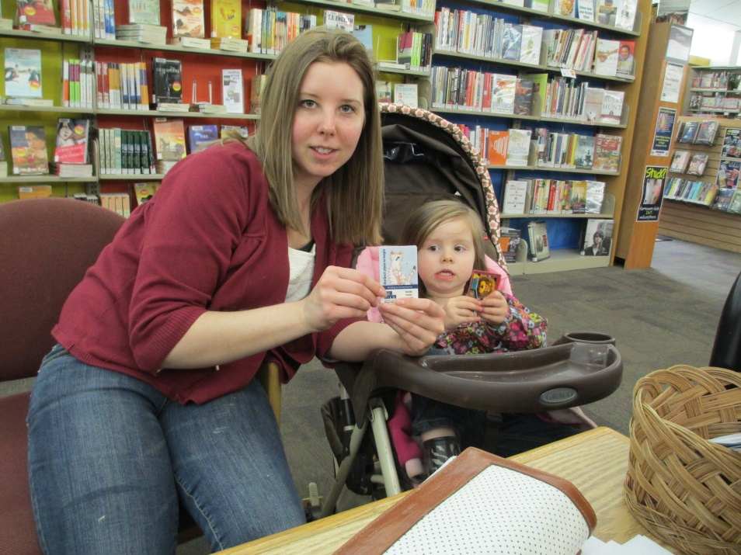
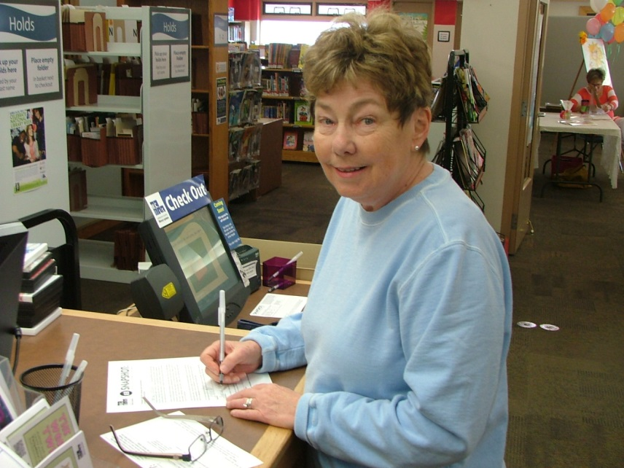
New Library
Accounts
974
In 2014

Slide 9
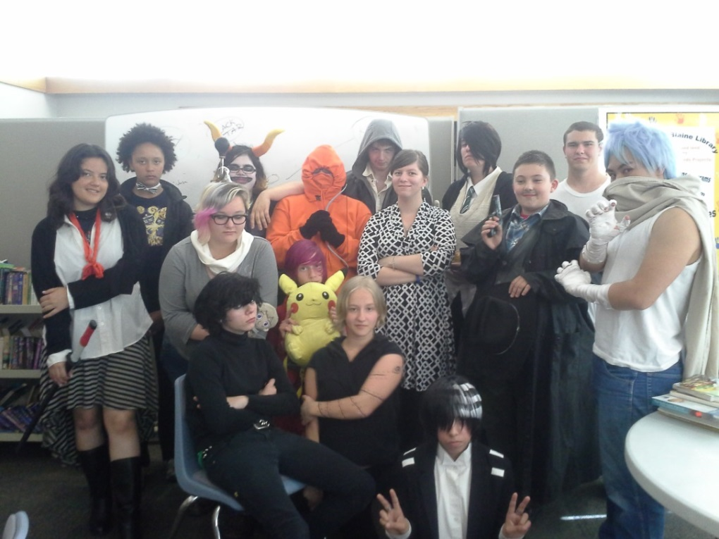
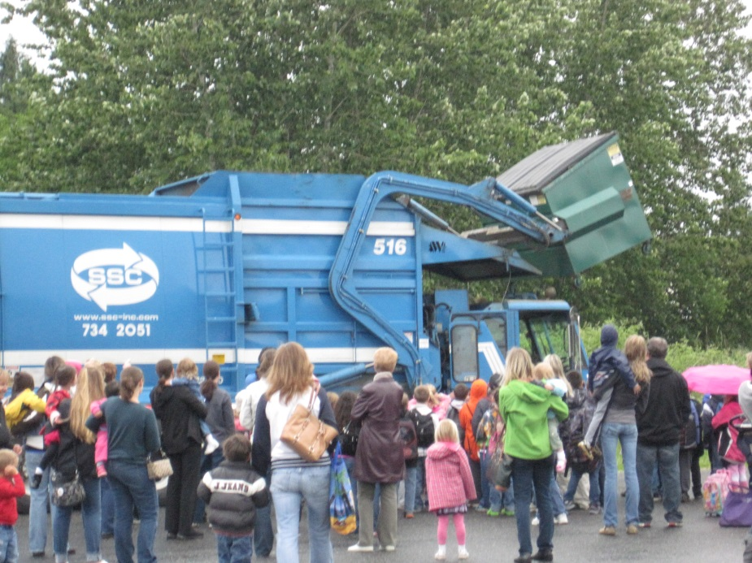
Programs
530 in 2014
Attendance
6,449

Slide 10
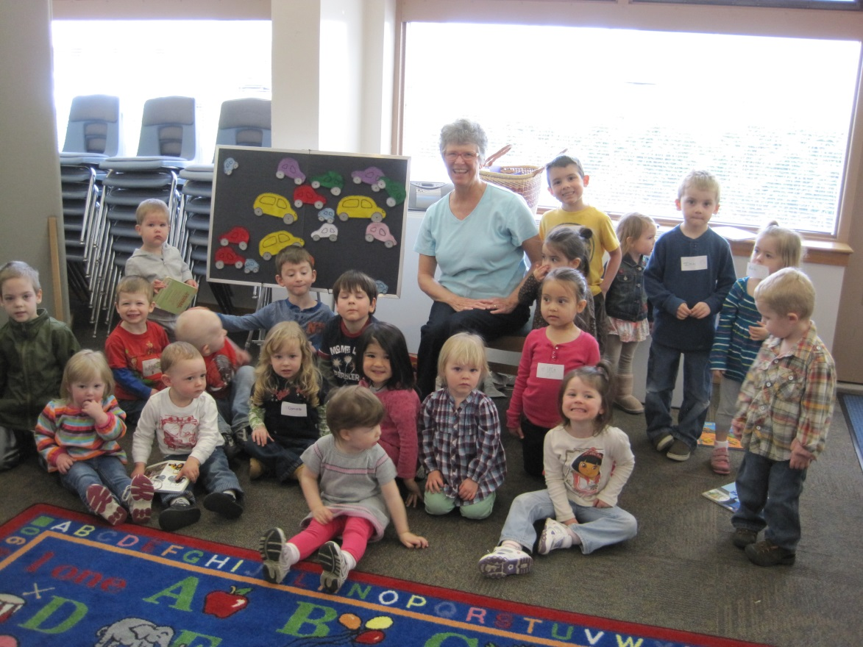
Weekly Story Time Attendance
20 children
16 adults
On average
In 2014

Slide 11
So what’s the problem

Slide 12
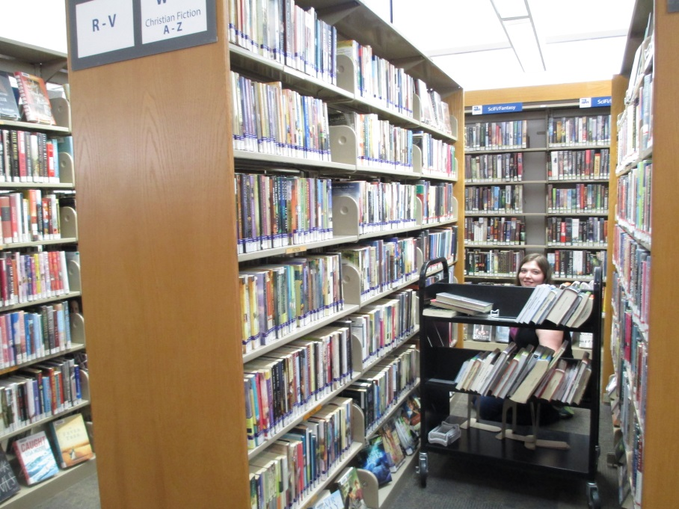
Third highest volume branch in WCLS
Narrow aisles create difficulty for patrons and staff
Often falling short of ADA guidelines

Slide 13
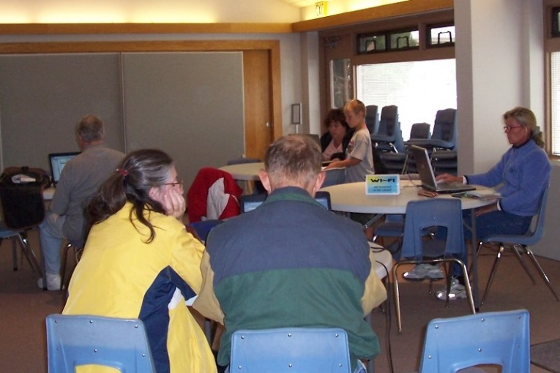
Changes in technology since 1988 require upgrades in infrastructure not
easily achievable on a concrete slab
Power supply and space requirements to support internet stations, printers, scanner, photocopier, digital screens and seating areas for laptop users is insufficient and limited

Slide 14
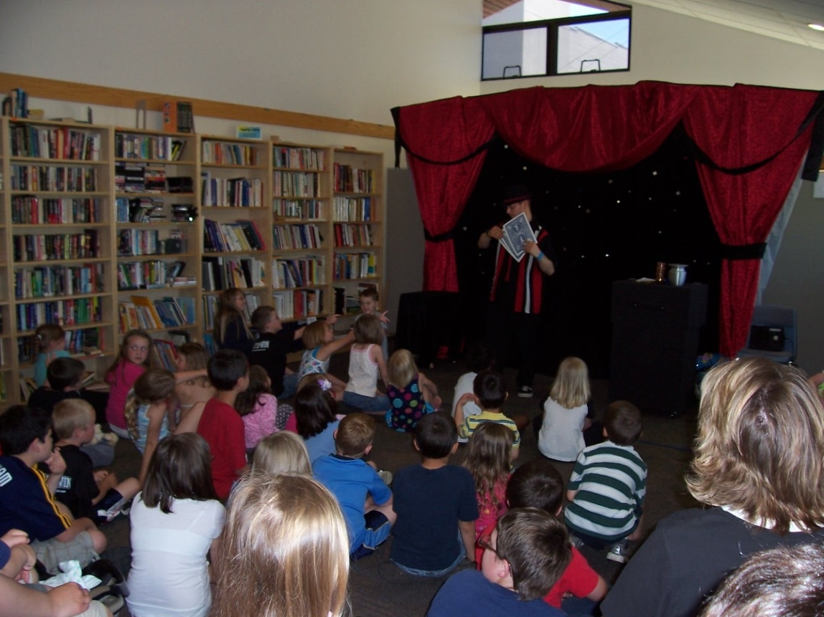
Program attendance often exceeds meeting room capacity

Slide 15
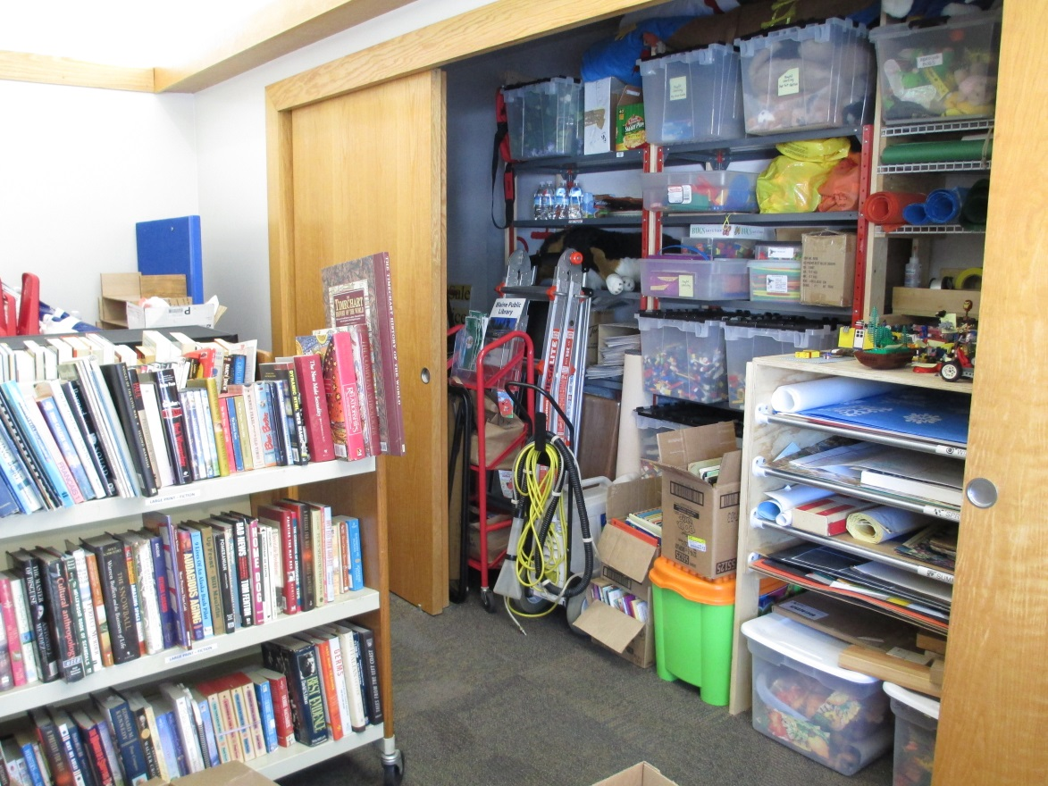
Storage space is seriously lacking
for library materials, equipment,
and donations to the book sale

Slide 16
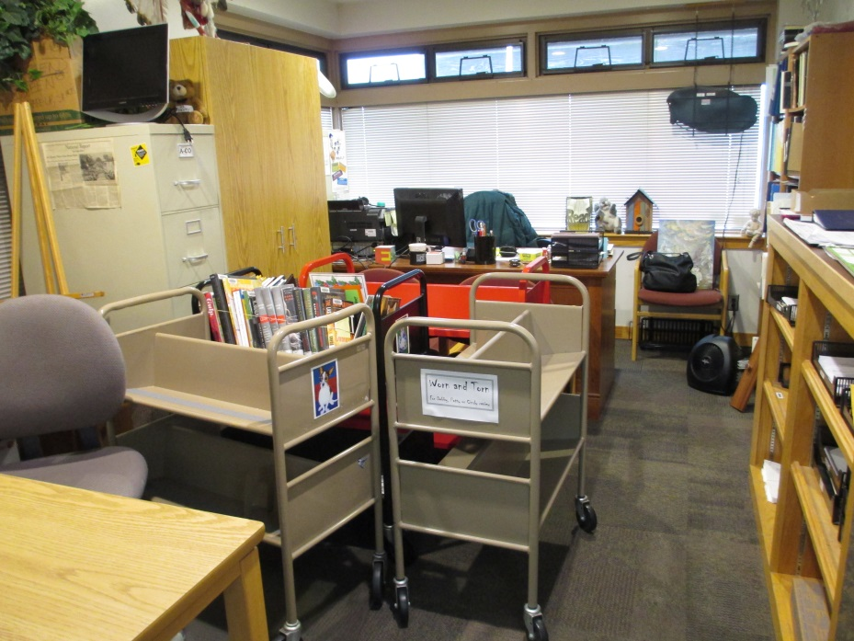
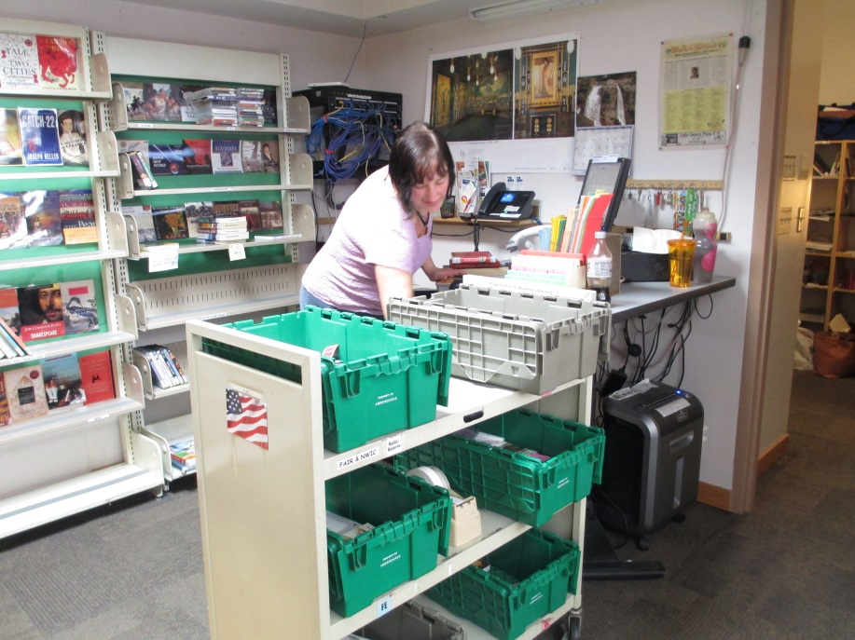
Staff work areas often cannot be accessed without repositioning carts or furniture
Check-in area is limited to one station, which is overwhelmed with an annual quarter million returns and requests

Slide 17
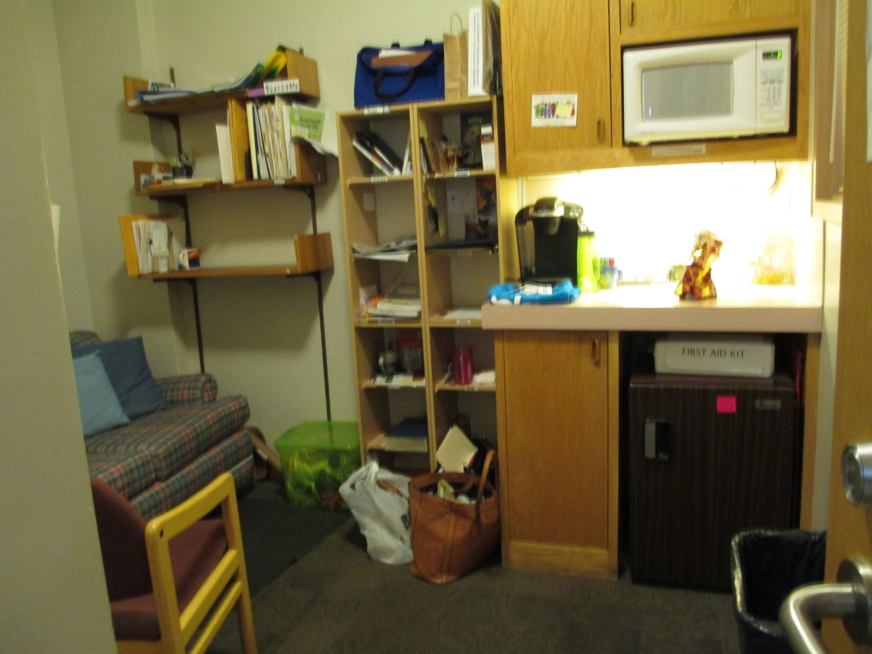
The staff
break room, restroom, and personal storage space is confined to a total 8’ x 10’ area and serves a staff of 14

Slide 18
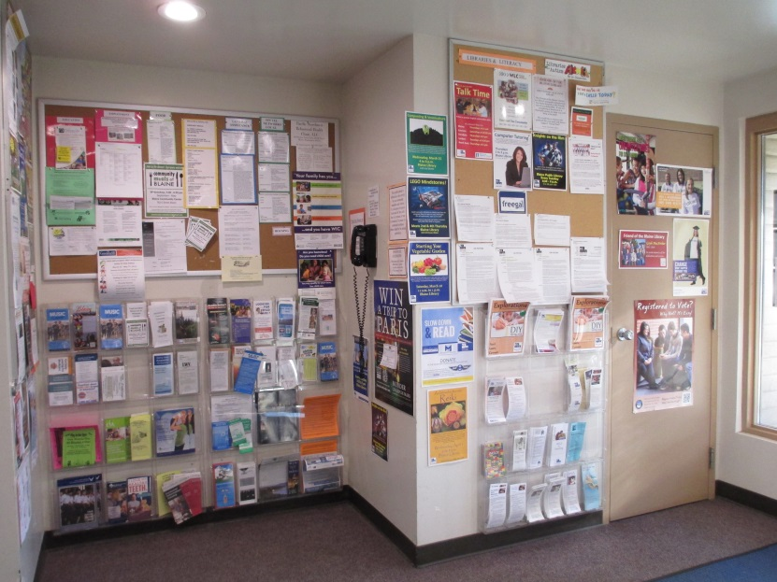
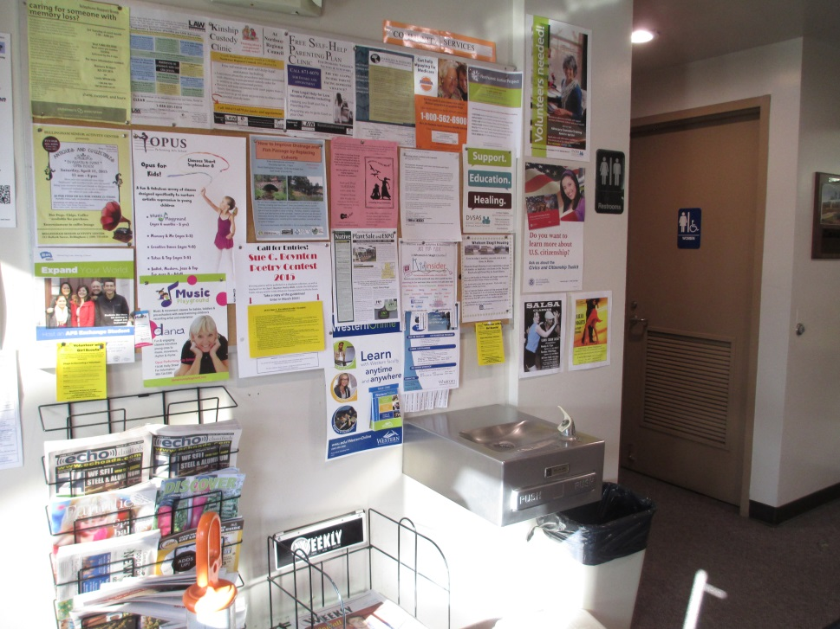
The foyer provides a free local phone, water fountain and restroom access,
but is inadequate to handle the number of people that use the amenities, and lacks adequate display space for community information needs

Slide 19
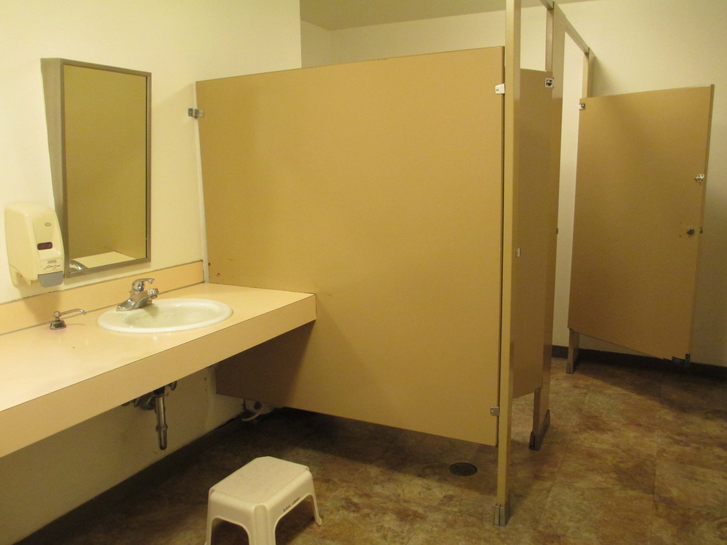
The public restrooms serve thousands of visitors, but are in need of upgrade and
to be brought
up to ADA standards

Slide 20
Why should a new library be the community’s top priority

Slide 21
Accomplishes many community goals
Equitable access to services and resources for all members of the community
Open 6 days a week (Future Sunday hours being discussed)
Program and meeting space
Visitor information and services
U.S. Immigration, Customs, and IRS help
Local history center
Community gathering center

Slide 22
Benefits local economic development
Increases attractiveness of the community to business because of its cultural and educational assets
Contributes to developing skills, with consequent increases in work force productivity
Provides information services and support to businesses
Makes available free materials for patrons, freeing up personal discretionary income that may be spent at local businesses

