Slide 1

City Council
Inverness
PUD and Preliminary Plat
Hearing Examiner Recommendation
August 11, 2025 6:00 PM
Alex Wenger, AICP CDS Director
City of Blaine Community Development Services
Notes:
East Maple Ridge Planned Unit Development (File 2020018), Preliminary Plat (File 2020019), and associated permits (Critical Areas Review (Permit 2020020) and SEPA (Permit 2020021)).

Slide 2
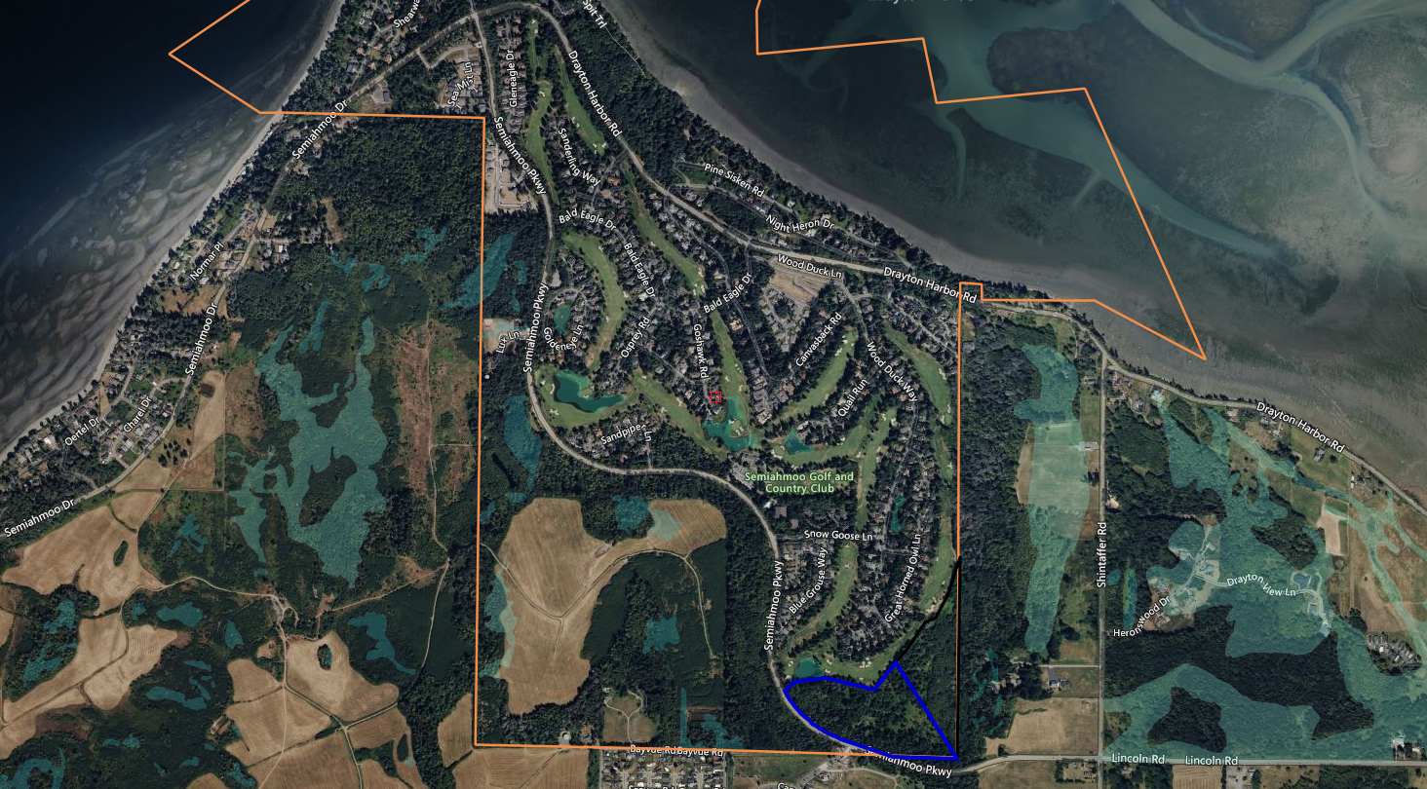
Project Description & Background
Inverness

Slide 3
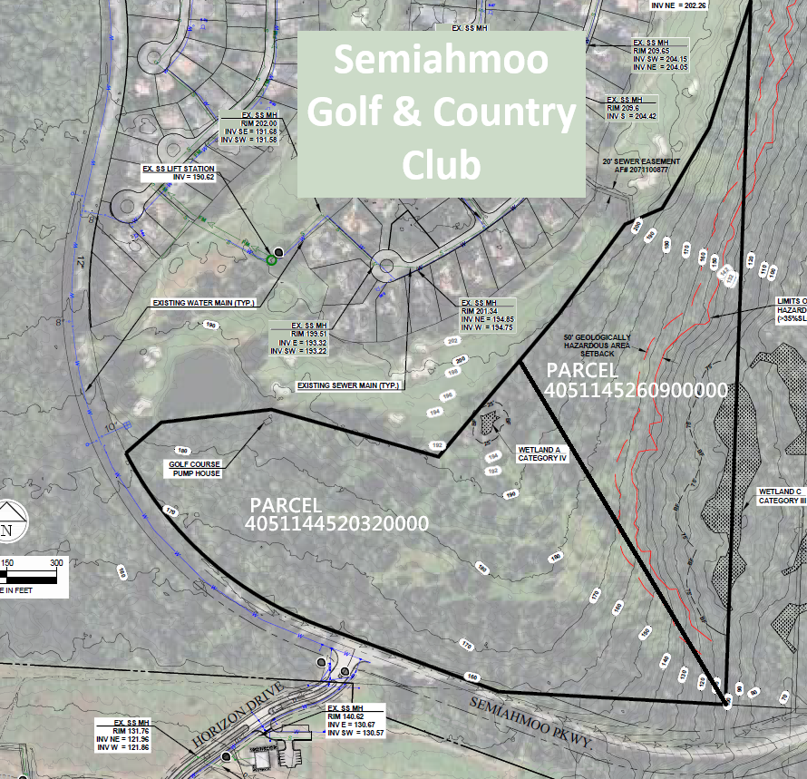
Project Description & Background
Applicant: Fratelli’s LLC
Agent: Cascade Engineering Group
37.01-acre site
Two parcels
Steep slopes
Two wetlands

Slide 4
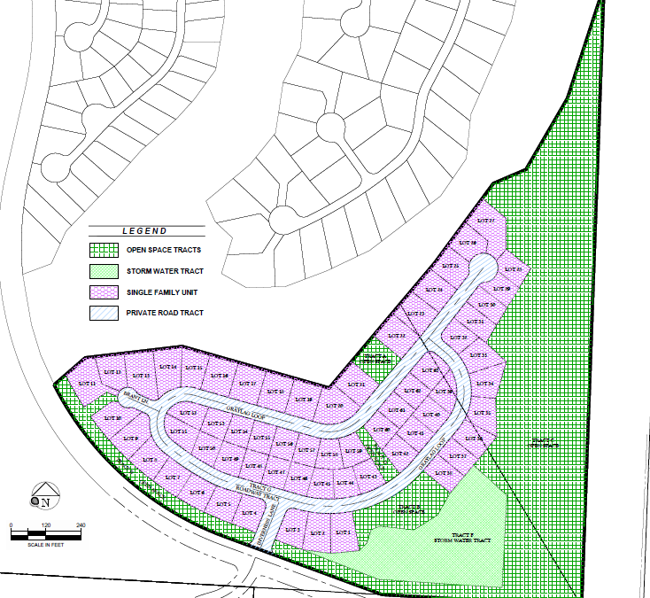
Project Description & Background
63 SFR lots
- single phase
Open Space tracts
Community park
Stormwater tract
Private roads
Connecting trails

Slide 5
Review Process
Planned Unit Development and Preliminary Plat
BMC 17.06 – Both Type II CC Decisions
BMC 2.58.070.B empowers Hearing Examiner
Open record hearing
recommendation to City Council
Quasi-judicial decision
Final decision by City Council – Closed Record

Slide 6
Review Process
5/25/2022 Community Conference
12/29/2022 Application Complete
12/29/2022 Notice of Application
9/25/2024 SEPA Determination
6/10/2025 Critical Area Determination
6/10/2025 Public Hearing Notice
BMC 17.06.100-110 Notice requirements met

Slide 7
Project Review
Public Comments
Comments summarized, addressed in staff report.
Concerns raised re: Density; Landscape design; Maintenance; Stormwater, flooding and erosion; Roads; Draft CC&Rs; Safety; Semiahmoo Resort Association responsibilities and obligations.
One SEPA comment re: traffic impacts, downstream drainage impacts.

Slide 8
Project Review
BMC 3.80 Impact Fees
BMC 17.05 Traffic Concurrency
BMC 17.80 SEPA
BMC 17.82 Critical Area Review
BMC 17.38 Residential Planned Recreation
BMC 17.60 Subdivisions
BMC 17.68 Planned Unit Development
BMC 17.74 Subdivision Design Standards

Slide 9
PUD Application Requests
Pedestrian/Bicycle facilities
Trail easement
Buffer perimeter planting
PUD buffer
Foundation height – minimal increase
Lot Coverage - Standard per RSMP
25% Building Coverage
35% Lot Coverage
Setbacks – Standard per RSMP
25’ Front, 30’ Rear and 10’ side

Slide 10
Project Review
BMC 17.80 SEPA
SEPA MDNS issued 9/25/2024 Exhibit # 55
Conditions address project impacts – County traffic impact, Open Space, enhanced perimeter screening, lift station cost sharing
One comment received
- Amy Keenan, Whatcom County - Exhibit # 58

Slide 11
Project Review
Comprehensive Plan, RSMP Consistency
Consistent with comprehensive plan for West Blaine.
GMA-consistent with goals to encourage urban development, reduce sprawl, housing, open space and environmental protections. ✓

Slide 12
Project Review RPR Zone regulations
17.38.020 Permitted uses ✓
17.38.030 Permitted accessory uses ✓
17.38.031 Conditional uses. n/a
17.38.050 Minimum lot size. ✓
17.38.055 Residential design standards ✓ (Master Plan)
17.38.060 Setback – Land coverage – Height – Lot width. ✓ PUD
17.38.070 Off-street parking. ✓ 2 per unit, (Master Plan)

Slide 13
Project Review PUD
BMC 17. 68 Planned Unit Development
17.68.080.A-K - Criteria for Approval
Design ✓
Meets PUD criteria ✓
Comprehensive Plan ✓ consistency ✓
Public Welfare ✓
Compatible with ✓ Environs
Natural Features ✓
Circulation ✓
Open Space and ✓ Landscaping
Covenants ✓
Public Services ✓
Phasing ✓

Slide 14
Project Review PUD
BMC 17.68.120 Residential PUD Standards
F. Lot configuration ✓
Smallest parcel 8,004 sq. ft. - 4,000 sq. ft. required
Most parcels 80 feet wide, some constrained (cul-de-sac)
RPR zone 75 feet required
Reduced lot widths permitted for PUDs, PUD allows increased residential density
Project subordinate to Semiahmoo Resort Community Master Plan, CC&Rs, Semiahmoo Resort Association oversight.

Slide 15
Project Review Subdivision Design
BMC 17.74 Subdivision Design Standards
Right-of-way widths ✓
Additional ROW ✓
Utility easements ✓
Required Improvements
- Municipal utilities ✓
- Streets ✓
- Lighting ✓
- Street trees with final
- Pedestrian facilities ✓
Block Length ✓
Neighborhood pattern ✓
Irregular lot shapes ✓
Lot orientation ✓
Flag lots ✓
Through lots ✓
Stormwater management ✓
Trail corridors ✓
Parks and open space ✓

Slide 16
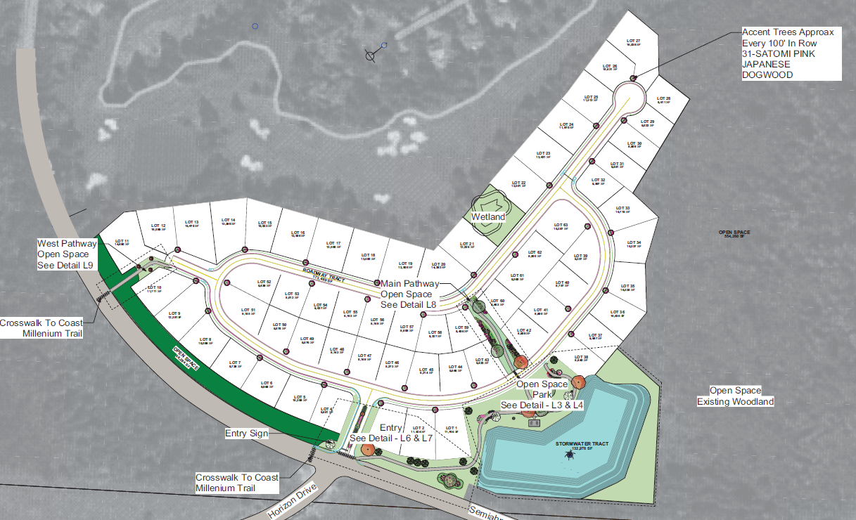
Project Landscaping Layout

Slide 17
Staff Recommendations
Conclusions in the Staff Report
Processed per Type II – CC procedures
SEPA Conducted – MDNS issued
Complies with Planned Unit Development, preliminary plat policy/use regulations.
Consistent with goals, policies and regulations applicable to this proposal.
Specific requirements and recommendations listed in Hearing Examiner’s Recommendation.

Slide 18
Conclusion
Staff concurs with the Hearing Examiner's recommendation and advises that Council pass a motion to approve Ordinance 25-3034 and the Inverness PUD and Preliminary Plat.

Slide 19
City Council
Inverness
PUD and Preliminary Plat
Hearing Examiner Recommendation
August 11, 2025 6:00 PM
Alex Wenger, AICP, CDS Director
City of Blaine Community Development Services
Notes:
East Maple Ridge Planned Unit Development (File 2020018), Preliminary Plat (File 2020019), and associated permits (Critical Areas Review (Permit 2020020) and SEPA (Permit 2020021)).

