Slide 1

City Council
Residential Office Zoning Text Amendment
June 23, 2025
6:00 PM
Alex Wenger, AICP, CDS Director
City of Blaine Community Development Services

Slide 2
Planning Commission Recommendation
May 8th – PC voted unanimously to recommend approval (7-0).
April 17th – PC held a public hearing
March 13th – PC discussed zoning changes
City Council to receive PC’s recommendation and then schedule a meeting to deliberate & take action.

Slide 3
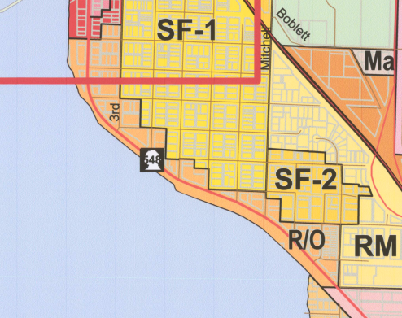
R/O Zoning District

Slide 4
Text Amendment Background
Docketed by City Council in 2024 & 2025
Accommodate housing as part of Comp Plan
Amendment properly noticed and published
Additional outreach to property owners
Two comments (Salishan Neighborhood, Dave & Eve Tupper)
SEPA Determination issued
No comments
Legislative amendment – PC recommendation
City Council makes final decision

Slide 5
Purpose
The proposed text changes to BMC 17.26 are intended to encourage a broader range of uses within the zone and create flexibility in development regulations.
Housing Goal #1: To encourage the development of a variety of housing types and prices, including an adequate supply of housing in a price range affordable to employees at available jobs in Blaine and housing which meets the needs of senior citizens.
Housing Goal #2: To preserve and enhance the housing and residential neighborhoods which currently exist within the City.

Slide 6
Zoning Amendment Overview
Add townhouses, multifamily, hotels & motels as permitted uses
New hotels and motels are conditionally permitted east of Harrison Avenue
Increase building height for commercial, mixed-use and multifamily to 45 feet, east of Harrison Avenue.
Allows for smaller lots for townhouses w/cc&r’s
Allows Accessory dwelling units
Adjusts building standards:
New setbacks.
20% Open Area for multifamily
10% for commercial

Slide 7
Zoning Amendment Overview
New design standards
Remove language with ambiguous terms
Add required architectural standards
Administrative departure process
Note - No changes to parking requirements

Slide 8
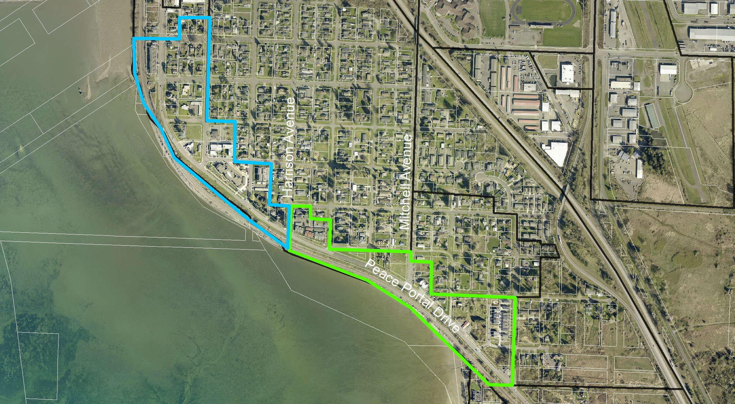
Permitted Uses & Building Heights

Slide 9
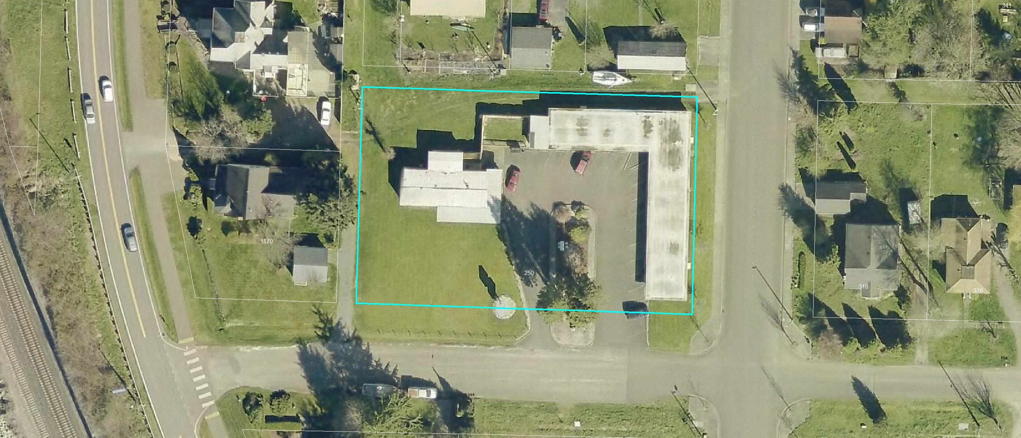
Motel 1

Slide 10
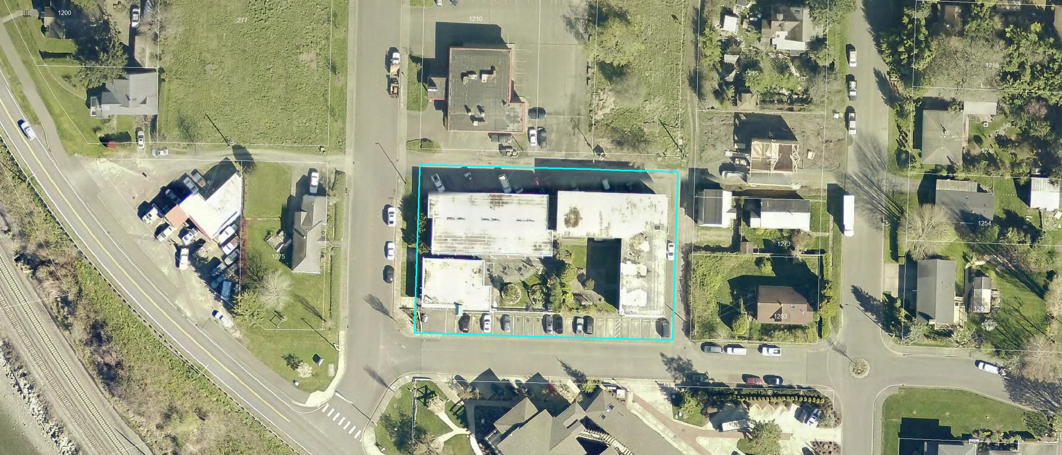
Motel 2

Slide 11
Next Steps
Per BMC 17.04.050(B)(6) – Council should make a motion to put the proposal on a future meeting agenda to deliberate and take action.
Staff recommends July 14th.

Slide 12
City Council
Residential Office Zoning Text Amendment
June 23, 2025
6:00 PM
Alex Wenger, AICP, CDS Director
City of Blaine Community Development Services

