Slide 1
City Council
Final Plat of
East Maple Ridge
Division 4
December 9, 2024
6:00 PM
Alex Wenger, AICP
CDS Director
City of Blaine Community Development Services
Notes:
East Maple Ridge Planned Unit Development (File 2020018), Preliminary Plat (File 2020019), and associated permits (Critical Areas Review (Permit 2020020) and SEPA (Permit 2020021)).

Slide 2
Site
Notes:
Part of east Blaine Subarea
North of H Street, east of Jerome Street, and west of North Harvey Road
89 acre site

Slide 3
Project Background
Prior approvals (2020 - 2023):
Preliminary Plat (for all phases);
Planned Unit Development;
SEPA Review;
Critical Areas Review; and
Final Plat Approval for Divisions 1, 2 & 3

Slide 4
Proposal
Notes:
The applicant, East Maple Ridge LLC, proposes to develop 353 dwelling units. The project also includes a neighborhood commercial center consisting of 24,000 square feet of commercial space.

Slide 5
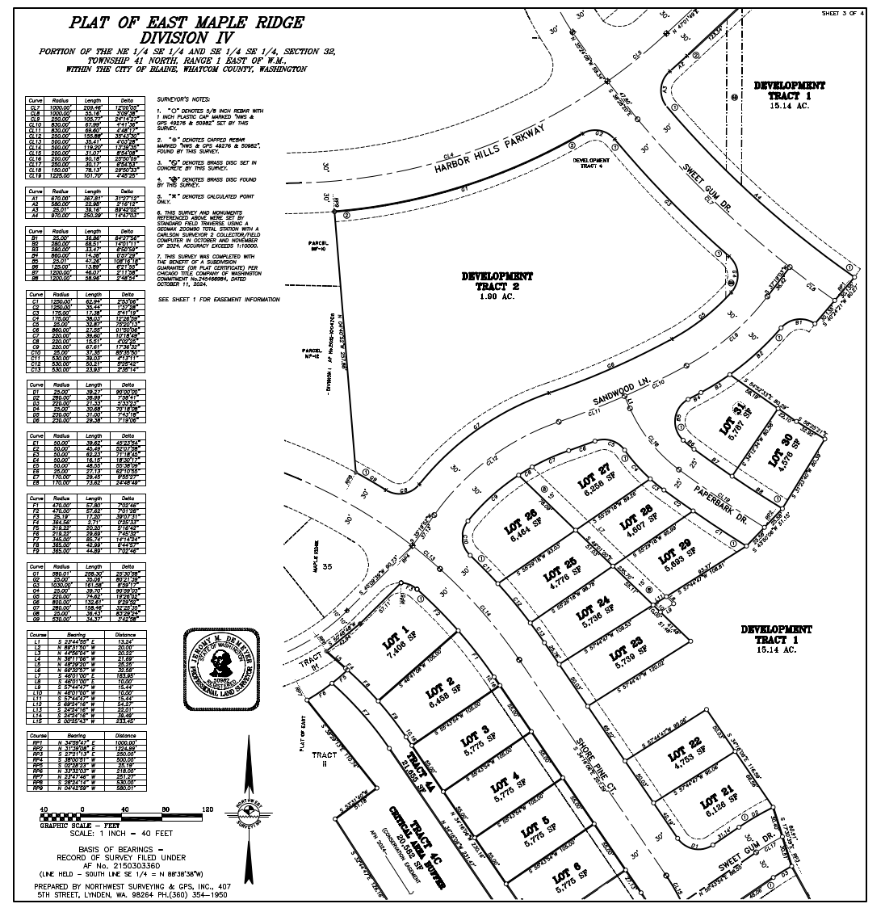

Slide 6
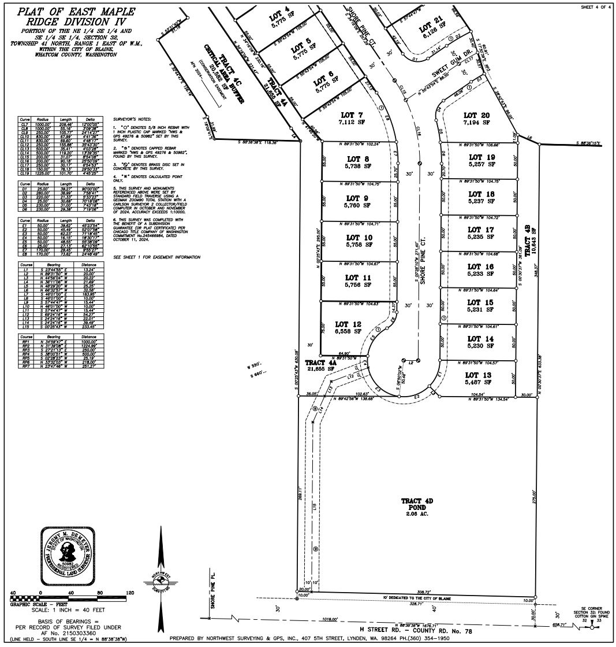

Slide 7
Criterial for Approval
RCW 58.17.110
Public use and interest will be served
BMC 17.60
Infrastructure over 80% complete
Final mylar and associated documents
Department Recommendations
Public Works
Community Development Services
Performance security for deferred improvements
Permits in place
= Consistent with recommended conditions

Slide 8
Recommendation
Community Development Services (CDS) respectfully recommends that the City Council consider approving the final plat for Division IV of the East Maple Ridge PUD, subject to Conditions of Approval, by passing a motion to approve Ordinance 24-3021.

Slide 9
Conditions of Approval
Prior to the mylar being signed by the City, the applicant must:
a. Complete minor administrative modifications, as may be necessary, based upon final review and acceptance of the final plat drawings/mylars (Attachment 1A) by the City.
b. Complete construction of Public Works Department punch list items, and/or;
c. Submit a financial security to the City in an amount equal to 150 percent of the estimated cost of the deferred improvements as determined by the Public Works Director based on the engineer of record’s estimate.

Slide 10
City of Blaine City Council
City website:
www.ci.blaine.wa.us
For Additional Information:
Call Alex Wenger at 360-332-8311
Email to awenger@cityofblaine.com
Alex Wenger, AICP
CDS Director
City of Blaine Community Development Services

