Slide 1
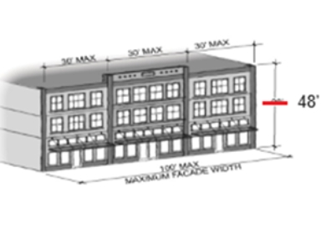
4 story buildings
on the marina view side of Peace Portal

Slide 2
1. Decisions about the city
2. What would we gain?
3. Impact on Blaine's biggest asset
that draws visitors and pleases residents
4. Ad hoc recommendations
5. Survey results.

Slide 3
Decisions about the city

Slide 4
Why have we gone far over budget on Plover? Why not buy a new big shiny modern boat? ...

Slide 5
Why have we gone far over budget on Plover? Why not buy a new big shiny modern boat? Attraction to Blaine: Historic, small, old, cute.

Slide 12
What would we gain?: 4 story on view side
Some housing (no incentive or obligation to be affordable)
Some property tax
Stop there being vacant space on the view side of Peace Portal Dr

Slide 17
13% of our city revenue is from property tax @ $1,221,423
26% comes from people spending money in Blaine @ 2,555,414

Slide 18
DRAYTON HARBOR BUILDING LLC 477 Peace Portal Dr.
valued at $1,307,734
$8798 per year all total property tax, $969.85 to Blaine
HORSESHOE BUILDING LLC 810 Peace Portal Dr.
valued at $472,484
$3181.93 per year all total property tax, $350.41 to Blaine
LOOMIS HALL 288 Martin St.
valued at $1,299,457
$8742.33 per year all total property tax, $963.72 to city of Blaine.

Slide 19
Blaine city annual share of the property tax of all three combined is $2,282
or .00186, aka less than a fifth of one percent of the 13% of our operating funds that come from property tax.

Slide 20
Any decision is a trade off.
Allowing 4 story on the water view side of Peace Portal Dr.
could get us something like $2,282 property tax,
and a spot for 14-30 residents, give or take.
Would we trade DHOC, the 4th of July fireworks and the water tower and the Peace Arch for a building with 14 condos in it ?
Would we bulldoze 18 heritage homes in Salishan for a Walmart?
Of course not, that would be a bad trade.

Slide 21
What could possibly go wrong?
Marketing our small town harbor feel, but 1 or 2 four story buildings at the most focal visible, visited attraction area.
There not actually being businesses on the ground floor.
Blaine by the sea, with less sea
Reduced quality of the Starbucks / taco outdoor seating.
Reduced values of properties with blocked views

Slide 30
Ad hoc committee
The ad hoc committee was a very small group less than 15 people, many of whom either own property in the area requesting additional building height, or who generally participate in profitable ventures such as building condos. Only 2 members of the committee represented the general resident population whose concerns were more limited to the overall feel and look an pleasure of being downtown as a resident or visitor of Blaine.
The recommendations were not surprising.

Slide 31
Survey poll
Survey poll was conducted October 14 to 22.
Called from a list of 500 Blaine city residents, selected and weighted for a proportional representation of ages, home values, and political leanings.

Slide 32
Survey question
Hello is that _____. Hi, I am seeking input about the city of Blaine's new development downtown.
Could you tell me if you would support 4 story condo buildings built on the currently vacant VIEW side of Peace Portal Drive, that might block views of the marina and water from places like the sidewalk seating at Starbucks and the taco place. It would add some places to live. Would you support this, or prefer if bigger condo buildings go somewhere else?

