Slide 1

City Council Meeting
Downtown Waterview 36 Zoning Text/Map
Amendments -
Height
November 12, 2024
6:00 PM
Alex Wenger, AICP, CDS Director
City of Blaine Community Development Services
Notes:
East Maple Ridge Planned Unit Development (File 2020018), Preliminary Plat (File 2020019), and associated permits (Critical Areas Review (Permit 2020020) and SEPA (Permit 2020021)).

Slide 2
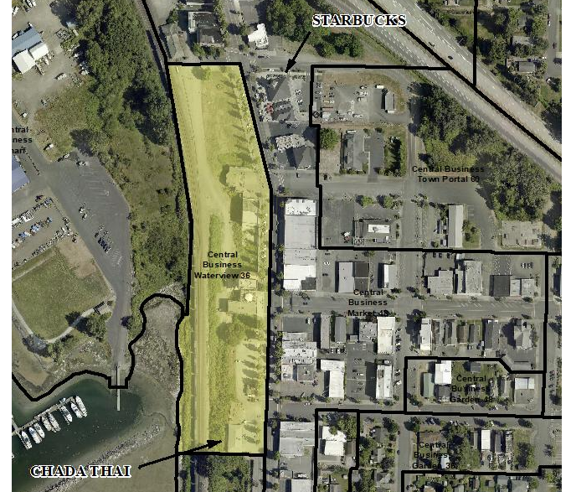
Waterview 36 Subdistrict

Slide 3
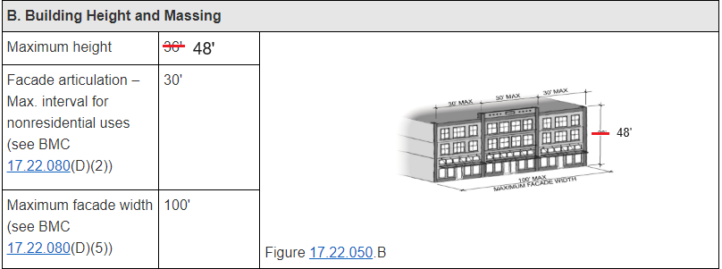
Height Regulations, proposed
Amend zoning code and map to increase maximum height in the Central Business District Waterview subdistrict from 36 to 48 feet.
Table 17.22.050

Slide 4
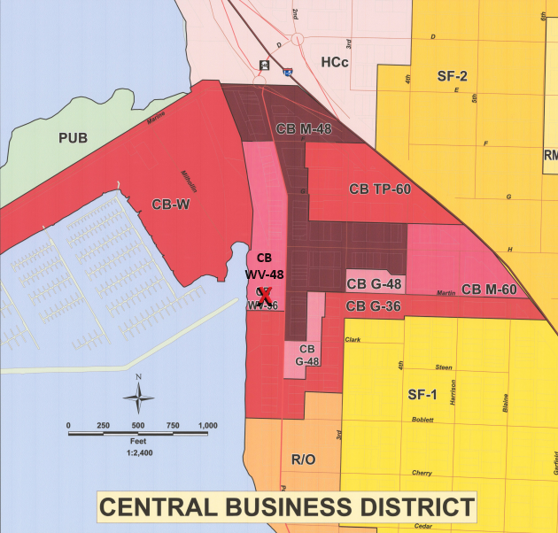
Waterview 36 District

Slide 5
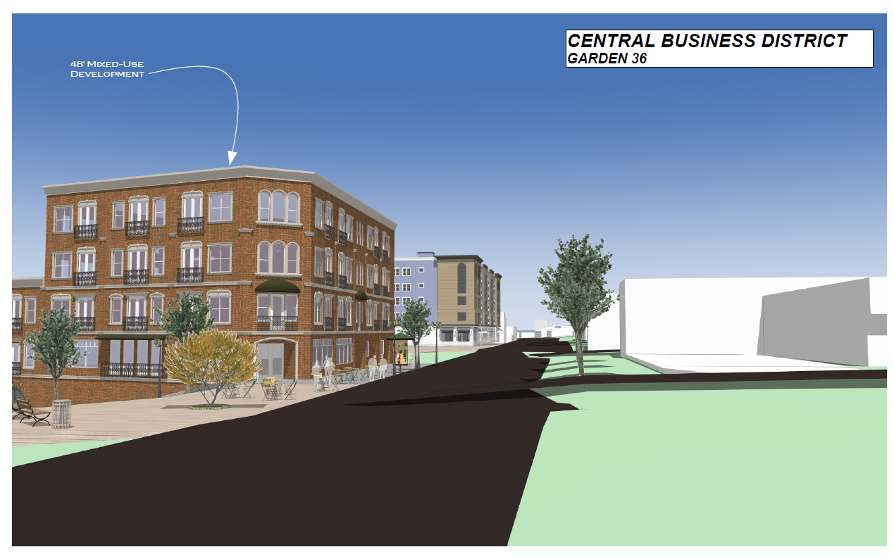
Building height renderings images by Haven Design, Ferndale

Slide 6
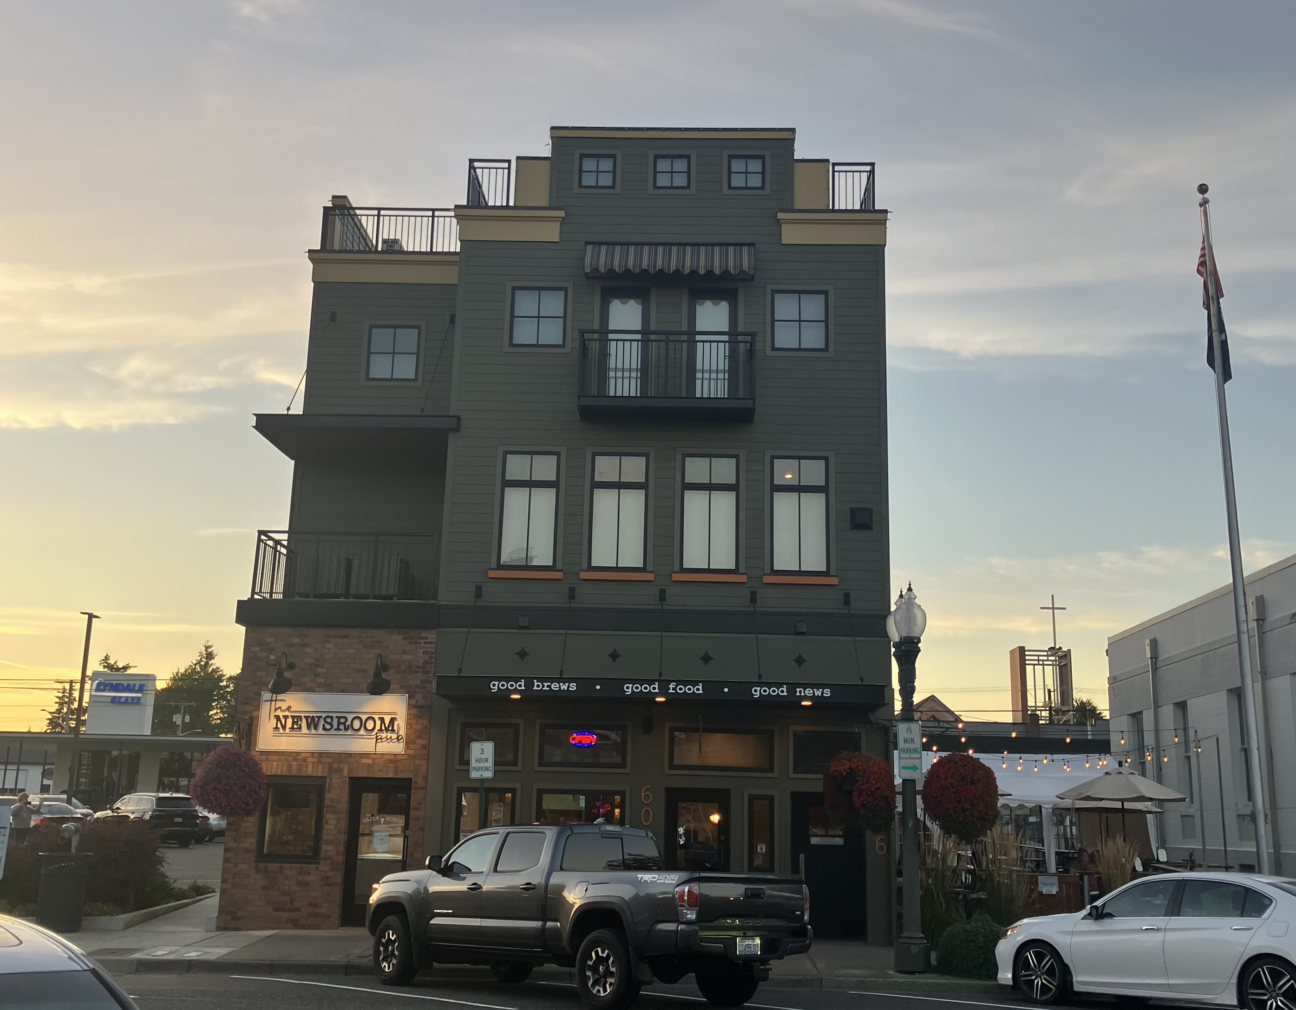
41’8” tall

Slide 7
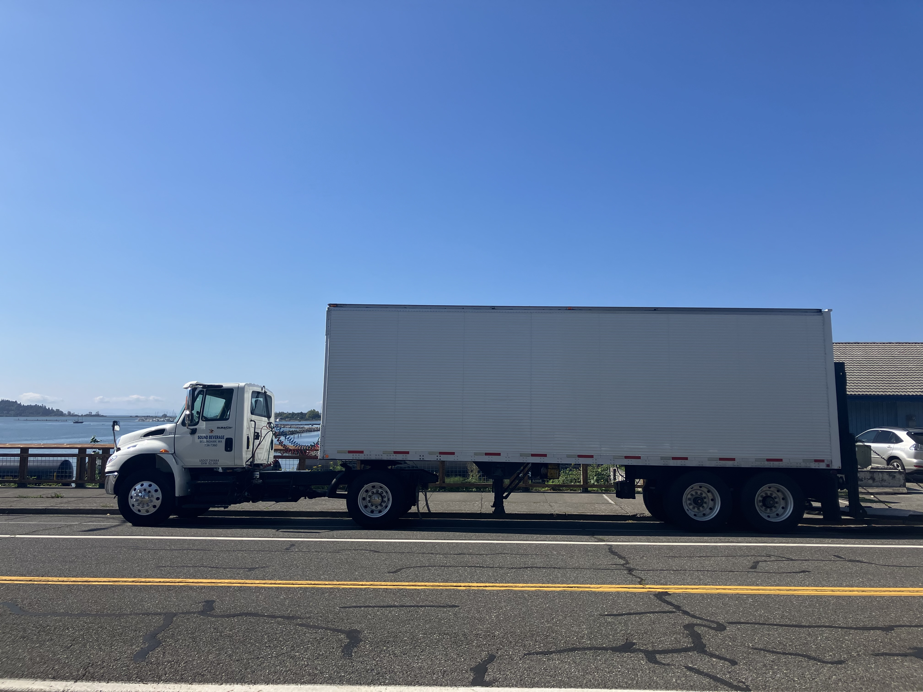

Slide 8


Example Upper Floor Views
~ 2% view window
Other
Elevator
HVAC
Residential 4th Floor
Residential 3rd Floor
Residential 3rd Floor
Residential 2nd Floor
Residential 2nd Floor
Commercial & Parking 1st Floor
Commercial & Parking 1st Floor
Street (80’ wide)
Building (90’ wide)

Slide 9
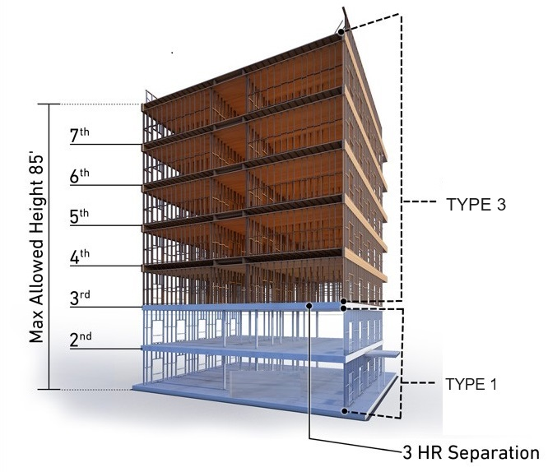
Building height - Discussion
Type III – metal studs or fire-treated wood exterior frame, standard wood interior framing
5 floors max
Type V – standard wood framing
4 floors max
Type I – 1 or 2 stories concrete podium base
Treated as separate buildings with fire separation

Slide 10
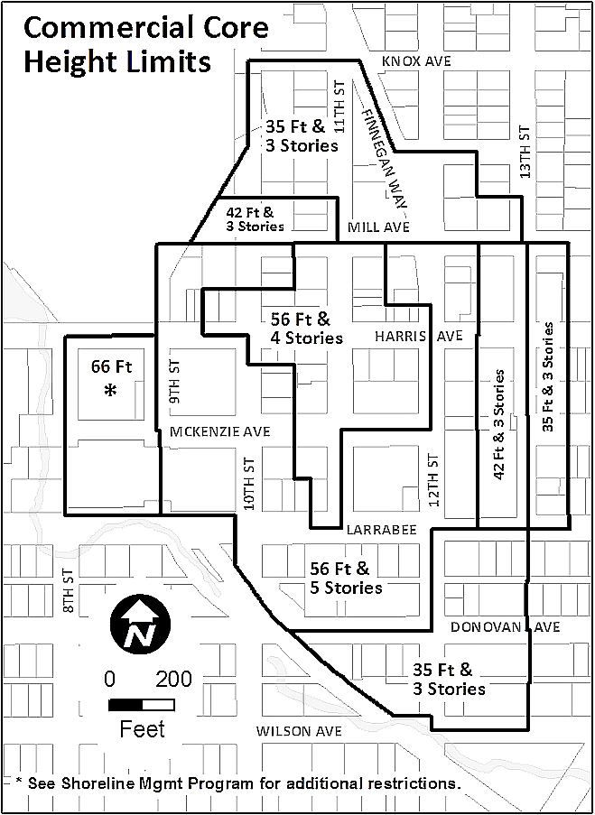
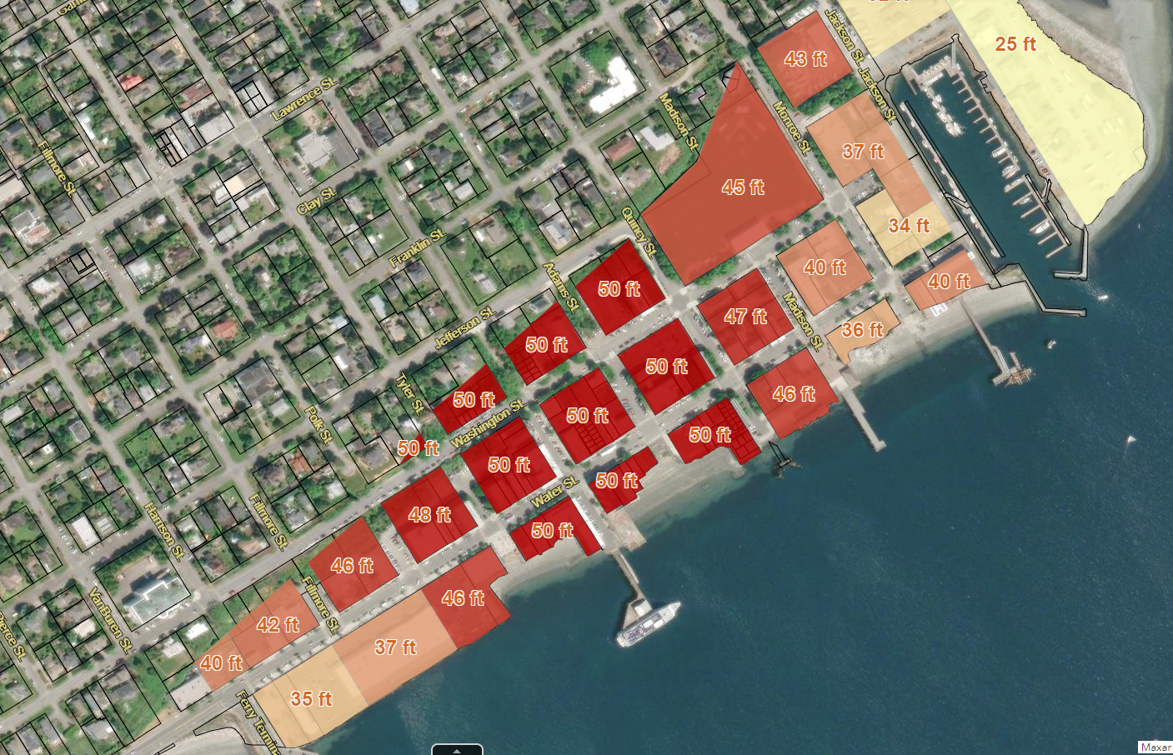
Building height - Discussion
Height limits in similar jurisdictions
please refer to packet pages 51-54
Port Townsend
Fairhaven

Slide 11
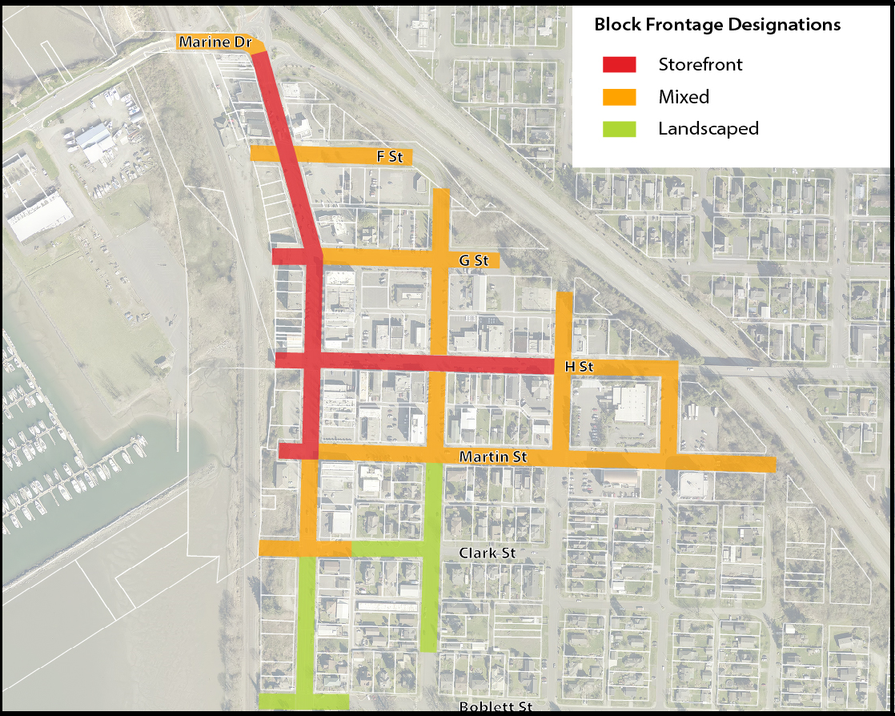
Building height - Discussion
Turn-of-the-Century design standards if applicable
Excerpt from BMC 17.22.080 – Block Frontage map
BMC 17.22 CBD zoning regulations
BMC 17.22.050
BMC 17.22.080
Please refer to packet pages 11-48

Slide 12


Building height - Discussion
ECONorthwest. We had a kick-off meeting in mid March to launch the MFTE program evaluation project, supported by Sustainable Connections
Transpo Group parking study. Completed parking inventory in August, 2024 with similar results.

Slide 13
Building Height - Discussion
Rationale
This is not about affordability, or “self-dealing to developers”. It’s about a core piece of our zoning that doesn’t work.
We have a vision, we have design standards, there is a plan for downtown. We have branding.
There has been robust public process.
We’ve considered alternatives.
Council has asked for and docketed this proposal.

Slide 14
Building Height –Recommendation
The Planning Commission voted 4 to 1 to recommend approval of the proposed amendment.
CDS Department recommends placing the proposal on the November 12th City Council agenda to deliberate.
At a future meeting Council may:
Approve
Modify within the scope of the application
Requires a public hearing
Remand to the Planning Commission, with direction
Deny

Slide 15
City of Blaine Planning Commission
City website:
www.ci.blaine.wa.us
For Additional Information:
Call Alex Wenger at 360-332-8311
Email to awenger@cityofblaine.com
Alex Wenger, AICP, CDS Director
Mike Beck, AICP, Senior Planner
City of Blaine Community Development Services

