Slide 1
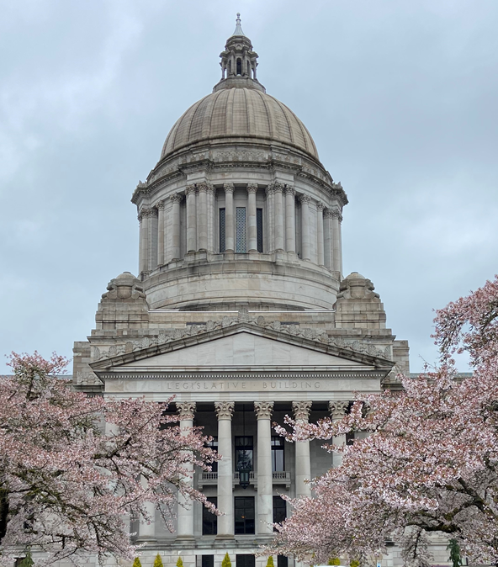

City of Blaine
2023 LEGISLATIVE session
June 26, 2023
Holly Cocci

Slide 2
Purpose
Overview of the 2023 Legislative Session
Outcome of Blaine Priorities
Additional Legislative Issues
Next Steps

Slide 3
Overview of 2023 Legislative Session
General Context
Political Context
Democrats held the majority in House and Senate
First year of the biennium,105-day session
Adopted 2023-25 operating, capital, and transportation budgets
There were new legislators in positions of leadership and Committee Chairs
Any legislation that did not pass, will be reconsidered next session
2,156 bills introduced, 485 passed into law
Special session - May 16th to address Blake
Notes:
2,156 bills considered, 485 passed into law

Slide 4
2023 Budget Overview
Operating
Capital
Transportation
Funds all state agency operations
March revenue forecasts $65.7 billion for the next biennium
$69.8 billion total budget, $3.6 billion in reserves
Local Investments: Climate change planning (HB 1181), housing & homelessness, encampment response, crisis response services and facilities, BLEA
Funds public and nonprofit construction projects (excluding transportation)
$9 billion total budget
Combination of bond capacity, federal funds, MTCA, CCA, etc.
Key investments in housing & homelessness, behavioral health, education
$13.5 billion budget
First full biennium of revenues and investments from Move Ahead WA
March revenue forecast continued decline, primarily stemming from fuel taxes.
Honors delivery of many commitments from Connecting WA & Move Ahead WA
CCA revenues: investments in carbon-reducing programs such a Safe Routes to School, Pedestrian and Bicycle Safety, Complete Streets

Slide 5
2023 legislative Budget Requests
East Blaine Well Field
Capital budget request: $2 million
Bell Road Intersection project to Grade Separation project
Met with delegation in advance of session and throughout
2021-23 Capital Budget Investments:
$500,000 – Water Pump Station
$500,000 – Downtown Revitalization
Bell Road/SR 548
Transportation budget request for transfer of project funds: $2.2 million
Challenge: Budget leaders advising many communities to seek grant funding opportunities
Connecting Housing to Infrastructure Program (CHIP)
Final Budget: $2.2 million transferred to Grade Separation Project
Partners: BNSF, Blaine and WSDOT
Pursuing federal funds
City’s preferred approach and Legislative Delegation in support
Final Budget: Did not include project funding

Slide 6

2023 Legislative Priorities
Fiscal Sustainability
1% property tax cap
State shared revenues
Local Transportation Preservation & Maintenance
Public Works Assistance Account
Housing
Market Rate: middle housing, ADUs, permitting, SEPA exemption, etc.
Subsidized: REET and Governor’s bond proposal
Grant Funding
TIF – Technical Fix

Slide 7

Next steps
Thank the 42nd Legislative Delegation
Interim Action Plan & Steps to prepare for the 2024 session
2024 Legislative Session begins January 8th
Implement new policies/projects implemented/funded with state awards

Slide 8
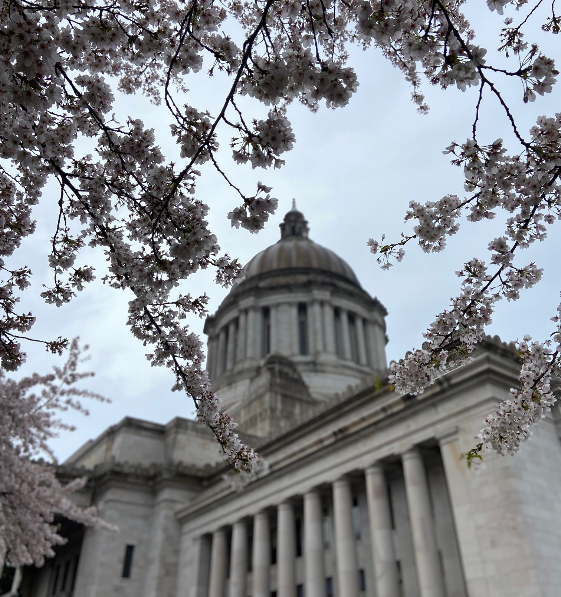
Questions?
Holly Cocci
Cell: (253) 509-2403
E-mail: hcocci@gth-gov.com

