Slide 1

Blaine City Council TIF - Discussion
BRIEF OVERVIEW OF TIF AND TWO-STEP APPROACH
STEP 1 AND 2 UPDATE

Slide 2
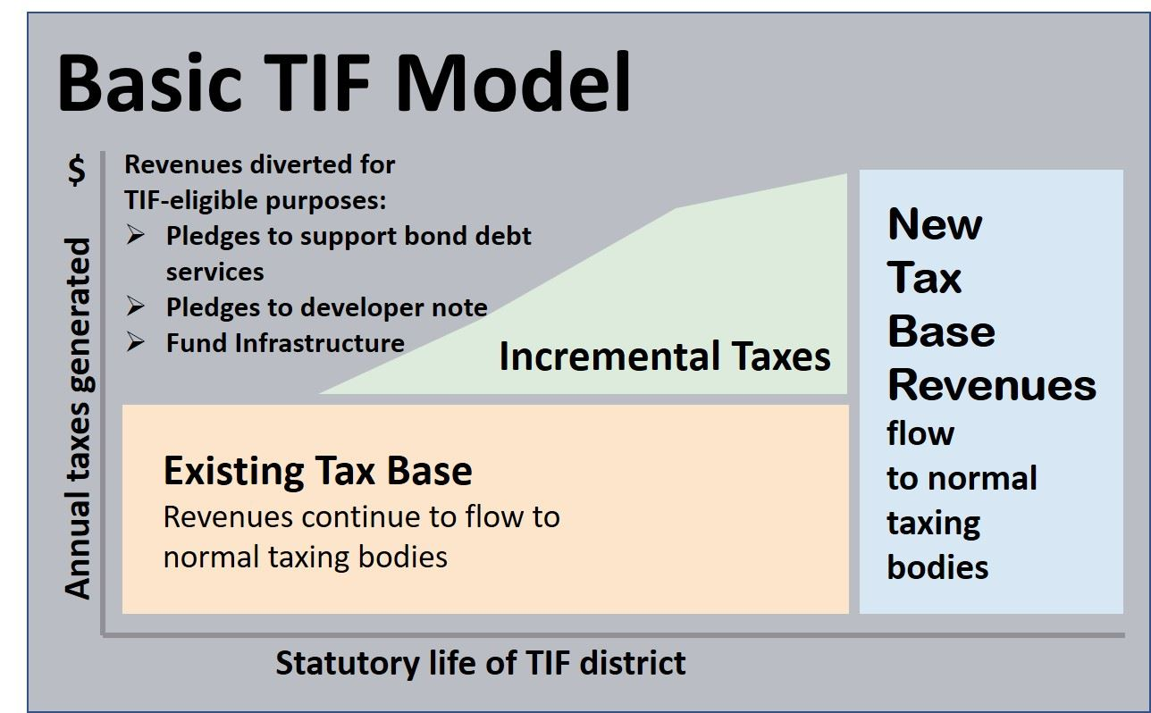
Overview of Tax Increment Financing
Model
Generally, TIF captures property taxes generated from the increased assessed valuation on the site that results from private development following infrastructure investment.
Washington State TIF law excludes State property tax and voter approved school levies.
Revenues from REGULAR property taxes assessed against the Increment Value only, are captured:
To pay “public improvement costs”
To repay bonds issued for “public improvements”

Slide 3
Overview of Tax Increment Financing
SUMMARY
Available to cities, counties, and ports.
Powerful economic development tool.
Designed for specific project/site – Not build infrastructure and hope/wait for development.
Projects will not occur “but for” the public investment in infrastructure – “But-For” Requirement
Results in creation of new assessed value, public benefits, construction of desired development and short/long-term jobs.
Taxes from the development fund the public infrastructure needed by the development; no impact on individual property owners.

Slide 4
Overview of Tax Increment Financing
INFRASTRUCTURE
Eligible Infrastructure improvements owned
by a local government within or outside of and serving the increment area that include:
Street and Road Construction;
Water and Sewer System Construction And Improvements;
Sidewalks and Other Non-motorized Transportation Improvements and Streetlights;
Parking, Terminal, and Dock Facilities;
Park and Ride Facilities or Other Transit Facilities;
Park and Community Facilities and Recreational Areas;
Stormwater and Drainage Management Systems;
Electric, Broadband, or Rail Service;
Mitigation of Brownfields; Or
Eligible expenditures for any of the following purposes:
Purchasing, Rehabilitating, Retrofitting for Energy Efficiency, and Constructing Housing for the Purpose of Creating or Preserving Long-term Affordable Housing;
Purchasing, Rehabilitating, Retrofitting for Energy Efficiency, and Constructing Child Care Facilities Serving Children and Youth that are Low-income, Homeless, or in Foster Care; Providing Maintenance and Security for the Public Improvements; Historic Preservation Activities Authorized Under RCW 35.21.395.

Slide 5
Overview of Tax Increment financing
KEY ELEMENTS
City, county, or port adopts an ordinance designating increment area, and identifying the public improvements to be financed, and whether bonds will be issued. Limitations:
No more than two active increment areas per sponsoring jurisdiction and they may not overlap.
Increment areas may not total more than $200 million in assessed valuation, or more than 20% of the total assessed valuation of the sponsoring jurisdiction, whichever is less.
Cannot add additional public improvements or change the boundary of the increment area once adopted.
Must include a deadline by when construction of public improvements will begin.
The local government may only receive TIF revenues for the period of time necessary to pay the costs of the public improvements.
If the local government finances the public improvements, the increment area must be retired no more than 25 years after the adoption of the ordinance designating the increment area.

Slide 6
Overview of Tax Increment Financing
Ordinance is adopted, effective in June each year. Increment funds distributed as early as the following year, likely later.
Applies to local property taxes only.
Limited to the amount needed to fund the public improvements outlined in ordinance.
Additional revenues not needed to repay bonds or pay other costs of the public improvements are then allocated back to the taxing districts in proportion to their regular tax levy rates.

Slide 7
Overview of Tax Increment Financing
Project Analysis to be submitted to State Treasurer’s Office
Boundaries and duration of the increment area.
A description of the expected private development within the increment area, including a comparison of scenarios with and without proposed public improvements.
A description of the public improvements, estimated public improvement costs, and the estimated amount of bonds or other obligations expected to be issued.
Assessed value of real property within the increment area and an estimate of the increment value and tax allocation revenues expected.
Estimate of the job creation reasonably expected to result from the public improvements and the private development.
An assessment of any impacts and necessary mitigation to address impacts on affordable and low-income housing, local business community, local school districts, local fire service
If 20% of the assessed valuation of fire district is within the increment level or there is an increase in level of service to increment area, must negotiate a mitigation plan.

Slide 8
Overview of Tax Increment Financing
Required Outreach
Hold two public briefings exclusively on the project.
Submit a project analysis to the State Treasurer for review.
Publish notice in public newspaper.
Notice to county treasurer, county assessor, and governing body of each taxing district where the increment area is located.

Slide 9
Overview of Tax Increment Financing
TAX IMPACTS
Taxpayer Impacts
The levy rate in the increment area and outside the increment area remain the same.
Minimal impacts on taxpayers outside the taxing district.
Developer Tax Impacts:
Pays the same levy rate as any other taxpayer.
Pays more (amount) because the assessed valuation of the site is increasing.

Slide 10
Step 1 Strategy
Identify potential TIA.
Assess private development scope and timing
Project TIF revenues based on expected private development
Nexus between needed public improvements and private development – focus on public improvements that are outside of private developments ability to fund.
Preferred TIA

Slide 11
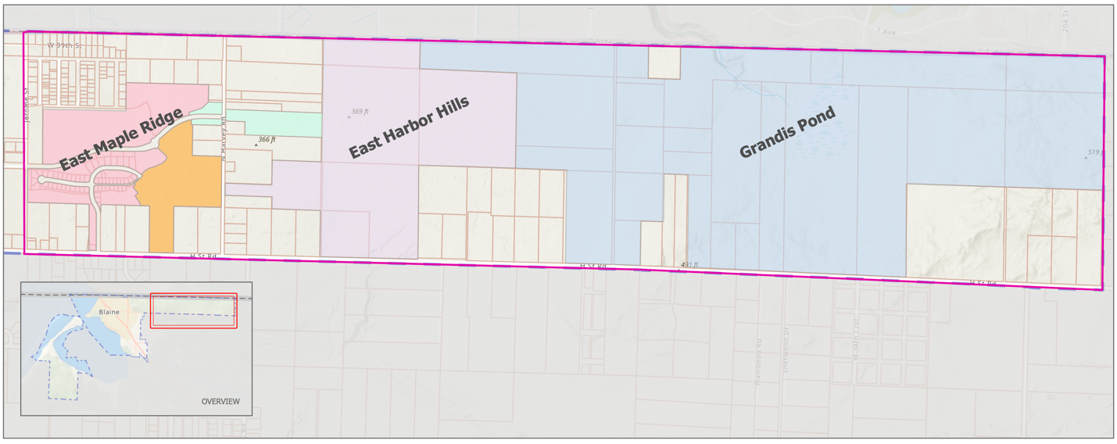
Tax Increment Area (TIA)
TIA: 667 Acres
AV: $31 Million

Slide 12
TIA LEVY: 3.6333

Slide 13
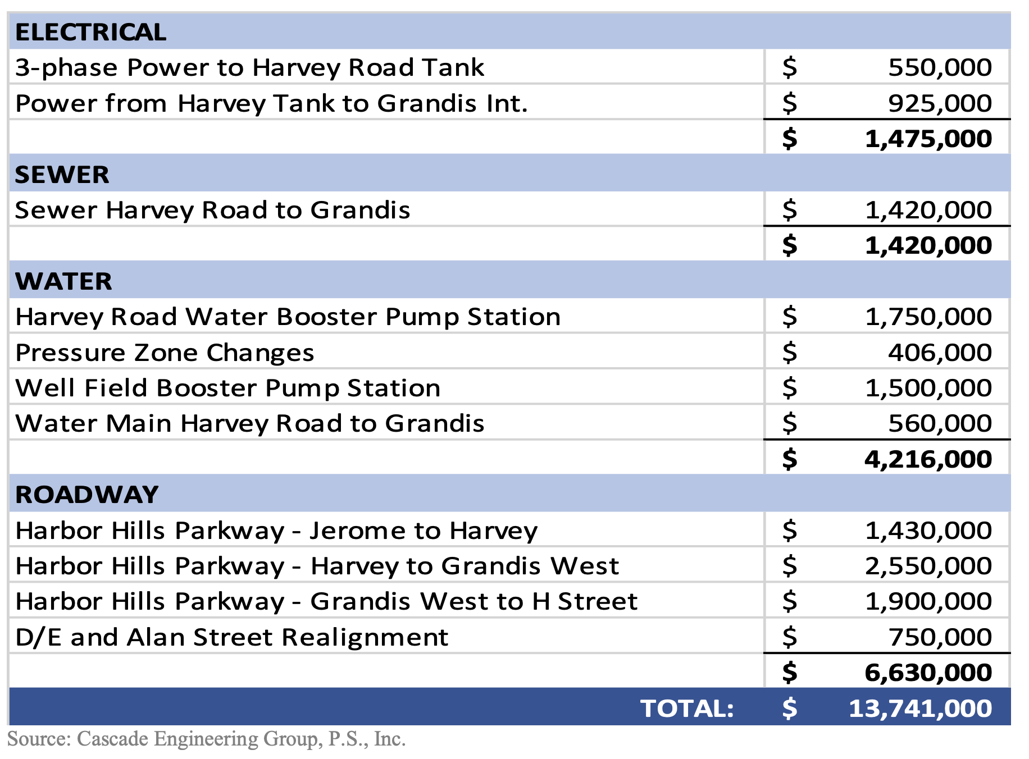
Infrastructure Needs - $14M
TIF to Fund Between $6.6M to $14M

Slide 14
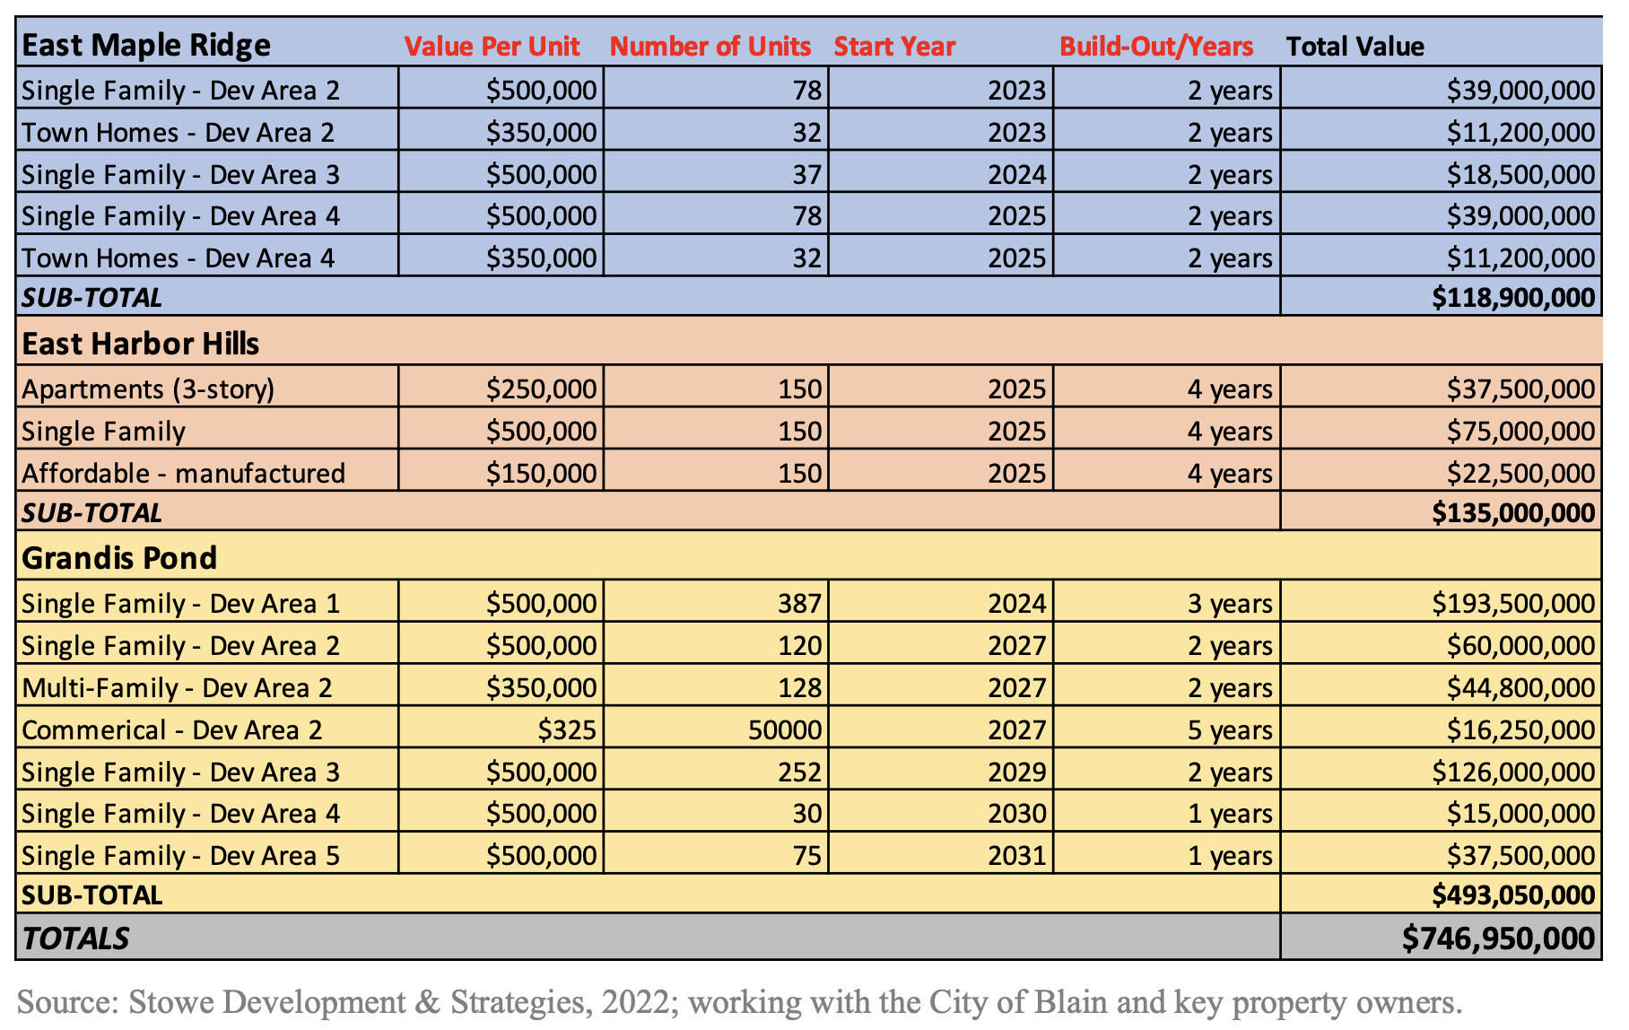
Private Development

Slide 15
Potential TIF Revenue
Baseline: Reflects the development program shown above and represents the most aggressive scenario for development.
Alternative 1: Uses the Baseline and makes the following adjustments:
Doubles the build-out/years (absorption) on all development.
Reduces commercial development by 50 percent.
Alternative 2: Uses the Baseline and makes the following adjustments:
Reduces all residential development by 25 percent.
Starts all development 2-years later.
Doubles the build-out/years (absorption) on all development.
Reduces commercial development by 75 percent.

Slide 16
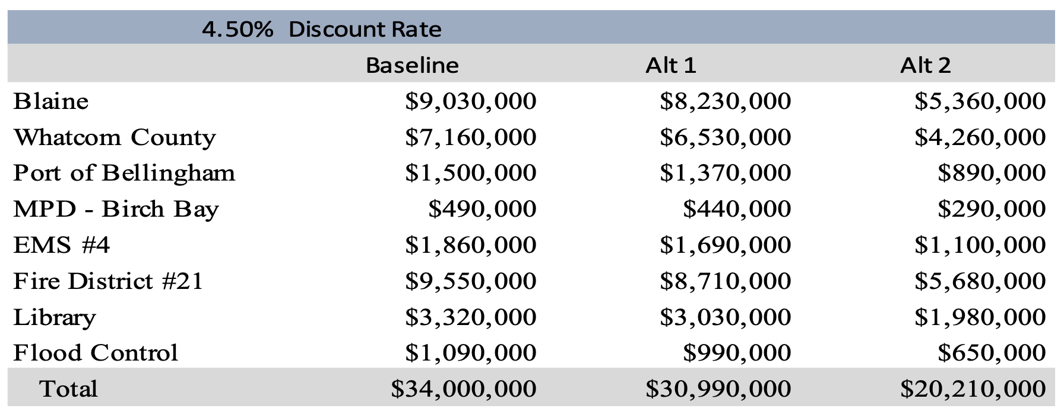
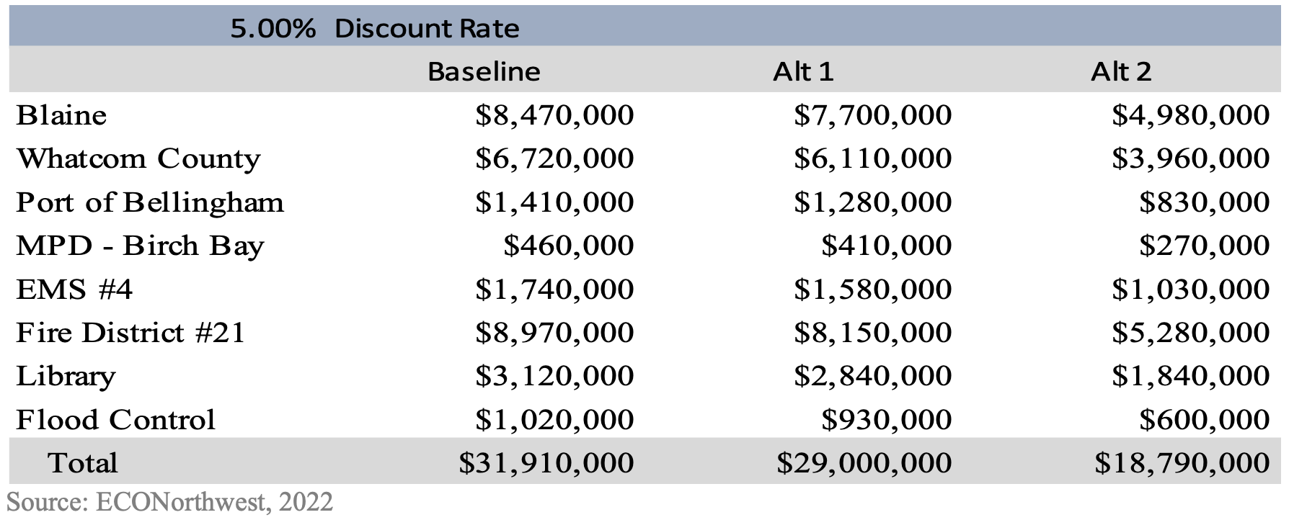
Potential TIF Revenue

Slide 17
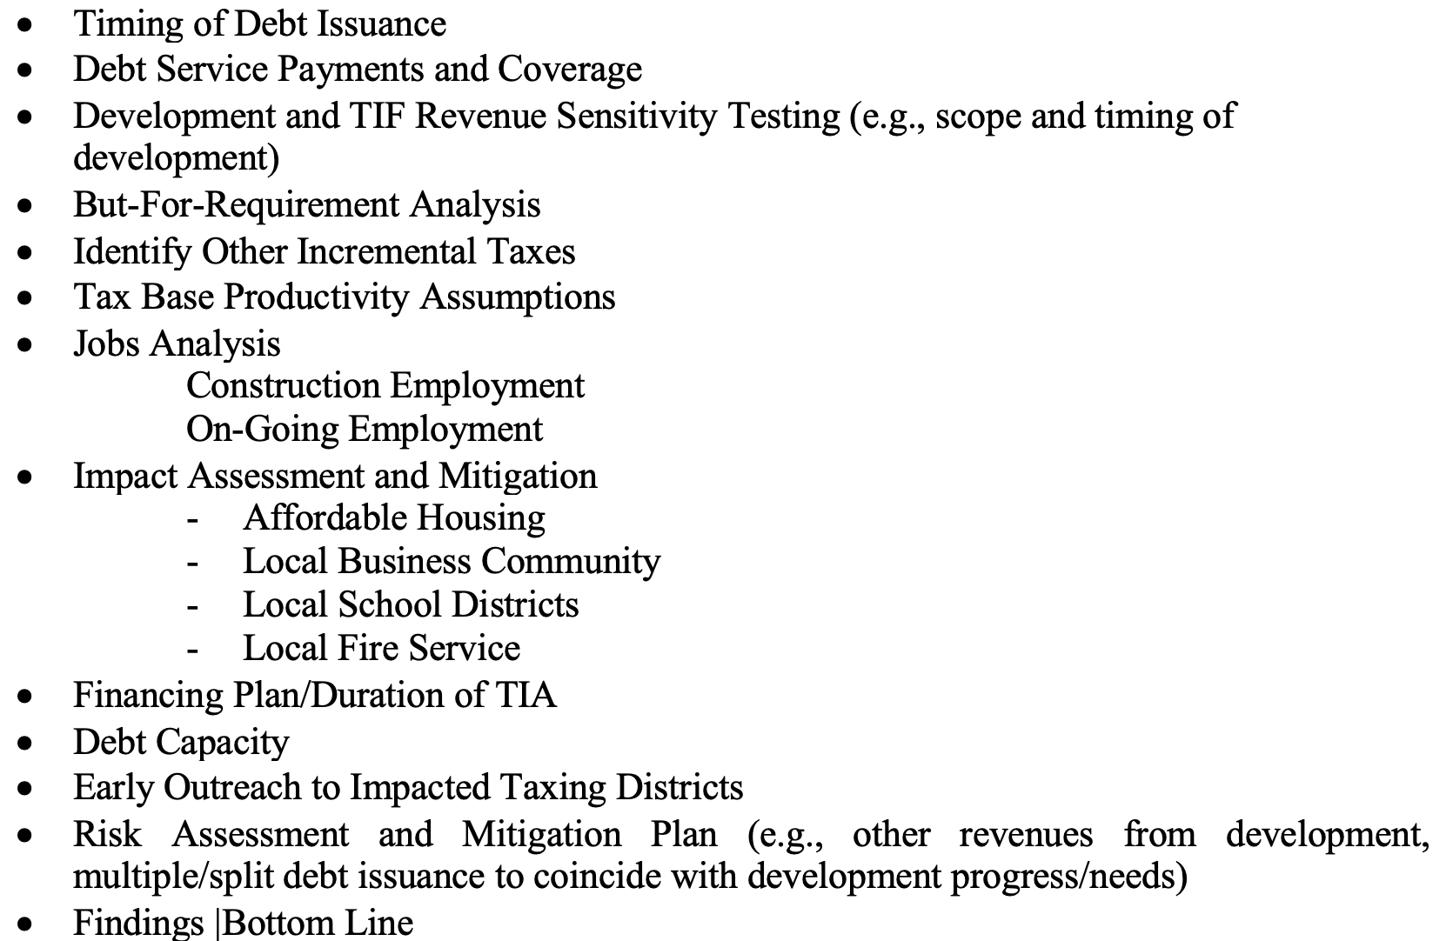
Step 2 Elements

Slide 18
Schedule
Draft of Project Analysis: By end of January/First February
Final Project Analysis to OST: By mid-February
OST Review: 90 Days (Feb-April)
Early Outreach to Taxing Districts: January
Draft Ordinance and Study Discussion with Council: February
Two Public Briefings: April/May
Council Consideration of TIA Ordinance: May
TIA Effective: June 1, 2023

Slide 19

www.stoweds.com

