Slide 1

General Fund Preliminary 2016 Budget
Council Work Session
November 16, 2015

Slide 2
Presentation Overview
Revenue Sources
Expenditure Planning
Updated Strategic Plan – Core Objectives
Five-Key Deliverables
2016 and 2017 Funding Options
2015 Revenues and Expenditures Actual – thru Oct 31 and projected
2016 Revenues and Expenditures – 102%
2017 Revenues and Expenditures
2016 Department Budgets
Council Direction

Slide 3
Revenue Sources
Sources of General Fund Revenue
Sales Tax – projected 2% growth
Property Tax – no direct benefit in 2016
Utility Taxes (Increase)
Permit and License Fees (Increase)
B and O Tax (New)
Cemetery Fees (Increase/Privatize)
Transportation Benefit District (New)
Reserves
Rural Economic Development Funds – R.E.D.

Slide 4
Expenditure Planning
Updated Strategic Plan – Core Objectives
Five-Key Deliverables
Individual Department Work Plans
Department Budget Highlights
Funding Recommendation and Alternatives

Slide 5
Updated Strategic Plan – Core Objectives
Promote an economically viable and adaptable community through supporting downtown development
Stewards of our natural and built environment
Deliver efficient, quality services in a friendly and proactive manner

Slide 6
Five Key Deliverables
Safety
Preservation of Assets
Legal Mandates
Contractual Obligations
Economic Development

Slide 7
2016 and 2017 Funding Options
Increase on going revenues
On December 31, 2017 the street bond is payed off releasing $660,000 of General Funds to City Council discretion.
Implement two short-term loans from the Reserve and R.E.D. funds to the General Fund and payback commitment starting in 2018:
25% -$125,000 of R.E.D. Funds – (current balance:)
25% -$225,000 Reserves – (current balance:)

Slide 8
2015 Revenues & Expenditures General Fund (October Month End)

Slide 9
2015 Revenues & Expenditures General Fund (Projected)

Slide 10
2016 Revenues & Expenditures General Fund ( 102% Projected Budget)

Slide 11
2017 Revenues & Expenditures General Fund (Projected Budget)

Slide 13
Budget Instructions
Departments directed to deliver maximum 102% of the 2015 budget.
Budget requests critical to departments, reduce or delete 2015 budget to accommodate the request.
Deleted items and unfunded new requests are described as one-time or ongoing, presented with funding options.

Slide 14
Department Workplan-Building

Slide 15
Department Workplan-Building

Slide 16
Department Workplan-Building

Slide 17
Department Workplan-Building

Slide 18
Department Workplan-Building

Slide 19
Department Workplan-Building

Slide 20
Department Workplan-Planning

Slide 21
Department Workplan-Planning

Slide 22
Department Workplan-Planning

Slide 23
Department Workplan-Planning

Slide 24
Department Workplan-Plannning

Slide 25
Department Workplan-Planning

Slide 26
Department Workplan-Parks

Slide 27
Department Workplan-Parks

Slide 28
Department Workplan-Parks

Slide 29
Department Workplan-Parks

Slide 30
Department Workplan-Parks

Slide 31
Department Workplan-Parks

Slide 32
Department Workplan Public Safety

Slide 33
Department Workplan Public Safety

Slide 34
Department Workplan Public Safety

Slide 35
Department Workplan Public Safety

Slide 36
Department Workplan Public Safety

Slide 37
Department Workplan Public Safety

Slide 38
Department Workplan Public Works - Streets
***Includes $70,000 REET Transfer***

Slide 39
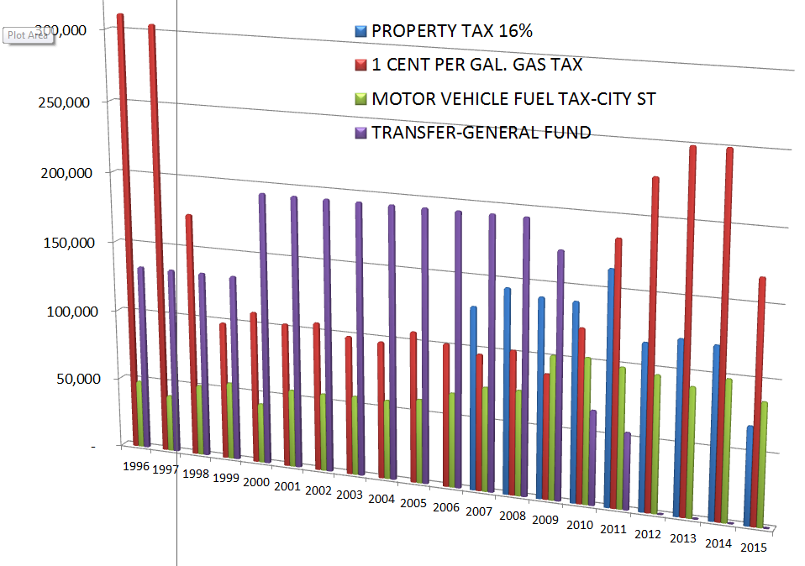

Slide 40
Department Workplan Public Works - Streets

Slide 41
Department Workplan Public Works - Streets

Slide 42
Department Workplan Public Works - Streets

Slide 43
Department Workplan Public Works - Streets

Slide 44
Department Workplan Public Works - Streets

Slide 45
Department Workplan Public Works - Streets

Slide 46
Department Workplan Public Works - Facilities

Slide 47
Department Workplan Public Works - Facilities

Slide 48
Department Workplan Public Works - Facilities

Slide 49
Department Workplan Public Works - Facilities

Slide 50
Department Workplan Public Works - Facilities

Slide 51
Department Workplan Public Works - Facilities

Slide 52
Department Workplan-Administrative Services

Slide 53
Questions? Discussion Overall work plan Funding strategies Priorities New items Next Steps

