Slide 1

2019 Capital Improvement Plan
Council Study Session
October 1, 2018

Slide 2
Presentation Outline
Fund 314 – PARK PROJECTS
Fund 307 - FACILITY PROJECTS
Fund 332/3 – STREET PROJECTS
Fund 324 - ELECTRIC UTILITY
Fund 329 - WATER UTILITY
Fund 325 - WASTEWATER UTILITY
Fund 328 - STORMWATER UTILITY
Discussion and Direction

Slide 3
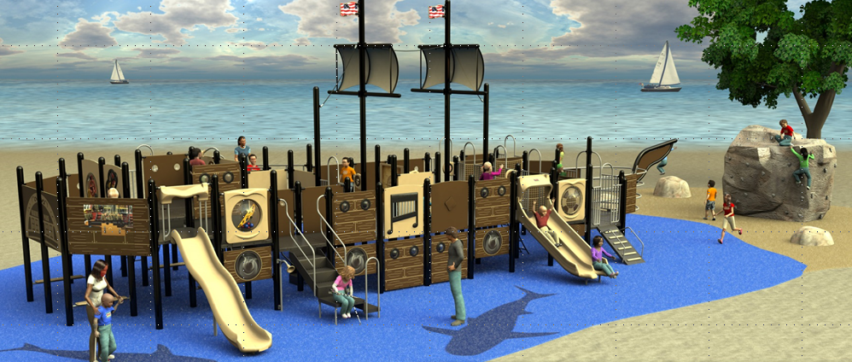
Parks Projects

Slide 4
2019 Park and Trail Improvements
Project | Scope | Amount
Semiahmoo Spit Trail Phase I | Design & Permit | $25,000
Semiahmoo Spit Trail Phase II | Build | $120,000
Peace Portal Parklet Plaza | Design & Build | $85,000
Cain Creek Park and Trail | Design & Permit | $20,000
Marine Park Irrigation Phase II | Design & Build | $25,000
Lincoln Park H St. Improve/Sign | Design & Build | $15,000
Peace Portal Community Trail | Phase 2 – see Street Fund | *TBD
Funding Sources:
  Grants or Strategic Initiative
  Subdivision Bond
  Transportation Benefit District*
  REET 2
  Impact Fee Reserve

Slide 5
Facilities Projects

Slide 6
2019 Facility Improvements
Project | Funding Source | Amount
Demolish Old City Hall | Airport Sale | $100,000
Demolish Fern Street House | REET1 | $50,000
Build New Evidence Room | REET 1 | $175,000
Demolish Dilapidated Structure on Peace Portal | General Fund Reserve | $400,000
Police Interview Rooms, Antennae Tower | Rebudgeted from 2018, REET 1 | $25,000
Cemetery Niche Wall | Rebudgeted from 2018 | $40,000
Funding Sources:
  REET 1
  General Fund Reserves
  Airport Sale (1x revenue)

Slide 7
Street Projects

Slide 8
2019 Street Improvements
Project | Funding Sources/Scope | Amount
Boblett Channelizaton and Corridor Improvements | Federal, Local, Private Design Only, TBD | $100,000
Hughes Avenue Improvements | Federal, State, Local, TBD Construction (Re-budget) | $1,762,000
Annual Pavement Preservation Program | Local Funds Annual program | $100,000
Annual Sidewalk Program | Local Funds Bi-annual program | $50,000
H Street School Safety | State, Local. (Re-budget) | $320,000
BNSF Alley Improvements | Local, (TBD Eligible) | $10,000
Peace Portal Community Trail Phase 2 | State, Local Design & Construction | $330,000
Semiahmoo Bike Path | Local Funds, Annual | $50,000
TBD Projects for 2019:
$100,000 - Boblett Road Channelization
$ 60,000 – Hughes Avenue Improvements
$ 40,000 – Peace Portal Community Trail

Slide 9
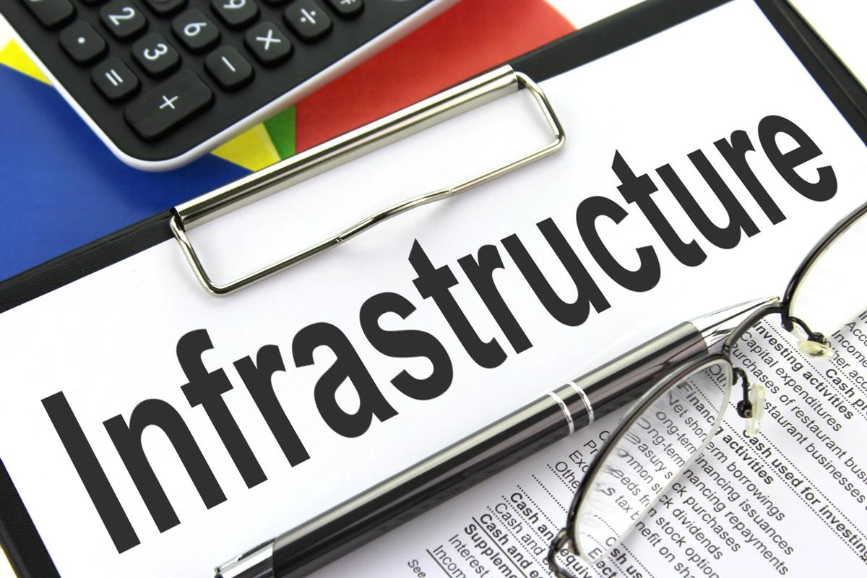
E. Blaine Infrastructure
2018 Legislative Grant Allocation

Slide 10
E. Blaine Infrastructure
Fund | Estimate* | City | Grant | Developer
Sewer | $1.7M | $400K | $885K | $450K
Electric | $2.2M | $350K | $279K | $1.5M
Water | $2.4M | $0 | $0 | $2.4 M
TOTAL | $6.3M | $750K | $1.2M | $4.4M
*Discussion Points: Value: ~$3.1M
Design and Construction Management Costs (0-18%)
Suitable Contingencies for Budgeting (0-20%)
Maintenance Access (~$200,000)
Need for Hydrants ($20,000)
Looping of Water Main, Fire-flow and Water Quality (~$285,000)
Design of Water Booster Pump Station “Temporary”(~$450,000)
Extent and Timing of 3-Phase Power (~$400,000)

Slide 11
Electric Fund Projects

Slide 12
2019 Electrical Improvements
Project | Scope | Amount
Circuit 17 600 Amp Loop | Design for loop to improve reliability in Manufacturing District | $30,000
East Blaine – E St. to East Maple Ridge | Extension of Single Phase Circuit to serve East Blaine | $860,000*
East Blaine – H St. to Grandis Pond | Extension of Three-Phase Circuit from Ludwick to Harvey Tank | $1,290,000*
*Funding Sources:
  Light Fund - $350,000
  Grant - $279,000
  Developer Contribution - $1,521,000** ** (in discussion, not final number)

Slide 13
Water Fund Projects

Slide 14
2019 Water Improvements
Project | Scope | Amount
Instrumentation | System reliability/controls | $35,000
Well Prospecting & Water Rts. | Perfecting existing rights | $200,000
Well 5 House Rehabilitation | Re-budget from 2018 | $200,000
Corrosion Protection Program | Cathodic Protection | $15,000
Future Well Pump Replacement/Upgrades | Improve capacity of existing wells | $150,000
Booster Pump Station (E. Blaine Improvements) | Adjacent to Harvey Tank, new pressure zone | $1,076,400*
Water Line Extension/Loop (E. Blaine Improvments) | Loop main from H Street | $1,338,000*
Water Line Replacement | Design only for 2020 | $30,000
New Storage Tank (171) | Design only for 2020 | $50,000
*Funding Source:
  Developer - Funded
Notes:
Cathodic protection (CP) is a technique used to control the corrosion of a metal surface by making it the cathode of an electrochemical cell. A simple method of protection connects the metal to be protected to a more easily corroded " sacrificial metal " to act as the anode.

Slide 15
Wastewater Fund Projects

Slide 16
2019 Wastewater Improvements
Project | Scope | Amount
TSS Reduction Improvements | Investigation & Design Only, Permit Compliance | $50,000
Pipe Replacement, I&I Removal, Rehabilitation | Improvements to remove stormwater in sewer pipe | $100,000
E. Blaine Sewer Extension- Lincoln Park to Harvey Tank | Extend sewer through East Maple Ridge | $1,270,000*
E. Blaine Sewer Extension – Harvey Tank to Grandis Pond | Extend sewer to Grandis Pond | $450,000*
Lift Station Instrumentation | System notification improvements | $30,000
*Funding Sources:
  Sewer Fund - $385,000
  Grant - $885,000
  Developer Contribution - $450,000**
  ** (in discussion, not final number)

Slide 17
Stormwater Fund Projects

Slide 18
2019 Storm Water Improvements
Project | Scope | Amount
Semiahmoo Spit Erosion Control | Monitoring and design of shoreline enhancements | $15,000
Storm Sewer Rehabilitation and Replacement | Part of effort to keep storm water from impacting sewer, streets | $75,000
Gateway Regional Storm Water Pond LID | Includes design and construction of regional pond to serve Manufacturing District | $2,000,000*
*Funding Sources:
  Local Improvement District
  Grant/Loan combination to be determined
  Airport Sale to fund trail improvements

Slide 19
Questions?
Discussion?

