Slide 1
CITY OF BLAINE CITY COUNCIL
Request for Council Action: Peace Portal Drive Revitalization
www.cityofblaine.com
September 12, 2022: 6 PM
Council Chambers
City Manager
Public Works Department
Community Development Services
www.blainebythesea.com

Slide 2
Recommendation
The City Manager respectfully recommends that Council consider authorizing him to execute a contract with KPG Psomas for engineering design services, assistance with bidding, and construction oversight for the Downtown Revitalization project.

Slide 3
PRESENTATION OUTLINE
Recommendation
Funding: Planning, Design, and Construction
Next Steps
Project History and Scope

Slide 4
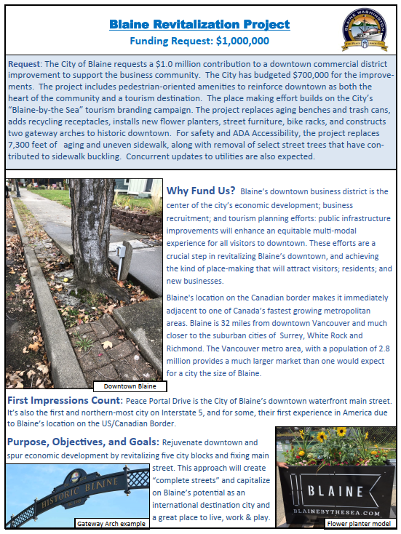
Project History
2020: Resolution 1836-20
City Council approves the 2021 Legislative Agenda.
2021: Lobbyist secure funding
Funds secured through 2021 – 2023 Capital Budget.
2022: Capital and Transportation Improvement Plans
Both the Transportation and Park CIPs (2022-2027) include funding for planning, design, and construction.
2022: RCW 35.77.010
2023 – 2028 TIP
2022: RFQ
KPG Psomas, Inc.

Slide 5
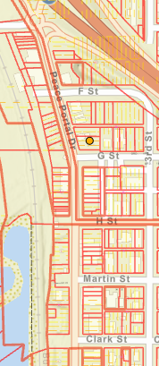
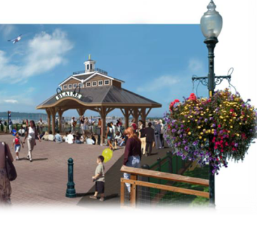
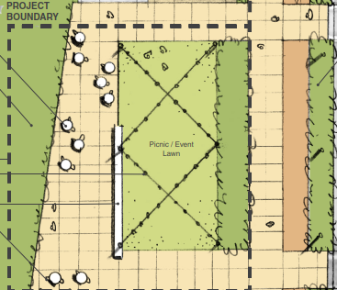
Contract Scope
Peace Portal Revitalization
G Street Pavillion
Martin Street Parklet
Clark Street to Marine Drive.
RES 1860-21
RES 1865-21

Slide 6
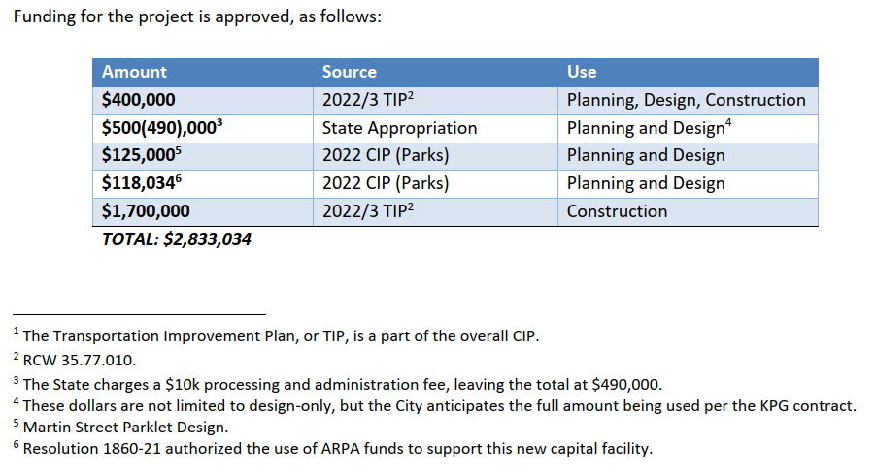
Funding

Slide 7
Next Steps
KPG Presentation
Planning, Design, Engineering and Permitting: Through the end of 2023
Bidding and Construction: 2024

Slide 8
CITY OF BLAINE CITY COUNCIL
Request for Council Action: Peace Portal Drive Revitalization
www.cityofblaine.com
September 12, 2022: 6 PM
Council Chambers
City Manager
Public Works Department
Community Development Services
www.blainebythesea.com

