Slide 1
City of Blaine Council Public Hearing
January 10, 2022 at 6:00 PM
Zoom Meeting
H Street Road
Annexation Petition
Stacie Pratschner, AICP, RPA
Community Development Director
City of Blaine Community Development Services

Slide 2
Presentation Outline
I. Background and History of Proposal
IV. Next Steps: Motion and the Whatcom County Boundary Review Board
III. Written Public Testimony
II. Legal and Procedural Compliance

Slide 3
I. Authorizing Legislation: State, County, and City Regulations
State
RCWs: 35.13, 35A.14, and 35.10.
County
County Wide Planning Policies (CWPPs).
The 2016 Comprehensive Plan.
City
WACs: 173-26-150 and -160.
RES 1844-21.
The Land Use Element (goals and policies).

Slide 4
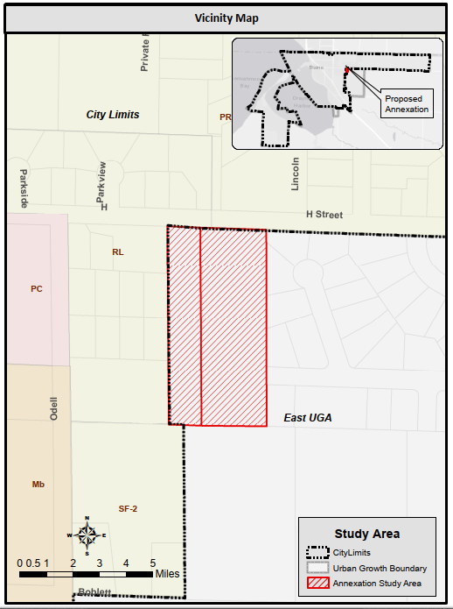
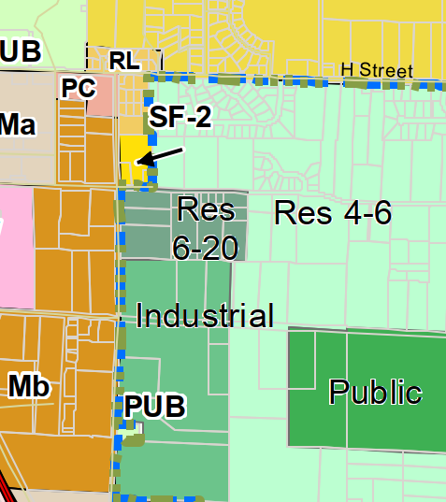
I(a). Request Location: 4455 H Street Road and 2221 Cedarwood Lane, Blaine, WA

Slide 5
I(b). UGA Planning and the Annexation Request
Current UGA
Outside Utilities Agreement
Map LU-2
Discussions with City
Application
RES #s 1844-21 and 1846-21
2016
2018 and 2019
2020
2021
2002
1990s

Slide 6
I(c). May 2021 to Present: Jurisdiction of the Boundary Review Board.
Public Hearing
Transmission to the BRB
RES 1858-21: Remand the petition back to the City.
RES 1859-21: Continued Review and Circulation
Certificate of Sufficiency
Public Hearing
August 25, 2021
September 13, 2021
November 5, 2021
January 10, 2022
May 24, 2021
May 10, 2021

Slide 7
II. Assessor’s Certificate of Sufficiency: Legal, Procedural, and Factual Compliance.
Procedural
Sufficiency of signatures.
Factual
Legal description of area to be annexed.
Legal
Complete Petition: Approved Certificate of Sufficiency from the Whatcom County Assessor.

Slide 8
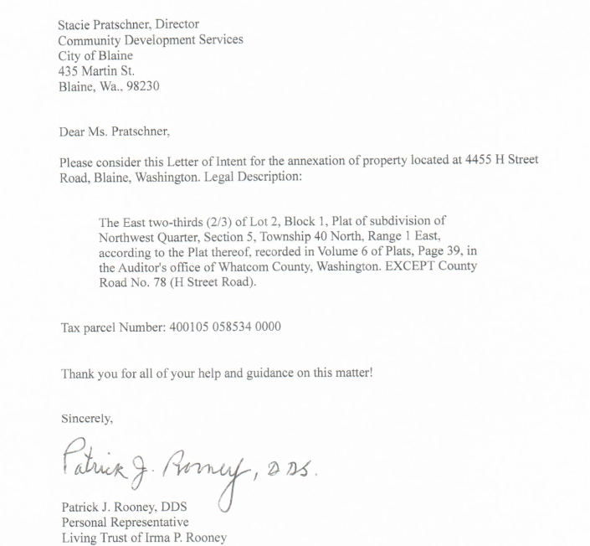
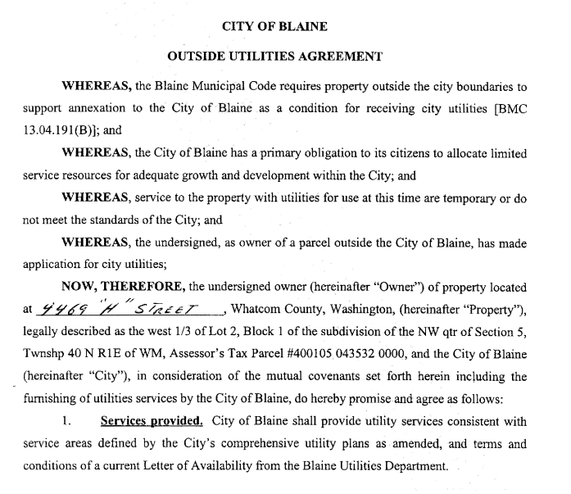
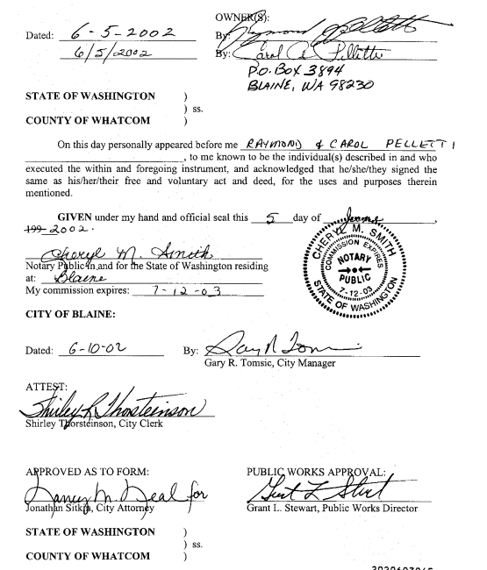

Slide 9
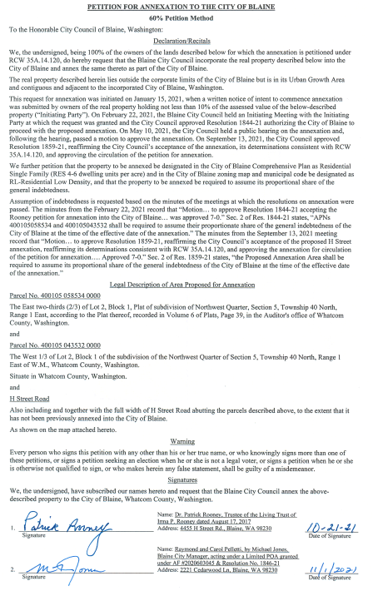
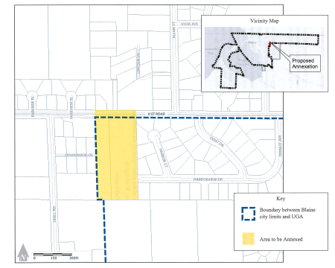
II(a). Signatures and Legal Descriptions: RES 1858-21
Legal Description
Signatures (RES 1844-21

Slide 10
III. Public Testimony
Comment concerning increased traffic resulting from future development of the subject parcels to urban levels.
City’s website: https://www.ci.blaine.wa.us/Calendar.aspx?EID=2406&month=5&year=2021&day=10&calType=0

Slide 11
IV. Recommendation and Next Steps
Department has fulfilled the directive from Council to complete the procedural steps and processing of the annexation request pursuant to Resolutions 1858-21 and 1859-21.
Draft Motion included with the Request for Council Action.
Pursuant to Chapter 36.93 of the RCWs, the Motion serves as the Notice of Intent to Annex for consideration by the Boundary Review Board.
If a citizen requests a Review from the BRB, the Board will schedule both procedural and substantive hearings to review the annexation request.

Slide 12
City of Blaine Council
City website:
www.cityofblaine.com
For Additional Information:
Call Stacie Pratschner at 360-332-8311
Email: spratschner@cityofblaine.com
Stacie Pratschner, AICP, RPA
Community Development Director
City of Blaine Community Development Services

