Slide 1
Circuit #11 Outage Wednesday 9.15.21 Chain of Events
Approximately 0300 Hrs Circuit #11 feeding Semiahmoo trips
By 0330 Hrs Crew arrives to begin fault locating by reading “fault locators” in various vaults
At 0900 Hrs a customer comments of hearing a very loud bang
Fault located by approx. 1000 Hrs and switching commences to feed Semiahmoo area on Circuit #15
Semiahmoo area returned to power by 1230 Hr
Cable replacement work continued until Friday 9.10.21 at which time Semiahmoo area was returned to normal Circuit #11

Slide 2
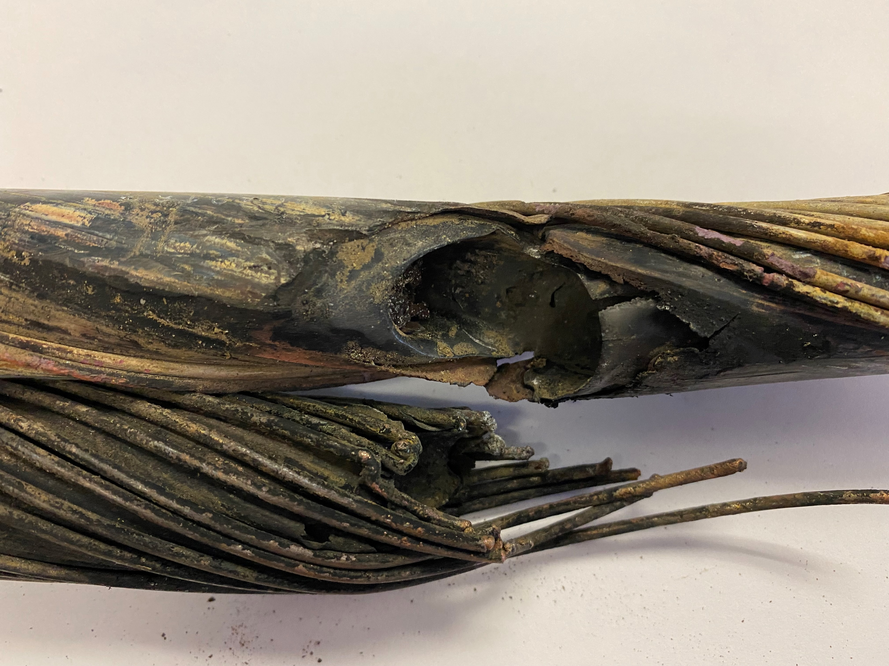
Circuit #11 Outage Wednesday 9.15.21
Fault located at 585ft of 800ft run
Phase “A”
Subsequent Arc Penetration
Vaporized Conductor
Phase “B”
Main Fault Area

Slide 3
Circuit #11 Outage Wednesday 9.15.21 Lessons Learned
Cable locators were not reliable due to age very old style
Incorrect mapping data found in some areas
Transfer and retransfer of WWTP worked flawlessly
A few specific tools for vault work need to be purchased
Need to check if hoses for Vactor truck can be purchased to support out-of-the-way vaults

