Slide 1
City Council Deliberations
Final Plat Deliberation: Division I of the East Maple Ridge PUD
September 13 at 6 PM
Council Zoom Meeting
Stacie Pratschner, AICP, RPA
Community Development Services Director
City of Blaine Community Development Services

Slide 2
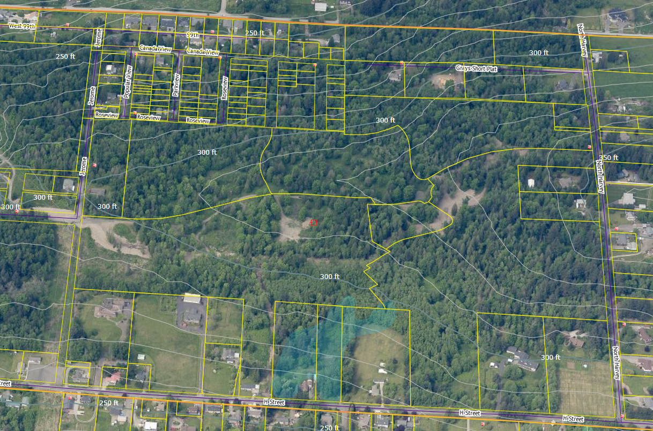
Project Site
Division I of East Maple Ridge (Phases 1-3)
East Maple Ridge PUD (All Phases)

Slide 3
Project Background
Prior approvals (2020):
Preliminary Plat (for all phases);
Planned Unit Development;
SEPA Review; and
Critical Areas Review.
ORD 20-2947

Slide 4
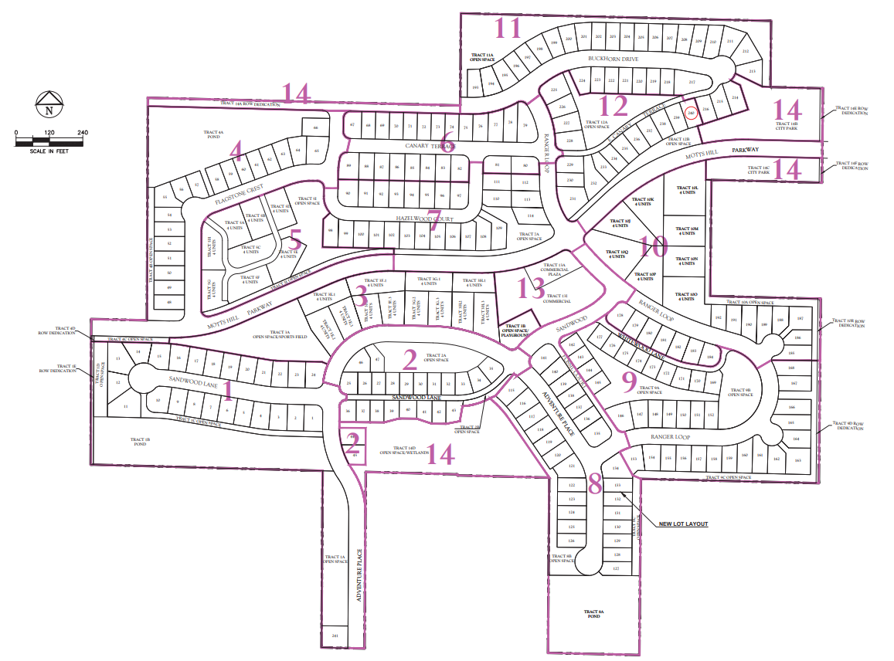
Project Background
Overall PUD:
353 Units
13 Phases
Division I of East Maple Ridge (Phases 1-3)
East Maple Ridge PUD (All Phases)
Notes:
The East Maple Ridge PUD is to develop 353 dwelling units, with a mix of single family, cottage, and multifamily housing. The project also includes a neighborhood commercial center, Open space, a playground, roads, utilities and a park site are included in the project
The first phase is located in the SW corner, comprised of Phases 1-3

Slide 5
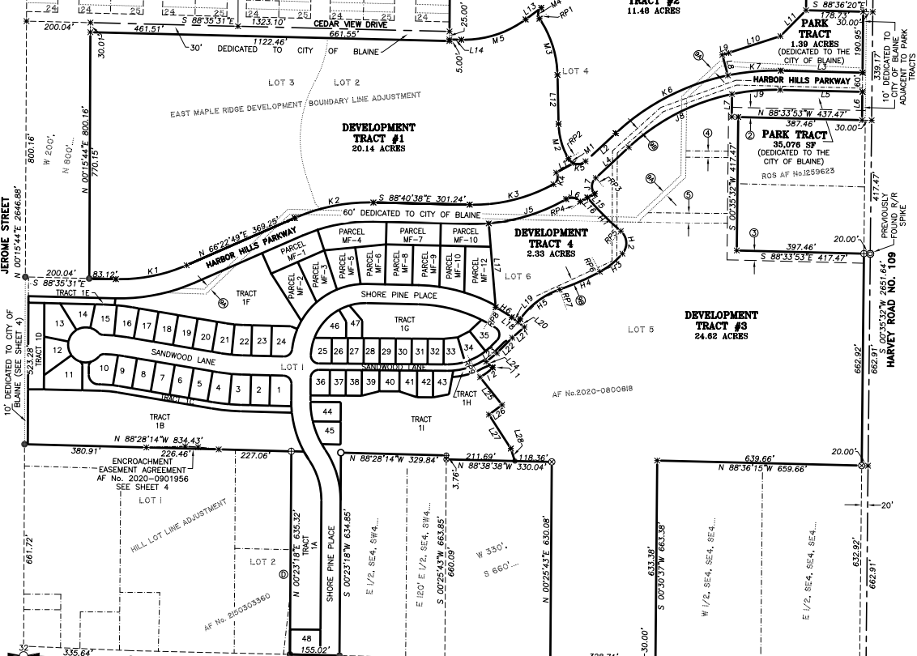
Division I of East Maple Ridge: Final Plat Layout
48 Lots (single family and cottage);
12 multifamily Parcels (with the potential of forty-eight (48) Dwelling Units);
Open space and common areas;
Dedication of park;
Dedication of new east-west connector road;
On-site trail and recreational improvements;
New public roads, storm system and utilities.

Slide 6
Approval Criteria
RCW 58.17.110
Public use and interest will be served
BMC 17.60
Infrastructure over 80% complete
Final mylar and associated documents
Department Recommendations
Public Works
Community Development Services
Performance security for deferred improvements
Permits in place
= Consistent with recommended conditions
= Consistent

Slide 7
Recommendation
CDS and Public Works recommend that the City Council consider approving Division I of East Maple Ridge, subject to the conditions of approval, by passing a motion to approve Ordinance 21-2965.

Slide 8
City of Blaine – City Council
City website:
www.cityofblaine.com
For Additional Information:
Call Stacie Pratschner at 360-332-8311
Email to spratschner@cityofblaine.com
Stacy Pratschner, AICP, RPA
Community Development Director
City of Blaine Community Development Services

