Slide 1

City of Blaine 2021 mid year budget presentation
SEPTEMBER 13, 2020
Daniel Heverling, Finance Director

Slide 2
General fund revenue
Notes:
This is the public hearing on the proposed preliminary 2021 budget. I will give a short presentation. The budget is still under development and will be presented to Council for final adoption on December 14th.
I will give a brief recap on the budget meeting held to date. Council and staff have had three budget study sessions: The budget information that has been presented during those study sessions include general fund revenue and expenditures, the enterprise funds, the street fund, lodging tax fund, and capital improvement plans for the utilities, transportation, parks, and general government.

Slide 3
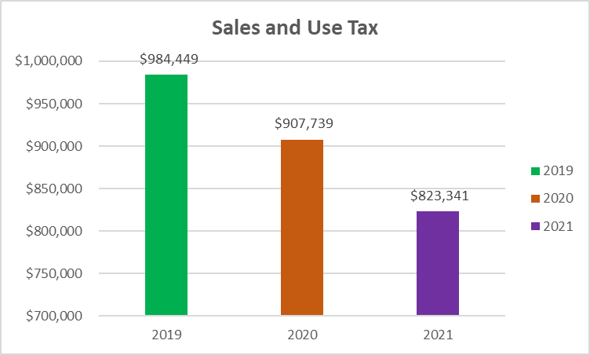
Sales and use tax comparison as of June 30
Notes:
This is the public hearing on the proposed preliminary 2021 budget. I will give a short presentation. The budget is still under development and will be presented to Council for final adoption on December 14th.
I will give a brief recap on the budget meeting held to date. Council and staff have had three budget study sessions: The budget information that has been presented during those study sessions include general fund revenue and expenditures, the enterprise funds, the street fund, lodging tax fund, and capital improvement plans for the utilities, transportation, parks, and general government.

Slide 4
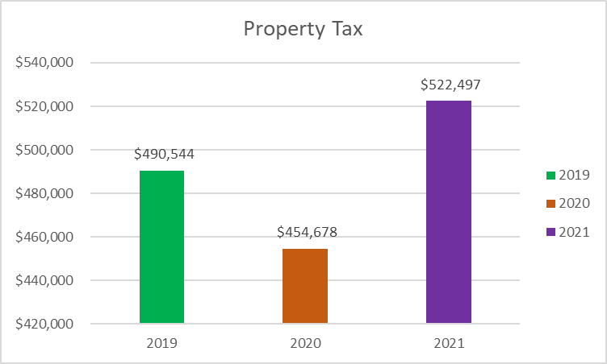
Property tax comparison as of June 30
Notes:
This is the public hearing on the proposed preliminary 2021 budget. I will give a short presentation. The budget is still under development and will be presented to Council for final adoption on December 14th.
I will give a brief recap on the budget meeting held to date. Council and staff have had three budget study sessions: The budget information that has been presented during those study sessions include general fund revenue and expenditures, the enterprise funds, the street fund, lodging tax fund, and capital improvement plans for the utilities, transportation, parks, and general government.

Slide 5
General fund expenses
Notes:
This is the public hearing on the proposed preliminary 2021 budget. I will give a short presentation. The budget is still under development and will be presented to Council for final adoption on December 14th.
I will give a brief recap on the budget meeting held to date. Council and staff have had three budget study sessions: The budget information that has been presented during those study sessions include general fund revenue and expenditures, the enterprise funds, the street fund, lodging tax fund, and capital improvement plans for the utilities, transportation, parks, and general government.

Slide 6
Lodging tax fund revenue
Notes:
This is the public hearing on the proposed preliminary 2021 budget. I will give a short presentation. The budget is still under development and will be presented to Council for final adoption on December 14th.
I will give a brief recap on the budget meeting held to date. Council and staff have had three budget study sessions: The budget information that has been presented during those study sessions include general fund revenue and expenditures, the enterprise funds, the street fund, lodging tax fund, and capital improvement plans for the utilities, transportation, parks, and general government.

Slide 7
Lodging tax fund expenses
Notes:
This is the public hearing on the proposed preliminary 2021 budget. I will give a short presentation. The budget is still under development and will be presented to Council for final adoption on December 14th.
I will give a brief recap on the budget meeting held to date. Council and staff have had three budget study sessions: The budget information that has been presented during those study sessions include general fund revenue and expenditures, the enterprise funds, the street fund, lodging tax fund, and capital improvement plans for the utilities, transportation, parks, and general government.

Slide 8
Street fund revenue
Notes:
This is the public hearing on the proposed preliminary 2021 budget. I will give a short presentation. The budget is still under development and will be presented to Council for final adoption on December 14th.
I will give a brief recap on the budget meeting held to date. Council and staff have had three budget study sessions: The budget information that has been presented during those study sessions include general fund revenue and expenditures, the enterprise funds, the street fund, lodging tax fund, and capital improvement plans for the utilities, transportation, parks, and general government.

Slide 9
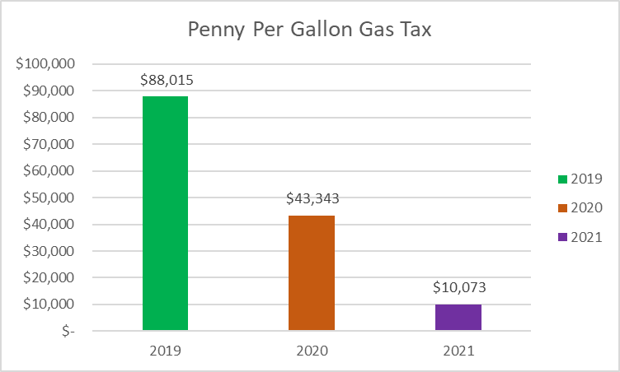
Penny per gallon gas tax comparison as of June 30
Notes:
This is the public hearing on the proposed preliminary 2021 budget. I will give a short presentation. The budget is still under development and will be presented to Council for final adoption on December 14th.
I will give a brief recap on the budget meeting held to date. Council and staff have had three budget study sessions: The budget information that has been presented during those study sessions include general fund revenue and expenditures, the enterprise funds, the street fund, lodging tax fund, and capital improvement plans for the utilities, transportation, parks, and general government.

Slide 10
Street fund expenses
Notes:
This is the public hearing on the proposed preliminary 2021 budget. I will give a short presentation. The budget is still under development and will be presented to Council for final adoption on December 14th.
I will give a brief recap on the budget meeting held to date. Council and staff have had three budget study sessions: The budget information that has been presented during those study sessions include general fund revenue and expenditures, the enterprise funds, the street fund, lodging tax fund, and capital improvement plans for the utilities, transportation, parks, and general government.

Slide 11
Electric fund revenue
Notes:
This is the public hearing on the proposed preliminary 2021 budget. I will give a short presentation. The budget is still under development and will be presented to Council for final adoption on December 14th.
I will give a brief recap on the budget meeting held to date. Council and staff have had three budget study sessions: The budget information that has been presented during those study sessions include general fund revenue and expenditures, the enterprise funds, the street fund, lodging tax fund, and capital improvement plans for the utilities, transportation, parks, and general government.

Slide 12
Electric fund expenses
Notes:
This is the public hearing on the proposed preliminary 2021 budget. I will give a short presentation. The budget is still under development and will be presented to Council for final adoption on December 14th.
I will give a brief recap on the budget meeting held to date. Council and staff have had three budget study sessions: The budget information that has been presented during those study sessions include general fund revenue and expenditures, the enterprise funds, the street fund, lodging tax fund, and capital improvement plans for the utilities, transportation, parks, and general government.

Slide 13
Electric fund capital
Notes:
This is the public hearing on the proposed preliminary 2021 budget. I will give a short presentation. The budget is still under development and will be presented to Council for final adoption on December 14th.
I will give a brief recap on the budget meeting held to date. Council and staff have had three budget study sessions: The budget information that has been presented during those study sessions include general fund revenue and expenditures, the enterprise funds, the street fund, lodging tax fund, and capital improvement plans for the utilities, transportation, parks, and general government.

Slide 14
Water fund revenue
Notes:
This is the public hearing on the proposed preliminary 2021 budget. I will give a short presentation. The budget is still under development and will be presented to Council for final adoption on December 14th.
I will give a brief recap on the budget meeting held to date. Council and staff have had three budget study sessions: The budget information that has been presented during those study sessions include general fund revenue and expenditures, the enterprise funds, the street fund, lodging tax fund, and capital improvement plans for the utilities, transportation, parks, and general government.

Slide 15
Water fund expenses
Notes:
This is the public hearing on the proposed preliminary 2021 budget. I will give a short presentation. The budget is still under development and will be presented to Council for final adoption on December 14th.
I will give a brief recap on the budget meeting held to date. Council and staff have had three budget study sessions: The budget information that has been presented during those study sessions include general fund revenue and expenditures, the enterprise funds, the street fund, lodging tax fund, and capital improvement plans for the utilities, transportation, parks, and general government.

Slide 16
Water fund capital
Notes:
This is the public hearing on the proposed preliminary 2021 budget. I will give a short presentation. The budget is still under development and will be presented to Council for final adoption on December 14th.
I will give a brief recap on the budget meeting held to date. Council and staff have had three budget study sessions: The budget information that has been presented during those study sessions include general fund revenue and expenditures, the enterprise funds, the street fund, lodging tax fund, and capital improvement plans for the utilities, transportation, parks, and general government.

Slide 17
Wastewater fund revenue
Notes:
This is the public hearing on the proposed preliminary 2021 budget. I will give a short presentation. The budget is still under development and will be presented to Council for final adoption on December 14th.
I will give a brief recap on the budget meeting held to date. Council and staff have had three budget study sessions: The budget information that has been presented during those study sessions include general fund revenue and expenditures, the enterprise funds, the street fund, lodging tax fund, and capital improvement plans for the utilities, transportation, parks, and general government.

Slide 18
Wastewater fund expenses
Notes:
This is the public hearing on the proposed preliminary 2021 budget. I will give a short presentation. The budget is still under development and will be presented to Council for final adoption on December 14th.
I will give a brief recap on the budget meeting held to date. Council and staff have had three budget study sessions: The budget information that has been presented during those study sessions include general fund revenue and expenditures, the enterprise funds, the street fund, lodging tax fund, and capital improvement plans for the utilities, transportation, parks, and general government.

Slide 19
Wastewater fund capital
Notes:
This is the public hearing on the proposed preliminary 2021 budget. I will give a short presentation. The budget is still under development and will be presented to Council for final adoption on December 14th.
I will give a brief recap on the budget meeting held to date. Council and staff have had three budget study sessions: The budget information that has been presented during those study sessions include general fund revenue and expenditures, the enterprise funds, the street fund, lodging tax fund, and capital improvement plans for the utilities, transportation, parks, and general government.

Slide 20
Stormwater fund revenue
Notes:
This is the public hearing on the proposed preliminary 2021 budget. I will give a short presentation. The budget is still under development and will be presented to Council for final adoption on December 14th.
I will give a brief recap on the budget meeting held to date. Council and staff have had three budget study sessions: The budget information that has been presented during those study sessions include general fund revenue and expenditures, the enterprise funds, the street fund, lodging tax fund, and capital improvement plans for the utilities, transportation, parks, and general government.

Slide 21
Stormwater fund expenses
Notes:
This is the public hearing on the proposed preliminary 2021 budget. I will give a short presentation. The budget is still under development and will be presented to Council for final adoption on December 14th.
I will give a brief recap on the budget meeting held to date. Council and staff have had three budget study sessions: The budget information that has been presented during those study sessions include general fund revenue and expenditures, the enterprise funds, the street fund, lodging tax fund, and capital improvement plans for the utilities, transportation, parks, and general government.

Slide 22
Stormwater fund capital
Notes:
This is the public hearing on the proposed preliminary 2021 budget. I will give a short presentation. The budget is still under development and will be presented to Council for final adoption on December 14th.
I will give a brief recap on the budget meeting held to date. Council and staff have had three budget study sessions: The budget information that has been presented during those study sessions include general fund revenue and expenditures, the enterprise funds, the street fund, lodging tax fund, and capital improvement plans for the utilities, transportation, parks, and general government.

Slide 23
Summary of mid year budget presentation
Revenues are strong overall, compared to budget, not strong compared to trends
Expenses are tracking appropriately
Penny Per Gallon Gas Tax remains an issue for Street Fund
B&O Tax and Property Tax are strong
Notes:
As the City plans for 2021, major challenges are currently impacting the City’s budget and will continue for the foreseeable future.
The border closure is having a significant impact on the City’s general fund revenue. The estimated decrease for 2021 is 12% from the 2020 adopted budget. General Fund departments have made major cuts in their 2021 spending plans. Overall major cuts have been made to travel and training, supplies, and professional services. Depending on when the border reopens, the local economic recovery could take a year or two.
Another impacted revenue is the penny per gallon gas tax. An 80% decrease in this revenue source will have a major effect on street maintenance service levels.
The demand for transportation and utility infrastructure requirements continues to grow as the City grows in population.
The City’s utilities have adequate capital reserve balances to fund planned capital improvement projects for the next couple of years. However, long-term maintenance and capital needs will necessitate on-going investment in utility infrastructure improvement.
Those are some of the major budget challenges the City will have to plan for in next year’s budget.

