Slide 1
City Council Deliberations
Zoning Text Amendment:
Highway Commercial, Subzone C
June 14 at 6 PM
Zoom Meeting
Stacie Pratschner, AICP, RPA
Community Development Director
City of Blaine Community Development Services
Notes:
Good evening Planning commissioners and members of the public. Stacy Clauson, Community Planner II,
This public hearing has been continued to provide the public additional opportunity to comment on revisions to proposed code language requested by the Planning Commission at the May 13, 2021 meeting.

Slide 2
Presentation Outline
Recommendation
Project Proponent
Public Testimony
Next Steps: Ordinance
Proposal and Timeline
Notes:
The hearing will staff with a staff presentation, after which the applicant can address the Planning commission. At that point, we will take public testimony for any folks joining us by phone.
Then, the Planning commission will have an opportunity to ask questions and deliberate.

Slide 3
Timeline of Amendments to Chapter 17.24 BMC
Date | Chapter 17.04 BMC | Actions
February 22 | City Council Deliberations | Adopt Resolution #1843-21
March 10 | Conduct SEPA Review | Determination of Non-Significance
March 11 | Planning Commission Study Session | Introduce the proposed amendment.
April 2 | Department of Commerce | 60-day Notice of Intent issued.
April 22 | Planning Commission Study Session | Discuss zoning text amendment language.
April 30 | Notice of Public Hearing | Published and posted.
May 13 | Planning Commission Public Hearing | Commission request for changes
May 27 | Continuation of Public Hearing | Recorded motion.

Slide 4
Municipal Code Amendment Proposal
Purpose:
Spur economic growth
Modernize standards
Align with Central Business District
Proposal to amend:
Permitted and conditional uses
Setback standards
Height allowances
Parking and access Landscaping
Design Standards
Notes:
Proposal: Amend:
Permitted and conditional uses
Setback standards
Height
Parking and access
Landscaping
Purpose:
Spur economic growth
Modernize standards
Align with Central Business District
The purpose statement of the Highway Commercial notes that the zone is intended to provide for establishments offering accommodations or services to motorists, and to provide for non-pedestrian-oriented retail, wholesale, service and repair activities which do not contribute to the creation of unattractive, congested and unsafe highway conditions.. There are 4 subzones, and this proposal would apply to Subzone C.
Subzone C is located just north and east of the Central Business District and is and is generally bound by C Street on the north side, F Street on the south side, 4th Street on the east side and Semiahmoo Bay on the west side. Subzone C’s purpose is to provide for businesses and services that support the Central Business District. This district is intended to service highway motorists, the auto-oriented demand from the central business (CB) district and adjacent residential neighbors, including those in this district. While not a part of the CB district, its character and function should be complementary to the CB district with little impact on the low-density neighbors to the south and east.

Slide 5
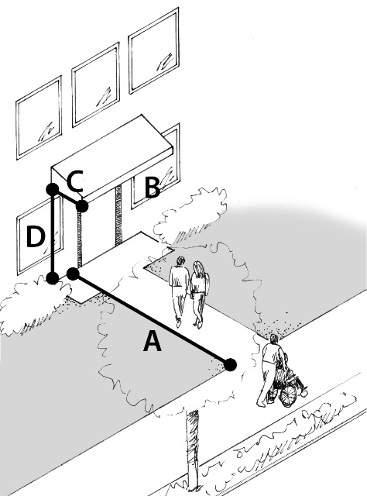
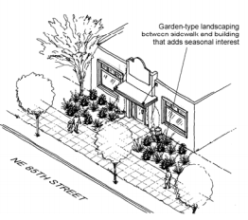
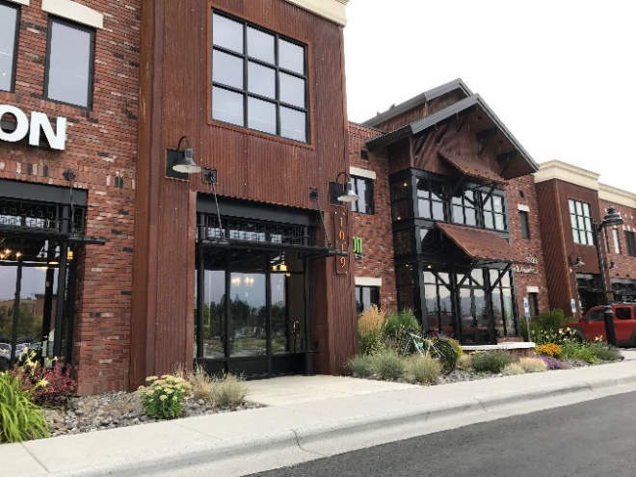
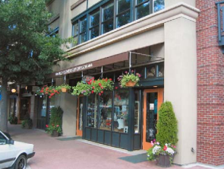
Planning Commission Recorded Motion
Pedestrian Oriented Street Frontage
Building Setback and Landscaping
A = 35%
B = 5 ft.
C = Over building entry
Notes:
Specifically, the Planning Commission requested additional design standards be included in proposed sections BMC 17.24.115 to implement the following new purpose statement proposed for this section: The purpose of this section is to ensure that new development in the Highway Commercial Subzone C visually is complementary to the Central Business District and acts as a gateway to the downtown, visually enhancing this route and providing a safe and welcoming pedestrian environment. The Planning Commission’s discussion was that the design standards did not contain sufficient provisions to ensure that the route would be visually enhanced and provide a safe and welcoming pedestrian environment. Staff was directed to bring back additional design standards for consideration.

Slide 6
Criteria for Analyzing Amendments: BMC 17.04.050.B.4
Consistency with goals, policies and objectives of the comprehensive plan.
Economic Goal 1
Economic Goal 3
Compliance with any other special provisions as provided by BMC 17.04.080.
CDS-Initiated
Authorized by Council for consideration
Economic Goal 6
Housing Goal 1
Continuation of earlier effort
Procedural requirements
= Consistent
= Not Consistent
Notes:
Application has met the procedural compliance standards:
Application has met the local public noticing requirements;
Planning Commission is holding duly-noticed public hearing to accept public testimony, and to deliberate on the proposal.
The proposal:
Offers greater flexibility to configure development proposals in order to support and encourage development and redevelopment opportunities within the subzone;
Includes standards for adequate access, parking and attractive buildings and site design in vicinity of an I-5 interchange and within this commercial district adjoining the downtown core; and
Allows new opportunities to meet Blaine’s demand for housing.
As such, the proposal is consistent with Economic Development Goals 1, 3, and 6, as well as with Housing Goal 1 of the Comprehensive Plan
GOAL 1: To encourage the development or expansion of businesses which will provide expanded employment opportunities for City residents; diversify the City economy; and generate a strong tax base to fund City services. GOAL 3: To encourage the development of automobile-oriented retail and service businesses malls and office parks in the Highway Commercial and Gateway zoning districts.
GOAL 6: To develop retail uses, restaurants, and hotels in the downtown core, along the SR-543 corridor, and at Interstate-5 interchanges.
Available here: https://www.ci.blaine.wa.us/DocumentCenter/View/12327/Economic-Development-Element?bidId=
GOAL 1: To encourage the development of a variety of housing types and prices, including an adequate supply of housing in a price range affordable to employees at available jobs in Blaine and housing which meets the needs of senior citizens. Available here: https://www.ci.blaine.wa.us/DocumentCenter/View/12326/Housing-Element?bidId=

Slide 7
Recommendation to Adopt
BMC 17.04.050(B)(7):
By ordinance, adopt the amendments.
By motion, reject the amendments.
By resolution, remand the amendments back to the Planning Commission.
Hold a City Council public hearing and depart from the recommendations.
Notes:
The Planning Commission is authorized by BMC 17.04.050.B.5 to recommend whether the amendment should be approved, approved with modifications or denied based on an evaluation of the amendment for consistency with the:
Goals, policies and objectives of the comprehensive plan; and
Compliance with any other special provisions as provided by BMC 17.04.080.

Slide 8
City of Blaine Planning Commission
City website:
www.cityofblaine.com
For Additional Information:
Call Stacie Pratschner at 360-332-8311
Email to spratschner@cityofblaine.com
Stacie Pratschner, AICP, RPA
Community Development Director
City of Blaine Community Development Services

