Slide 1
Blaine Sewer Capacity Review: East of I-5
Bernie Ziemianek and Greg Burg, Public Works
Rodney Langer David Evans and Associates, Inc.

Slide 2
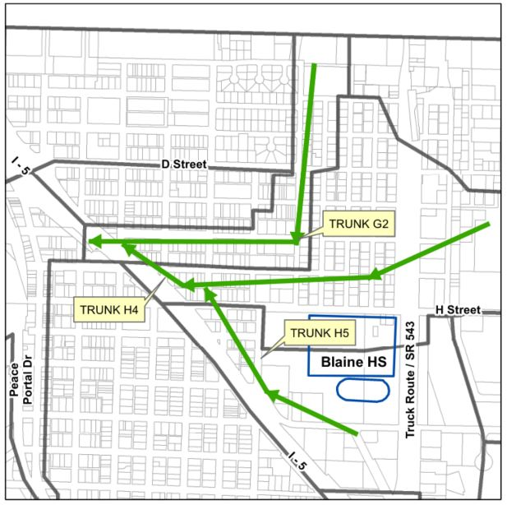
Sewer System East of I-5
Several sewer basins
Three “trunk” lines converge between G St and H St in one sewer main crossing under I-5
Other I-5 crossings to north

Slide 3
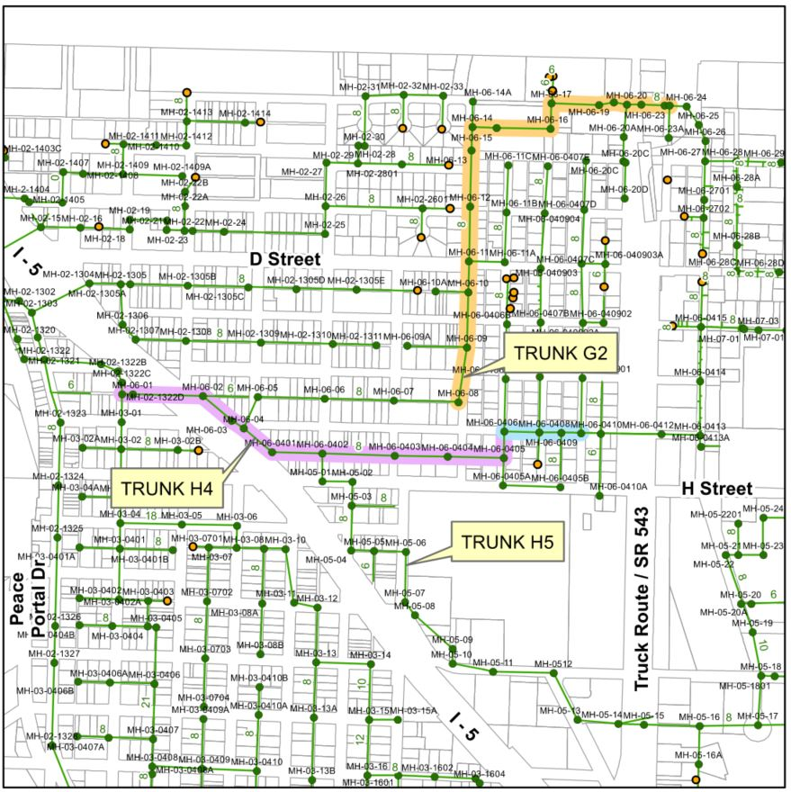
2005 General Sewer Plan (GSP)
Flow Data Collection
Population Growth – 20 years
4,100 to 10,900 persons
75% of growth east of I-5
Hydraulic Model
25-yr, 24-hour event
predict level of flow in pipes
Condition Assessment Recommended – need info
Projects recommended (not including I-5 crossing):
6,620 LF
$3.7 million (2020 $)
Prior to new treatment facility

Slide 4
Capacity and Surcharging
Gravity Flow
Max. capacity at full pipe
Function of pipe slope
Pressure Flow
Flow > Gravity capacity
“Surcharging”
Increased capacity but water level above pipe
Filling manholes
Backup in side-sewers
Impacts capacity upstream
Ground Level
Surcharging Level
Sewer Main
Manhole

Slide 5
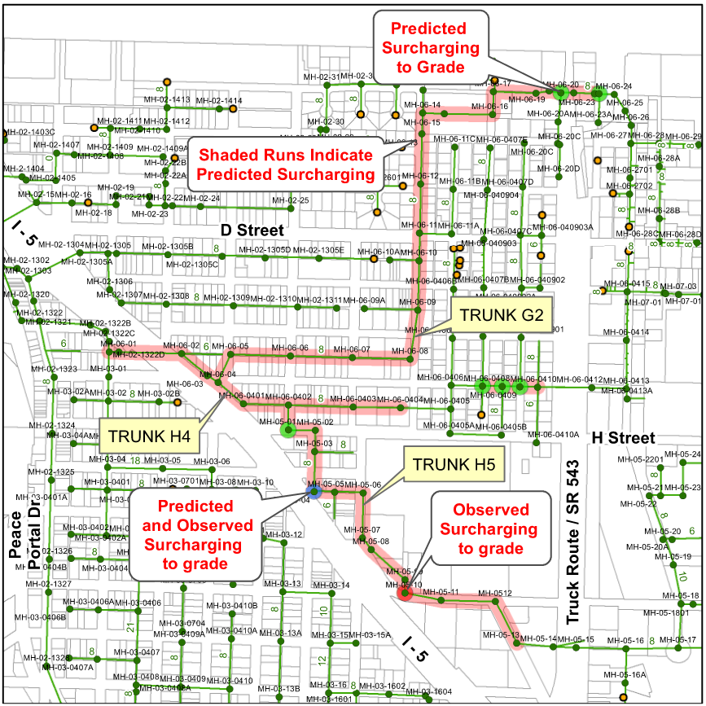
Surcharging
Anticipated
I-5 Crossing and upstream in Trunk H4 and Trunk H5
Surcharge to ground west of schools complex
Observed
Two locations west/southwest of schools complex

Slide 6
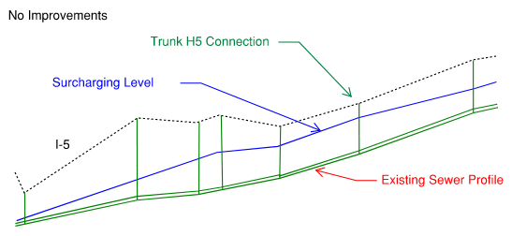
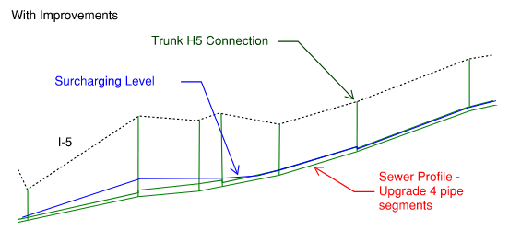
Focused Upgrades
Schematic Model
Interpret results of 2005 GSP
Data gaps/discrepancies
Defer Work Across I-5
Time, Permitting and Cost
Optimal long-term solution?
Upgrade Next Four Pipes
Reduce Surcharging Impact
Eliminate impact upstream in Trunk H5

Slide 7
Action Plan
Sewer System Mapping
For design, future hydraulic model and updates in GIS
CCTV/Manhole Inspections
Bellies/Roots/Sediment?
Sewer Main Improvements
GSP Update
Future Improvements

Slide 8
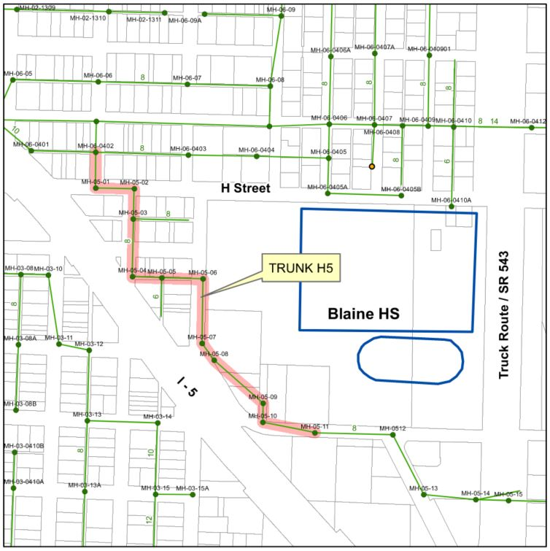
Trunk H5 Condition
Total Length – 3,300’ +/-
> 50% PVC, slope deficiencies
Multiple significant bellies
A few structural defects
Preliminary Recommendation
12” – 2,500 feet +/-
7
5/6
4
3
2
1

Slide 9
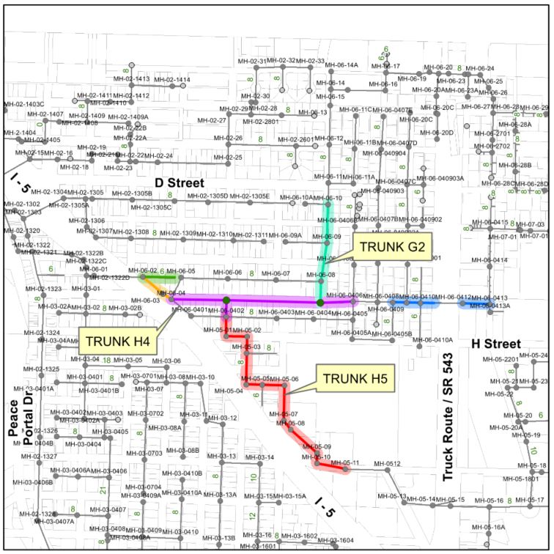
Recommended Improvements
Replace near I-5 (10” to 24”)
New trunk in G St. (18” & 15”)
Replace near SR 543 (8” to 15”)
Replace in 8th St. (8” to 12”)
Replace Trunk H5 (8” to 12”)
Replace lateral (6” to 8”)
6,800 feet +/-
$5 million project cost (preliminary)
4
6
8
2
1
3
5

Slide 10
System Capacity
Actual growth through 2020 about 60% of forecast City-wide
WITHOUT IMPROVEMENTS
Capacity deficiency – original projects planned for completion by 2009
Condition deficiency – structural and capacity-limiting conditions found, additional areas to investigate
WITH RECOMMENDED IMPROVEMENTS
Catch-up with core set of improvements recommended in 2005 for future growth
Add additional capacity in anticipation of growth not previously forecast
Address significant condition deficiencies in Trunk H5 and increase capacity for airport development area

Slide 11
System Benefits
Targeted projects to increase capacity and remove structural deficiencies
Catch-up with 2005 GSP Recommended Improvements for 20-year forecast population
Allow time for more detailed analysis
New GSP - Future Projects:
I-5 Crossing upgrade or additional crossing
Other capacity or condition solutions

