Slide 1
City of Blaine Council
March 8 at 6:00 PM
Zoom Meeting
City Of Blaine Land Use Code Enforcement
Allison Tompkins
Community Planner I
Code Enforcement Officer
City of Blaine Community Development Services

Slide 2
Study Session Outline
Regulatory Framework of Enforcement
“Police Power” and local jurisdictions
2020 Accomplishments
2021 Work Program
Notes:
Police = Constitutional Power

Slide 3
History of Police Power
Zoning
Nuisances
Individual properties.
Applies a broad paintbrush to land uses.
Constitutional Powers
Health, welfare and safety of the public
Notes:
State police power comes from the Tenth Amendment to the Constitution, which gives states the rights and powers which are not delegated to the Federal Government. States are thus granted the power to establish and enforce laws protecting the welfare, safety, and health of the public.
In the early 20th century, municipalities began developed zoning ordinance under the10th amendment, which looked to separate hazardous and harmful land uses from residential development and public spaces on a city wide scale. Along with this came regulations and processes for abating nuisances on individual properties that pose harm to the public on a neighborhood scale.
On a State level. Local jurisdictions are granted power through the RCW, WAC and growth management act to develop, regulate and enforce land use and zoning standards.

Slide 4
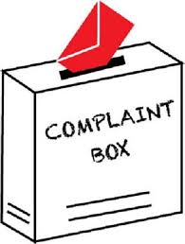
Complaint Based Enforcement
Supports a staff and community partnership
Relieves the administrative burden
Ensures that the City uses ethical and consistent enforcement practices.
Notes:
On a local level, police power is exercised through complaint based policies… which hold the community and staff members equally responsible for enforcing nuisances.
Most code enforcement programs are complaint-driven. Complaints result in an inspection and a warning letter to the violator, followed by a notice of citation if action to correct the violation have not been taken by the property owner. This is followed by official abatement proceedings if the violator still has not take care of the problem within a specified period of time. As an alternative to abatement, some cities use neighborhood mediation centers and voluntary agreements. Except for situations of imminent or immediate danger, the enforcement of nuisance provisions is a policy issue dependent on the level of service a community can provide with available resources.

Slide 5
Goals and Accomplishments of 2020
Code Enforcement Summary Report
 | 2020 | 2021
Closed | 13 | N/A
No Violation | 15 | N/A
Open | 3 | 2

Slide 6
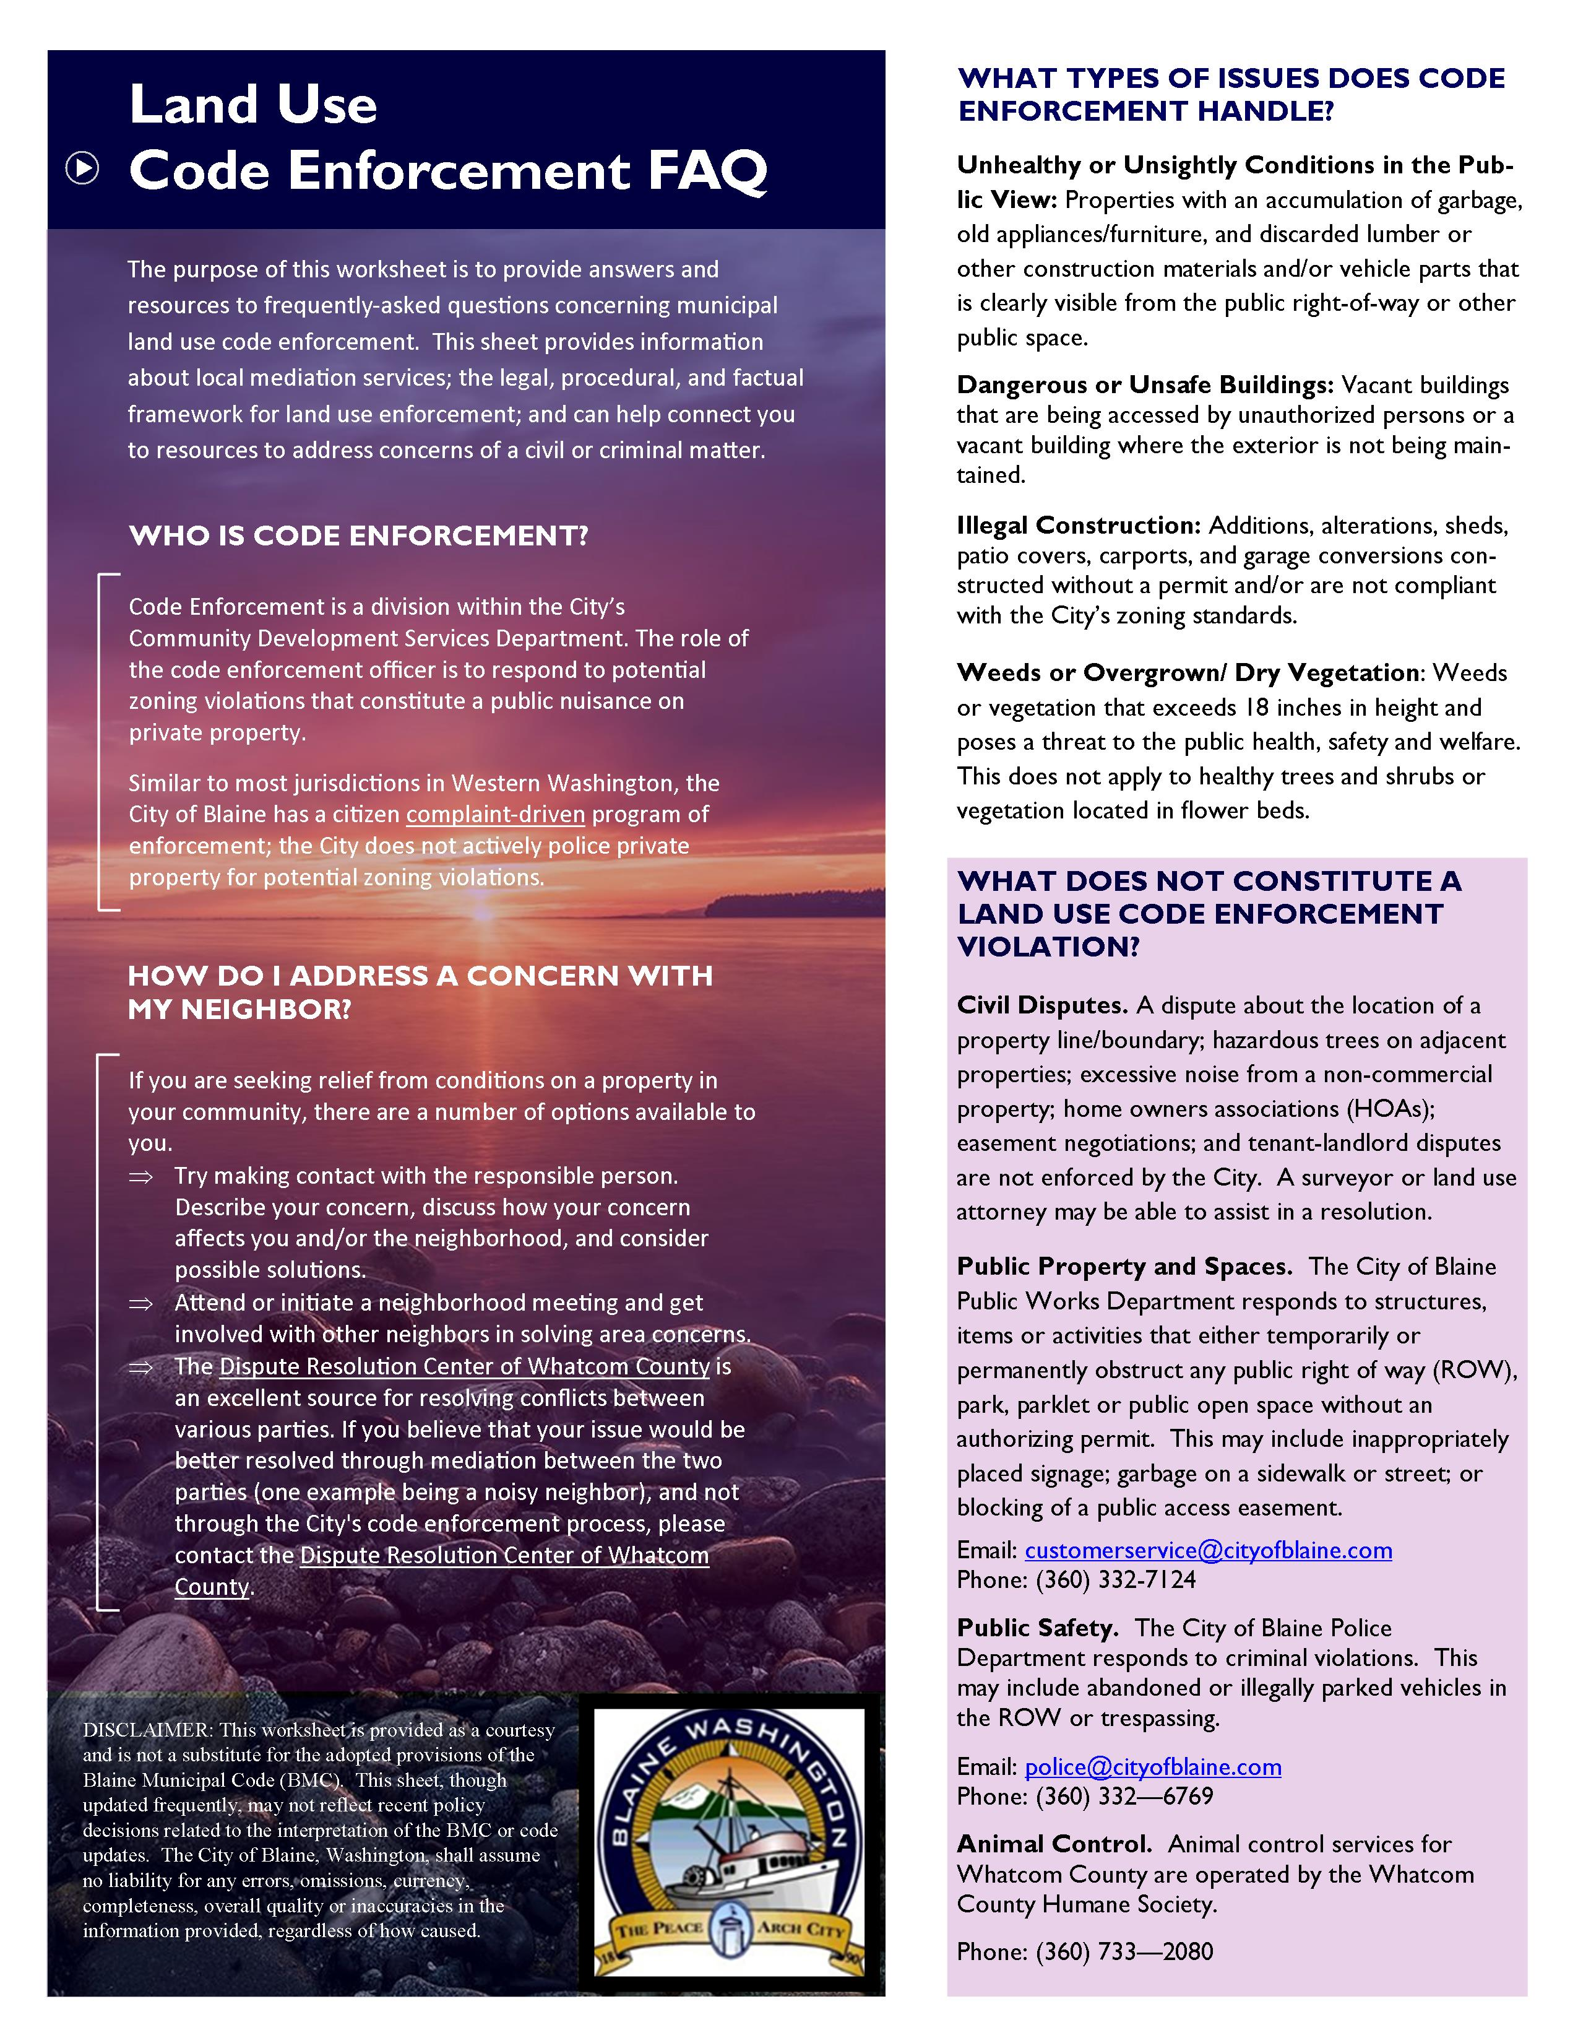
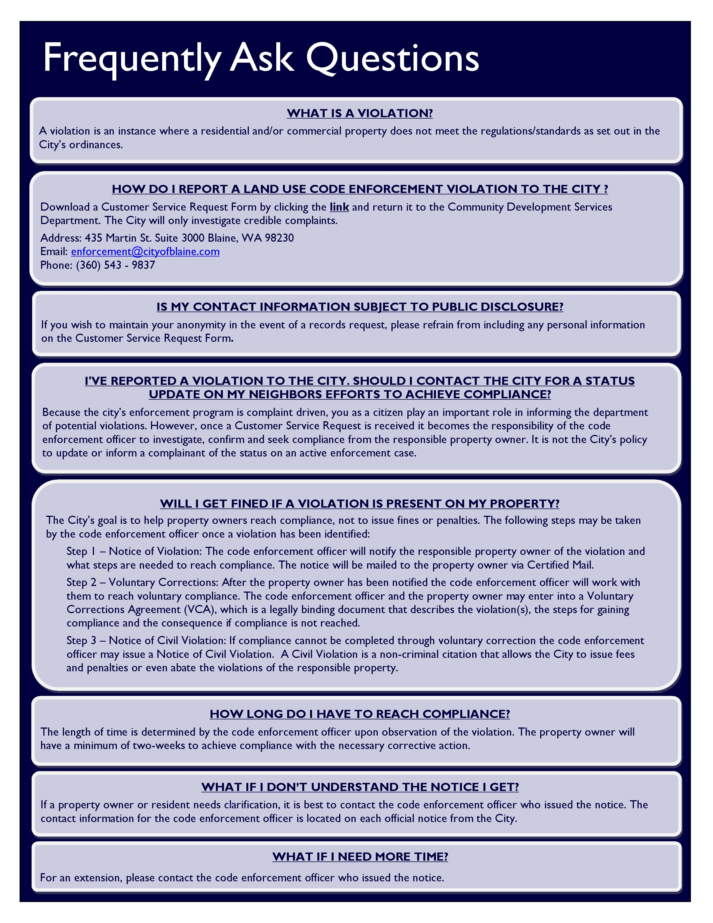

Slide 7
2021 Work Program
Neighborhood Outreach
Identify Active Neighborhood Association;
Establish the types of information neighborhoods need to address enforcement concerns;
Attend meetings and present on the City’s enforcement program.

Slide 8
City of Blaine Council
City website:
www.cityofblaine.com
For Additional Information:
Call Allison Tompkins at 360-332-8311
Email: atompkins@cityofblaine.com
Allison Tompkins
Community Planner I
Code Enforcement Officer
City of Blaine Community Development Services

