Slide 1
City of Blaine Council: City Manager Update
February 8, 2021 PM
Zoom Meeting
Marine Park Beach Erosion: Recent Storm Impacts
Michael Jones
Blaine City Manager

Slide 2
Presentation Outline
Summary of Impacts
Description by Park Areas: 1, 2, and 3
Action Alternatives
Next Steps

Slide 3
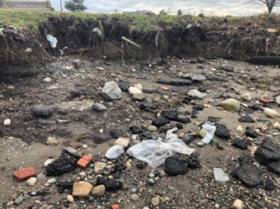
Summary of Impacts
January 12, 2021: Winter storm with high winds and tides resulted in erosion at Marine Park.
Recession of beach – undercutting of the bluffs
Exposed historic dump fill materials
Loss of park infrastructure: vegetation and a portion of the trail handrail
Undercutting and resulting exposed garbage in Area 1.

Slide 4
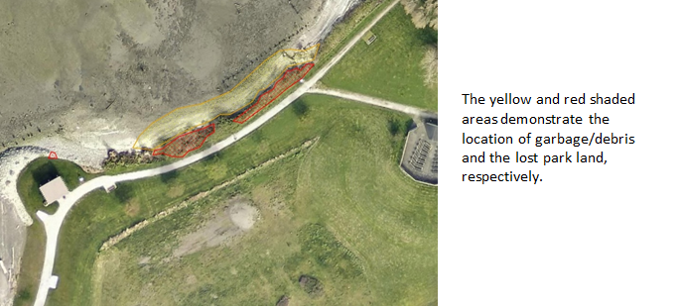
Marine Park: Area 1

Slide 5
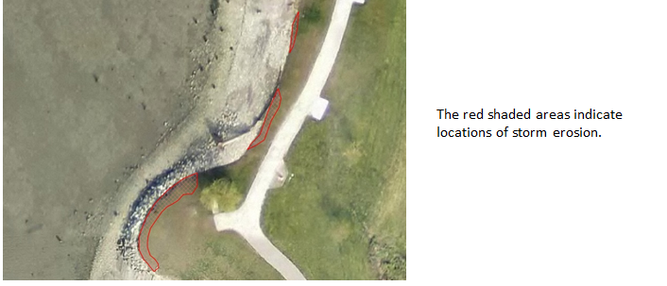
Marine Park: Area 2

Slide 6
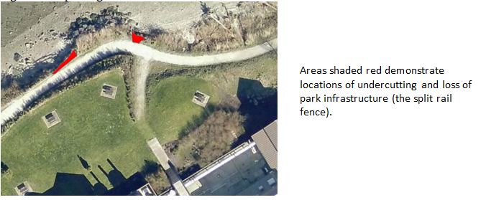
Marine Park: Area 3

Slide 7
Action Alternatives
No-action alternative
Shoreline permitting alternative
Consultant alternative
Next steps: Costs and timing.

Slide 8
City of Blaine Council
City website:
www.cityofblaine.com
For Additional Information:
Call Michael Jones at 360-332-8311
Email: mjones@cityofblaine.com
Michael Jones
Blaine City Manager

