Slide 1
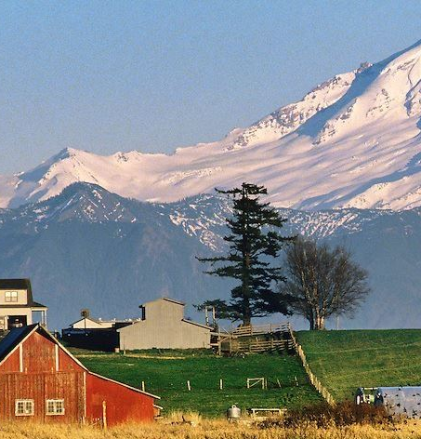
Building Community Resilience
Climate Action Coordination and Planning in Whatcom County
Blaine City Council Meeting February 8, 2021
Sarah Parker, SCP Graduate Assistant, Western Washington University
Chris Elder, Watershed Planner, Whatcom County

Slide 2
Agenda
Project overview
Project details and WWU partnership
Questions?

Slide 3
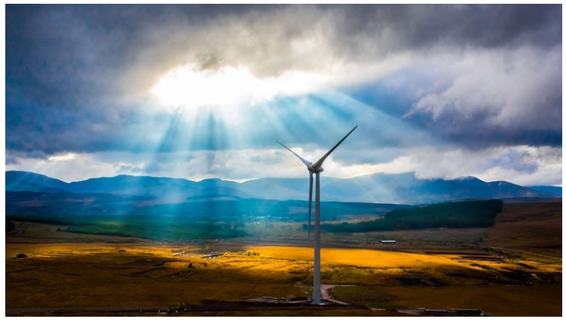
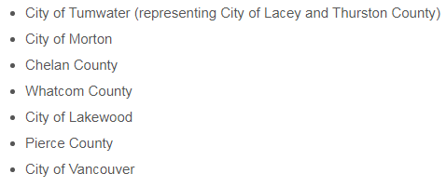
Funding was provided for integrating climate change planning and actions into GMA comprehensive plans.
Planning Grants were awarded to:

Slide 4
Project Overview
Goal: Build community preparedness and resilience within Whatcom County by supporting coordinated climate and natural hazard planning amongst jurisdictions.
How: Students in a WWU course led by Dr. Tammi Laninga will develop recommended language for jurisdictions to consider adopting into existing Comprehensive Plans.
** This is an opportunity to participate in a planning exercise and does not constitute a policy decision commitment.**

Slide 5
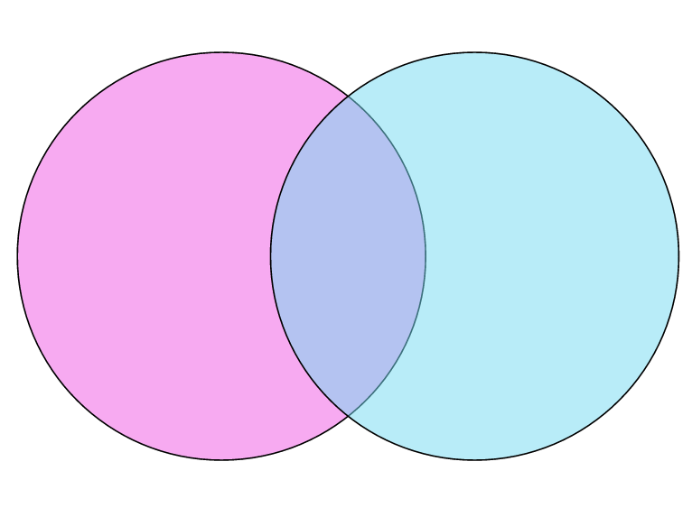
Climate and Natural Hazard Resilience Planning
MITIGATION
Reducing greenhouse gas emissions
Renewable energy
Building efficiency
Carbon capture/sequestration
Hybrid or electric vehicles
ADAPTATION
Actions taken to reduce vulnerability
Flood-proof roadways and critical infrastructure
Planning for wildfire, drought, flooding, etc.
Plant trees
RESILIENCE

Slide 6
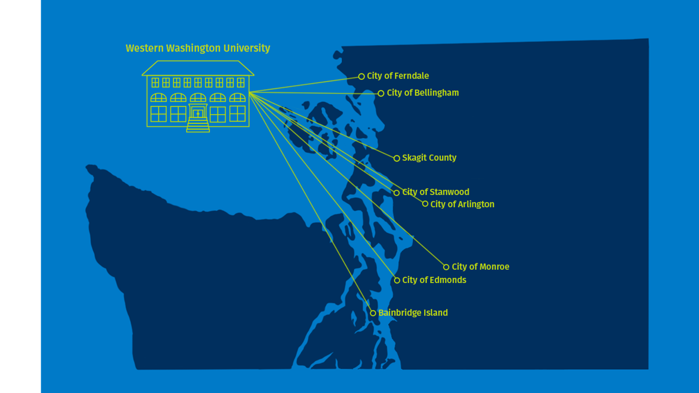
WWU Partnership

Slide 7
WWU Partnership
Graduate student coordinator throughout the process.
Student project work:
Upper-level students in Dr. Tammi Laninga’s Land Use Regulations course
Professional report including proposed language for your Comprehensive Plan
Final presentation from students
120 hours of student work/project team with faculty guidance

Slide 8
Project Details
There is no cost to participate.
Project team requests two-four hours of city staff time per month from February-June 2021.
Each of the Small Cities is invited to participate.
Engaging in this project represents a willingness to participate in a planning exercise and does not constitute a policy decision commitment.

Slide 9
Project Timeline
February 2021: Blaine commits to participation (by 2/26) March 2021: Staff lead/project team meet April-June 2021: WWU course engagement June 2021: Final presentation and recommendations

Slide 10
Questions?

Slide 11
Steering Committee:
Whatcom County Chris Elder
Senior Planner
celder@co.whatcom.wa.us
Port of Bellingham
Jennifer Noveck
Research and Communications Manager
jennifern@portofbellingham.com
Adrienne Hegedus
Sustainability Program Manager
adrienneh@portofbellingham.com
Kurt Baumgarten
Environmental Planner
kurb@portofbellingham.com
City of Bellingham
Clare Fogelsong
Environmental Resources Manager
cfogelsong@cob.org
Seth Vidaña
Climate and Energy Manager
savidana@cob.org
Western Washington University
Lindsey MacDonald
Director of the Office of Sustainability
macdonl6@wwu.edu
Sarah Parker
Huxley Graduate Student
Sustainable Community Partnership Graduate Assistant
scp2@wwu.edu

