Slide 1
City Council Deliberations
Grandis Pond on the 49th Parallel
PUD Modification;
Boundary Line Adjustment; and
Preliminary Plat Application
July 13, 2020 at 6 PM
GoTo Meeting
Stacie Pratschner, AICP, RPA
Community Development Director
City of Blaine Community Development Services
Notes:
Good evening Madam Mayor; Council Members. I’m Stacie Pratschner, the Director for Community Development Services. These are the deliberations to consider a recommendation from the Planning Commission to approve the Grandis on the 49th Parallel preliminary plat application, a modification to the Grandis Pond Planned Unit Development Master Plan Guidebook, and a boundary line adjustment of the underlying parcels that constitute the total Grandis Pond project area. Provided in the Councils packet in advance of the meeting this evening is the Planning Commissions recorded motion; the entire material record of the quasi-judicial proceedings; and a draft ORD for the Council’s consideration.

Slide 2
Presentation Outline
I. Site and Surrounding Properties
II. Project Background
III. Comprehensive Plan
IV. Proposals
V. Public Comments
VI. Council Alternatives
Notes:
II. Project background: beginning with the annexation of the East Blaine Subarea in the mid 90’s, and culminating with the recent extension of public utilities into the area.
Proposals consistency with the Comprehensive Plan
And the recommendation from the Planning Commission for each of the proposals.
VI. Four alternatives that the Council may consider pursuant to municipal code.

Slide 3
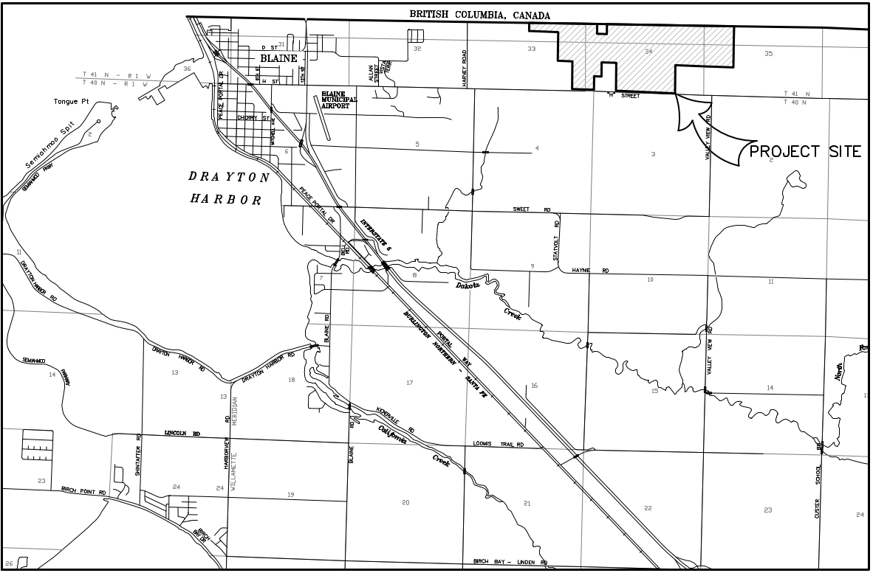
I. Site and Surrounding Properties
Notes:
The project site is located in what the City’s planning documents refer to as the East Blaine Subarea. The project area consists of approximately 483 acres one mile east of Harvey Road, between H Street and the Canadian Border. The site currently is undeveloped, and supports a forested landscape with wetland mosaics.
The Grandis Pond Planned Unit Development (or PUD) was approved by Council in 2011, and anticipates the creation of over a 1,000 new lots supporting new residential units; commercial development; parks and open spaces; utility and road infrastructure; and protected critical areas. The applications presented this evening have been evaluated for compliance with that approved and active PUD.

Slide 4
II. Project Background
1996: Annexation & Original Development Agreement
2009: East Blaine Infrastructure Plan Completed
2011: Grandis Pond Approved by City Council
2019: New Preliminary Plat Application Submitted
2020: Utility Extensions Completed
2020: Planning Commission Public Hearing
2005: Development Agreement
2014: Grandis Pond PUD Guidebook approved by the Planning Commission
Notes:
The City has been planning and preparing for development in East Blaine for almost 25 years, starting with the annexation of East blaine subarea
to the City in 1996. in 2005, Development Agreements detailing the obligations of the Developer and the City and specifying the standards and conditions that will govern development of the property. The East Blaine Infrastructure Plan was developed in 2009, which serves as the basis for both public and private infrastructure requirements in the Subarea. The Grandis Pond PUD was approved in 2011, subsequent to the issuance of the East Blaine Infrastructure Plan. The City is now in receipt of the new preliminary plat application for Phase I of the Grandis PUD, and this application coincides with development of utility extensions that recently were completed in the subarea per the Infrastructure Plan.

Slide 5
III. Comprehensive Plan – East Blaine
Vision for residential development with key bike/ped links providing access to downtown
Large portion of City’s planned residential growth
Planned density of 4 dwelling units/acre
Incorporates East Blaine Infrastructure Plan
Anticipates extension of municipal services
East Blaine is likely to develop additional neighborhood parks
Notes:
The City’s planning and preparing for development in East Blaine for the last 25 years is woven throughout the goals and policies of the City’s Comprehensive Plan. Some examples from the Comp Plan include statements about:
- Developing East Blaine with urban levels of residential development. The East Blaine Subarea is projected to support almost 40% of the City’s needed housing stock over the 20-year planning horizon
It is assumed that the East Blaine planning area will experience high levels of growth over the next twenty years as utility services are expanded east. The City has completed Phase 1 of sewer and power infrastructure installation for East Blaine.
As the area develops, the Comprehensive Plan acknowledges a need for additional neighborhood parks.
The proposed development is consistent with the City’s growth plans in East Blaine and capitalizes on recent funding secured from the State to extend utilities as anticipated in the East Blaine Infrastructure Plan.

Slide 6
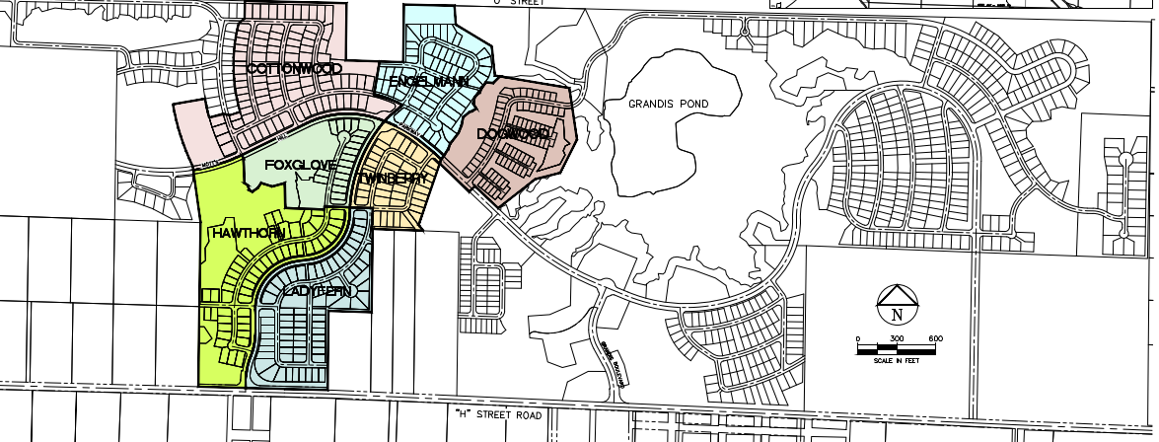
IV. Proposals
Planned Unit Development (PUD) Modification; Boundary Line Adjustment; and Preliminary Plat Applications
Notes:
The applicant, Grandis Pond LLC, proposes to develop 387 residential lots over approximately 119 acres as part of Phase I of the approved Grandis Pond PUD. The overall PUD includes 5 total phases, with 17 neighborhoods. Phase I includes 7 neighborhoods that will support a mix of single family and cottage housing. Stormwater facilities; active and passive open spaces; pedestrian trails; and the extension of Motts Hill Parkway (that’s the main utility / transportation corridor envisioned by the East Blaine Infrastructure Plan) will all support the development.
The applicant to facilitate their proposal has submitted three permit applications. First, there is the preliminary plat application, defined as a Type II quasi judicial permit subject to an open record hearing with a recommendation from the PC and approval by Council. The applicants have also submitted a Type I-administrative request for a PUD modification; and a Type – I admin request for a BLA.
I’ll briefly describe the applications and the Planning Commission’s recommendations.

Slide 7
IV(a): Proposals – Planned Unit Development Modification
Critical Areas
Stormwater
Lot counts
Road Layouts
PUD Phasing
Development
Area 1
Notes:
The applicant has applied for a PUD modification that would amend the Grandis Pond Master Plan to account for the reduction in lot counts; the slight shifts in road layout; and the updated Depart of Ecology requirements for stormwater mitigation subsequent to the updated ratings and buffers of the on site critical areas. Also proposed is a section on phasing, which anticipates build out over a 20-30 year period and will feature a number of neighborhoods constituting those five Phases.
The Planning Commission has found that the PUD modification criteria have been met, and recommends approval with Conditions.

Slide 8
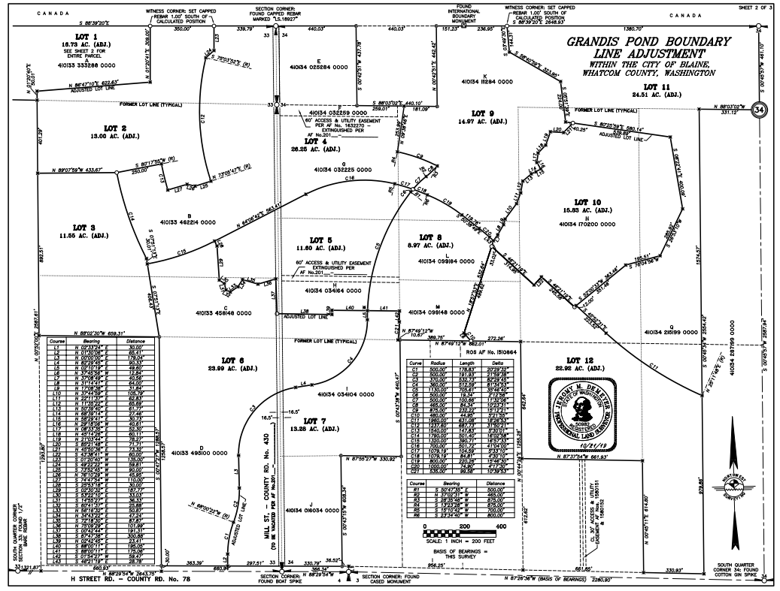
IV(b): Proposals – Boundary Line Adjustment
12 Lots
Match lot lines to
proposed plat phases
Street Vacation
Notes:
The applicant has also applied for a boundary line adjustment, which if approved will adjust the underlying 24 parent parcels into twelve lots that will approximately match the proposed neighborhood phasing. The applicant has also submitted a request to Public Works for a Street Vacation for a portion of Old Mill Road; this request will be reviewed by Council at a separate Public Hearing.
The Planning Commission has found that the BLA criteria have been met, and recommends approval with Conditions.

Slide 9
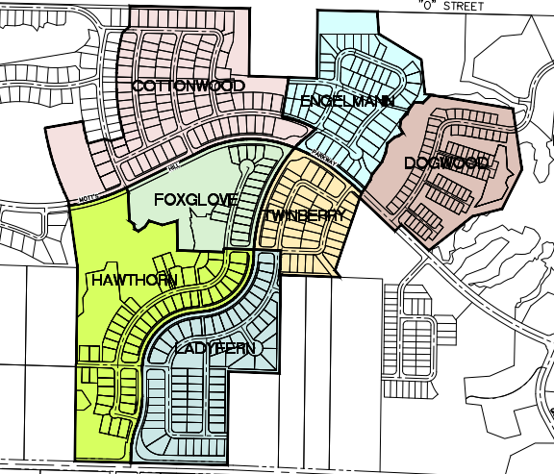
IV(c): Proposals – Preliminary Plat Application
Development Area Phase 1
7 Neighborhoods
387 Residential Lots
Motts Hill Parkway
Notes:
The third application is the preliminary plat proposal (READ POINTS). The project will support new internal, local roads that will connect with Mott’s Hill Parkway ( the East Blaine Infrastructure Plan states that Grandis will be responsible for the offsite extension of the Parkway west of North Harvey Road) and connect with H Street. Sewer, water, and electricity hooks ups and stormwater facilities will support the development. The following slides are graphics from the approved PUD Guidebook, and provide an overview of what these new neighborhoods will look like.

Slide 10
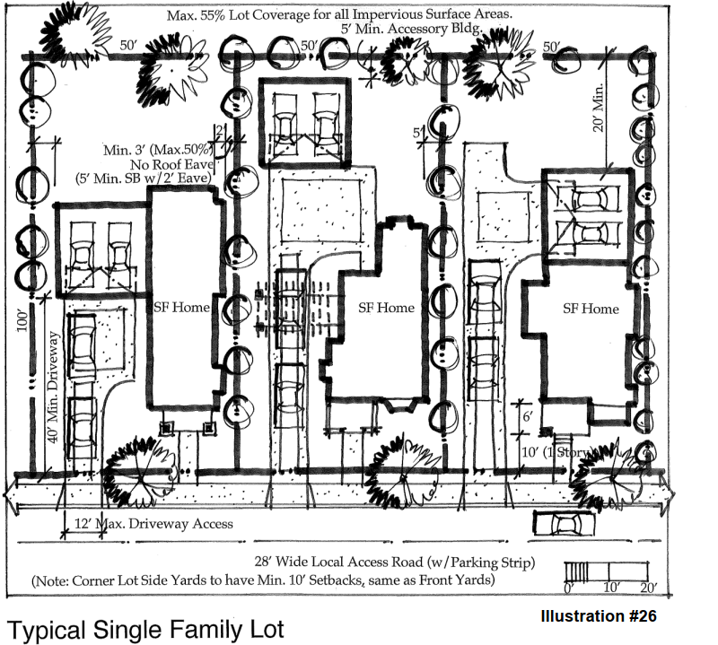
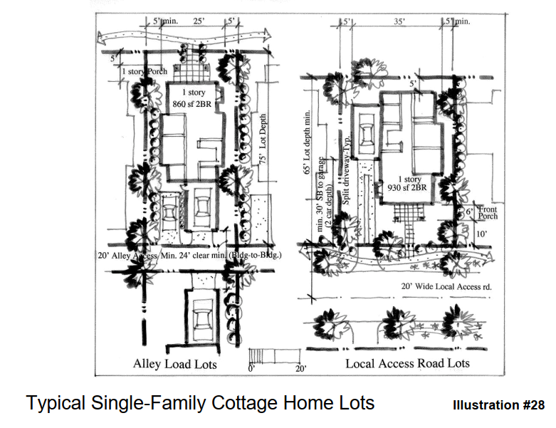
IV(c)(1): Proposals – Approved PUD Master Plan Plat Design Elements: Homes
Notes:
The seven neighborhoods that will constitute Phase I of the Grandis Pond PUD (this plat is called Grandis on the 49th Parallel) will include both single family residential and cottage home lots. All homes will need to meet the bulk and dimensional standards established by the approved PUD guidebook.

Slide 11
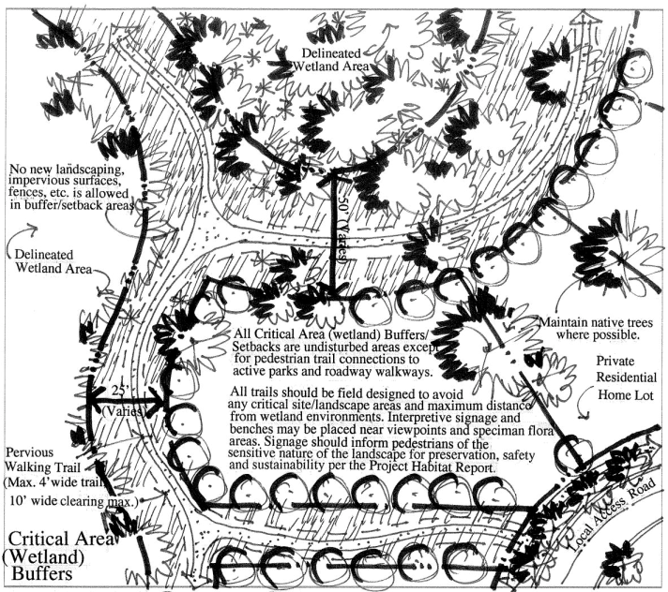
IV(c)(2): Proposals – Approved PUD Master Plan Plat Design Elements: Open Space and Parks
Neighborhood parks
Cottage Home Park (Dogwood Neighborhood)
Passive Open Space
Notes:
The Grandis Pond PUD is designed to accommodate a large amount of both active and passive recreational space. This is the result of a number of factors: one is the amount of wetlands on site, whose outer buffers provide an opportunity for walking trails and passive recreation. The second is the existence of Grandis Pond, which will ultimately be accessible through a series of interconnected trails throughout the PUD. Lastly, the PUD envisions a multitude of neighborhood common parks along Collector Roads, as well as a larger active Park when the Dogwood Neighborhood is developed.

Slide 12
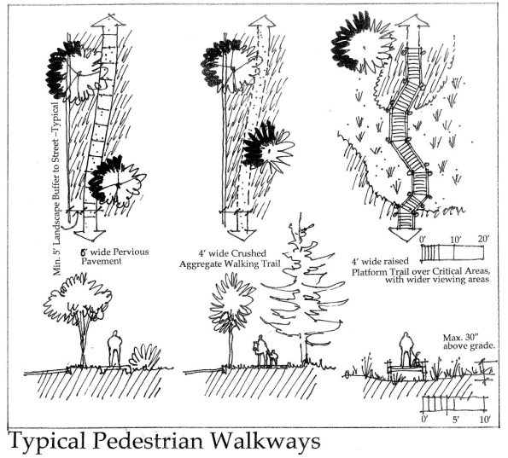
IV(c)(3): Proposals – Approved PUD Master Plan Plat Design Elements: Pedestrian Circulation
Notes:
The Grandis Pond PUD anticipates trail linkages throughout the development that take advantage of open space and views of protected critical areas Sheet PR4 of the Grandis on the 49th Parallel preliminary plans demonstrates those trail locations. All trails will need to be constructed according to the approved design elements in the PUD guidebook.

Slide 13
V. Public Comments
Five (5) Written Public Comments Received
Three (3) Citizen Comments: Traffic; Stormwater; Noise during Construction; Infrastructure; Rural Character; and Wildlife.
Two (2) Agency Comments: The DAHP and the LNTHPO - Archaeology
Seven (7) Members of the Public Submitted Testimony at the Hearing
Traffic; Stormwater; and Impact Fees.
Notes:
Responses noted in Recorded Motion

Slide 14
VI. Council Alternatives
Option 1. Approve the Preliminary Plat; PUD Modification; and BLA by adopting Ordinance # 20-2941.
Option 2. Modify and approve the Preliminary Plat; PUD Modification; and BLA by adopting a revised Ordinance # 20-2941.
Option 3. Deny the Preliminary Plat; PUD Modification; and BLA with findings supporting the denial.
Option 4. If the Council determines that the record compiled by the Planning Commission is incomplete or inadequate for the Council to make a decision, direct that the application be considered at a reopening of the hearing before the Planning Commission and specify the issues to be considered at the rehearing.
Notes:
The Department, in concurrence with the Planning Commission, respectfully recommends the Council consider Option 1.

Slide 15
City of Blaine Council
City website:
www.ci.blaine.wa.us
Questions?
Call Stacie Pratschner at 360-332-3811
Email to spratschner@cityofblaine.com
Stacie Pratschner, AICP, RPA
Community Development Director
City of Blaine Community Development Services

