Slide 1
City of Blaine Council Study Session
Proposed Legislative Work Item: Downtown Vacancy Ordinance
January 27 at 4:30 pm
435 Martin Street
Suite 4000
Blaine, WA 98230
Stacie Pratschner, AICP, RPA
Community Development Director
City of Blaine Community Development Services

Slide 2
Presentation Outline
Statutory Background
Existing Plan and Code Provisions
Model Ordinances
Next Steps: Amendments & Enforcement

Slide 3
RCW 36.70A.020 and The Blaine Comprehensive Plan
Goal 2
Economic Element
Comprehensive Plan
GMA: 13 Goals
Increase Vibrancy Downtown
Enliven Vacant Storefronts
ACTIONS

Slide 4
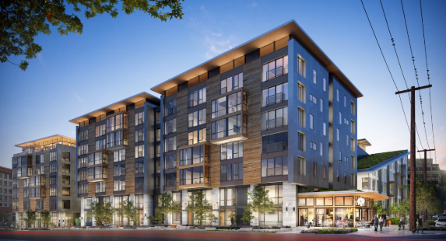
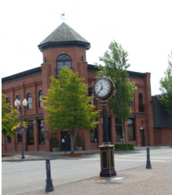
Existing City Provisions

Slide 5
Model Ordinances
Jurisdiction | Building and Enforcement Code Chapters | Provisions
Everett | Chapter 16.16 EMC: Maintenance of Vacant Commercial Space | Window displays, space registrations, delinquent fees.
Olympia | Chapter 16.06 OMC: Property Maintenance | Clean, safe, secure.
Yakima | Chapter 11.48 YMC: Minimum Standards for Vacant Buildings | Annual inspections, additional building security.
Seattle | Fire -> Code Enforcement -> Building Code | Fire Department inspections, property maintenance, secured entry.

Slide 6
Next Steps
Resolution
Code Drafts
Study Session(s)
ORD Adoption
2020Q1/Q2 Completion

Slide 7
City of Blaine Council
City website:
www.ci.blaine.wa.us
For Additional Information:
Call Stacie Pratschner at 360-332-8311
Email to spratschner@cityofblaine.com
Stacie Pratschner, AICP, RPA
Community Development Director
City of Blaine Community Development Services

