Slide 1


2020 Census 101 For
Community Leaders
What You Need To Know

Slide 2
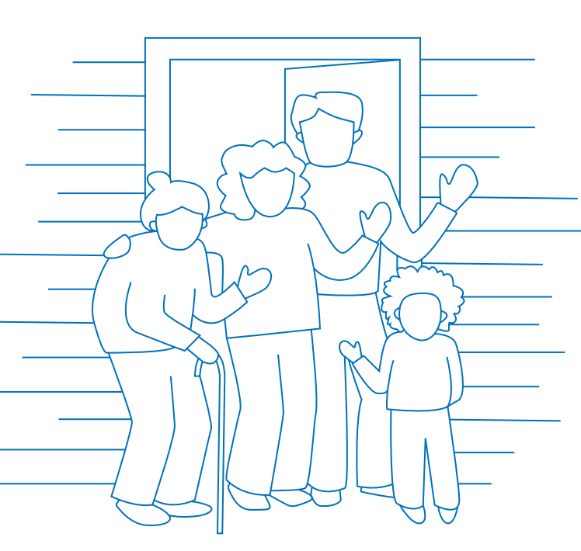
Everyone Counts:
April 1, 2020 is Census Day
The Census counts every person living in the U.S. once, only once, and in the right place.

Slide 3

Why do we have a Census?
The U.S. Constitution mandates that everyone in the country be counted every 10 years.
The first Census was in 1790

Slide 4
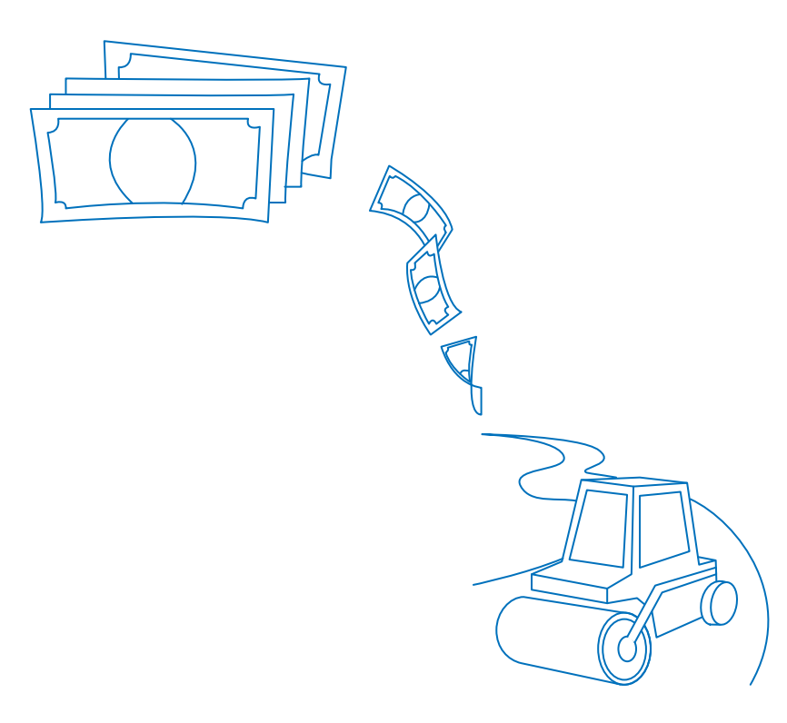

Why do we have a Census?
Distribution of more than $675 billion in federal funds to states, counties, and communities each year for the next 10 years!
Approximately $2400 per person, per year for 10 yrs
It’s about fair representation! The Census results are used to reapportion the 435 seats in the House of Representatives, determining how many seats each states gets.
Washington gained a seat in 2010!

Slide 5
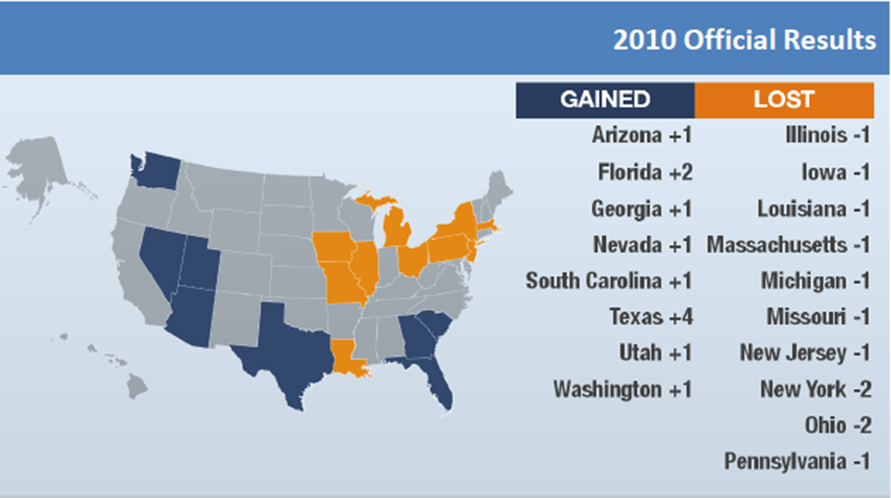
Representation in Congress

Slide 6
The Census determines the Distribution of Federal Funds
Medicaid
SNAP/WIC
Planning for roads, transportation, and emergency
Education/Pell Grant
Housing Vouchers/Section 8
Head Start

Slide 7

Your Information is protected by law

Slide 8

Title 13 ensures the protection of your data
Law states that information collected can only be used for statistical purposes
Your responses cannot be used against you by any government agency or court in any way! Not by the FBI, Homeland Security, and not by the US Immigration Customs Enforcement (ICE)
All Census Bureau staff take a lifetime oath to protect your personal information
Penalties for wrongful disclosure – 5 years in prison and/or $250,000 in fines

Slide 9

The 2020 Census will be easy to answer
Easy to answer individually:
    Internet
    Telephone
    Paper form
Field workers will use cell phones and electronic devices
It will be in Spanish and English
12 languages by phone
Language guide of 59 other languages

Slide 10
What are the 10 questions of the 2020 Census?
Address (Rent/Own)
Phone Number
Number of people living at the address
Name
Sex
Age and Date of Birth
Race
Hispanic, Latino, or Spanish Origin
Whether a person lives or stays somewhere else
Relationship

Slide 11
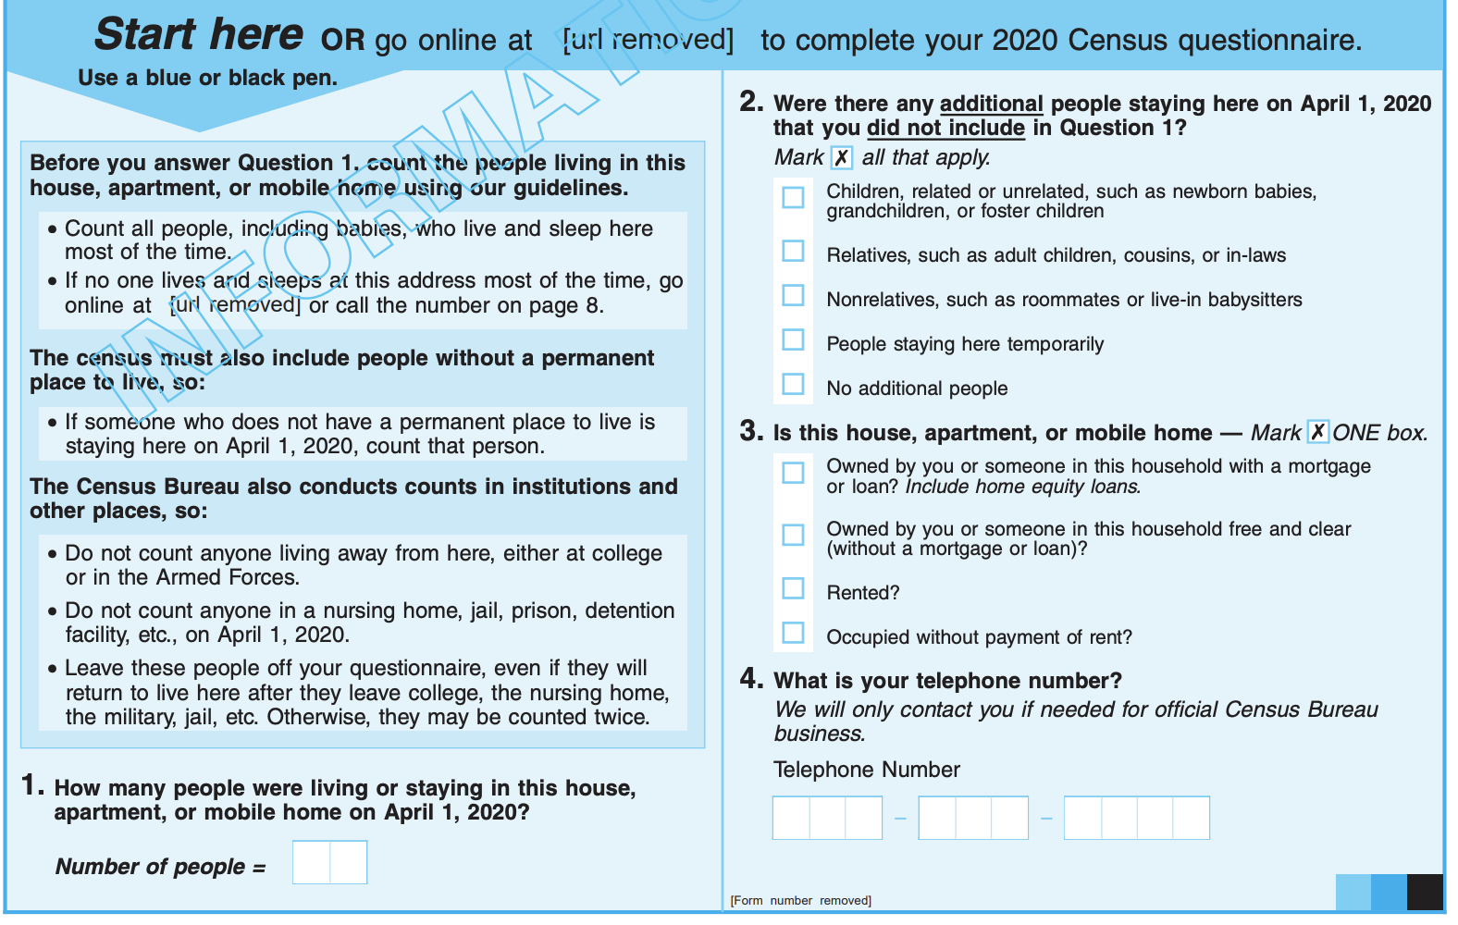
Census Form Example (page 1)

Slide 12
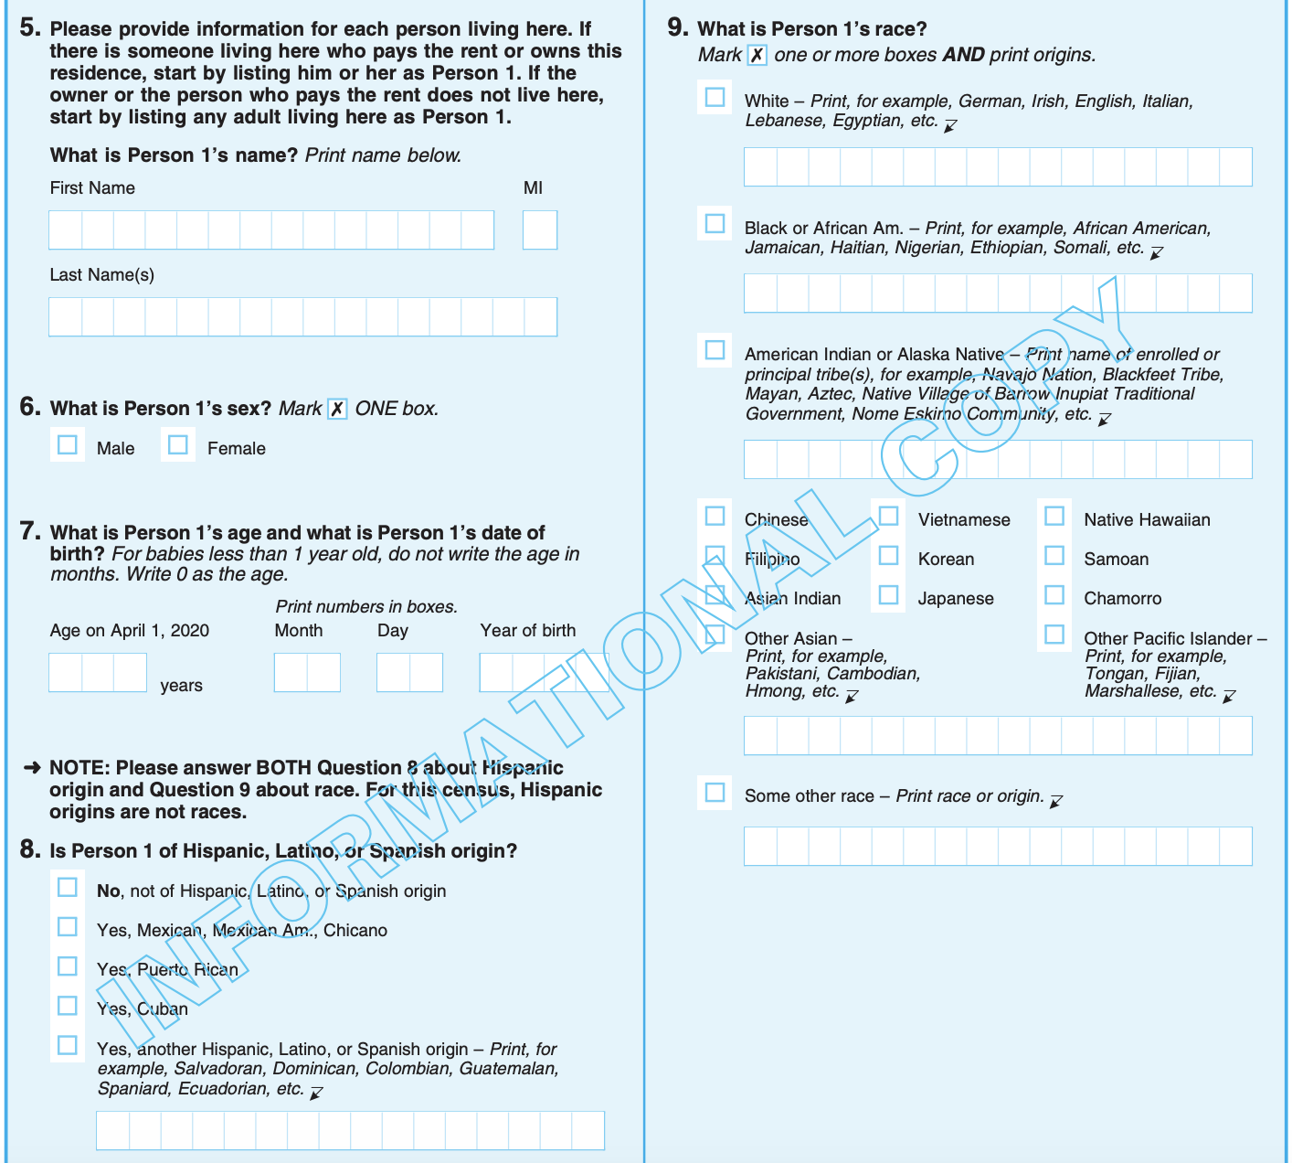
Census Form Example (page 2)

Slide 13
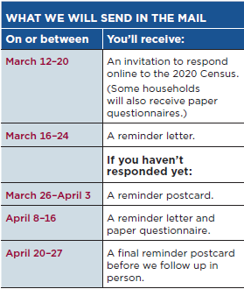
Beginning March 12th You will be able to self respond

Slide 14
Key Dates
Date | Items
2019 | Validate all residential units in the country
Early 2020 | Advertising Campaign
Mid- March 2020 | Online portal opens
1 April 2020 | CENSUS DAY!
April-June 2020 | Non-response Follow Up Quality Control
31 Dec 2020 | Results delivered to the president
31 Mar 2021 | Results delivered to the states

Slide 15
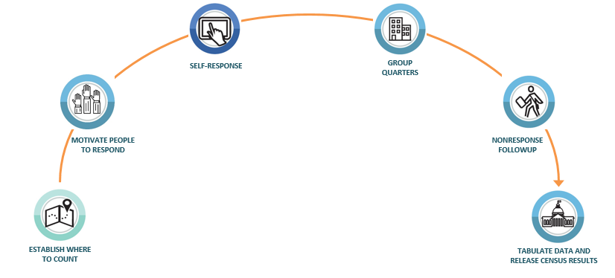
Timeline
Mid-March 2020
May-Aug 2020
Jan-Feb 2020
2018-2019
31 December 2020

Slide 16
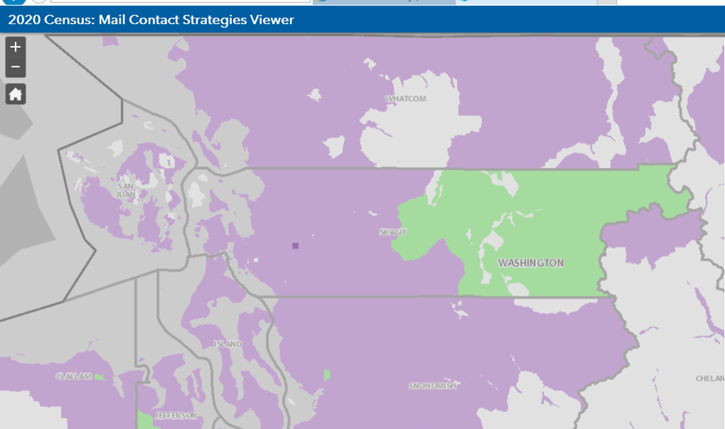
How it will work: Type of Enumeration

Slide 17
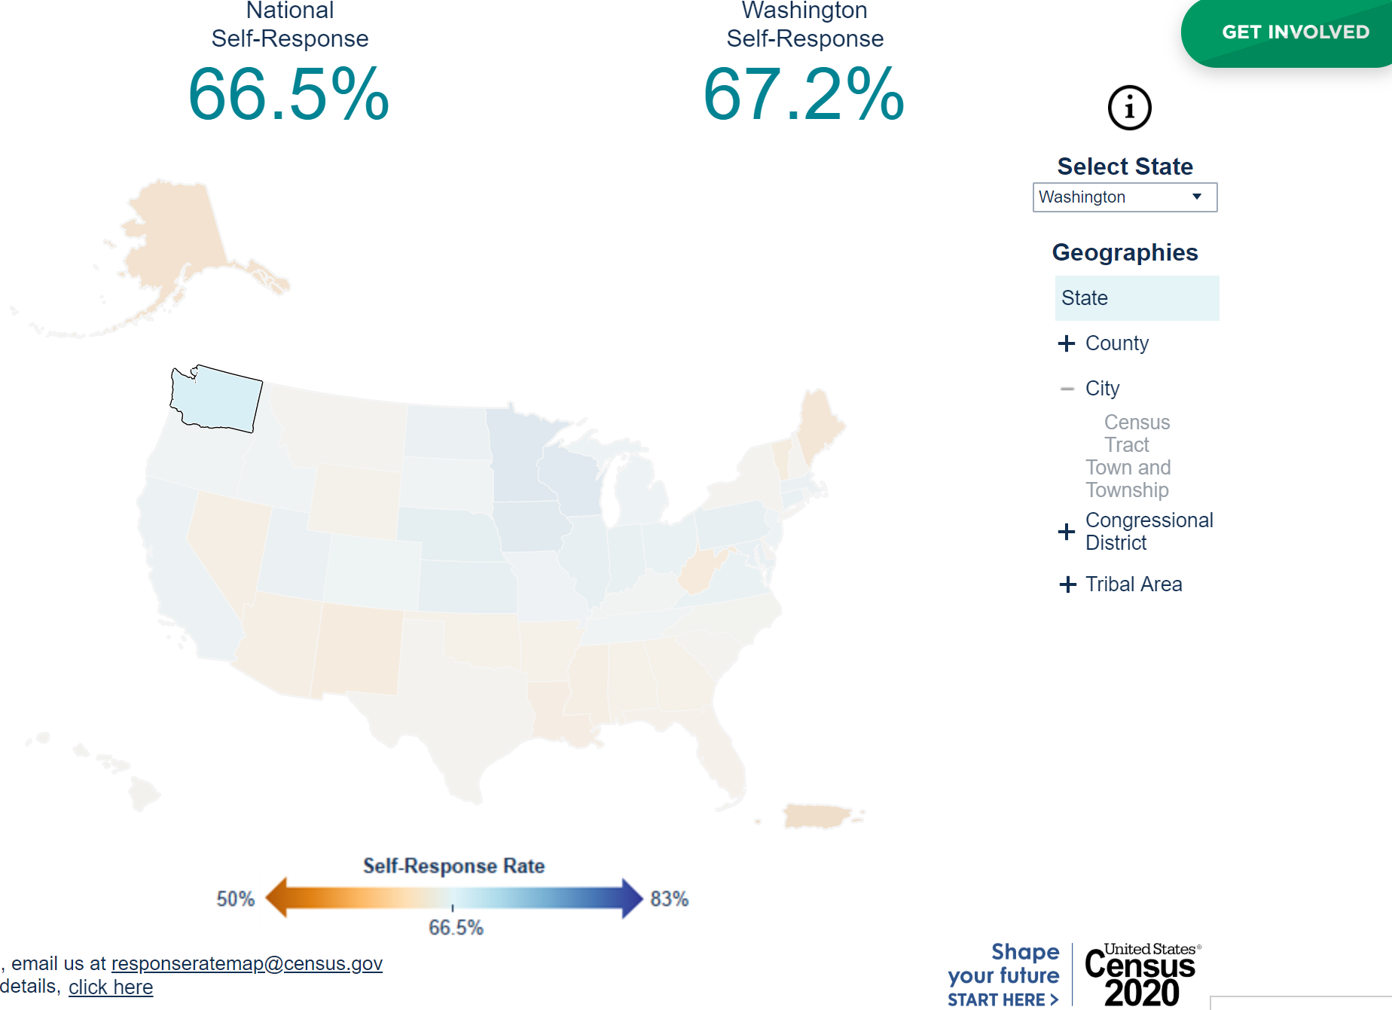
Curious about how many people in your community are responding to the 2020 Census?
Real-time response rates
Helps to determine outreach
Response Rate Toolkit
Response Rate Challenges

Slide 18
Hard-to-Count Population Groups
People of Color | LGBTQ+
Tribes | Rural Communities
Immigrants and Refugees | Renters
Children | Homeless Individuals and Families
Multifamily Households | Non-Native English Speakers
Low Income People | People Distrustful of Government
Seniors | People with Physical and Mental Disabilities

Slide 19
Review
Less than a week to go until invitations are mailed!
Responding to the Census tells officials that you and your family matter.
The Census matters to communities because of the three D’s: Dollars, Data, and Democracy.
The Census only happens every 10 years – don’t miss this chance to be shape your community’s future.
Participating helps ensure more funds for schools, roads, healthcare, and other community benefits.
Share the word and help inform neighbors on the importance of early and self-response!

Slide 20
Upcoming Town Halls and Census Celebration!
12 March 2020- South Fork Community Association: Van Zandt Community Town Hall
                6:00 PM Dinner served, all are welcome!
                7:00 Program- Presentation on Census 2020, also Whatcom County Auditor, and League of Women Voters will be presenting.
20 March 2020- Census Celebration at the Gurudwara
                5:00 PM Dinner served, all are welcome!
                176 E. Pole Rd. Lynden, WA

Slide 21

Thank You!
Sara Bernardy
Email: sara@wcog.org
Phone:970.387.8555

