Slide 1
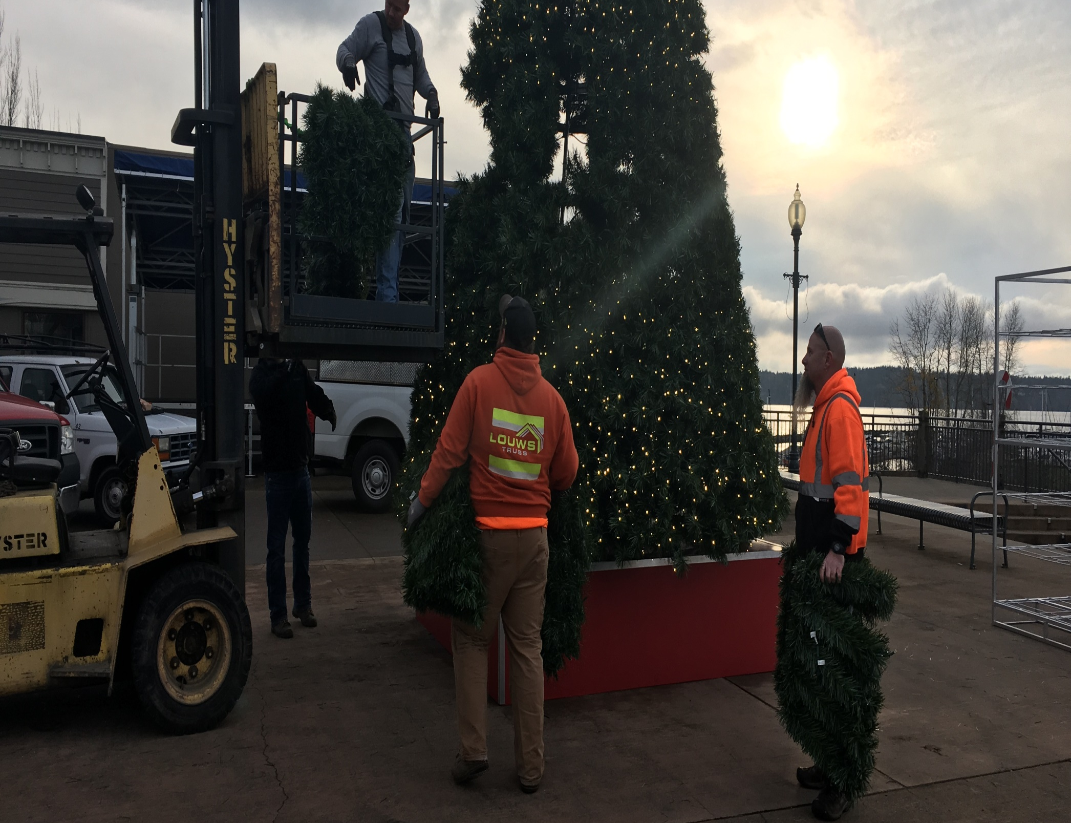


Slide 2
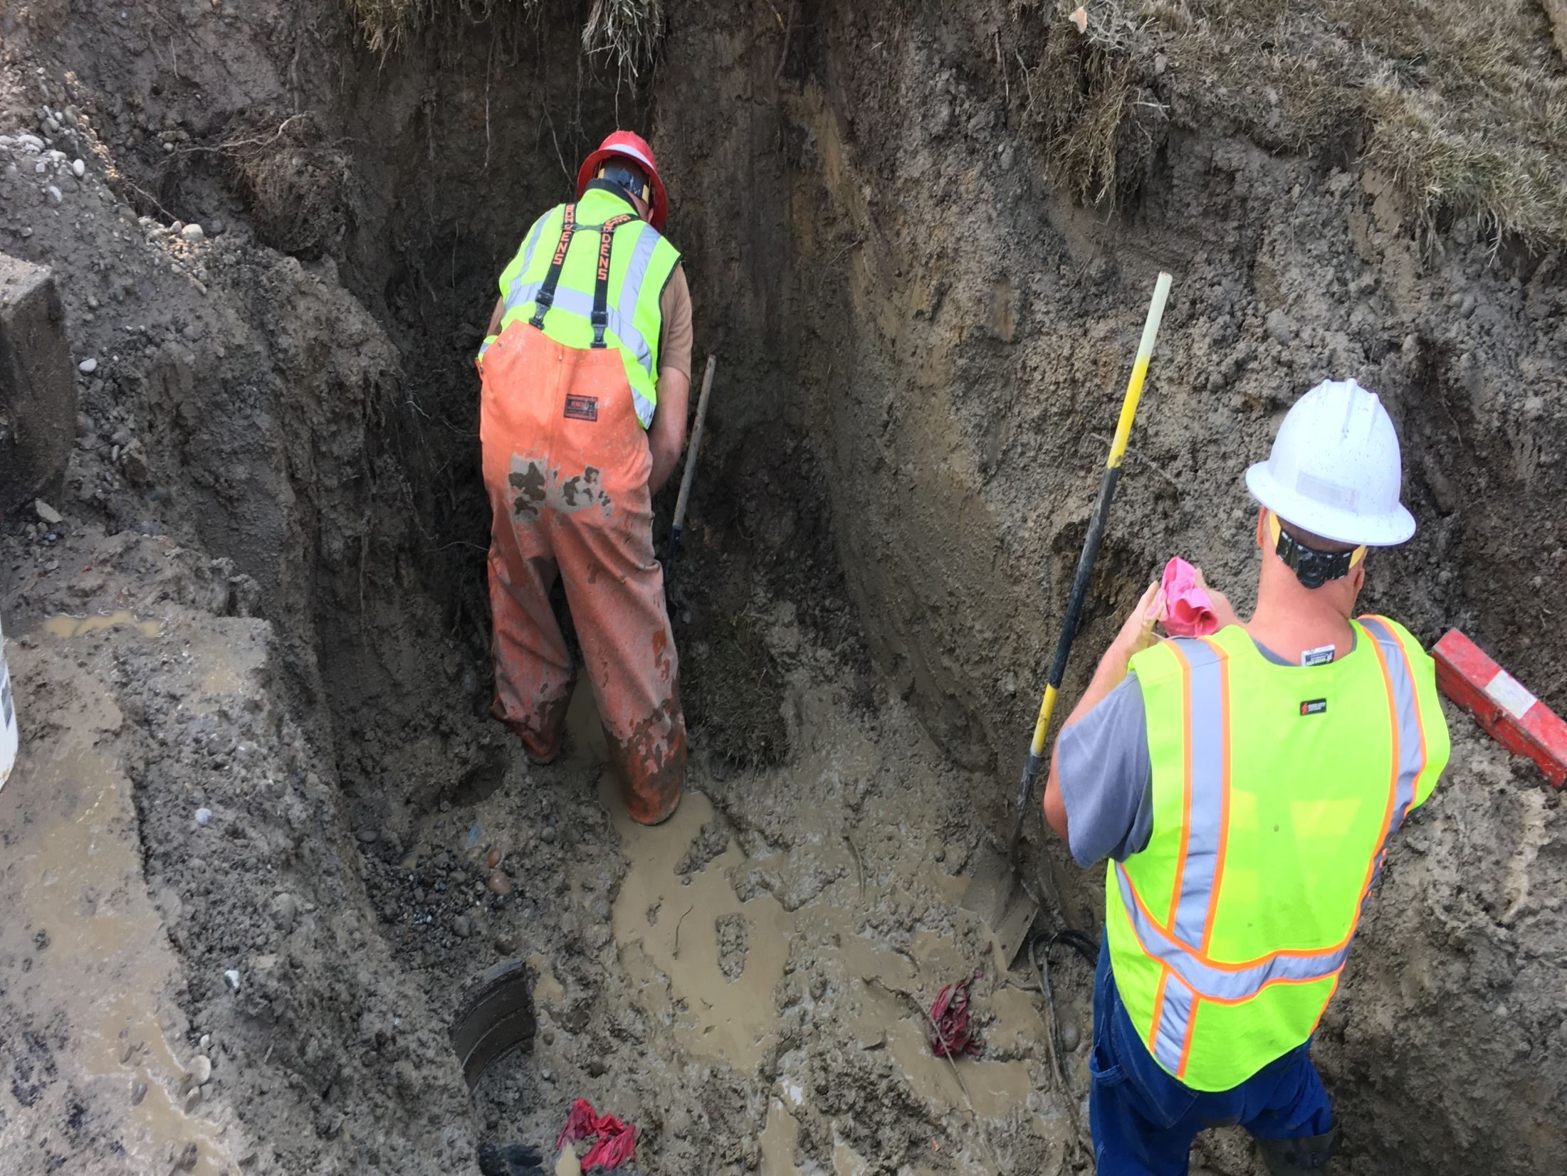
Alert Notifications
Blaine Public Works D.O.C.
Emergency Response
Mutual Aid Support

Slide 3
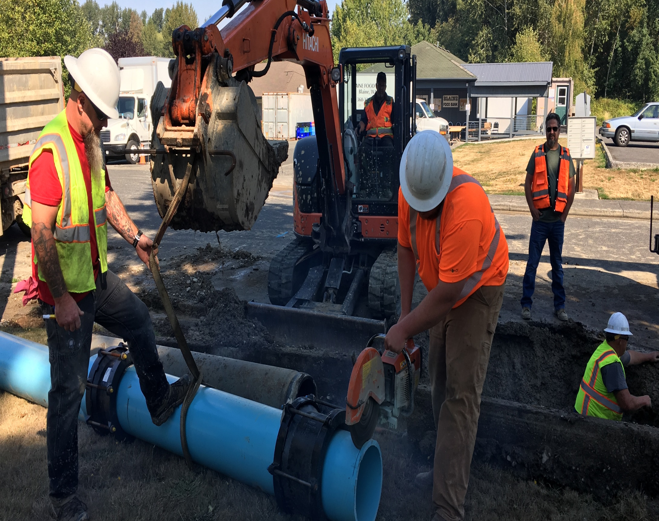
Beach Erosion Impacts
Road
Armoring

Slide 4
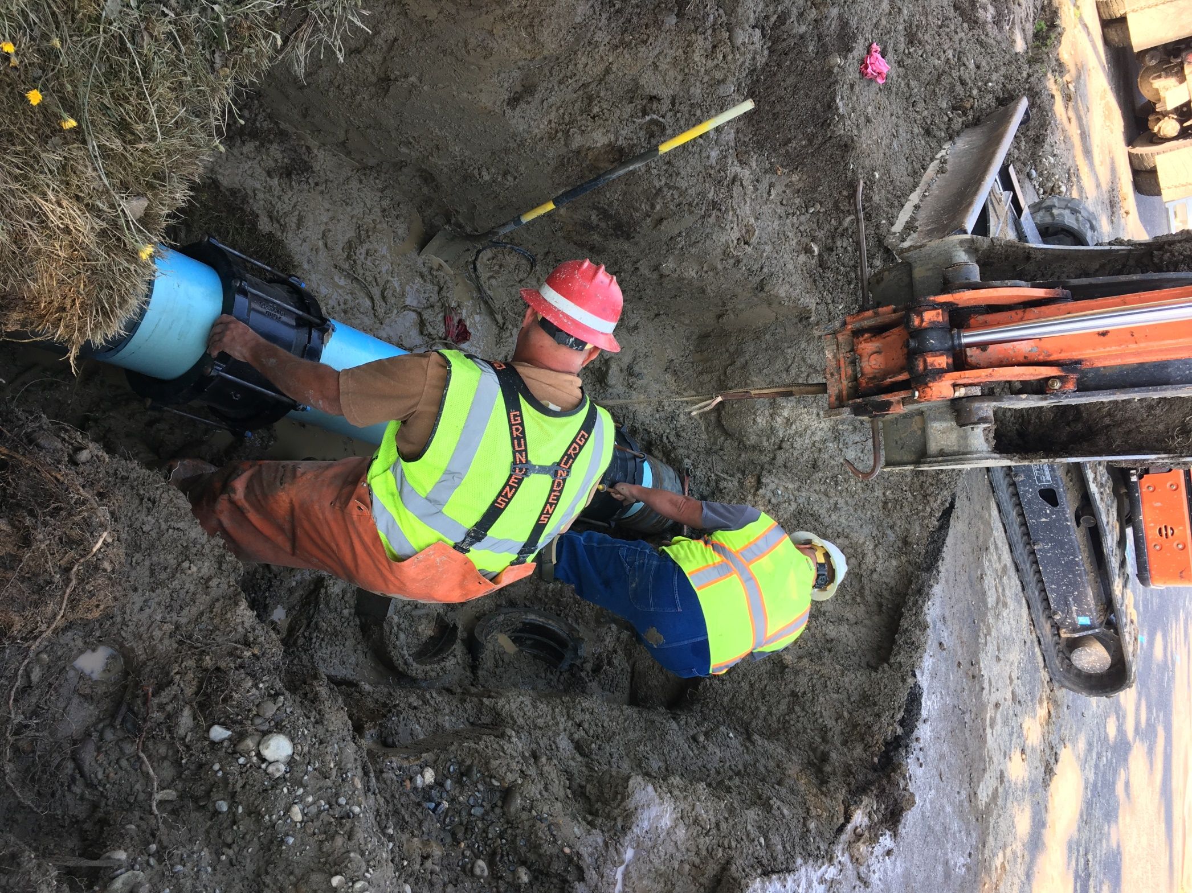
Asbestos Water Main Repair

Slide 5
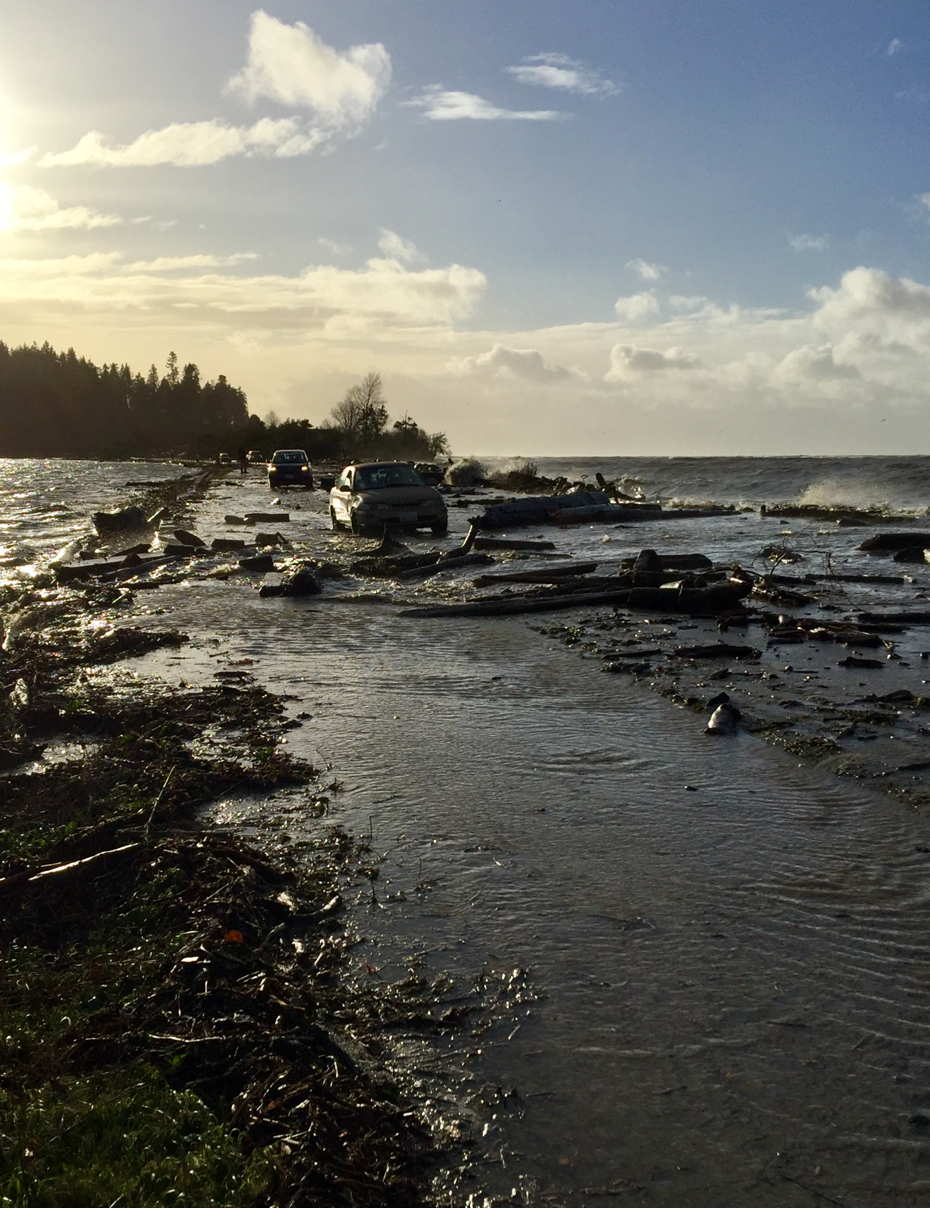
Critical Utility Corridor Vulnerability

Slide 6
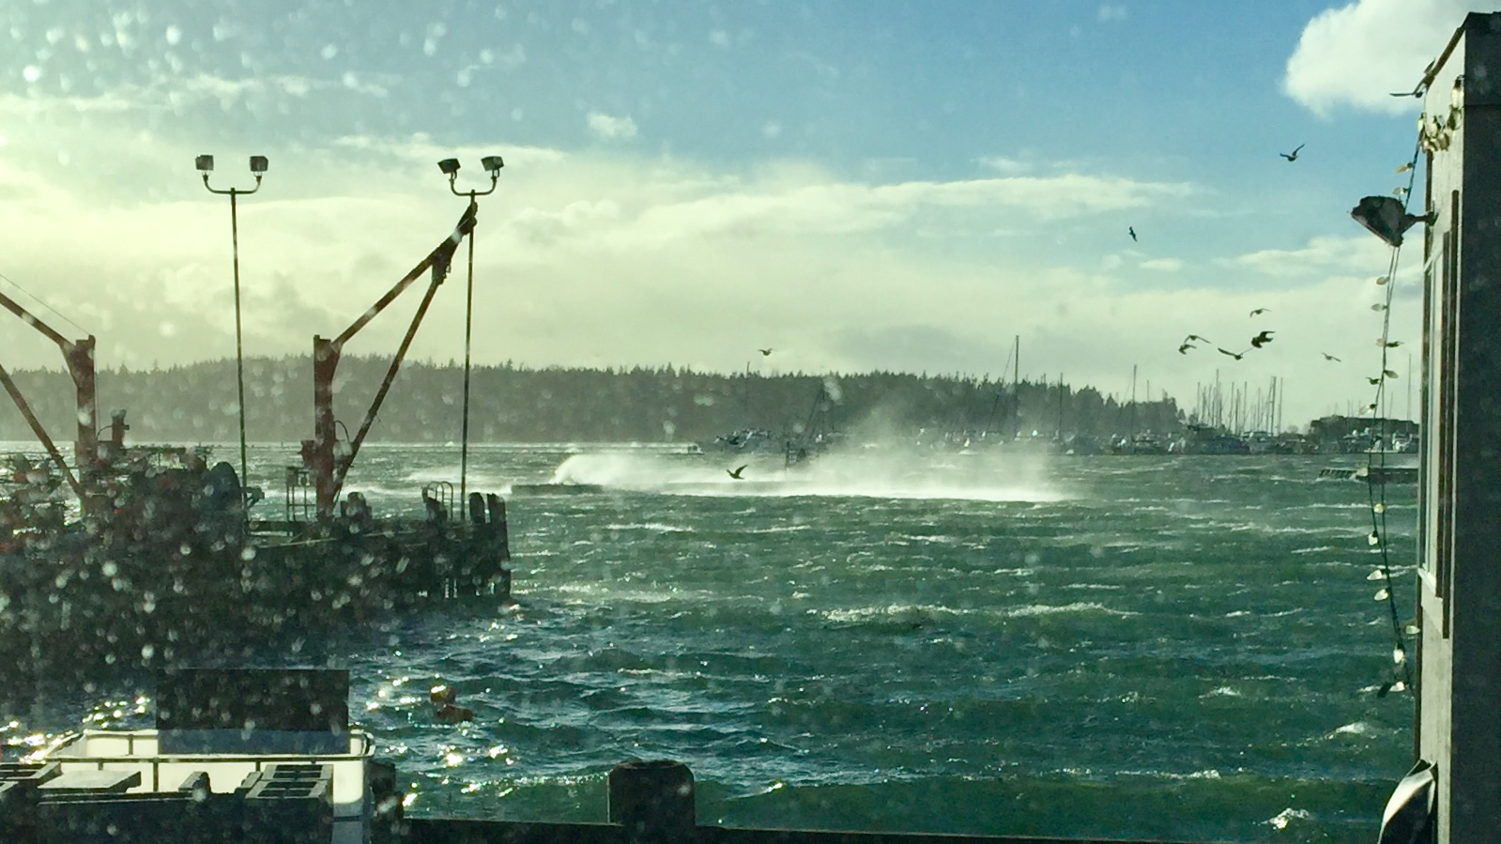
City of Blaine
Public Works Department

Slide 7
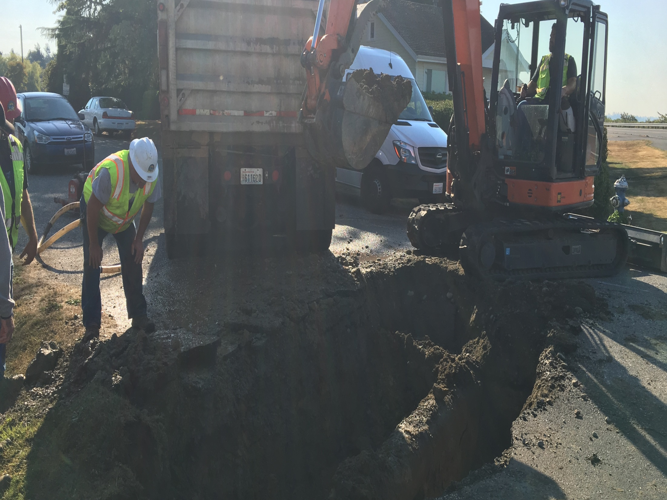

Slide 8
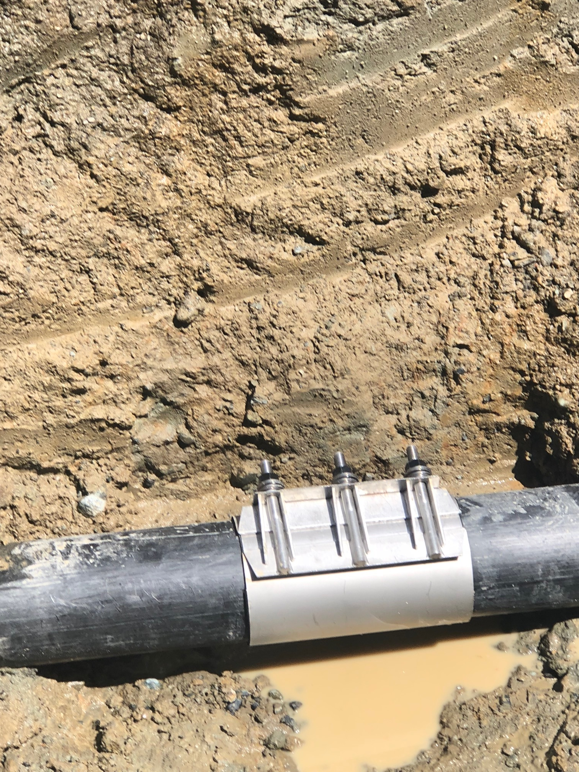

Slide 9
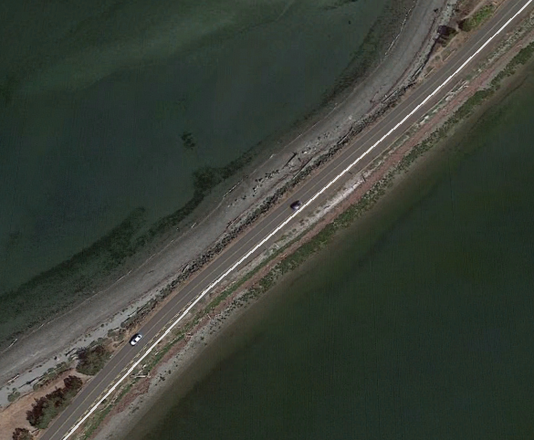
Army Corp Coordination – Design Support
Strategic Recovery Plan In Place
Damaged Section Threatening Infrastructure

Slide 10
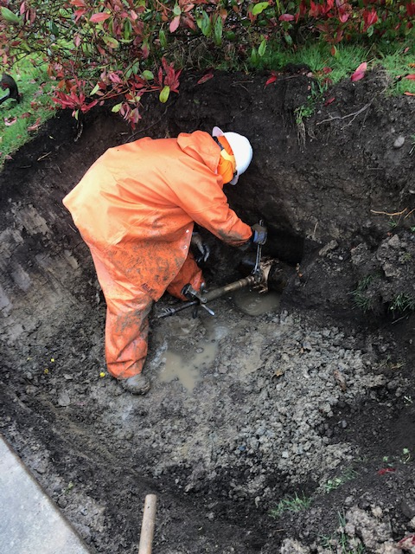
Water Main Service Tap

Slide 11
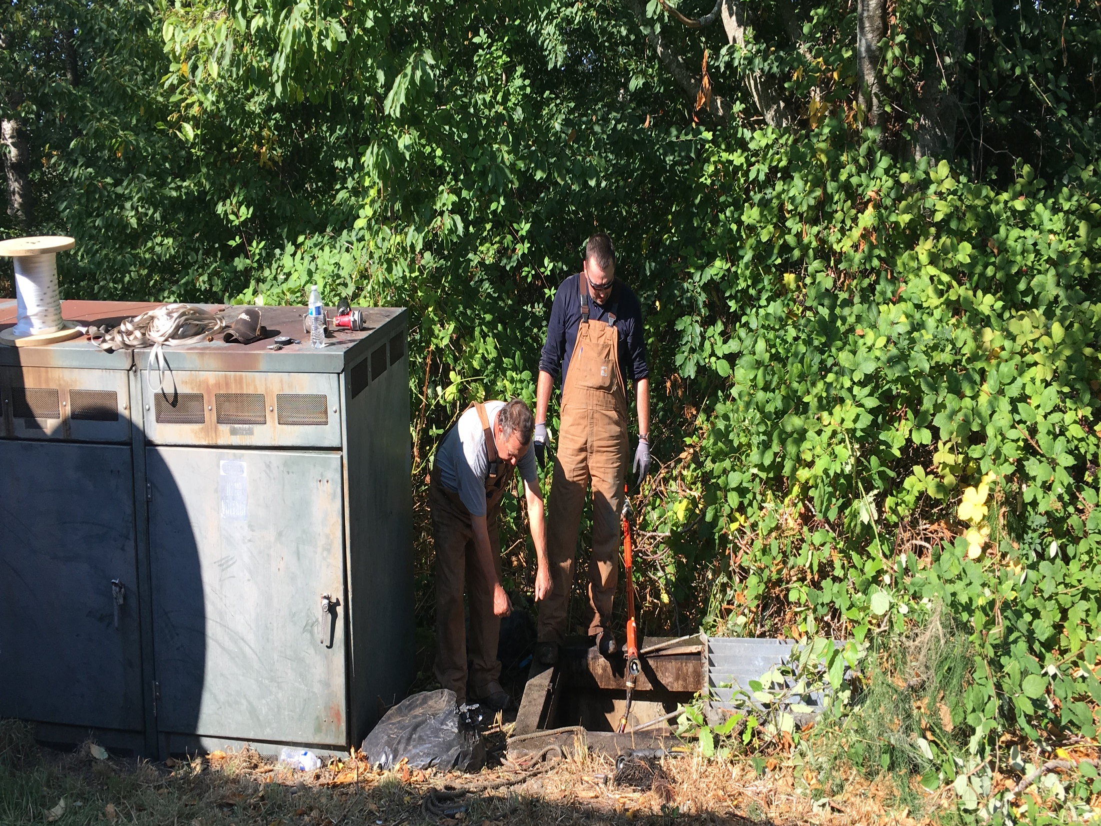
Critical Areas:
Pipeline Road Power Lines
Power Poles Leaning Severely
Evaluation Underway
Power Supply for Water Shed

Slide 12
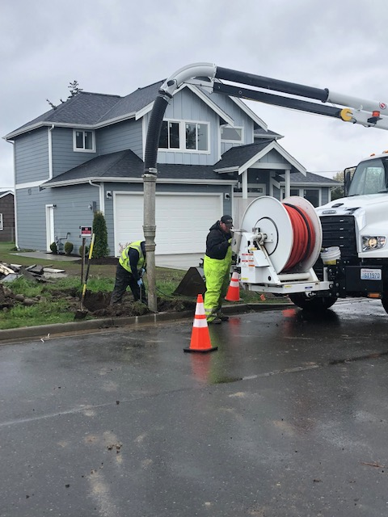

Slide 13
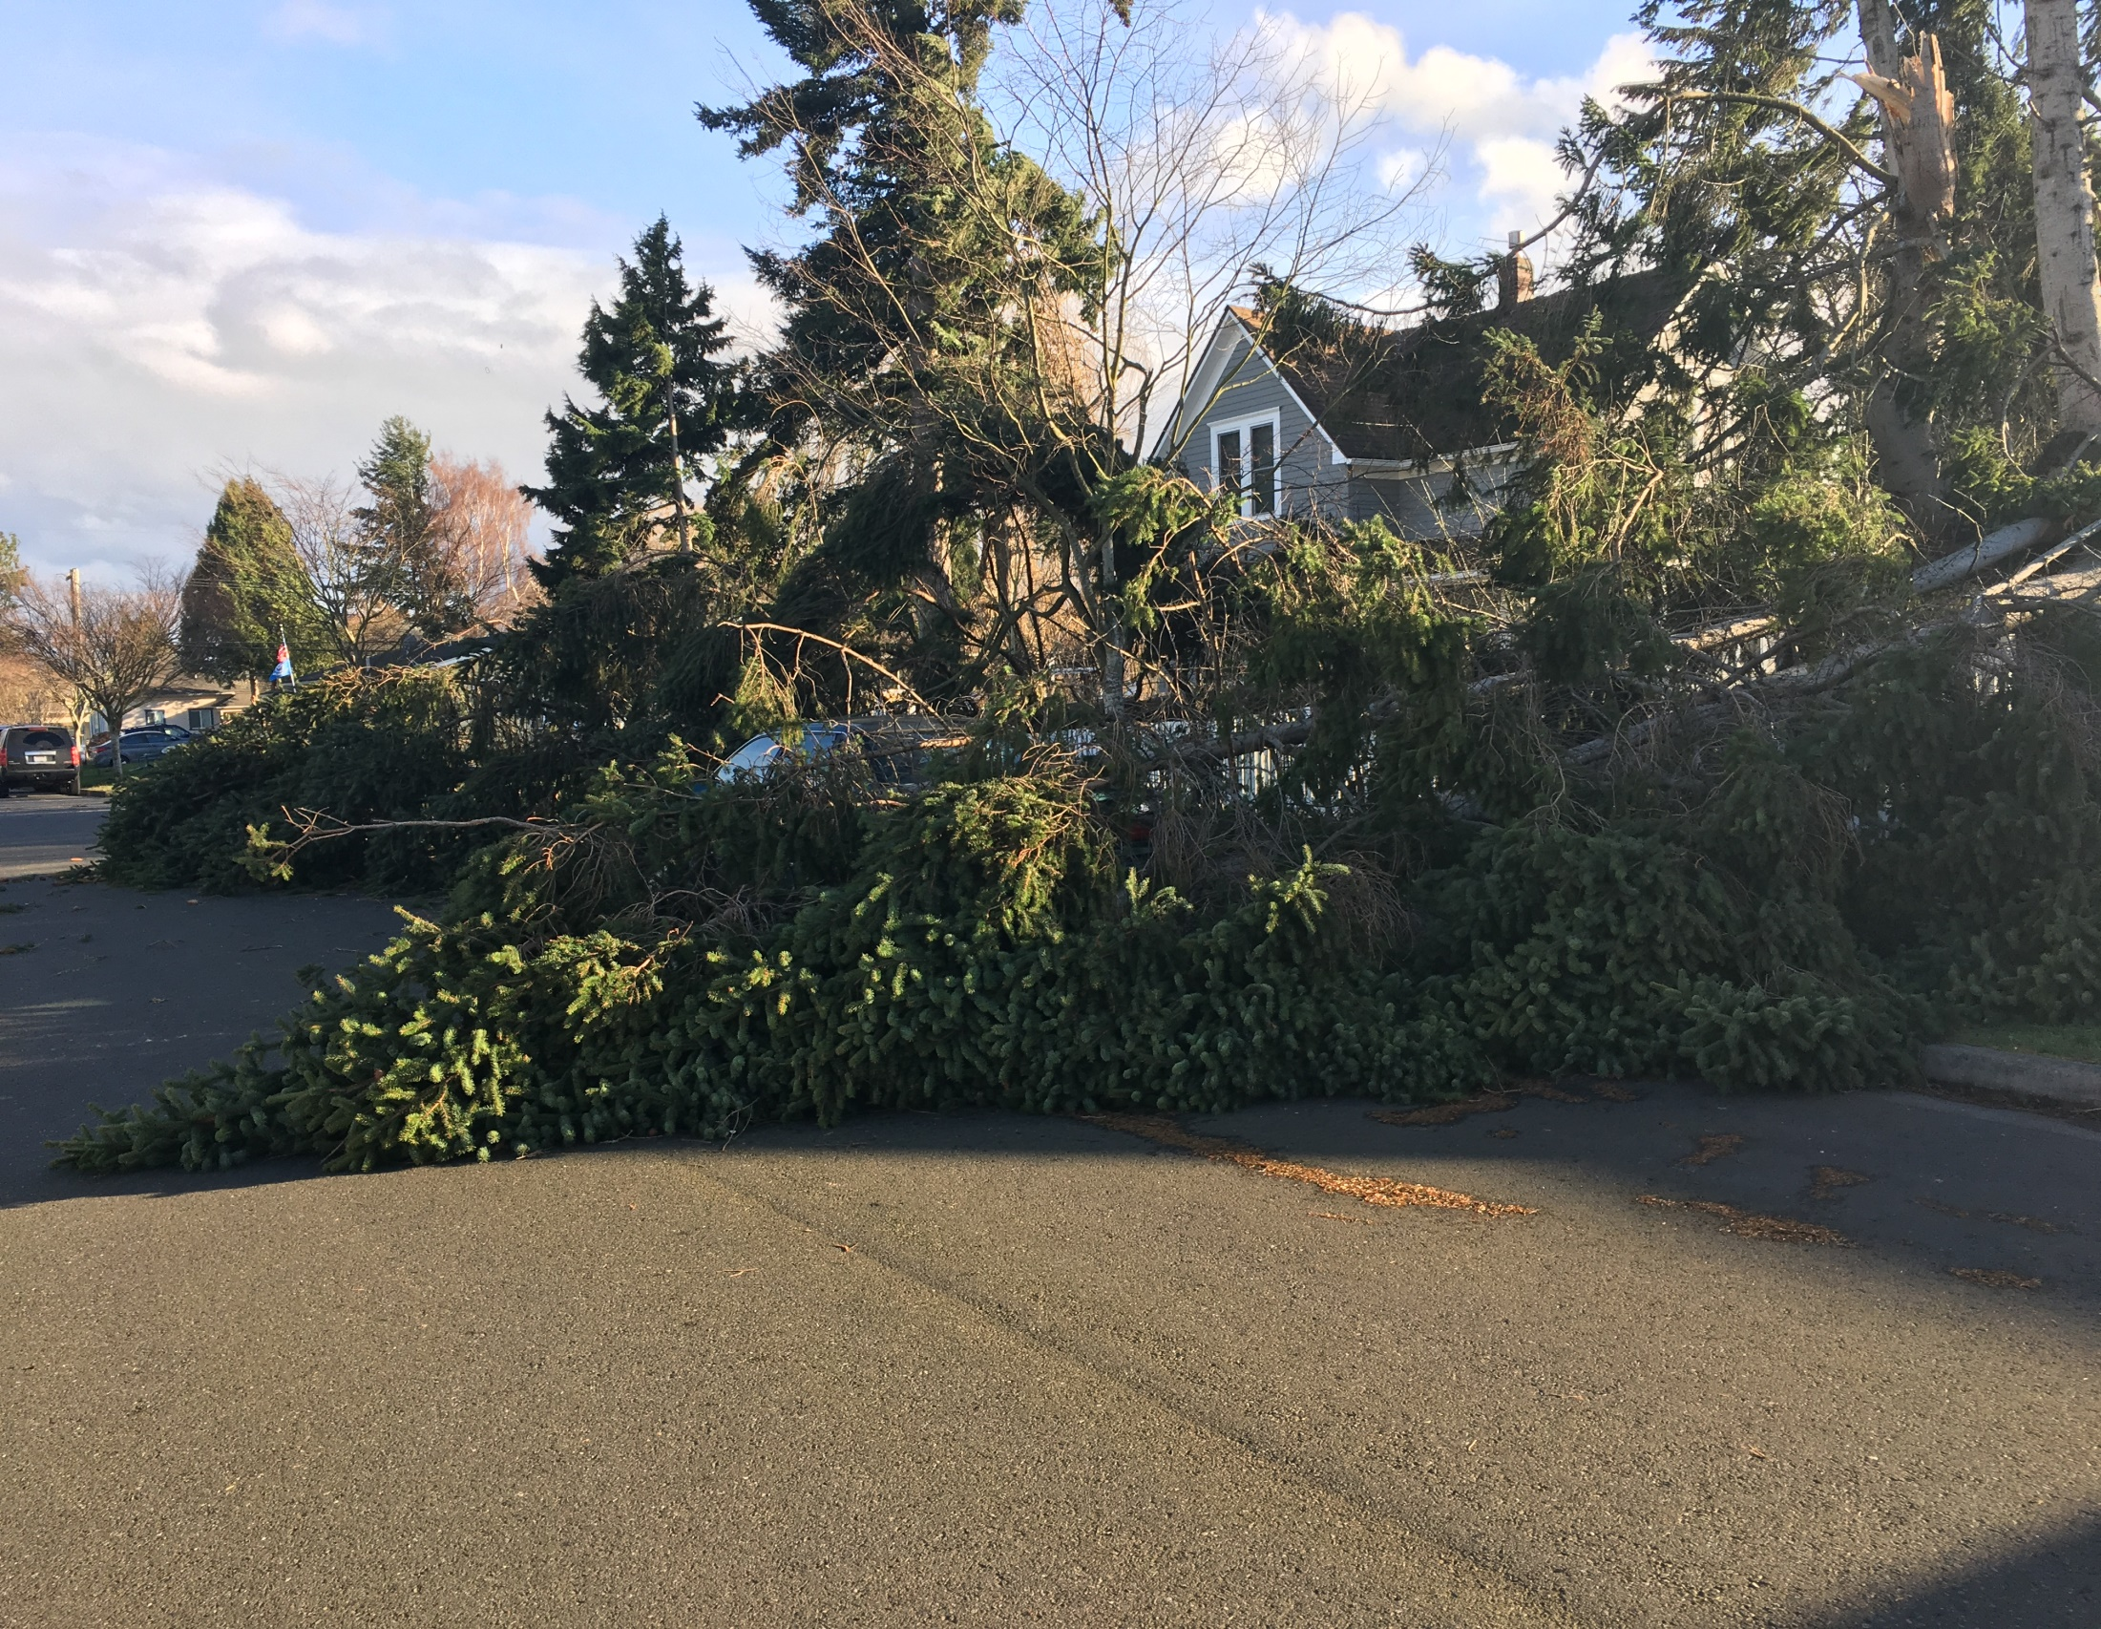
Damaged Vehicle Non Injury

Slide 14
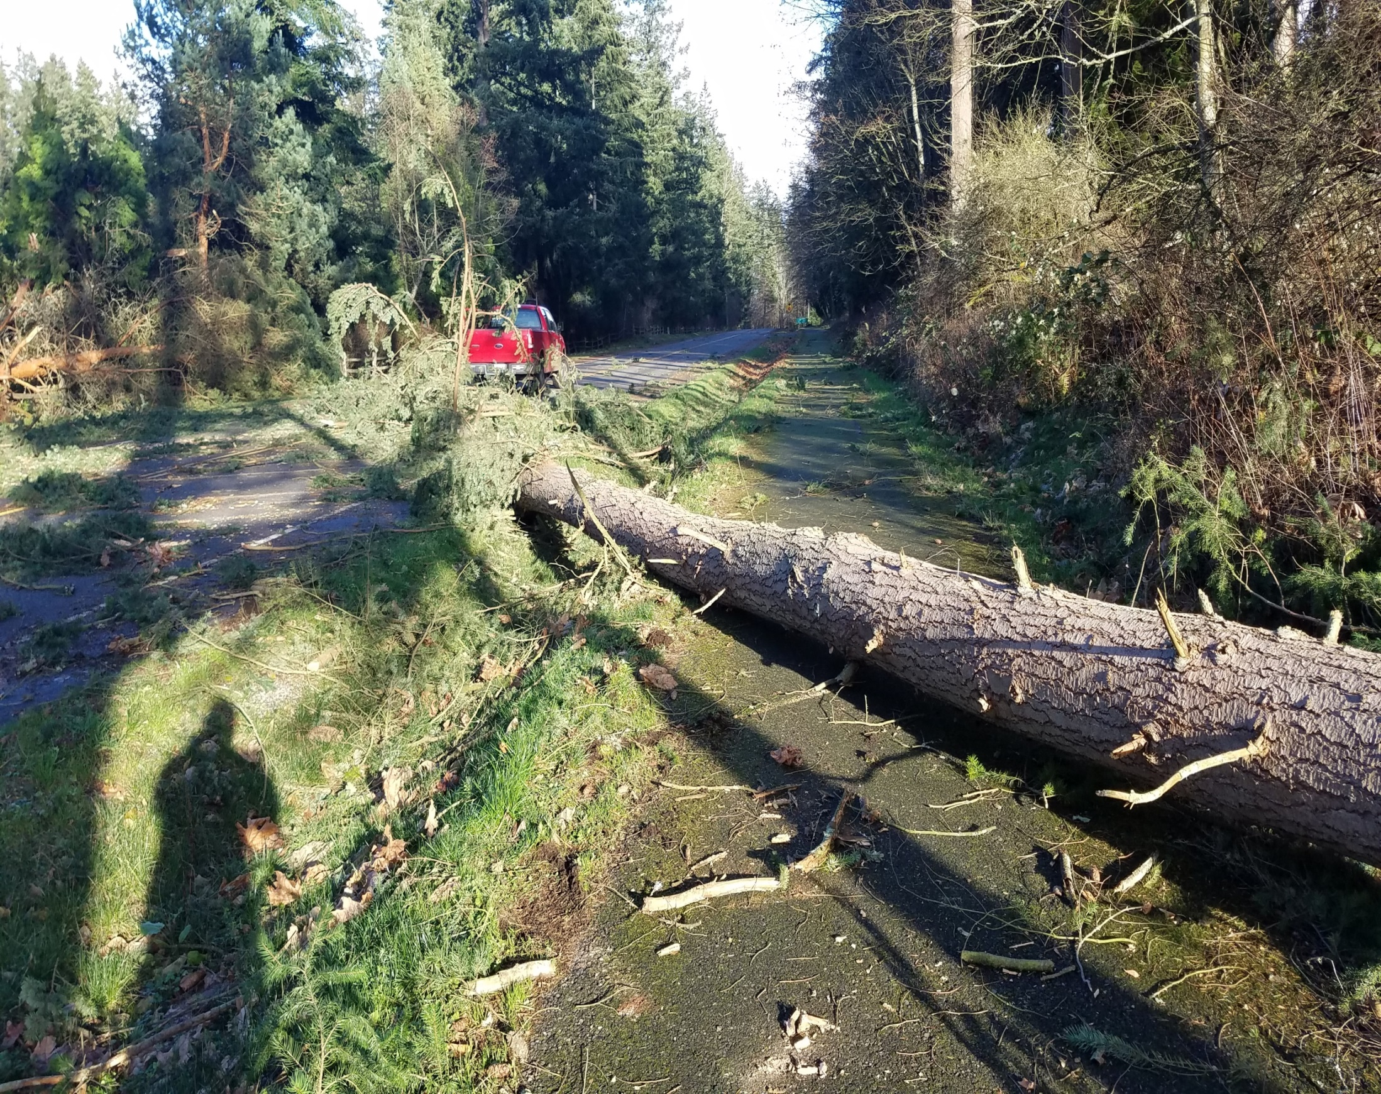
Tree’s Down Through The City

Slide 15
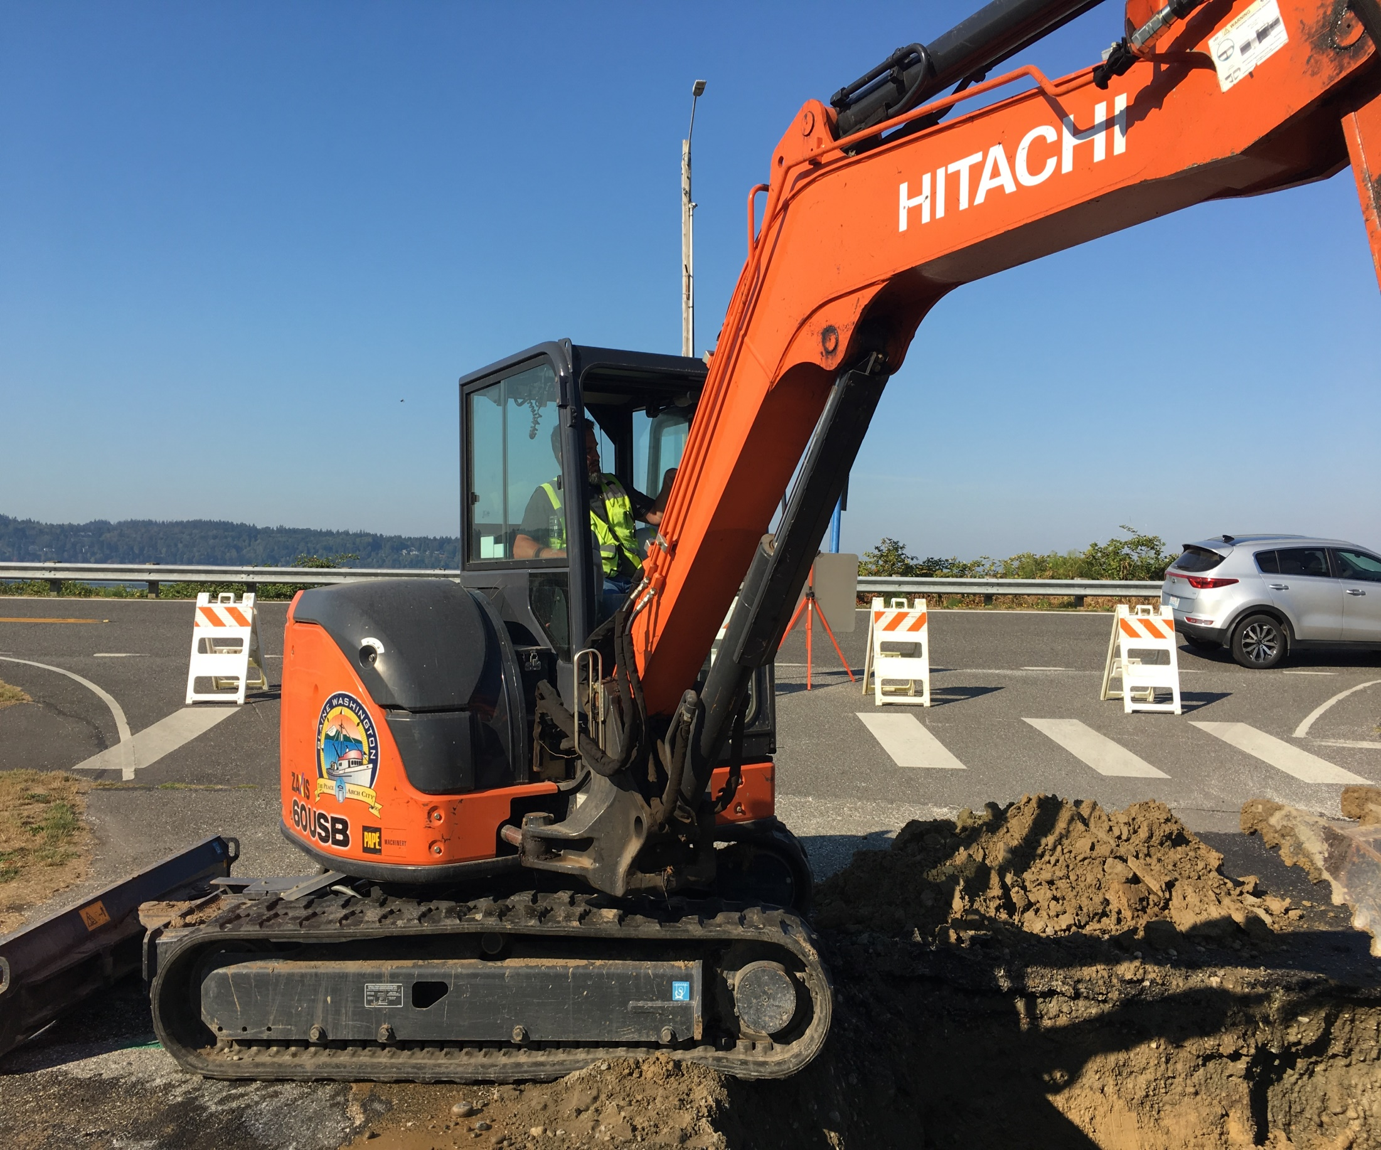

Slide 16
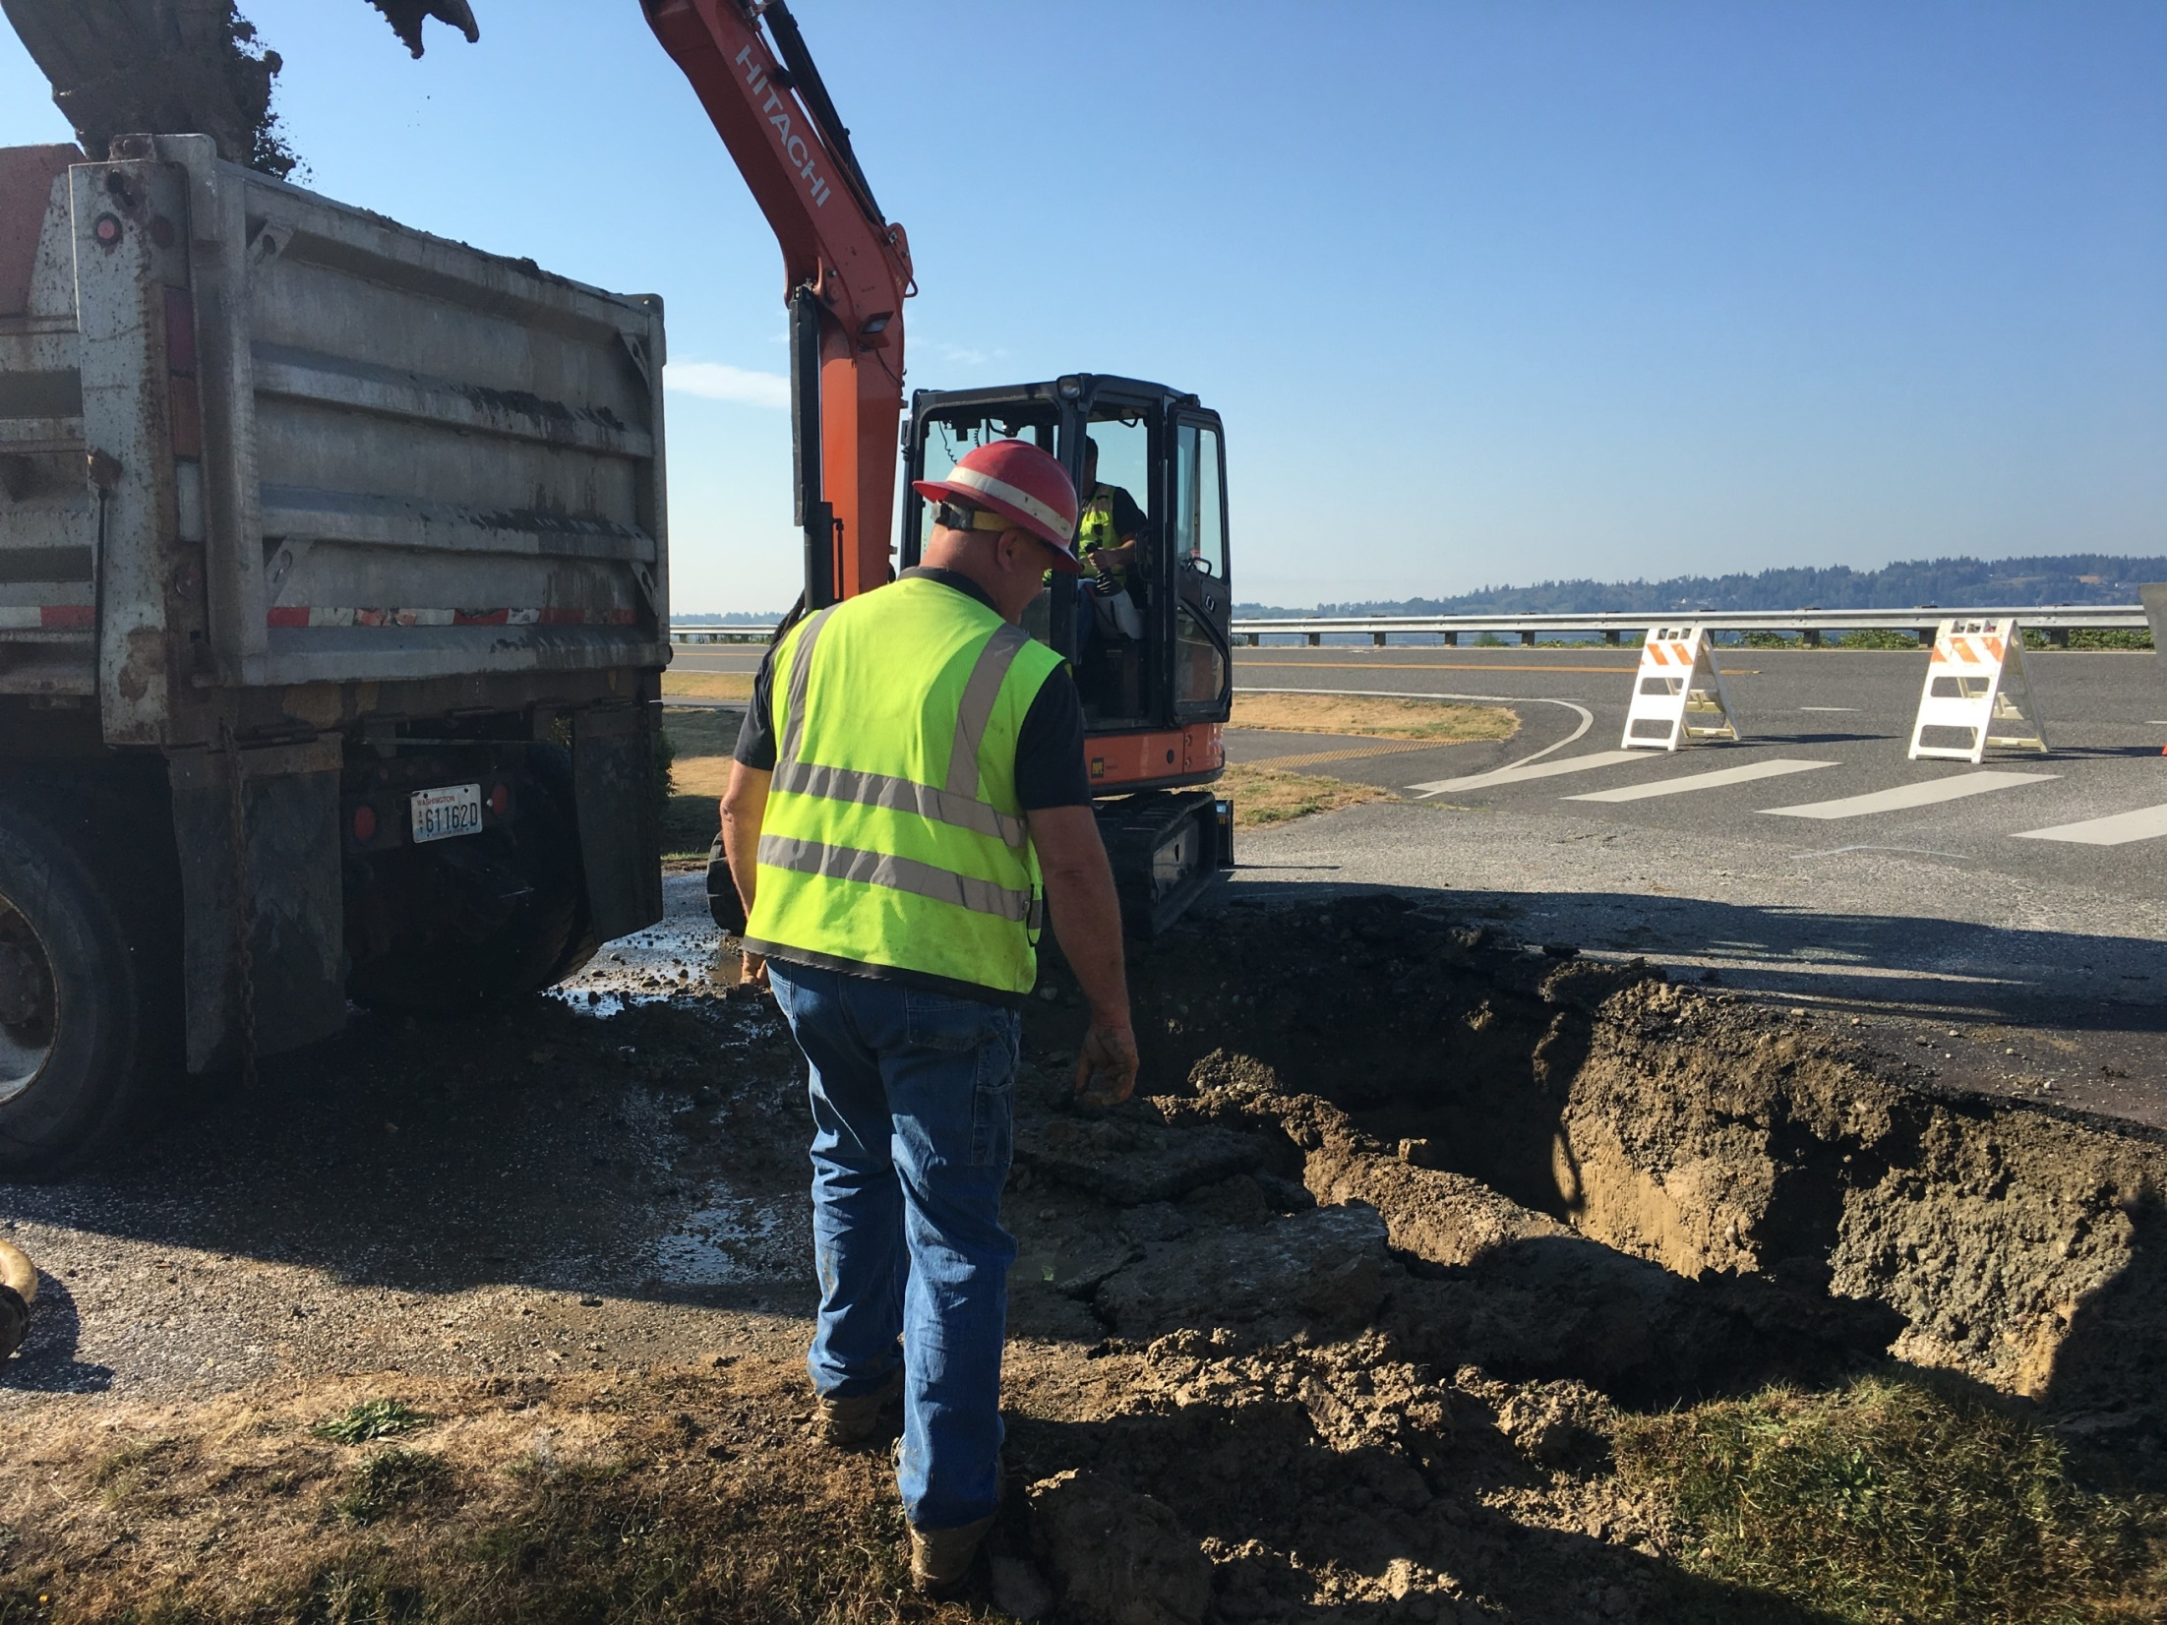

Slide 17
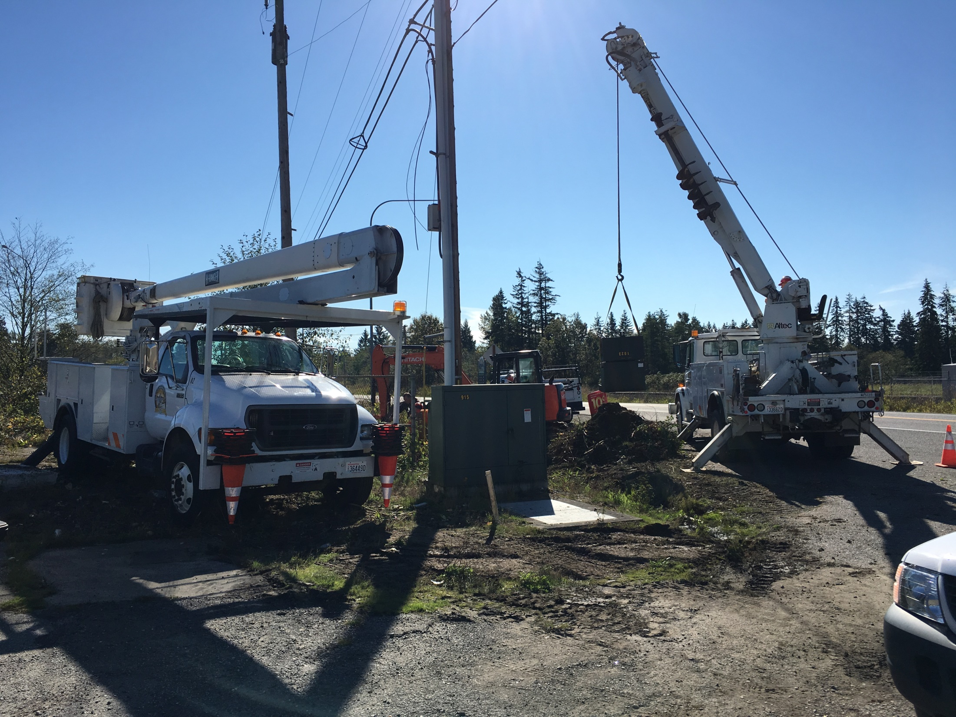

Slide 18
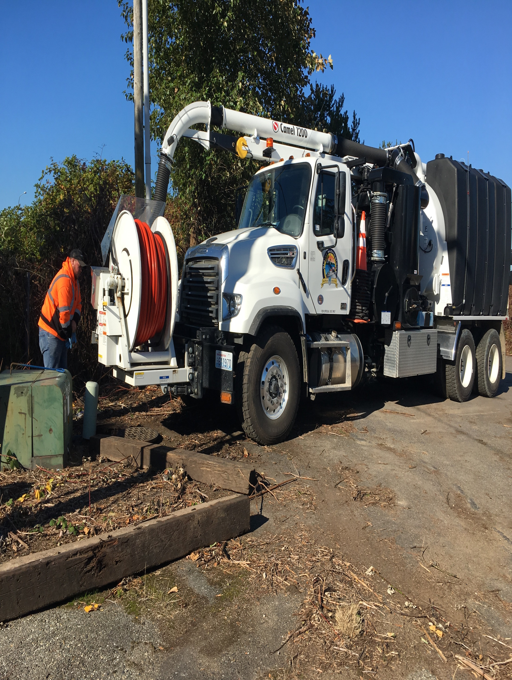

Slide 19
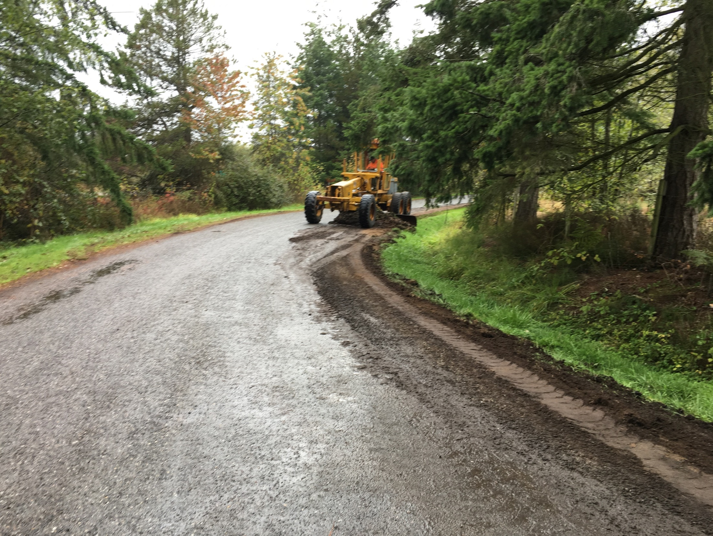

Slide 20
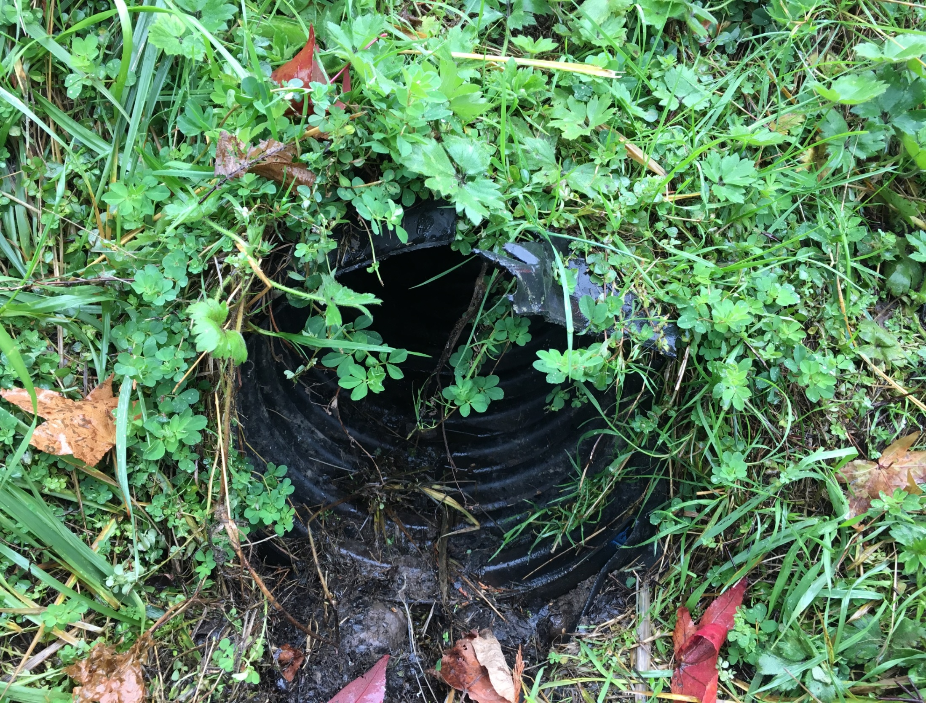

Slide 21
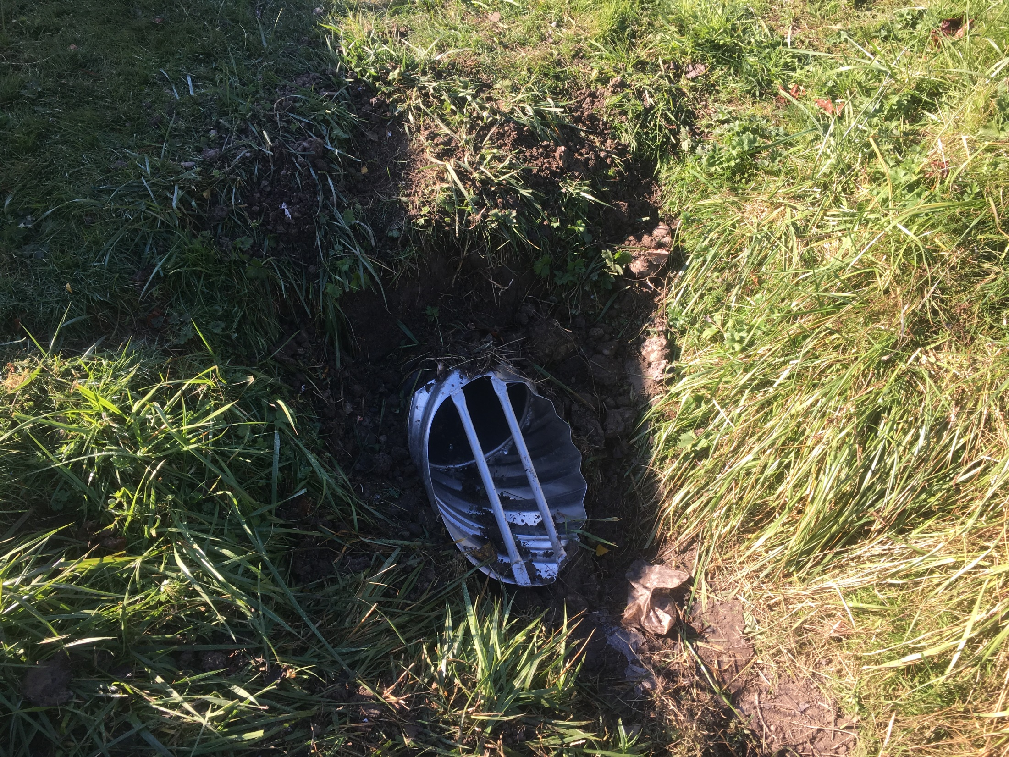

Slide 22
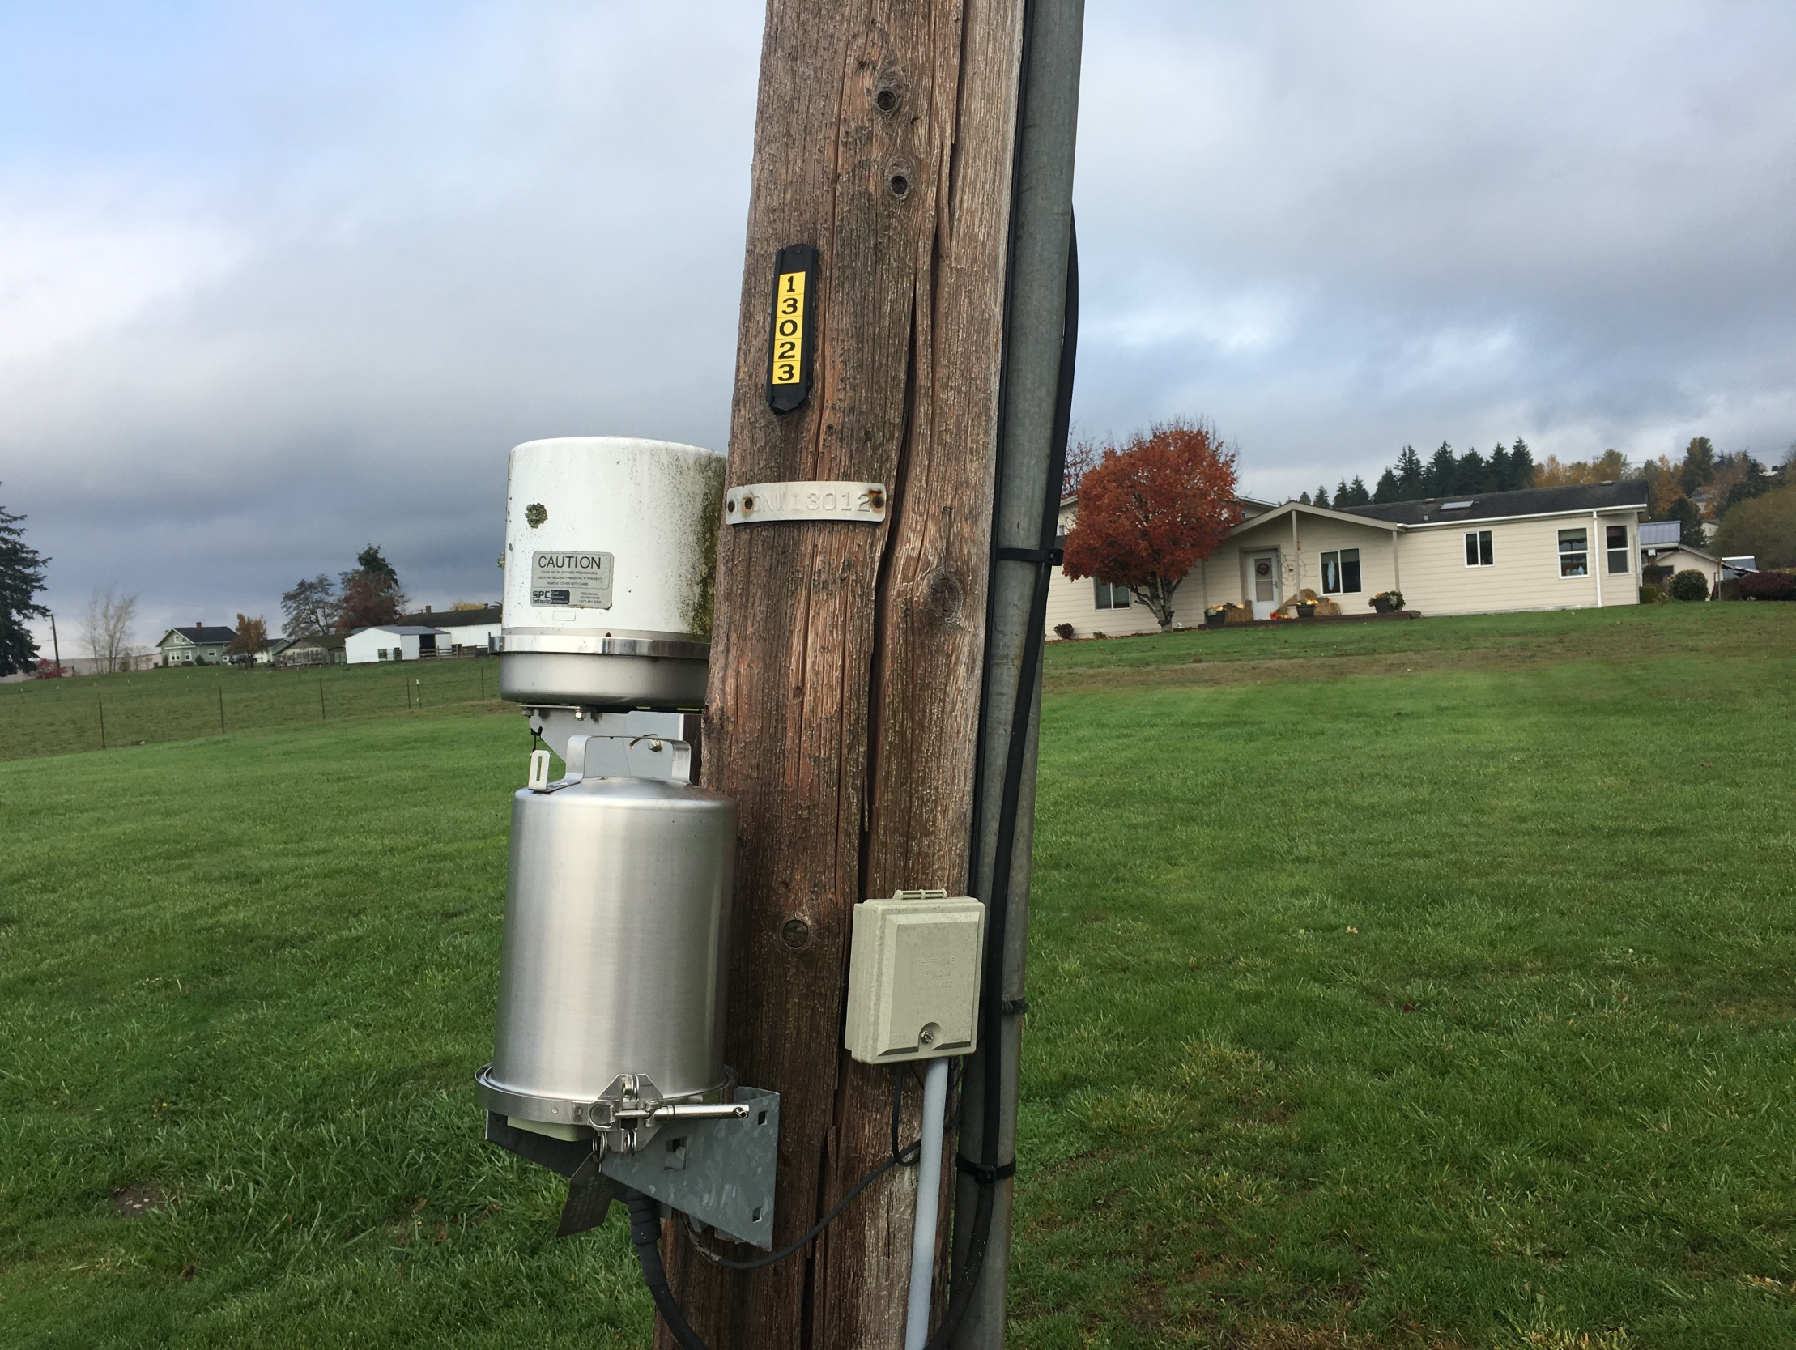

Slide 23
City of Blaine
PUBLIC WRKS 4 U

