Slide 1
City of Blaine 2020 Legislative Session
Briahna Murray, Vice President
Holly Cocci, Assistant Governmental Affairs Consultant
Gordon Thomas Honeywell Governmental Affairs

Slide 2
Overview
The goal for tonight’s discussion:
Overview of what to expect during the 2020 Legislative Session
Review Proposed 2020 State Legislative Agenda
Timeline to Prepare for 2020 Session

Slide 3
2020 Legislative Session
Second year of the two-year legislative biennium
Scheduled to last 60 days
Focus will be on amending the 2019-21 Operating, Capital, and Transportation Budgets
Operating: While the latest revenue forecast is up, the amount is minimal
Capital: Limited funding during the 2020 session
Transportation: Impact of I-976 unknown
Thousands of bills introduced; hundreds that will impact city business

Slide 4
2020 Legislative Session: Political Climate
Democrats continue to control all three “chambers”
New Speaker in the House
Rep. Laurie Jinkins (D-Tacoma) has been selected to serve as the new speaker
Election year: Statewide and legislative races on the ballot in November 2020
All legislators in the House and roughly half of those in the Senate are up for election.
Redistricting will follow the November 2020 elections

Slide 5
Guidance on Legislative Agenda
Take into account political climate/context
Keep agenda concise, and easily comprehendible
Consistency – build on previous successes
Return on investment

Slide 6
Grade Separation at Blaine Road (SR 548) Transportation Budget Request: $650,000
The City received $1.550 million in state transportation funds to engineer and design a grade separation project at Blaine Road (SR 548)
$550,000 will be used to achieve 30% design by mid-2020
$1 million will be used to acquire right-of-way acquisition
Next Steps:
Short-Term: Request $650,000 to fully fund right-of-way acquisition.
Long-Term: Request construction funding in the next transportation package. The proposed Forward Washington package introduced in the Senate in 2019, included $24 million as a placeholder.

Slide 7
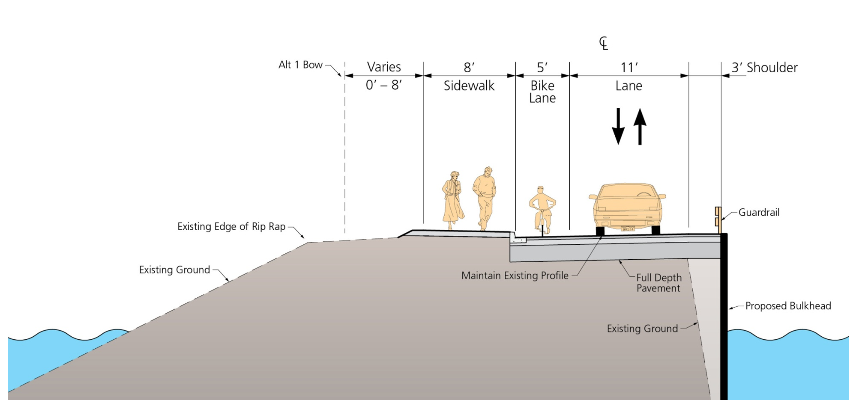
Marine Drive Reconstruction Project Transportation Budget Request: $3.1 million
The City and the Port of Bellingham are requesting $3.1 million in transportation funding to reconstruct the roadway to ensure access to the pier and protection of the harbor.
Under the proposed project, the roadway would be replaced with a single vehicle lane, a bike/ped lane and a bulkhead.

Slide 8
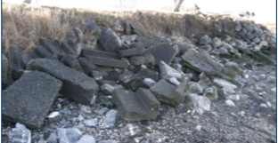
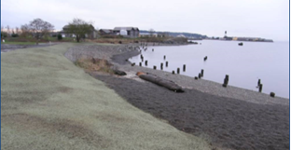
Marine Park Shoreline Restoration and Naturalization Final Phase II Capital Budget Request: $750,000
Before Phase I
Phase I: With the help of a $50,000 grant from the Washington State Department of Ecology’s Coastal Protection Program, the City completed Phase I in 2015 that restored 400-feet of shoreline by installing sand, gravel cobbles, and shoreline plants. The result was a clean enhanced public shoreline
Phase II: The final phase of the Marine Park Restoration and Naturalization project would allow the City to continue the removal of derelict debris and the installation of a natural beach. This final phase of the project is shovel ready with permits in hand through grant assistance from the Rose Foundation.
After Phase I

Slide 9
Local Transportation Revenue
The City asks that the state provide increased local funding tools to meet city transportation needs. One option would be to authorize an increase in the border gas tax by another cent.
Fish Landing Shared Revenue
The City supports the City of Westport’s efforts to change statute and require that 75% of the revenue from the state landing fee is shared with the municipalities that house such facilities.

Slide 10
2020 Legislative Session: AWC Priorities
City Transportation Package
Fund the Public Works Trust Fund
Tax Increment Financing
Increasing Funding Sources
Statewide Medication Assisted Treatment in Jail
Watershed Investments to Address Local Culverts
New Resources for Affordable Housing

Slide 11
Questions?
Briahna Murray
Vice President
Cell: (253) 310-5477
E-mail: bmurray@gth-gov.com
Holly Cocci
Assistant Governmental Affairs Consultant
Cell: (253) 509-2403
E-mail: hcocci@gth-gov.com

