Slide 1
City of Blaine Council: Deliberations
July 22, 2019 at 6 PM
435 Martin Street
Suite 4000
Blaine, WA 98230
Shoreline Management Master Program (SMP) Comprehensive and Periodic Updates
Stacie Pratschner, AICP, RPA
Community Development Director
City of Blaine Community Development Services

Slide 2
Shoreline Management in Washington State
1971. Passage of the Shoreline Management Act (SMA).
1990. Passage of the Growth Management Act (GMA).
1995. Legislature adds shoreline management to GMA (14th goal).
Comprehensive updates required pursuant to new state statutes.
2017. Programs subject to Periodic Review by Ecology.

Slide 3
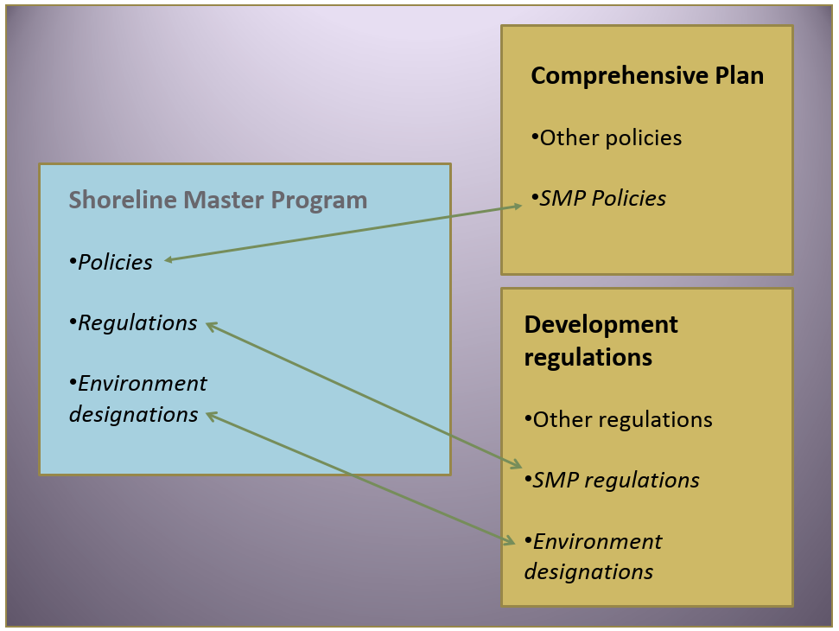
Regulatory Framework

Slide 4
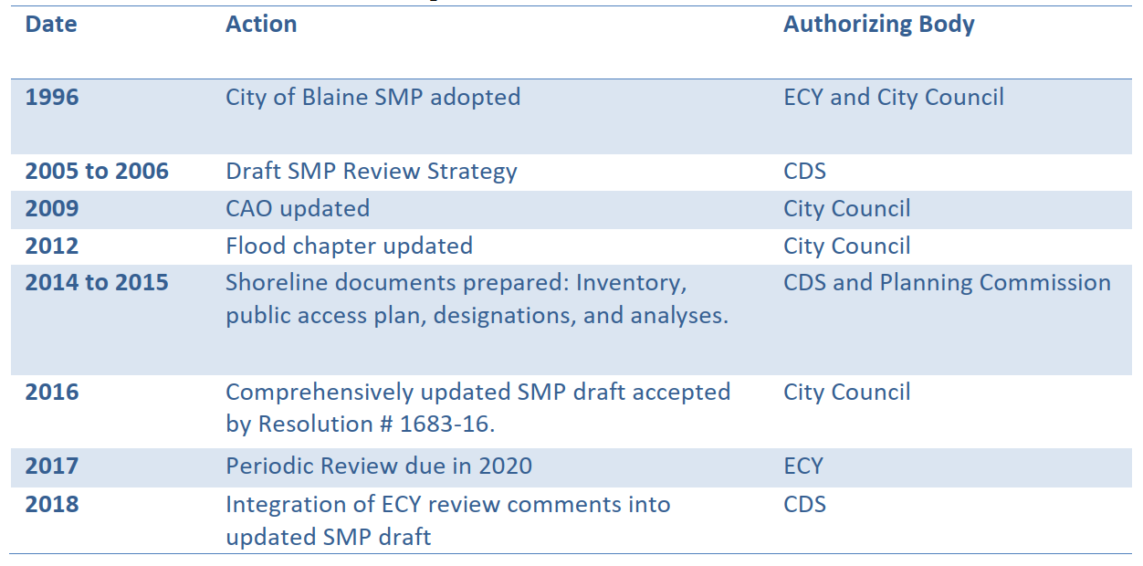
City of Blaine Shoreline Master Plan Updates

Slide 5
Periodic Updates to the SMP (WAC 173-26-090)
Inadvertent Archaeological Discovery Language;
Updated references to State statutes (RCWs and the WACs);
Conditional Use permit criteria; and
Application of Title 17 CAO buffers.

Slide 6
City of Blaine Council: Deliberations
City website:
www.ci.blaine.wa.us
For Additional Information:
Call Stacie Pratschner at 360-332-8311
Email to spratschner@cityofblaine.com
Stacie Pratschner, AICP, RPA
Community Development Director
City of Blaine Community Development Services

