Slide 1
City of Blaine Council: Study Session
June 10, 2019 at 5:40 PM
435 Martin Street
Suite 4000
Blaine, WA 98230
Lincoln Park Vegetation Monitoring Plan
Stacie Pratschner, AICP, RPA
Community Development Director
City of Blaine Community Development Services

Slide 2
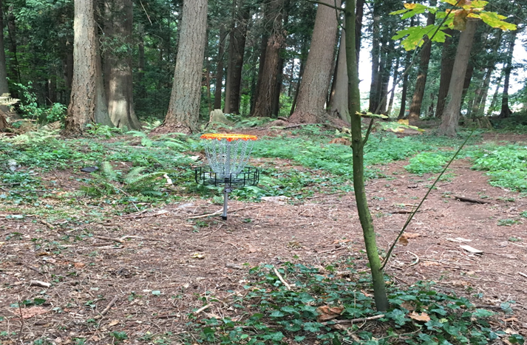
Presentation Outline
Lincoln Park Disc Golf Course
Vegetation Monitoring Plan
Methods and Results
Next Steps

Slide 3
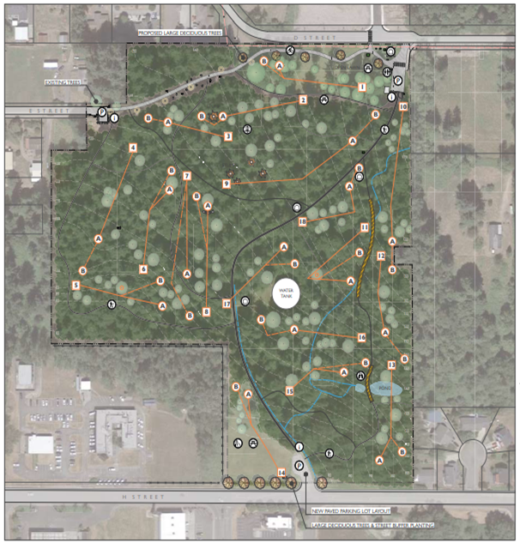
Establishment of the Lincoln Park Disc Golf Course
June 18, 2018: Course completed.
June 25, 2018: Council directs the Department and Park & Cemetery Board to develop a Vegetation Monitoring Plan.
July 9, 2018: Plan presented.

Slide 4
Vegetation Monitoring Plan
Purpose. Describe and adaptively manage the impacts to Lincoln Park resulting from the installation and use of the disc golf course.
Objective. Create a vegetation monitoring program to quantify impacts to the park forest plant community.
Methods. Photo monitoring -> 30 foot cross section -> Tree damage.

Slide 5
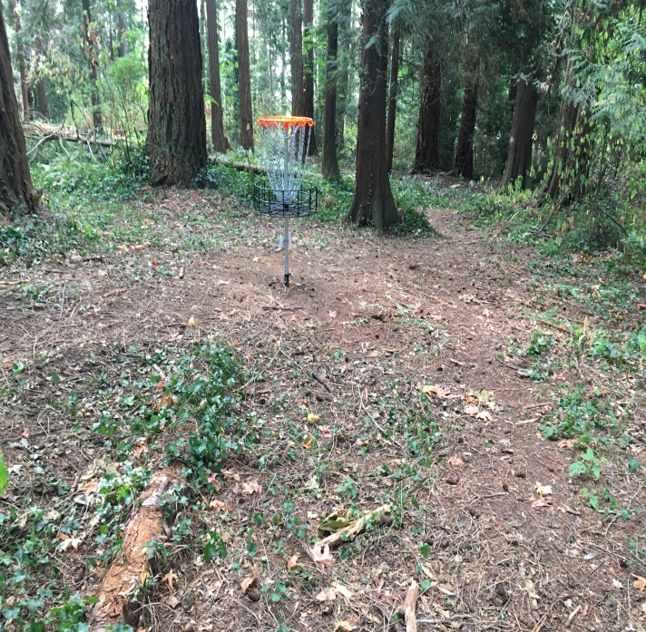
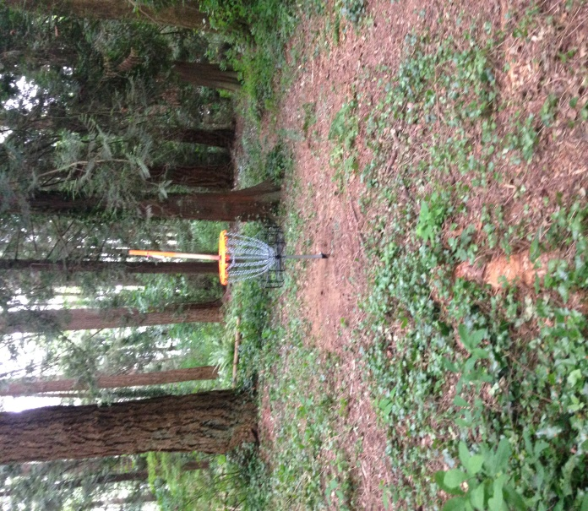
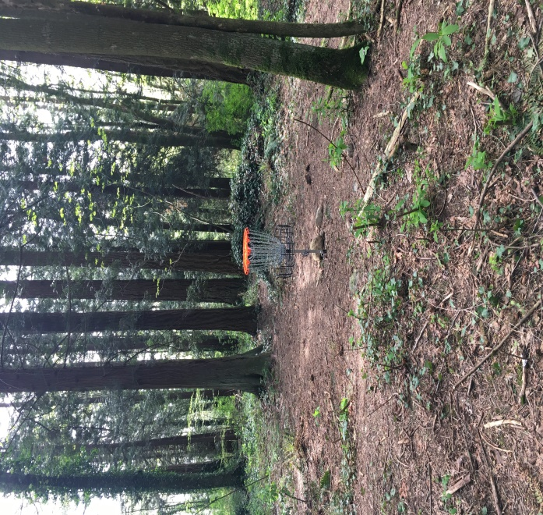
Photo Documentation: Vegetation at Hole 4
June 8, 2018
September 7, 2018
April 26, 2019

Slide 6
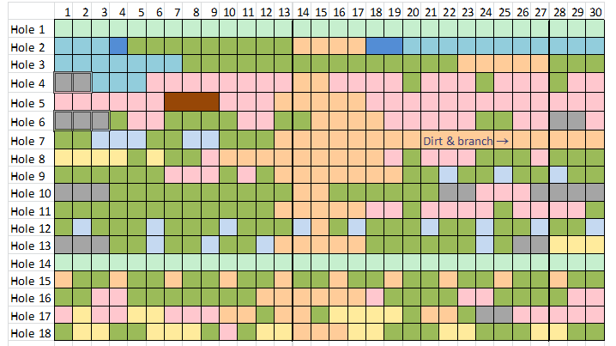
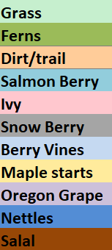
Documentation: Observed Vegetation

Slide 7
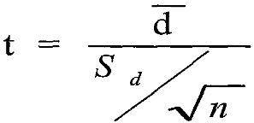
Results: Significant Differences in Observations?
Paired two-tailed t-test: mean difference between two sets of observations.
α = .05 | Result of paired t-test
8/18 and 9/18 | t = 0
8/18 and 4/19 | t = 0
9/18 and 4/19 | t = 0
The vegetation observations are not statistically different.

Slide 8
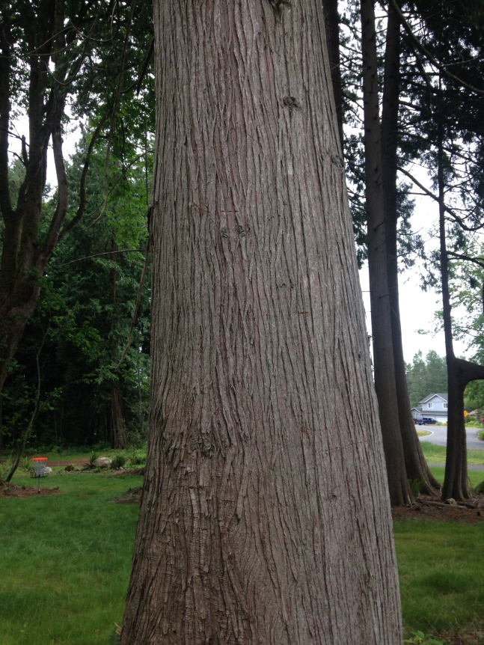
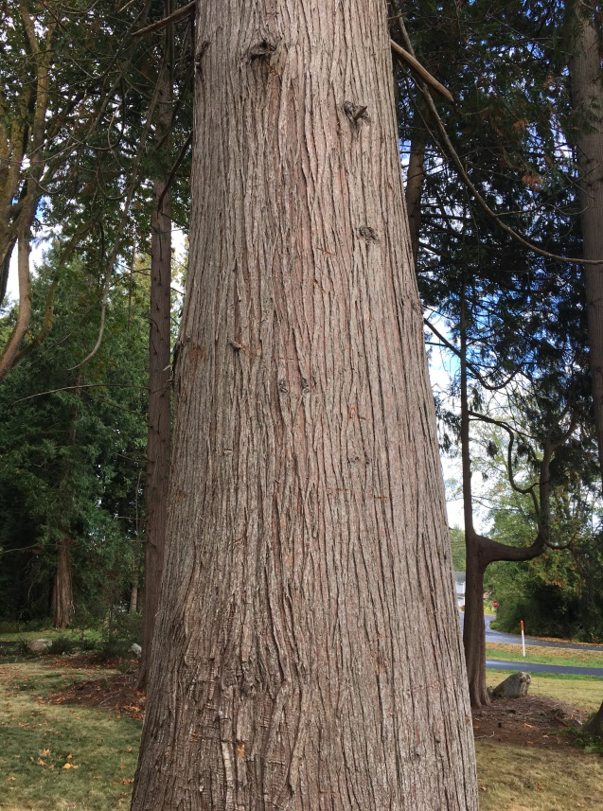
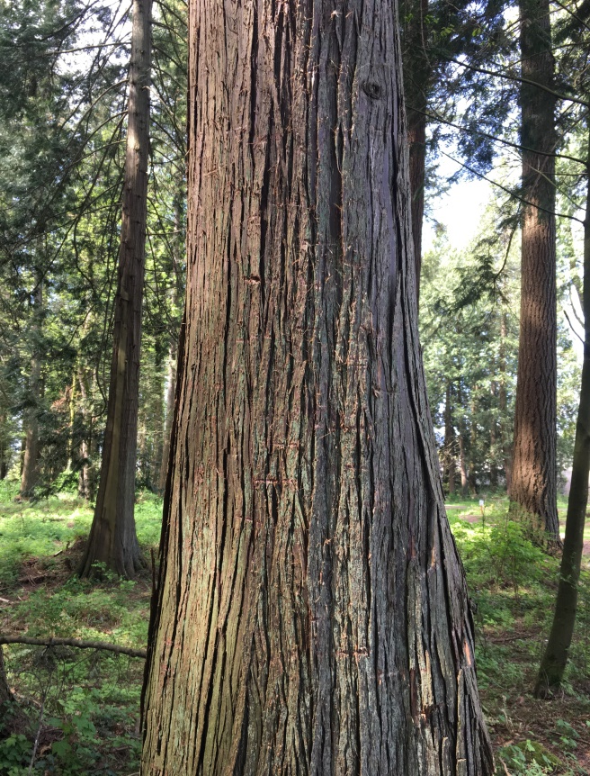
Photo Documentation: Cedar Tree at Hole 1
June 8, 2018
September 7, 2018
April 26, 2019

Slide 9
City of Blaine Council: Study Session
City website:
www.ci.blaine.wa.us
Questions?
Call Stacie Pratschner at 360-332-8311
Email to spratschner@cityofblaine.com
Stacie Pratschner, AICP, RPA
Community Development Director
City of Blaine Community Development Services

