Slide 1
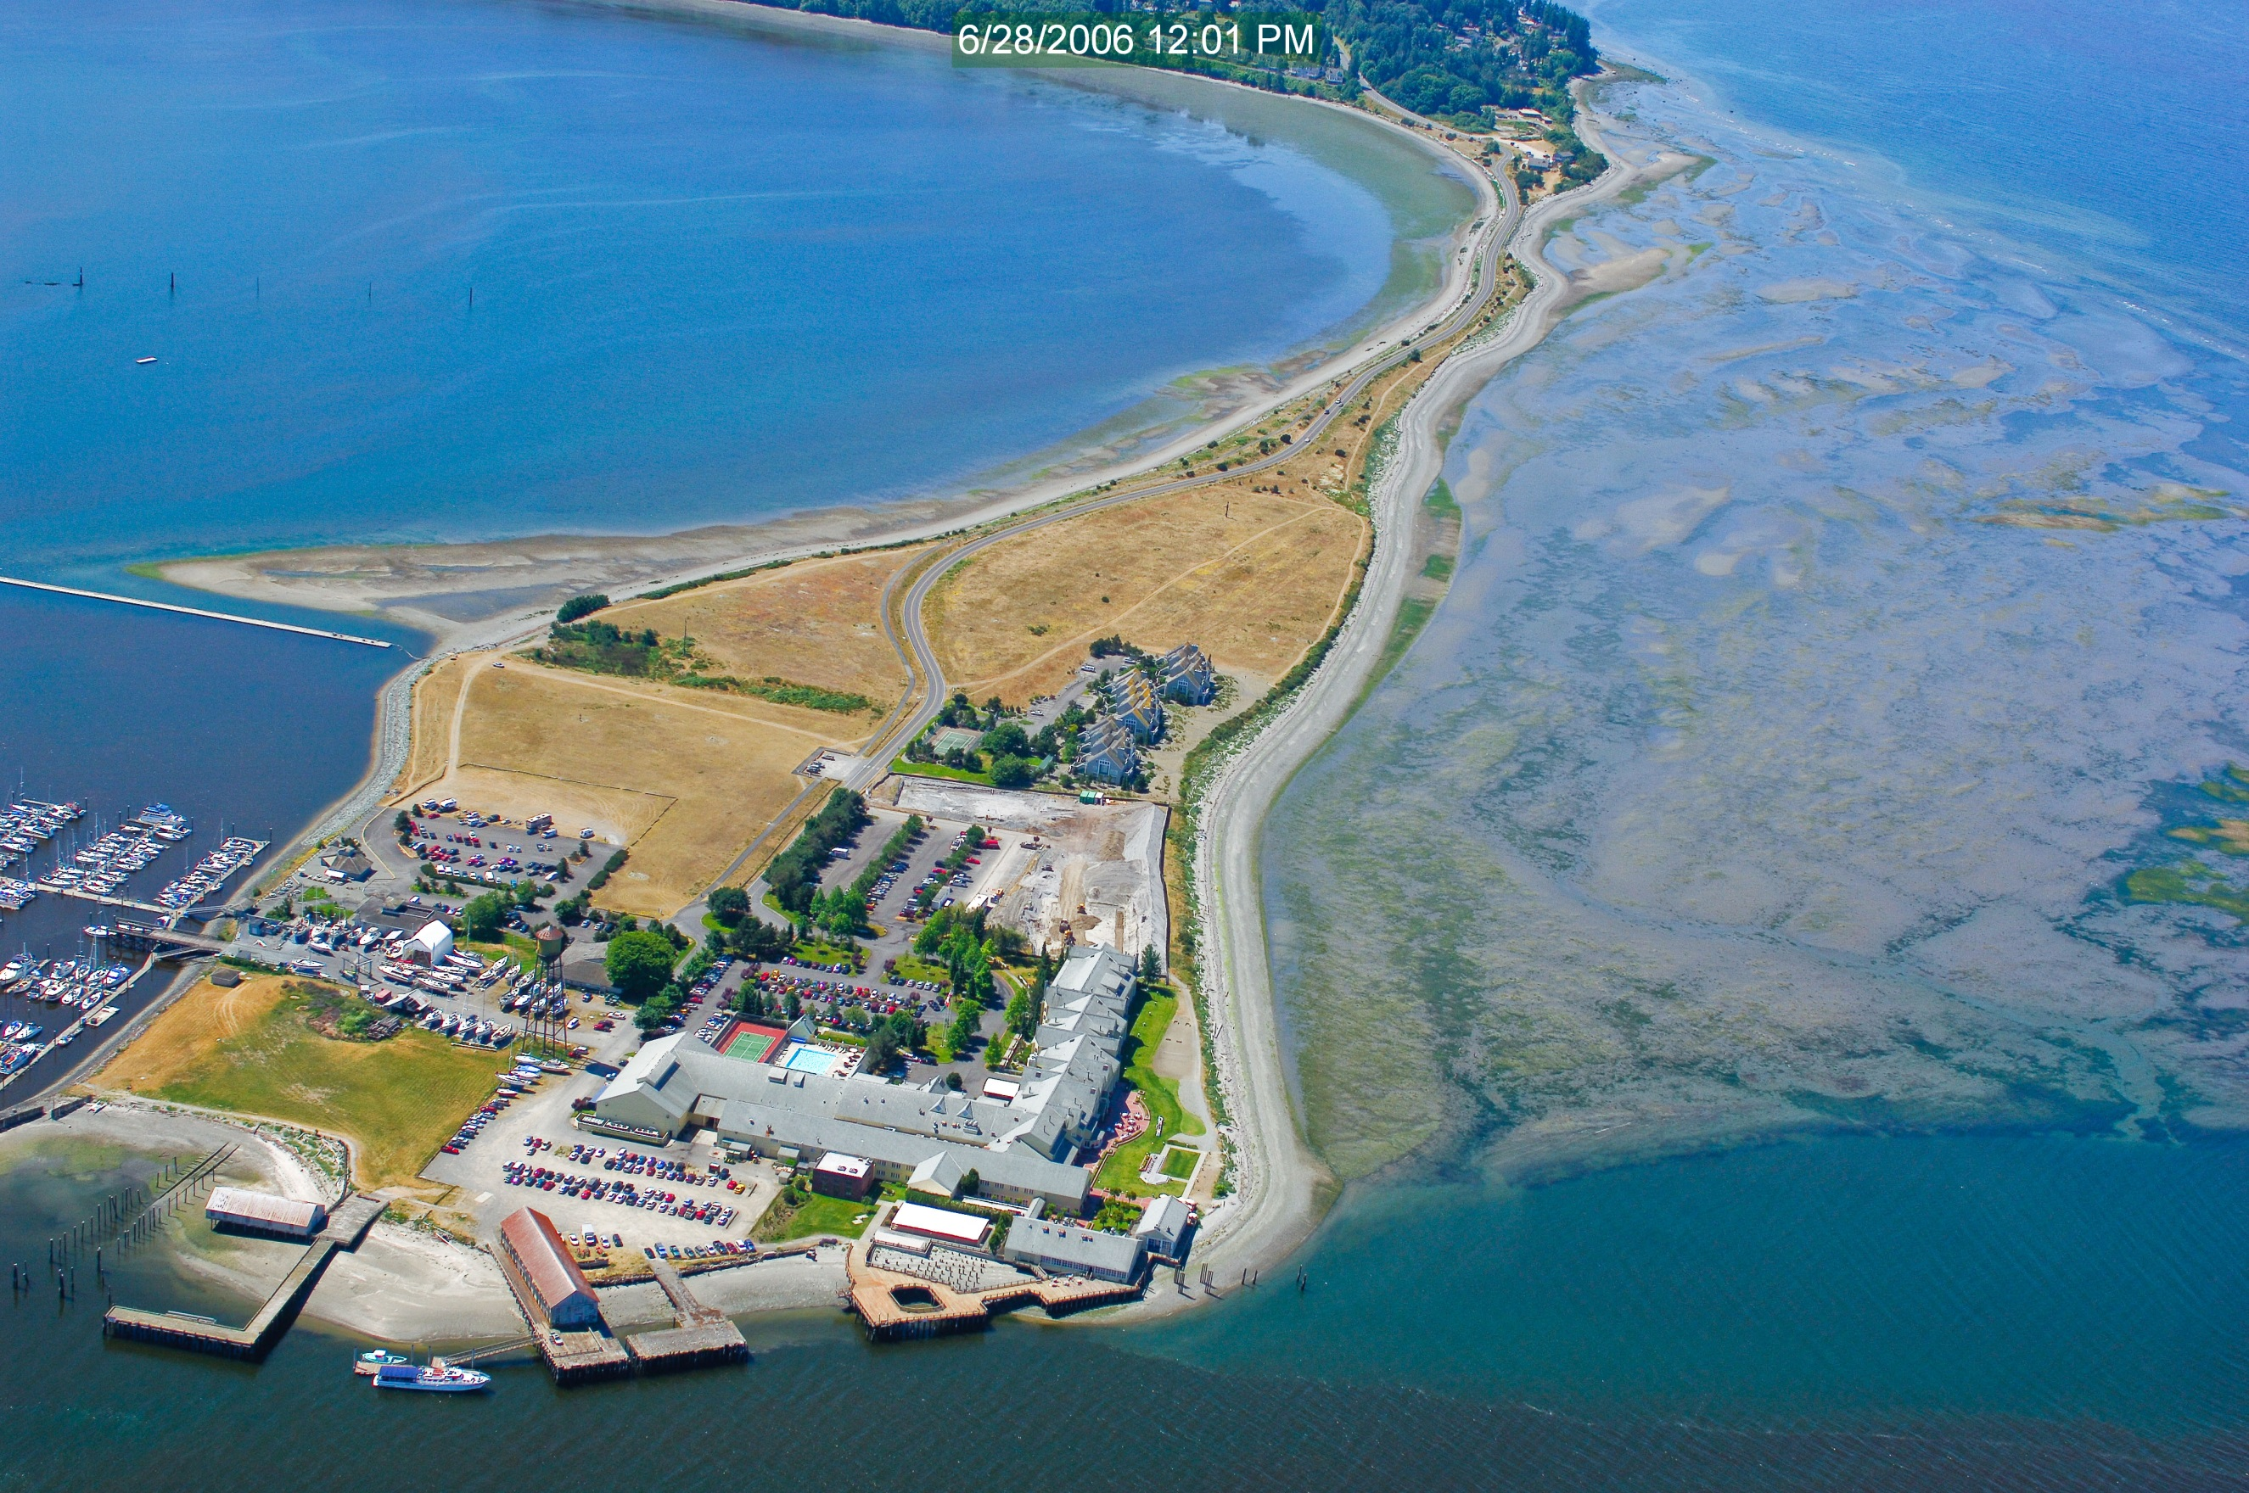
Resort Semiahmoo Master Plan
City Council work session
May 13, 2019

Slide 2
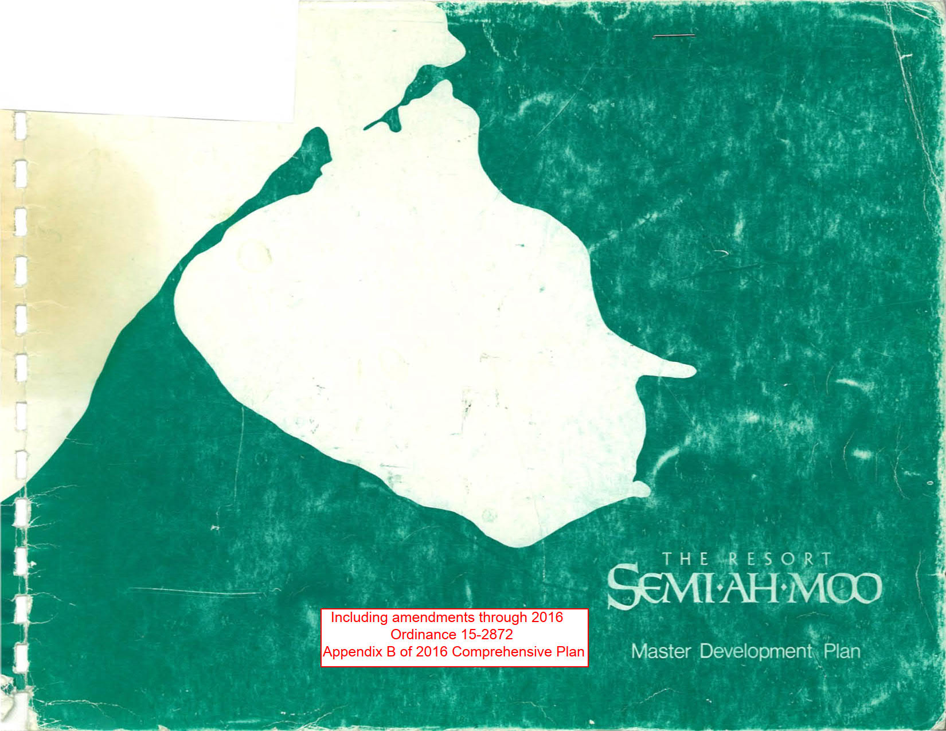

Slide 3
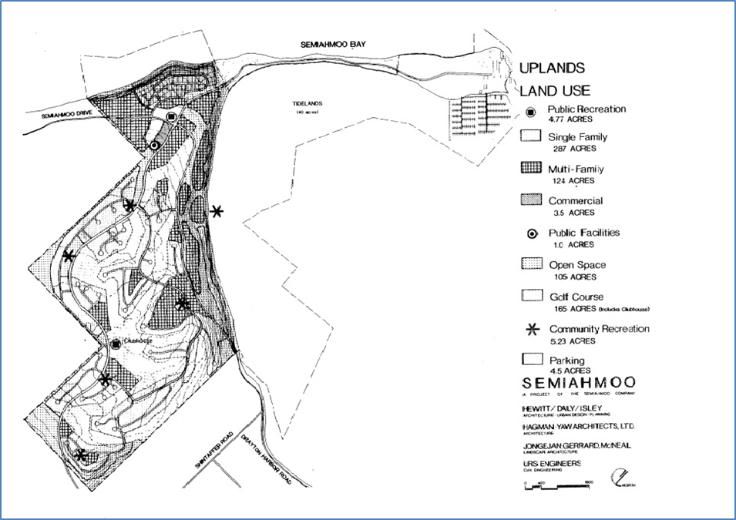
Figure 1. Map of the RSMP Uplands at the time of adoption.

Slide 4
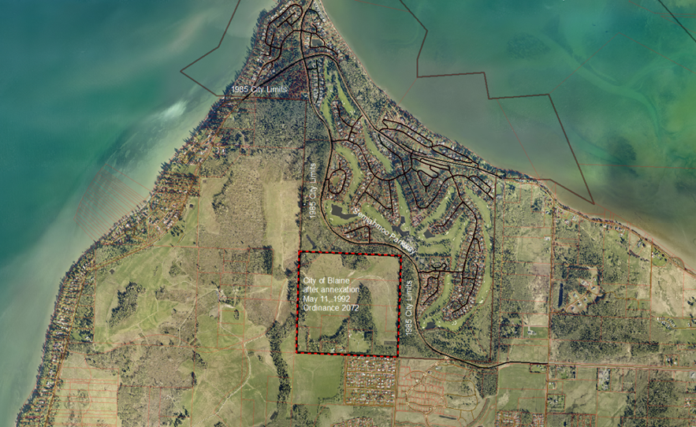
Figure 2. Map of 1992 West Blaine Annexation

Slide 5
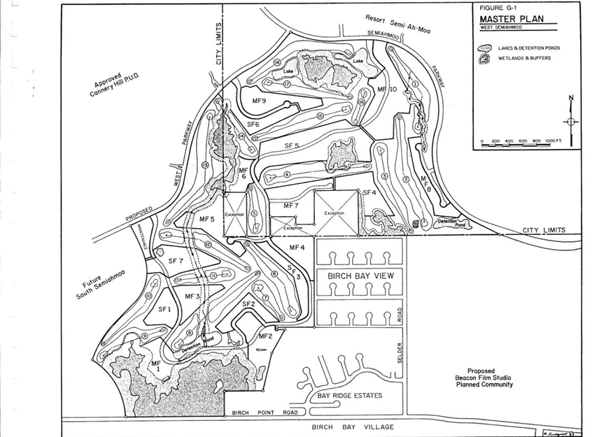
Figure 3: West Semiahmoo PUD Land Use Map
City Limits

Slide 6
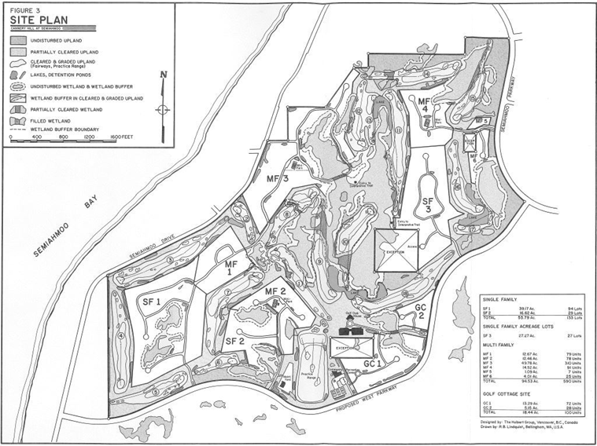
Figure 4: Cannery Hill PUD Land Use Map
City Limits
City Limits, 1992
City Limits, today

Slide 7
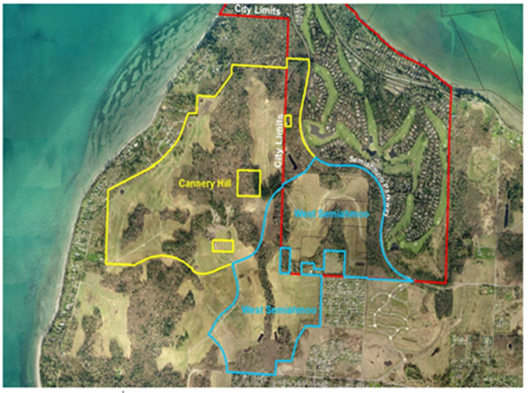
Figure 5. Map demonstrating Cannery Hill and West Semiahmoo in and outside the Blaine Urban Growth Area (UGA).

Slide 8
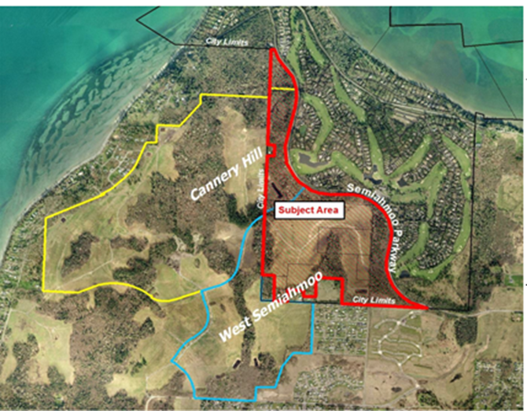
Figure 6. Area within city-limits subject to CPA-1-14.

