Slide 1
City of Blaine Council: Resolution No. 1759-19
May 13 at 6:00 PM
435 Martin Street
Suite 4000
Blaine, WA 98230
Multi-Family Development Tax Exemption – RCW 84.14
Stacie Pratschner, AICP, RPA
Community Development Director
City of Blaine Community Development Services

Slide 2
Residential Targeted Area – Criteria (RCW 84.14.040)
Located within an Urban Center:
Compact, identifiable district where urban residents may obtain a variety of products and services.
Diversity of uses and public facilities.
Targeted for housing opportunities.

Slide 3
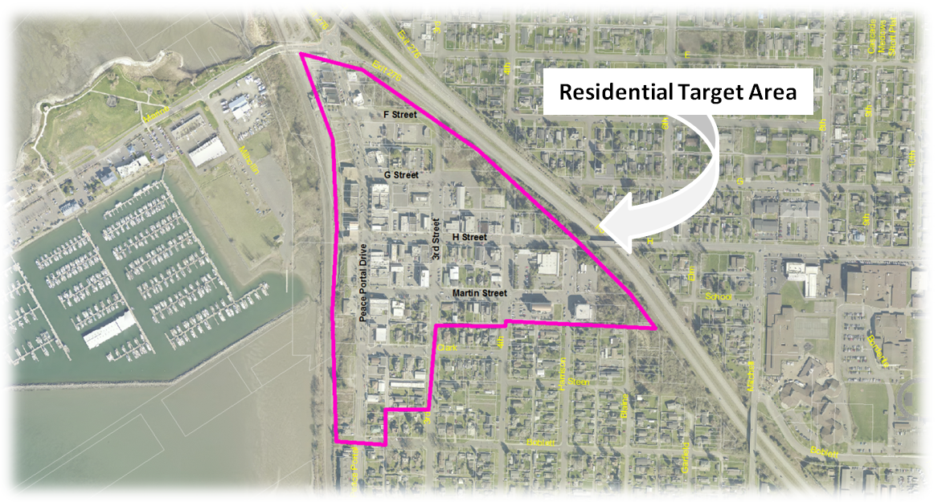
BMC 17.22 – Central Business Zoning District: Market, Town, Waterview, and Garden sub-districts

Slide 4
Next Steps
Draft code amendments to Title 5;
Develop an application form;
Schedule the hearing and begin the public comment period; and
Potentially adopt amendments implementing the exemption.

Slide 5
City of Blaine Council: Resolution No. 1759-19
City website:
www.ci.blaine.wa.us
Questions?
Call Stacie Pratschner at 360-332-8311
Email to spratschner@cityofblaine.com
Stacie Pratschner, AICP, RPA
Community Development Director
City of Blaine Community Development Services

