Slide 1
City of Blaine Council: ORD 19-2928
May 13 at 6:00 PM
435 Martin Street
Suite 4000
Blaine, WA 98230
Alteration of Boundary Ridge Subdivision: Lot 1, Division 2
Stacie Pratschner, AICP, RPA
Community Development Director
City of Blaine Community Development Services

Slide 2
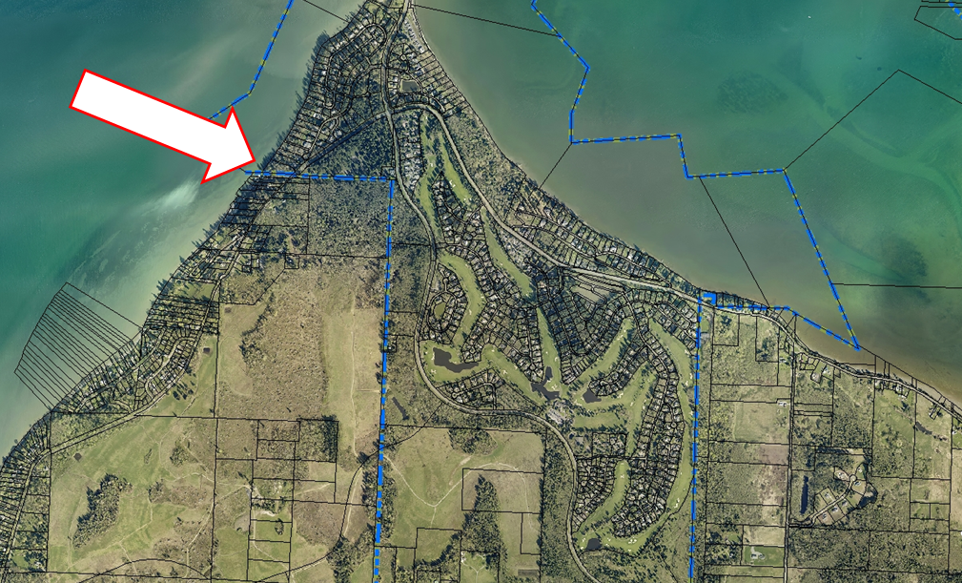
Project Location

Slide 3
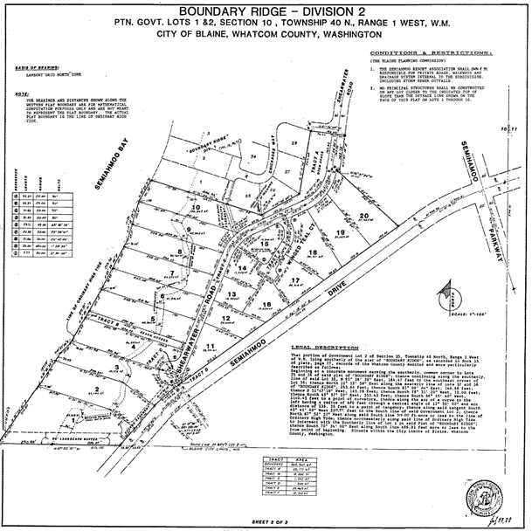
Boundary Ridge – Division 2

Slide 4
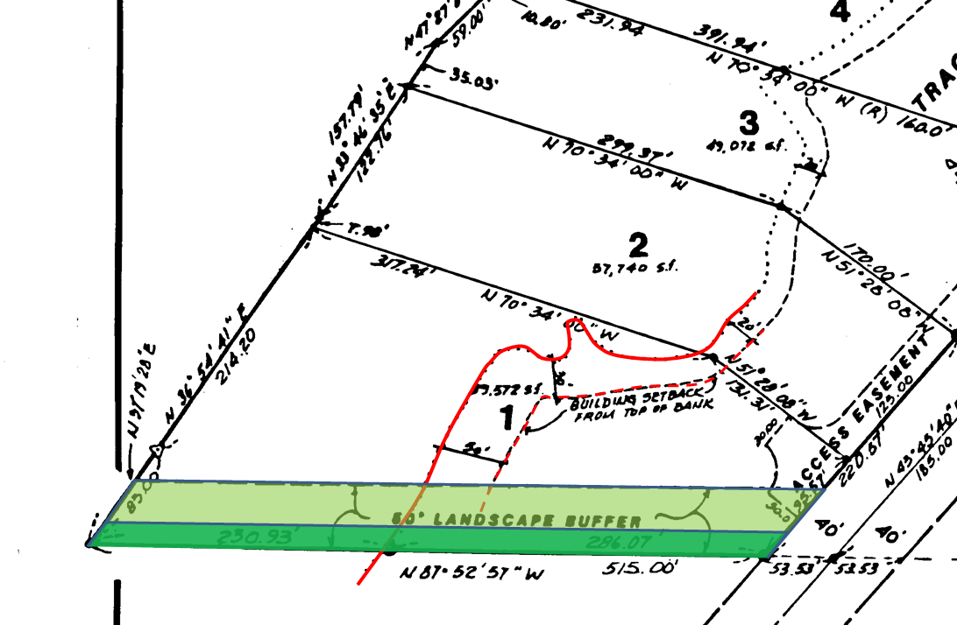
Existing Buffers

Slide 5
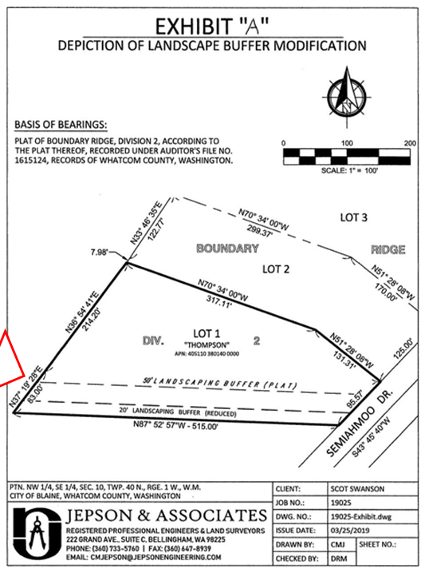
Proposed Buffer Reduction
RCW 58.17.215
Public notice
Plat alteration

Slide 6
City of Blaine Council: ORD 19-2928
City website:
www.ci.blaine.wa.us
Questions?
Call Stacie Pratschner at 360-332-8311
Email to spratschner@cityofblaine.com
Stacie Pratschner, AICP, RPA
Community Development Director
City of Blaine Community Development Services

