Slide 1


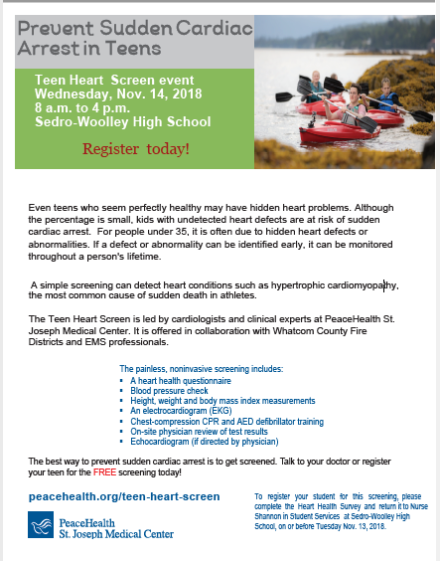
Blaine High School
November 2019
Outcomes & Findings

Slide 2
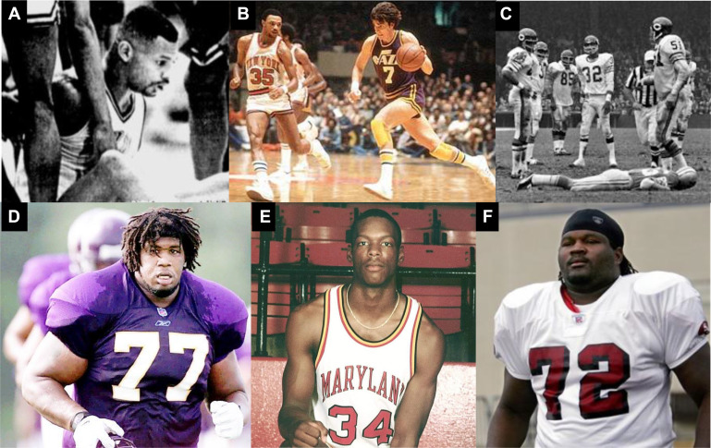
Sudden Cardiac Death in Athletes
Cardiac related death is the most common reason for non-traumatic death during sports in young athletes (70%)
Affects approximately 33.3 /100,000 athletes
Figure 5. Other notable athlete sudden deaths in the U.S. (A) Hank Gathers (1990) age 28 years; (B) “Pistol Pete” Maravich (1988) age 40 years; (C) Chuck Hughes (1971) age 28 years; (D) Korey Stringer (2001), age 27 years; (E) Len Bias (1986) age 22 years; (F)…….
Barry J. Maron, MD
Historical Perspectives on Sudden Deaths in Young Athletes With Evolution over 35 Years
The American Journal of Cardiology, Volume 116, Issue 9, 2015, 1461–1468
http://dx.doi.org/10.1016/j.amjcard.2015.07.072

Slide 3
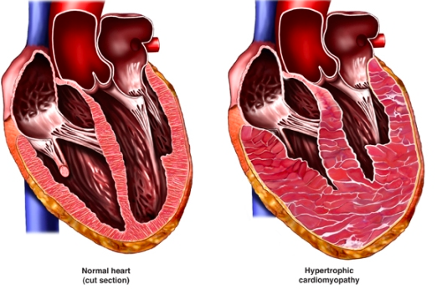
Sudden Cardiac Death in Athletes
Hypertrophic Cardiomyopathy
“Thickened heart muscle”
Abnormal coronary arteries
Arrhythmias
Enlarged aorta
Valve problems
Current sports screening recommendations only require physical exam and basic questionnaire
ECG can increase the sensitivity to detect causes for SCD ---saved 2.06 life-years per 1,000 athletes
Echocardiography can detect otherwise unrecognized aortic enlargement in selected individuals

Slide 4






Blaine High School Special Recognition
Scott Ellis, Principal
Sean Linville, Athletic Director
Wayne Vezzetti, Asst Principal
Connie Pilon, Registrar/Athletic Secretary
Brenda Post, Nurse
All the Staff & Student Volunteers from Blaine High School
Jodi Greene, Nurse

Slide 5





Partnerships
Program Partners

Slide 6











Participating Schools
Lynden School District
Linking head and heart, home and school, child and God.
Whatcom Community College
Blaine High School

Slide 7

Statistics & Findings
223 Students Were Screened
107 Female Students
116 Male Students
All of The 223 Students Screened Had a Chart Created and The Records of Their Screening Were Entered Into The PeaceHealth St. Joseph Medical Center Electronic Medical Record System

Slide 8
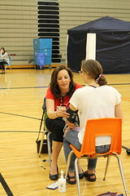
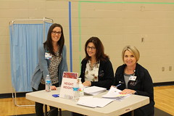
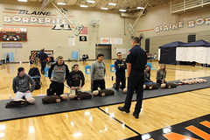
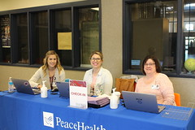
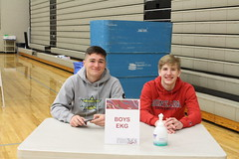
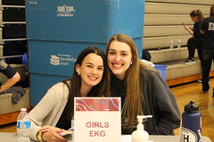
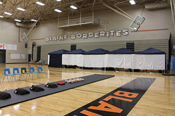
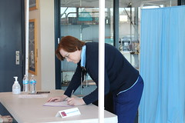
Screening Stations
Screening Stations & Medical Staff Volunteers
Registration
Station # 1 – Height & Weight
Station # 2 – Blood Pressure & Pulse
Station # 3 – 12 Lead EKG
Station # 4 – CPR (Chest Compressions) & AED Use
Station # 5 – Physician Evaluation
Station # 6 – Echocardiography (If Indicated)
Check Out
Dr. Mark Daniels – Physician Lead
Nickie Snyder, NP
Dr. Susan Kranzpiller
Dr. Rachel Lum Ho

Slide 9

Statistics & Findings

Slide 10




Statistics & Findings

Slide 11
Key Clinical Findings
Clinical Findings
55 Students Were Found to Have Positive Findings
4 Students With Significant Findings (Requiring More Immediate Follow-Up)
14 Year Old Male Student with Prolonged QT Interval
15 Year Old Male Student with Significant EKG Abnormality and Borderline Hypertension
16 Year Old Female Student with Positive PDA Patient Ductus and Systolic Murmur
16 year Old Male Student with Premature Beats Found on EKG and Abnormal Echocardiogram Showing Possible Bilateral Ventricle Dilation
51 General Positive Findings
20 Students with Generalized Hypertension (All BP’s Were Re-Checked)
13 Students with dyspnea, shortness of breath or chest pain on exertion
8 Students with Persistent Symptoms
4 Students with Significant Family History
3 Students with Sinus Tachycardia
2 Students with Syncope with Exercise
1 Student with Bradycardia
All 55 Students Have Been Notified Along with Their Parents and
Primary Care Physicians of Screening Results

Slide 12

