Slide 1

665 Peace Portal Demolition
Blaine City Council 4-22-19

Slide 2
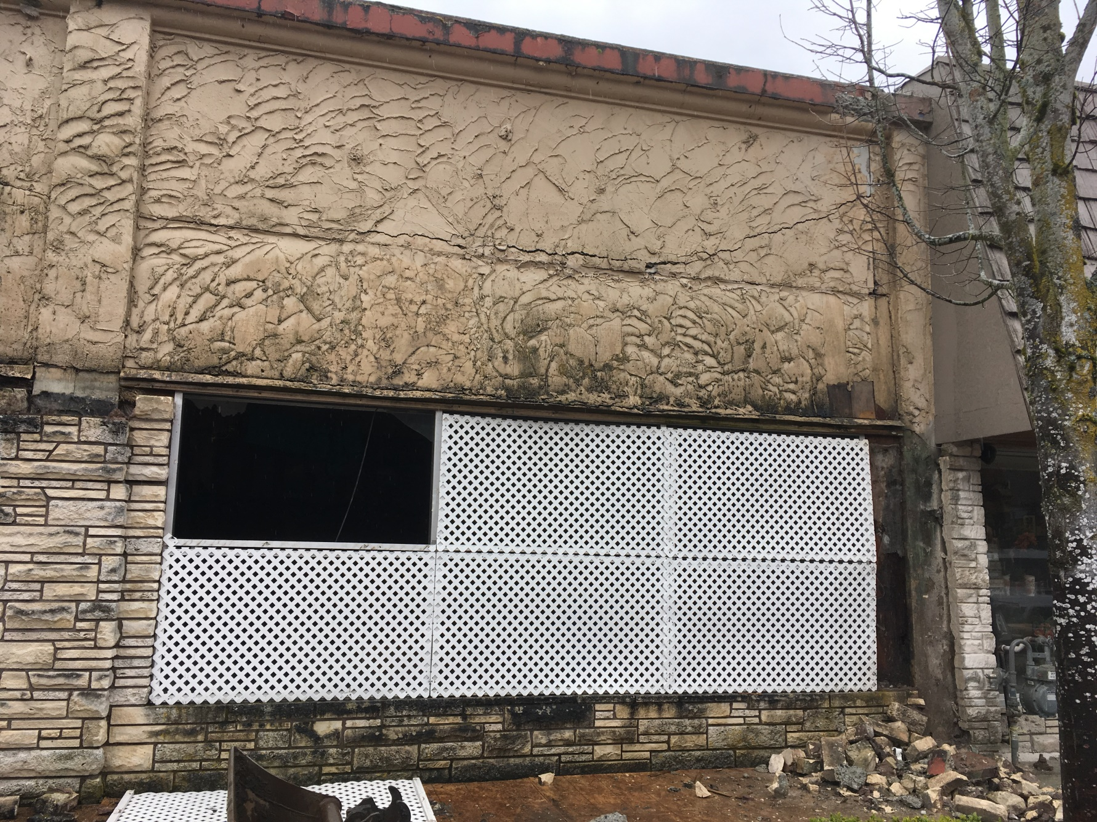
Pre-(De)Construction

Slide 3
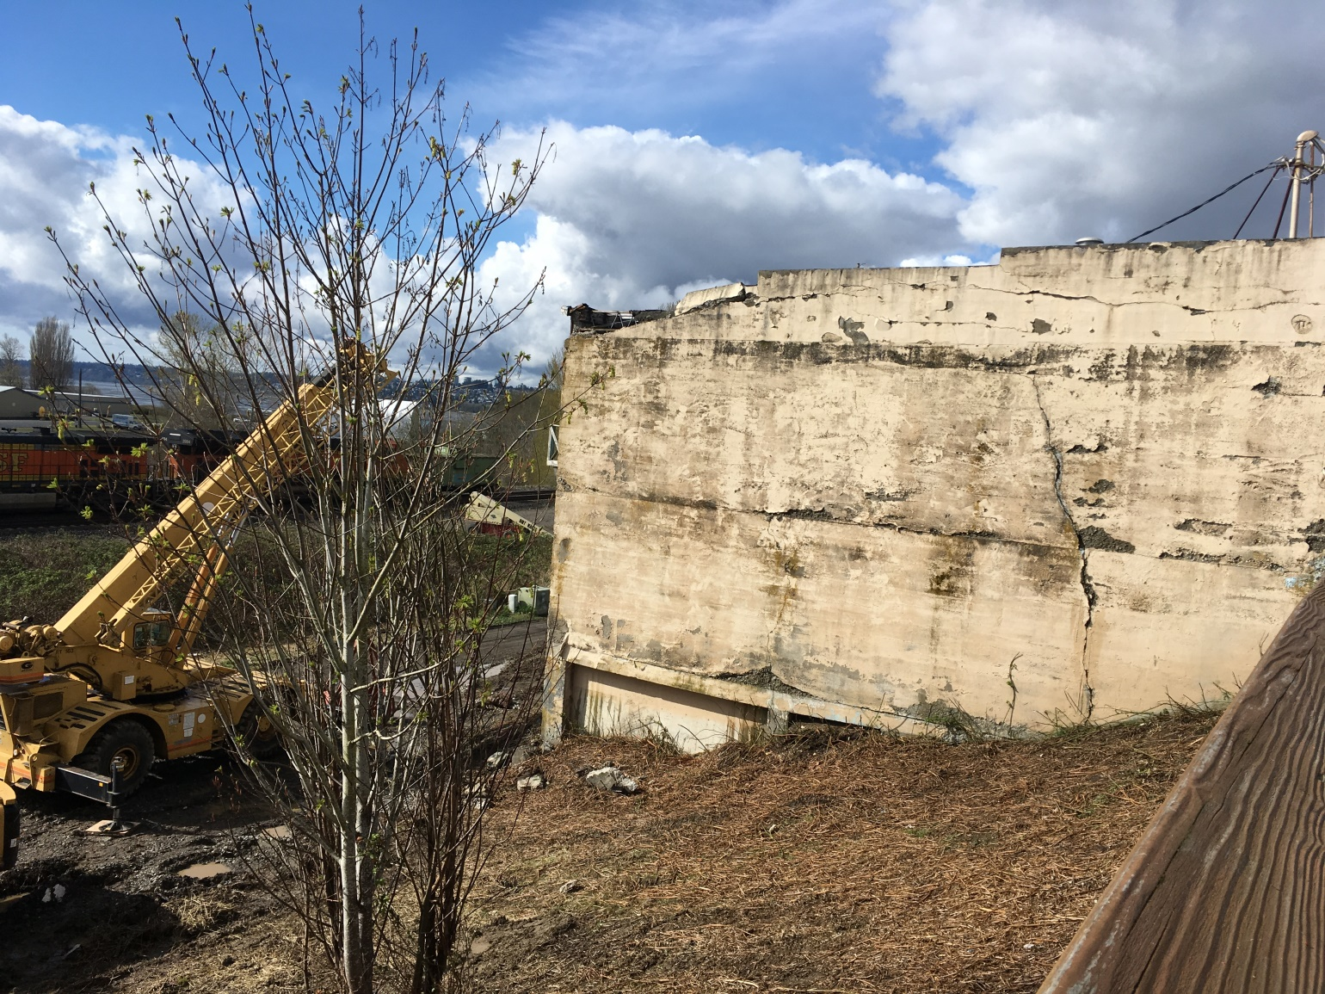
Mobilizing to Site

Slide 4
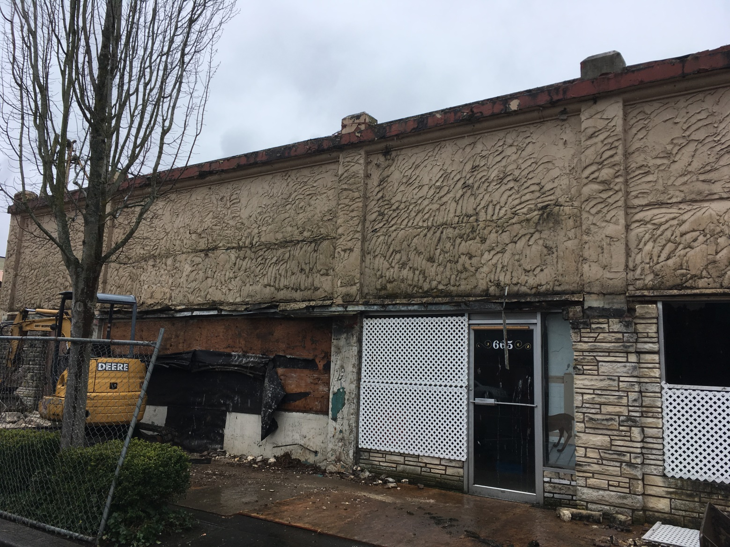
Begin (De)Construction

Slide 5
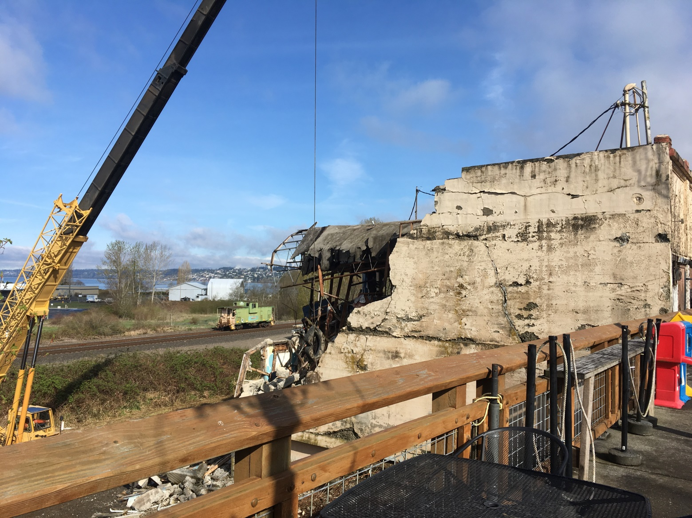
Day 1

Slide 6
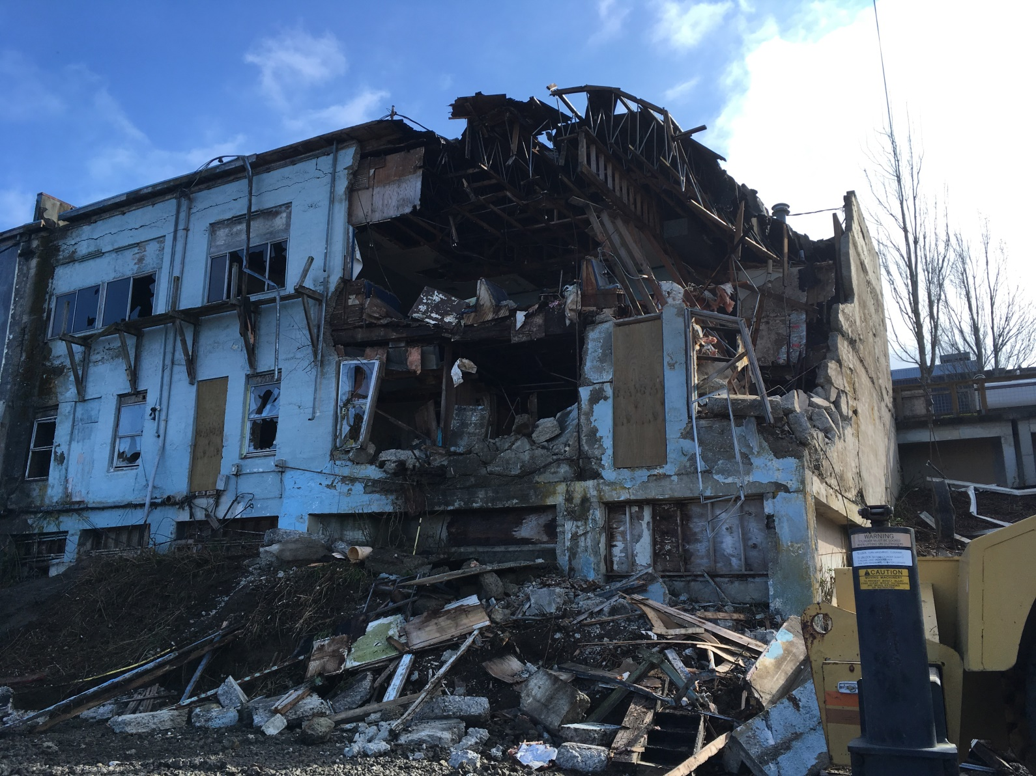
Day 1

Slide 7
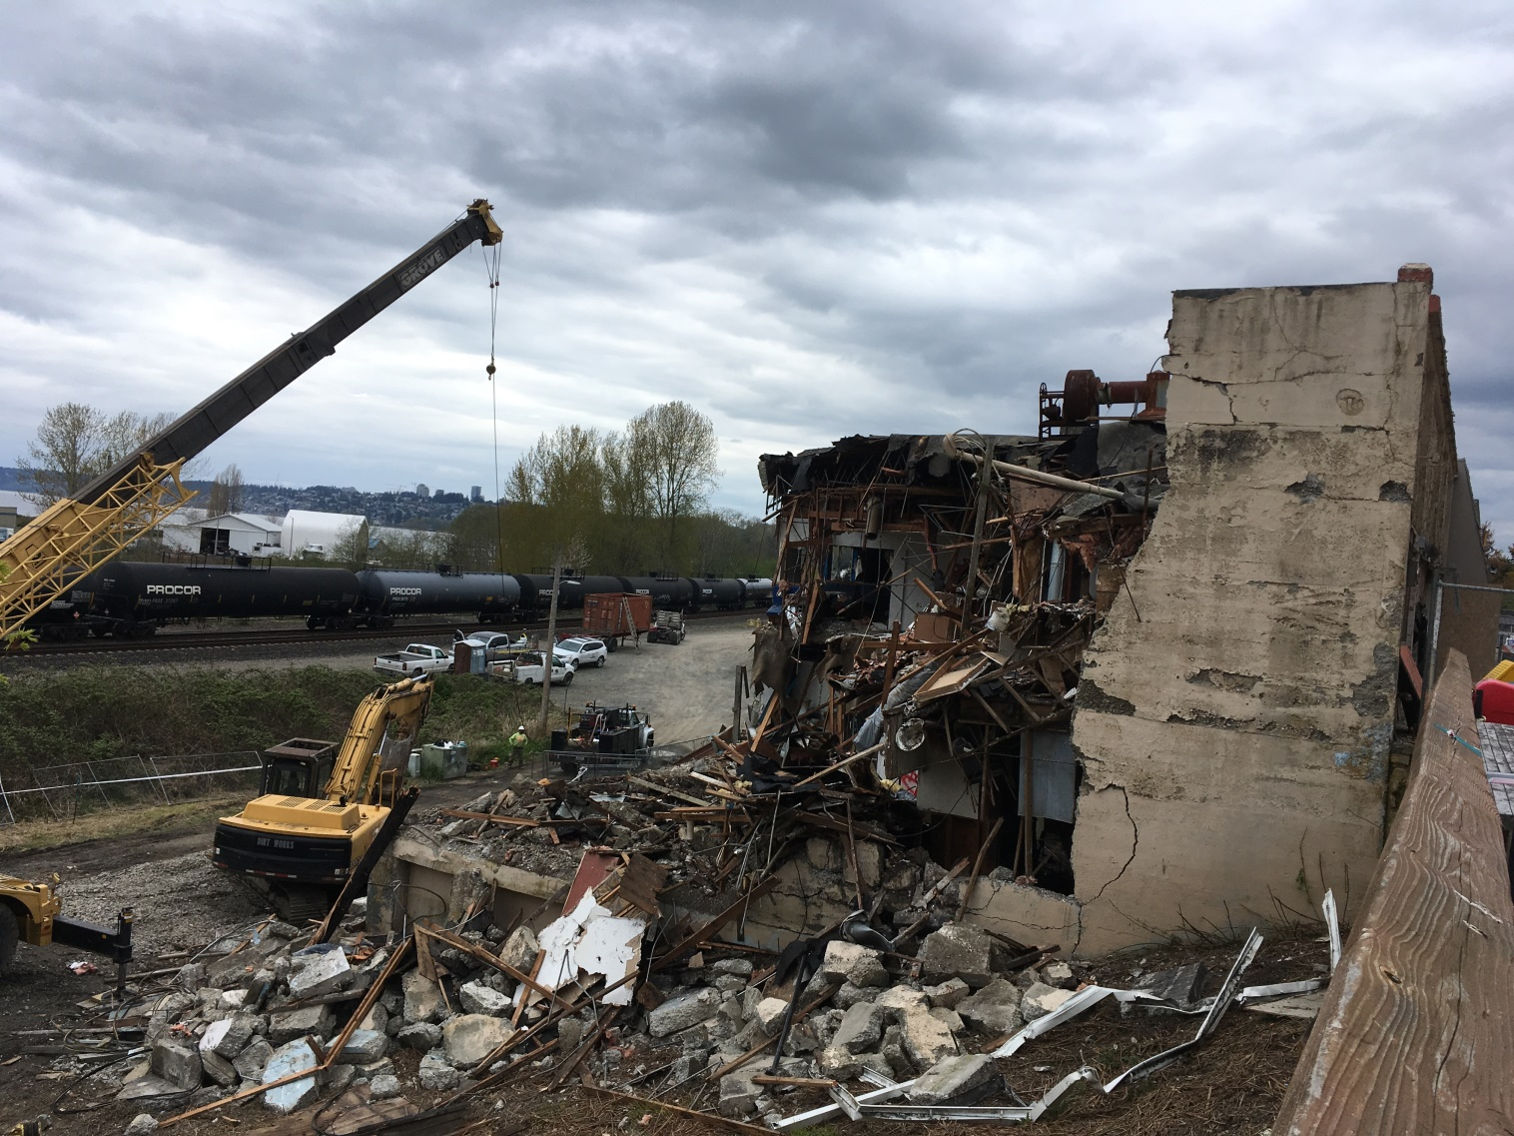
Day 3

Slide 8
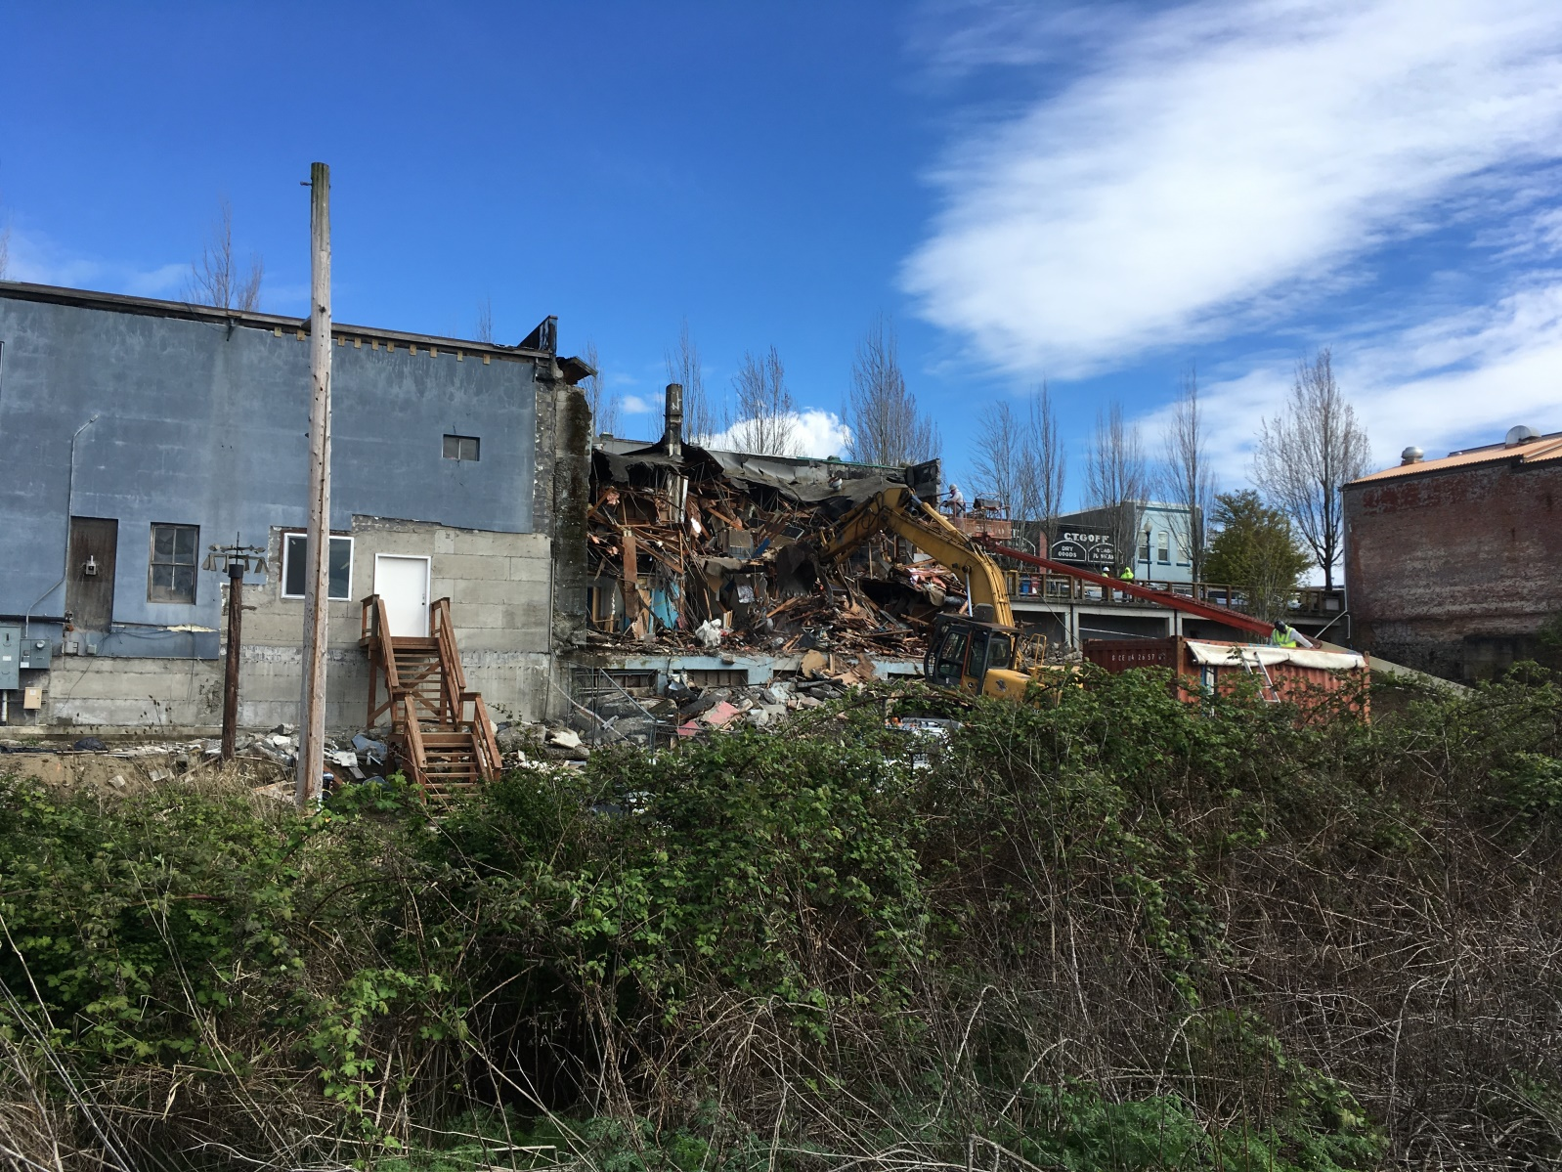
Day 4

Slide 9
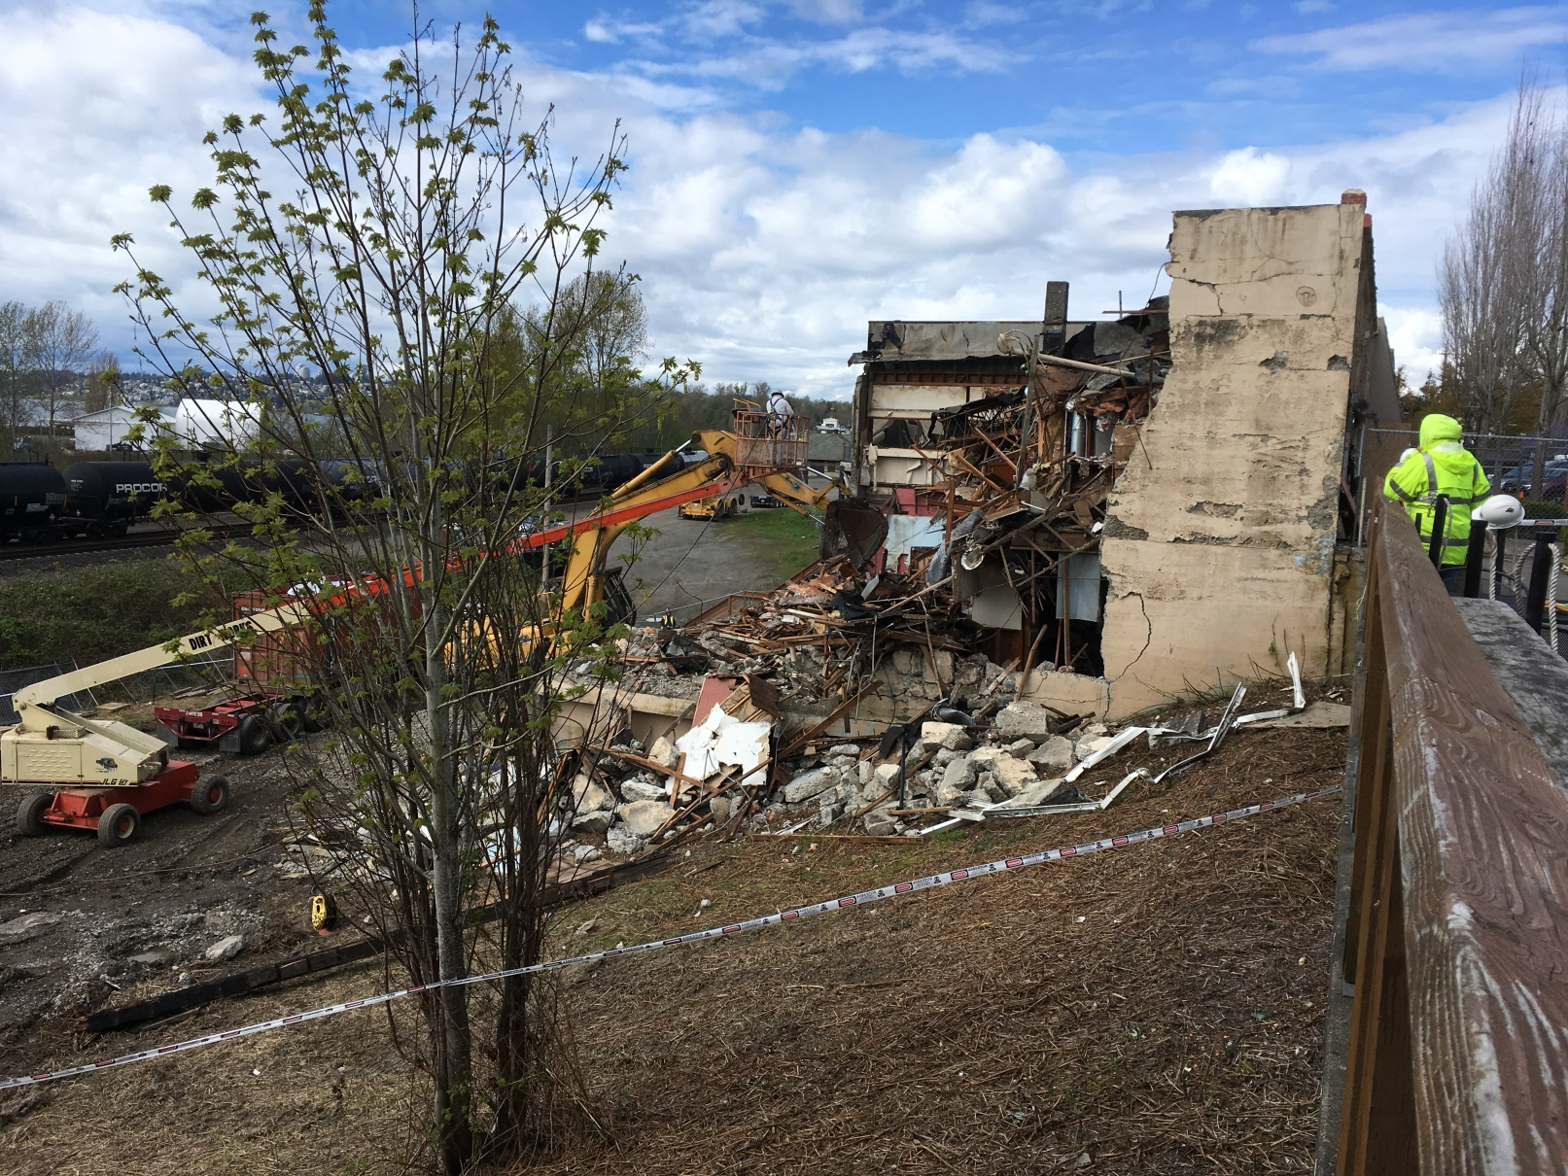
Day 5

Slide 10
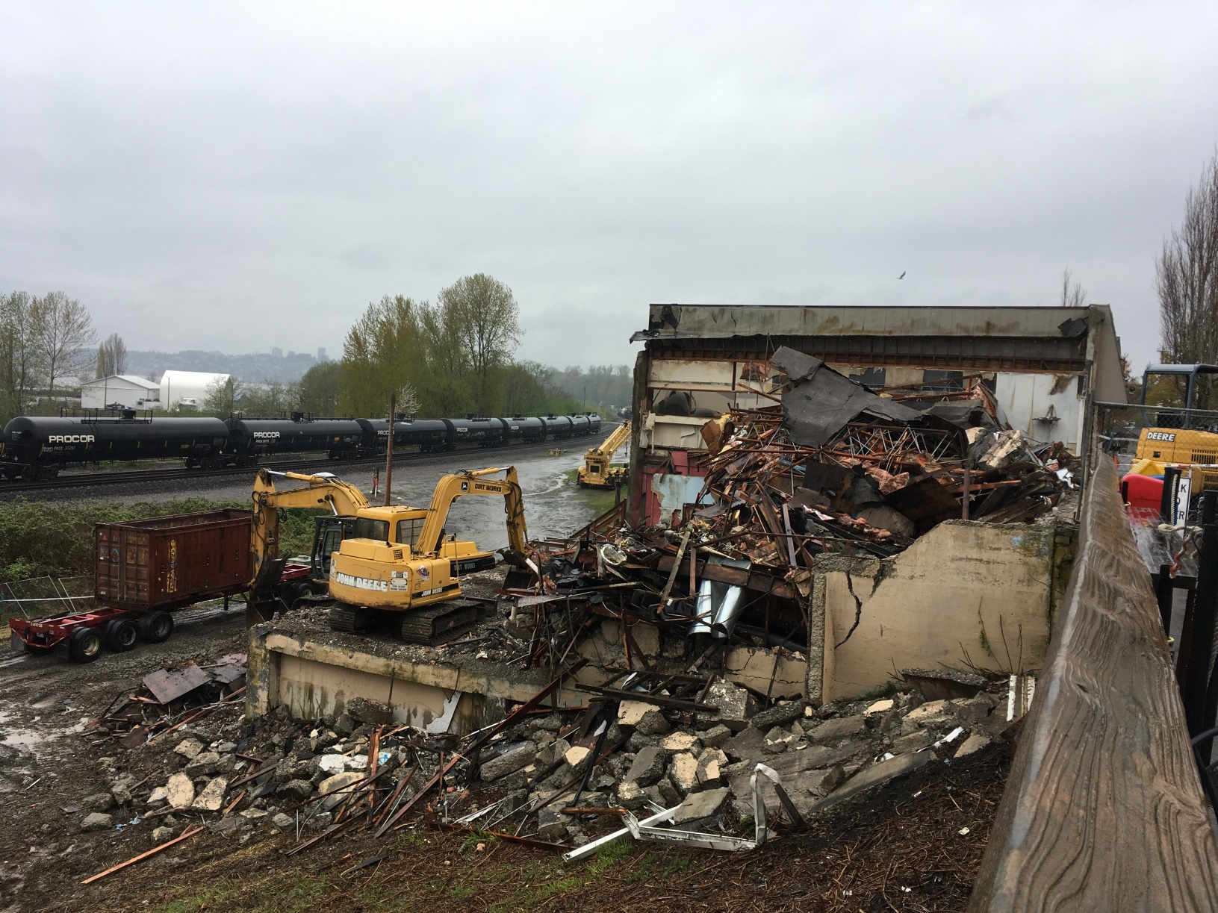
Day 6

Slide 11
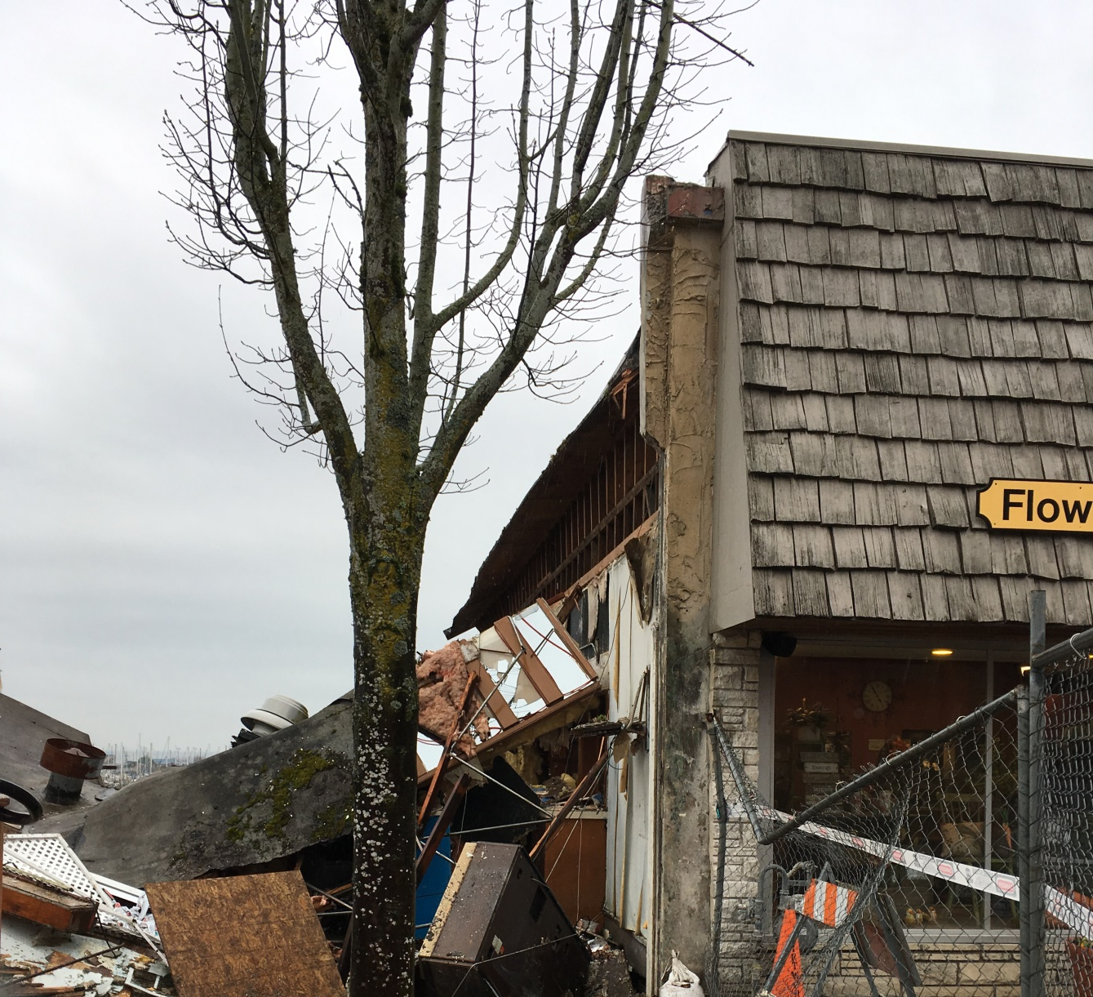
Day 7

Slide 12
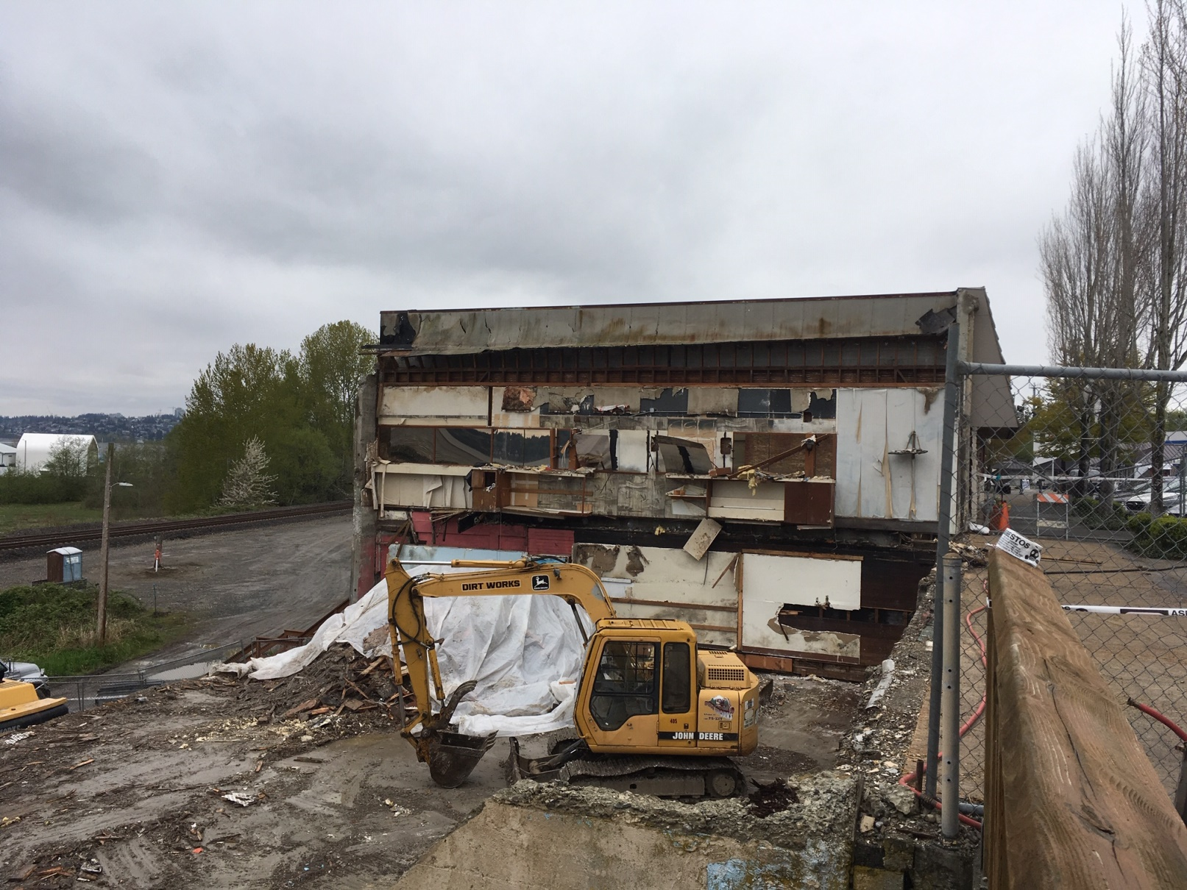
Today

Slide 13
H Street Plaza Progress
Blaine City Council, April 22, 2019

Slide 14
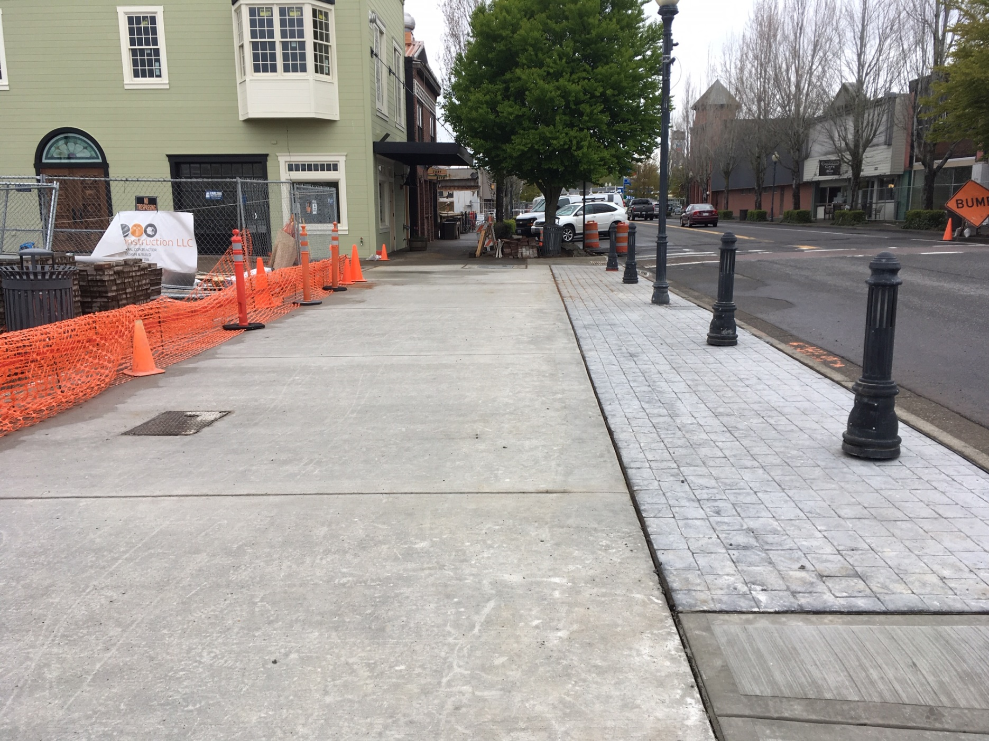

Slide 15
