Slide 1

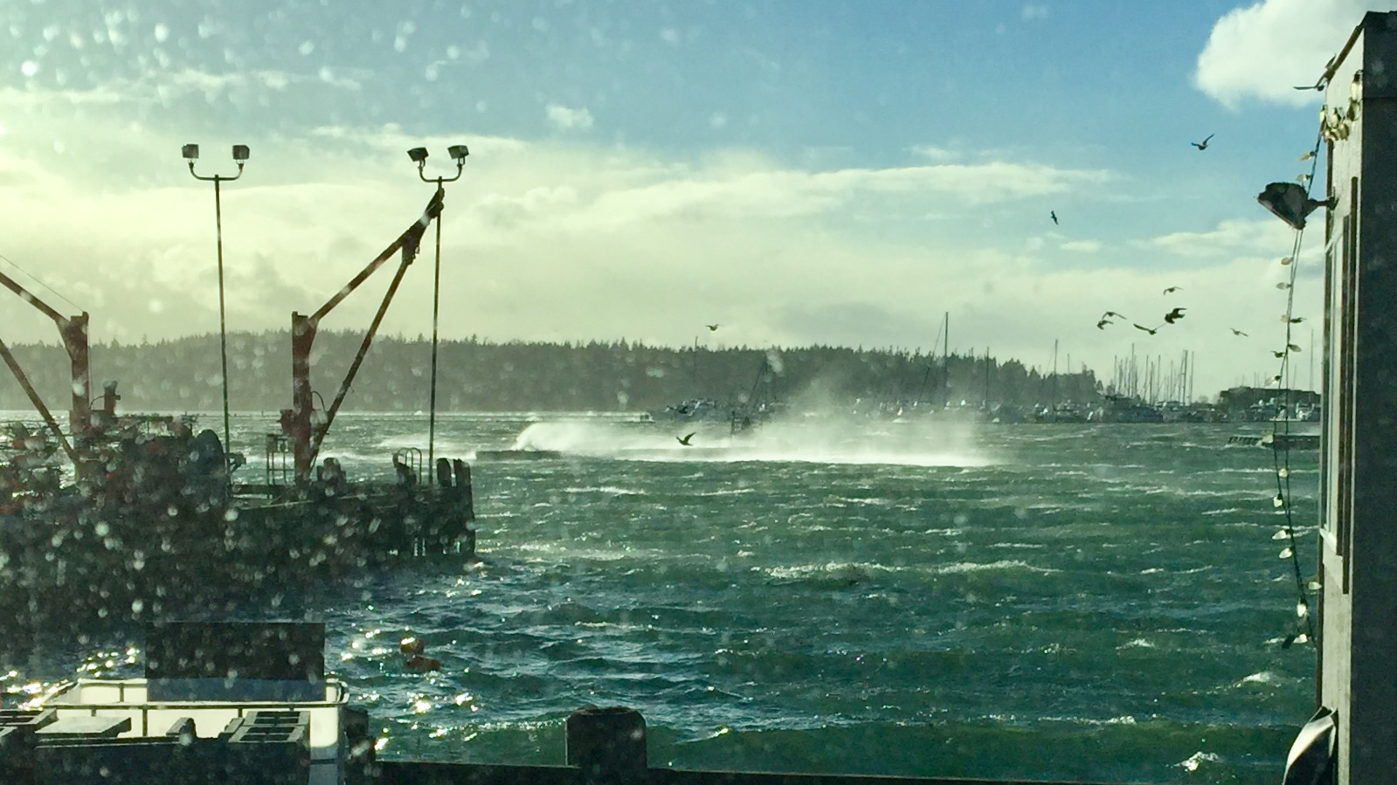
City of Blaine Public Works Department December 20, 2018 Winter Storm

Slide 2
Outline
Whatcom EOC Coordination
Impact Areas
Emergency Declaration
Summary – Next Steps

Slide 3

Alert Notifications
Blaine Public Works D.O.C.
Emergency Response
Mutual Aid Support

Slide 4
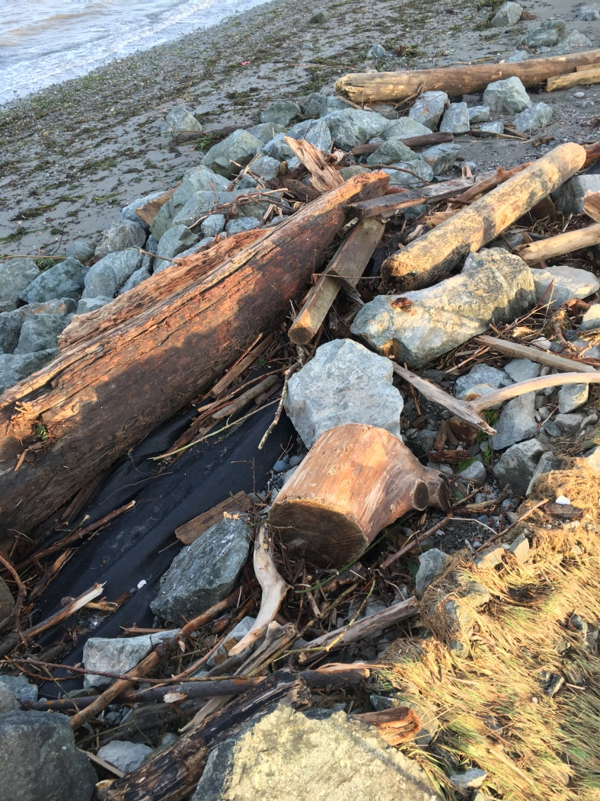
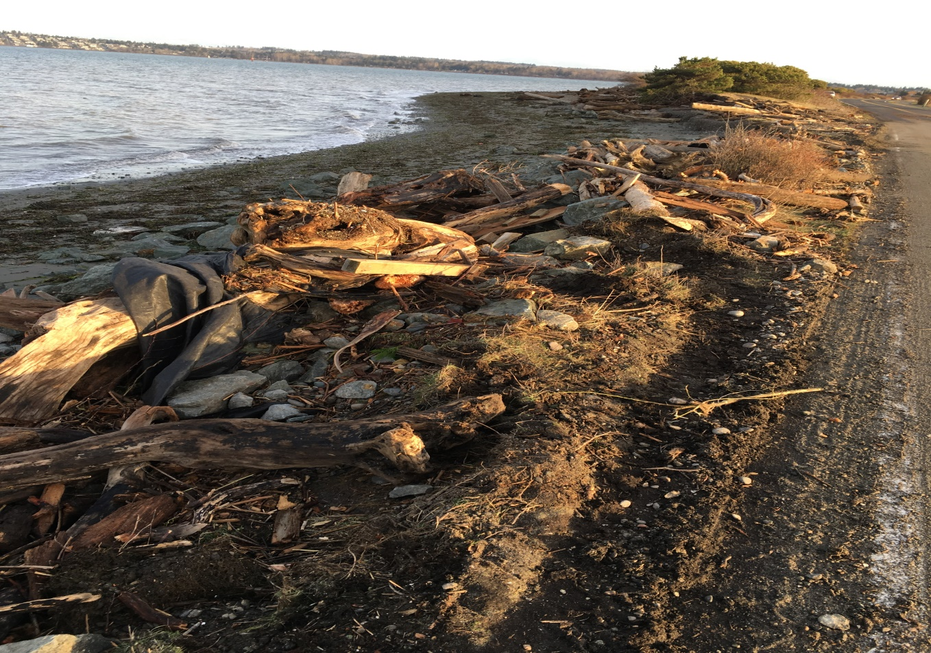
Critical Area – Semiahmoo Parkway
Beach Erosion Impacts
Road
Armoring

Slide 5
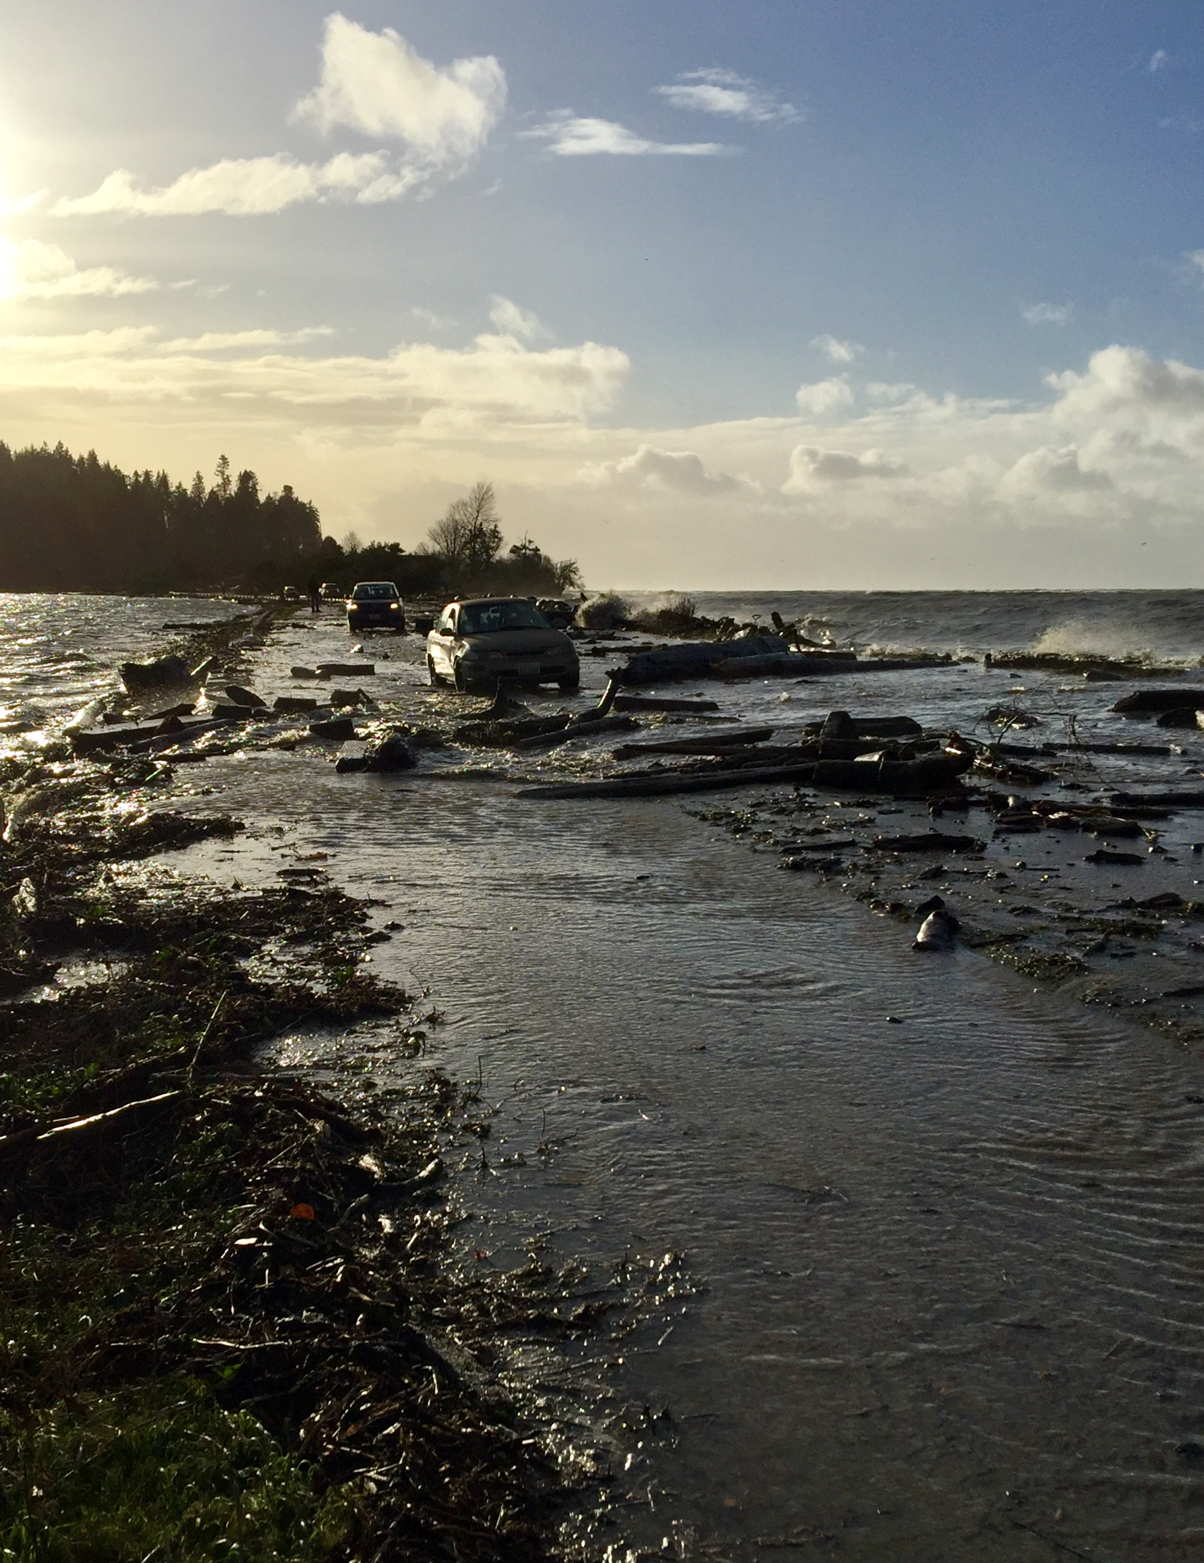
Critical Utility Corridor Vulnerability

Slide 6
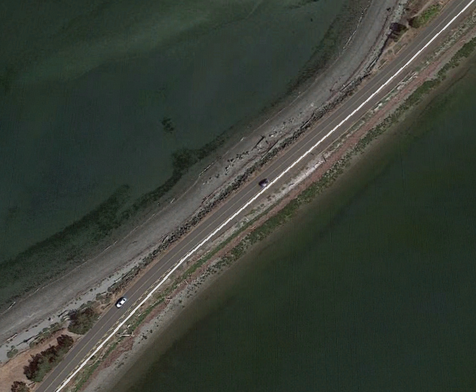
Army Corp Coordination – Design Support
Strategic Recovery Plan In Place
Damaged Section Threatening Infrastructure

Slide 7
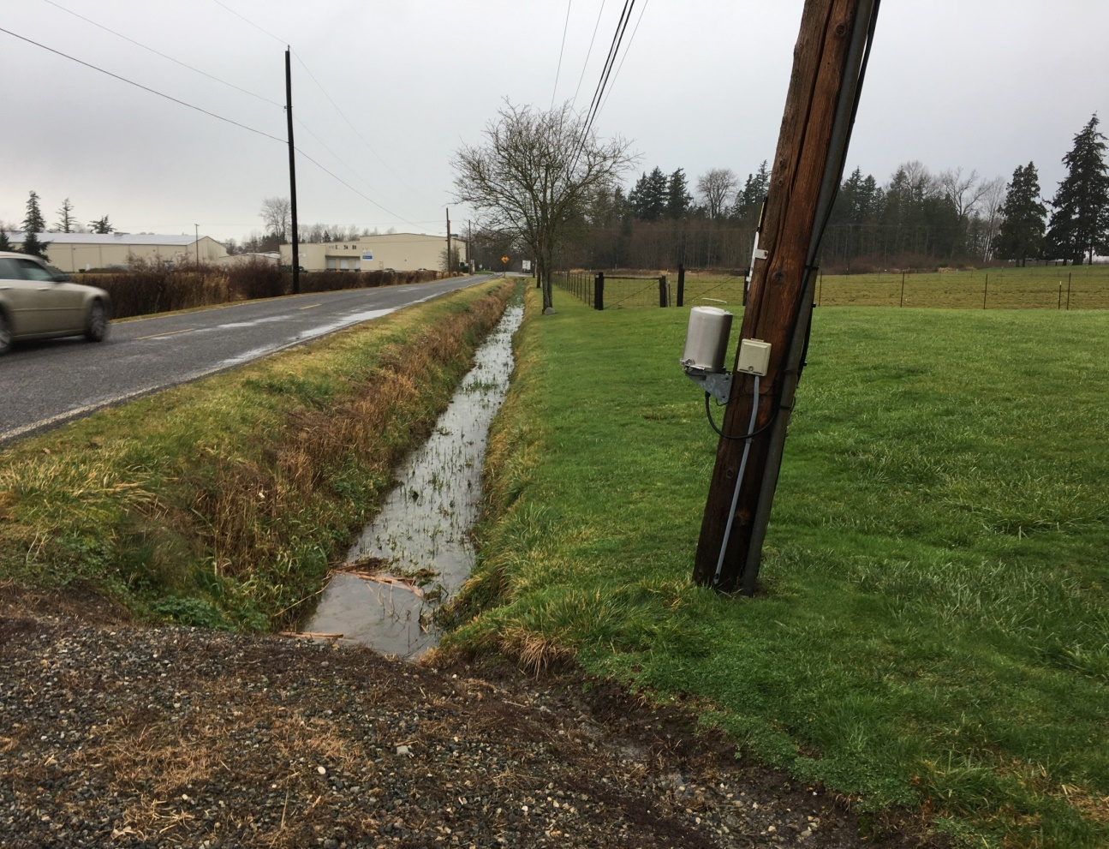
Critical Areas: Pipeline Road Power Lines
Power Poles Leaning Severely
Evaluation Underway
Power Supply for Water Shed

Slide 8
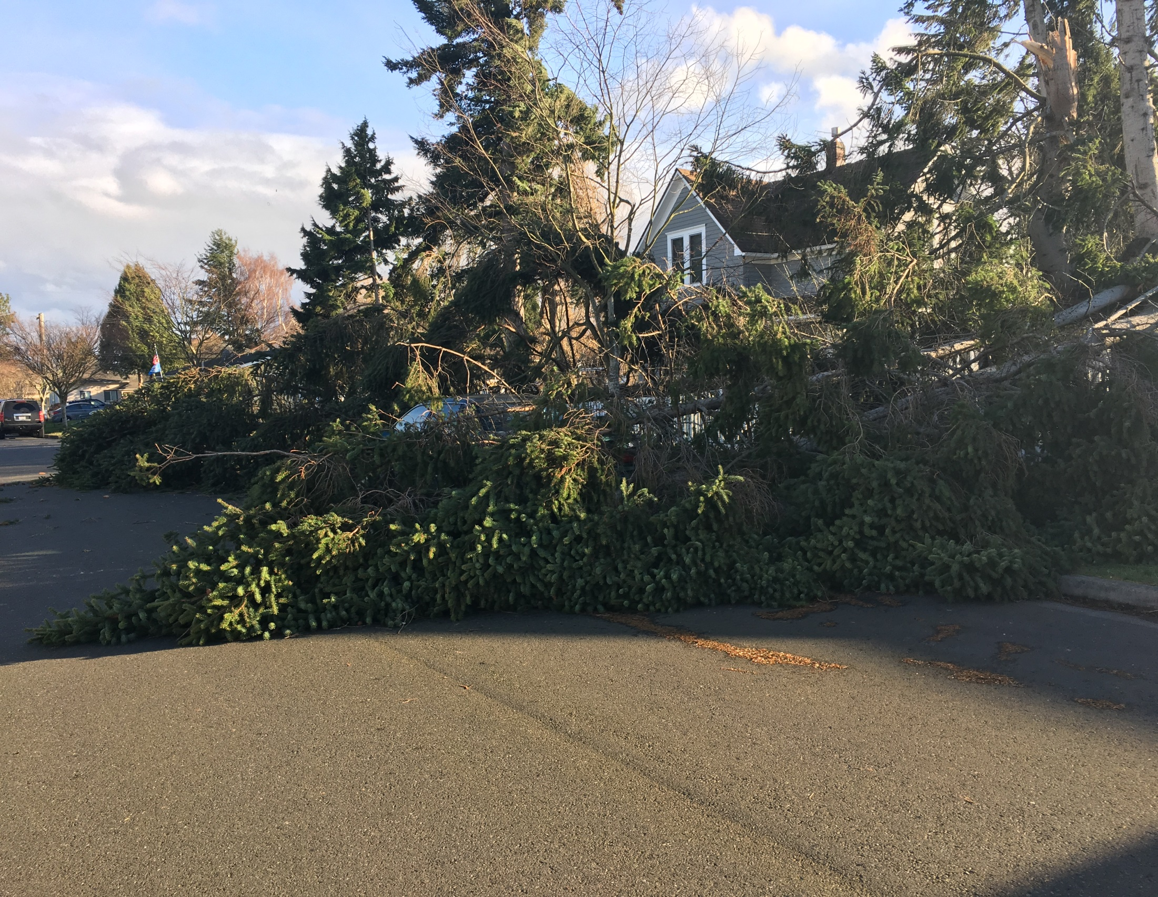
Damaged Vehicle Non Injury

Slide 9
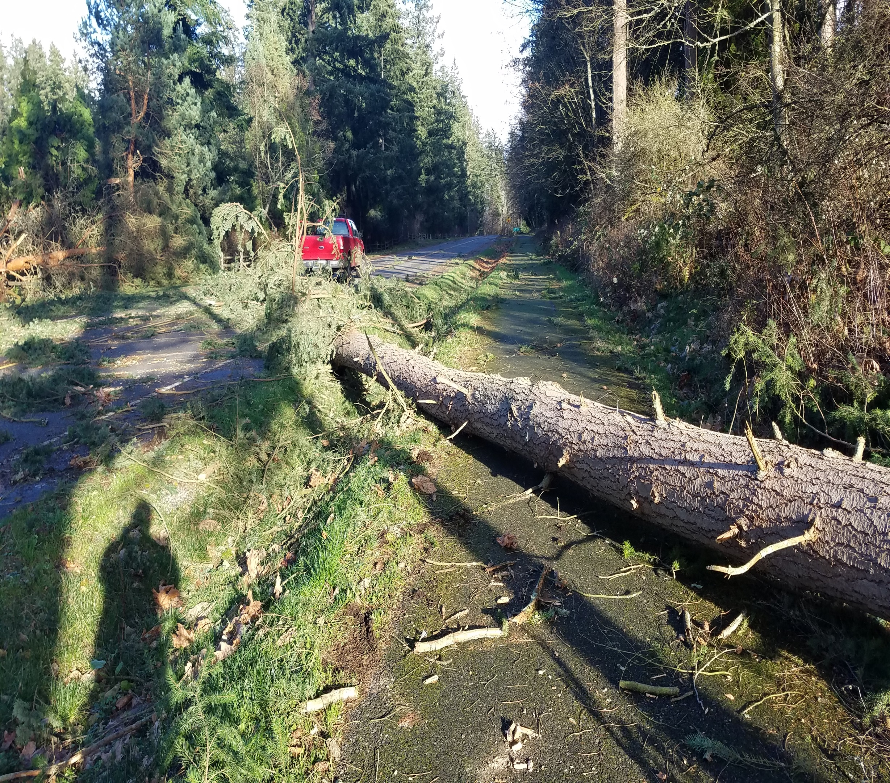
Tree’s Down City Wide

Slide 10
City of Blaine Declaration
Supports County Wide Effort For Reimbursement
Governor May Declare State Of Emergency
Damages State Wide Must Be In Excess Of 10 Million Dollars
Preliminary Damage Assessment

Slide 11
Summary – Next Steps
Final Damage Assessment
Permits
Recovery
Repair
Presented By
Sam Castro, CPO

